Slide 1
UNIT - 5
Multithreaded Programming
Collections Framework

Slide 2
Multithreaded Programming
Introduction
Need for Multiple Threads Multithreaded
Programming for Multi-core Processor
Thread Class
Main Thread-Creation of New Threads
Thread States
Thread Priority

Slide 3
Introduction
A Thread is a very light-weighted process, or we can say the smallest part of the process that allows a program to operate more efficiently by running multiple tasks simultaneously.
All the tasks are executed without affecting the main program.
In a program or process, all the threads have their own separate path for execution, so each thread of a process is independent.

Slide 4
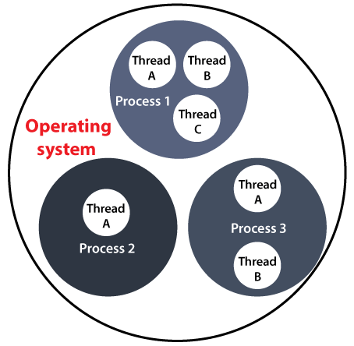
Introduction

Slide 5
Introduction
Another benefit of using thread is that if a thread gets an exception or an error at the time of its execution, it doesn't affect the execution of the other threads.
All the threads share a common memory and have their own stack, local variables and program counter.
When multiple threads are executed in parallel at the same time, this process is known as Multithreading.
Multithreading in Java is a process of executing multiple threads simultaneously.
Multiprocessing and multithreading, both are used to achieve multitasking.

Slide 6
Advantages of Java Multithreading
1. It doesn't block the user because threads are independent and we can perform multiple operations at the same time.
2. We can perform many operations together, so it saves time.
3. Threads are independent, so it doesn't affect other threads if an exception occurs in a single thread.

Slide 7
Multitasking
Multitasking is a process of executing multiple tasks simultaneously. We use multitasking to utilize the CPU.
Multitasking can be achieved in two ways:
o Process-based Multitasking (Multiprocessing)
o Thread-based Multitasking (Multithreading)
Process-based Multitasking (Multiprocessing)
o Each process has an address in memory. In other words, each process allocates a separate memory area.
o A process is heavyweight.

Slide 8
o Cost of communication between the process is high.
o Switching from one process to another requires some time for saving and loading registers, memory maps, updating lists, etc.
2) Thread-based Multitasking (Multithreading)
o Threads share the same address space.
o A thread is lightweight.
o Cost of communication between the thread is low.

Slide 9
Thread Class
Thread class provide constructors and methods to create and perform operations on a thread.
Thread class extends Object class and implements Runnable interface.
Commonly used Constructors of Thread class:
• Thread()
• Thread(String name)
• Thread(Runnable r)
• Thread(Runnable r,String name)

Slide 10
Commonly used methods of Thread class
• public void run(): is used to perform action for a thread.
• public void start(): starts the execution of the thread. JVM calls the run() method on the thread
public void sleep(long miliseconds): Causes the currently executing thread to sleep (temporarily cease execution) for the specified number of milliseconds.
• public void join(): waits for a thread to die.
• public void join(long miliseconds): waits for a thread to die for the specified miliseconds.

Slide 11
• public int getPriority(): returns the priority of the thread.
• public int setPriority(int priority): changes the priority of the thread.
• public String getName(): returns the name of the thread.
• public void setName(String name): changes the name of the thread.
• public Thread currentThread(): returns the reference of currently executing thread.

Slide 12
public int getId(): returns the id of the thread.
• public Thread.State getState(): returns the state of the thread.
• public boolean isAlive(): tests if the thread is alive.
• public void yield(): causes the currently executing thread object to temporarily pause and allow other threads to execute.
• public void suspend(): is used to suspend the thread(depricated).
• public void resume(): is used to resume the suspended thread(depricated).
• public void stop(): is used to stop the thread(depricated).

Slide 13
• public boolean isDaemon(): tests if the thread is a daemon thread.
• public void setDaemon(boolean b): marks the thread as daemon or user thread.
• public void interrupt(): interrupts the thread.
• public boolean isInterrupted(): tests if the thread has been interrupted.
• public static boolean interrupted(): tests if the current thread has been interrupted.

Slide 14
Main Thread
Whenever we run a Java program, main thread is created automatically.
This thread is responsible for execution of java program.
A Thread represents a separate path of execution.
Group of statements executed by JVM one by one.
If we're creating multiple threads then all child threads will be spawned from main thread.
This main thread is the first thread to be created and is generally the last thread and it is used to perform shut down tasks.

Slide 15
Main Thread – Example Program
To find the thread used by JVM to execute the statements (Main Thread):
class ThreadName
{
public static void main(String args[])
{
System.out.println("Welcome ");
Thread t=Thread.currentThread();
System.out.println("Current Thread is : "+t);
System.out.println("Current Thread Name is : "+t.getName());
}
}

Slide 16
currentThread() is a static method of Thread Class, which returns the reference of the current running thread.
Thread[main,5,main]
• Here Thread indicates that t is thread class object.
• The First main indicates the name of the thread that is executing the current code.
• 5 is the priority of thread.
The next main indicates the thread group name to which this thread belongs.

Slide 17
Creation of New Threads
Creating threads in java is simple. Threads are created in the form of objects that contain a method called run().
The run() is heart and soul of any thread. The whole code that constitutes a new thread is written inside the run() method.
Threads can be created by the user in two ways
1. By extending Thread class
2. By implementing Runnable interface

Slide 18
Creating thread by extending Thread class
Syntax:-
class <class name> extends Thread
{
public void run()
{
----------
---------- override run() method
----------
}
}

Slide 19
ob1 ob2 ob3
Note:
• Methods of Thread class are inherited in our own class, so every object created for our class is a thread.
• Every object(thread) has its own start(),run() and many more methods.
• Whenever start() method is called run() is executed.
• The run() method is just like our main() method where we can declare variables, use other classes, and can call other methods.
• The run() is an entry point for another thread. This thread will end when run() returns.
Run()
Run()
Run()

Slide 20
Example Program
class NewThread1 extends Thread
{
public void run() {
try
{
for(int i=1;i<=5;i++) { System.out.println(Thread.currentThread().getName()+" : "+i);
Thread.sleep(1000);
} }
catch(InterruptedException e){}
System.out.println("Child thread exiting....");
}; }

Slide 21
class NewThreadDemo1
{
public static void main(String args[])throws InterruptedException
{
NewThread1 t1=new NewThread1();
t1.setName("Child Thread");
t1.start();
}
};

Slide 22
By implementing Runnable interface
• We can’t extend more than one class to our class because multiple inheritance is not possible, in such situations we can implement runnable interface.
• Runnable implementation is slightly less simple. To run a separate thread, we still need a thread instance.
• To implement Runnable interface, a class needs to implement a single method called run().
Syntax: Public void run()

Slide 23
Example Program
class NewThread3 implements Runnable
{
public void run()
{
try {
for(int i=1;i<=5;i++) {
System.out.println(Thread.currentThread().getName()+" : "+i);
Thread.sleep(1000);
} }

Slide 24
catch(InterruptedException e){}
System.out.println("Child thread exiting....");
}; }
class NewThreadDemo3
{
public static void main(String args[])throws InterruptedException
{
NewThread3 obj=new NewThread3();
Thread t1=new Thread(obj);
t1.setName("Child Thread");
t1.start();
} };

Slide 25
Thread Priorities
When the threads are created and started, a “thread scheduler” program in JVM will load them into memory and execute them.
This scheduler will allot more JVM time to those thread which are having priority.
The priority numbers will change from 1 to 10.
Thread.MAX_PRIORITY – 10
Thread.MIN_PRIORITY – 1
Thread.NORM_PRIORITY - 5

Slide 26
Example Program
class MyClass extends Thread
{
int count=0;
public void run()
{
for(int i=1;i<=10000;i++)
count++;
System.out.println("Completed Thread:“ +Thread.currentThread().getName());
System.out.println("It's Priority:"+Thread.currentThread().getPriority());
} }

Slide 27
class Prior
{
public static void main(String args[])
{
MyClass m=new MyClass();
Thread t1=new Thread(m,"One");
Thread t2=new Thread(m,"Two");
t1.setPriority(2);
t2.setPriority(Thread.NORM_PRIORITY);
t1.start();
t2.start();
}
}

Slide 28
Thread States (OR) Life Cycle of the Thread
During the life time of a thread, there are many states it can enter. They are
1. Newborn State
2. Runnable State
3. Running State
4. Blocked State
5. Dead Sate
A thread is always in one of these five states. It can move from one state to another state via a variety of ways.

Slide 29
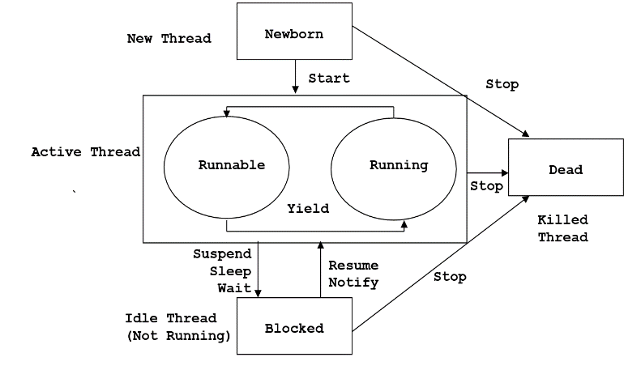

Slide 30
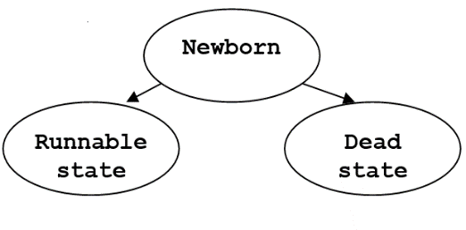
Newborn state
When a thread object is created it is said to be in newborn state. It is not yet scheduled for running. At this stage we can do only following things.
Schedule it for running using start() method.
Kill it using Stop() method.
If scheduled, it moves to the runnable state. If any other method is used an exception will be thrown.

Slide 31
Runnable state
Runnable state means the thread is ready for execution and is waiting for the availability of the processor. i.e The thread has joined the queue of threads that are waiting for execution.
If all threads have equal priority, they are given time slots for execution in round robin fashion. i.e first come first serve manner.
The thread that relinquishes control joins the queue at the end and again waits for its turn. This process of assigning time to threads is knows as time slicing.

Slide 32
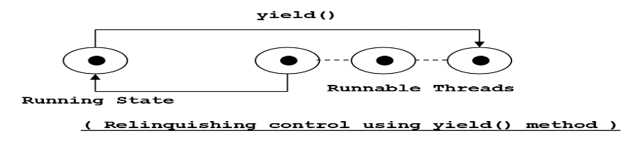
If we want a thread to relinquish control to another thread of equal priority before its turn comes, we can do so by using the yield().

Slide 33
Running State
• Running means the processor has given its time to the thread for execution.
• A running thread may relinquish its control in one of the following situtations.
a) Suspend
It has been suspended using suspend() method. A suspended thread can be revived using resume() method. This is useful when we want to suspend a thread for some time due to certain reason. But do not want to kill.

Slide 34
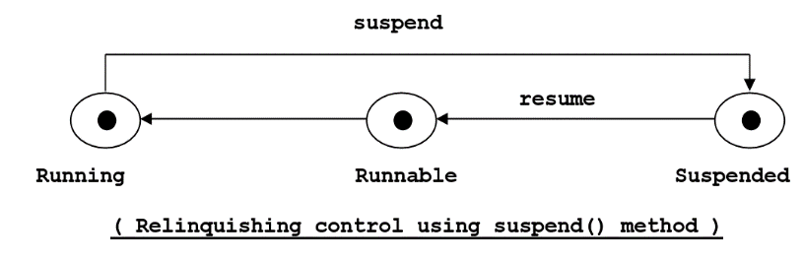

Slide 35
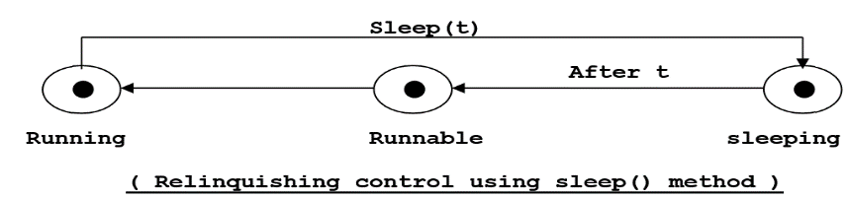
b) Sleep
It has been made to sleep. We put a thread to sleep for a specified time period using the method sleep(time) where time is in milliseconds. This means that the thread is out of the queue during this time period. It re-enters the runnable state as soon as time period is elapsed.

Slide 36
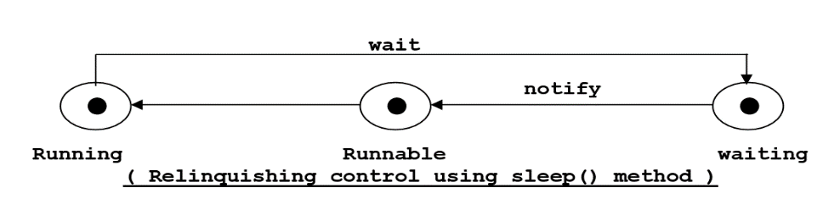
c) Wait state
It had been told to wait until some event occurs. This is done using wait() method. The thread can be scheduled to run again using notify() method.

Slide 37
Blocked State
A thread is said to be blocked when it is prevented from entering into the Runnable state. Subsequently the running state.
This happens when the thread is suspended, sleeping or waiting in order to satisfy certain requirements.
A blocked thread is considered “NOT RUNNABLE” but not dead and therefore fully qualified to run again.

Slide 38
Dead state
• Every thread has a life cycle.
• A running thread ends its life when it has completed executing its run() method.
• It is a natural death.
• We can kill a thread by sending stop message to it at any state thus causing a premature death.
• A thread can be killed as soon as it is born, or while it is running or even when it is in “NOT RUNNABLE”(blocked) condition.

Slide 39
Daemon Threads
• Threads that work continuously without any interruption to provide services to other threads (works in the background to support the runtime environment) are called daemon threads.
Eg: the clock handler thread, the idle thread, the garbage collector thread, the screen updater thread etc.
• By default a thread is not a daemon thread.
The life of a daemon thread depends on the mercy of user threads, meaning that when all user threads finish their execution, the Java Virtual Machine (JVM) automatically terminates the daemon thread.

Slide 40
Daemon Threads
Methods:
o void setDaemon(true) turns a thread into deamon thread.
o boolean isDaemon() to know whether a thread is Daemon or not.
Exceptions:
IllegalThreadStateException: if only this thread is active.
SecurityException: if the current thread cannot modify this thread.

Slide 41
Collections Framework
Introduction, Purpose of Collection Framework, Application of Collection Framework, Hierarchy of collection Interfaces / classes, Methods defined in Collection Interface, Interface Iterator, Collection classes/Interfaces –List, Queue, Set, ArrayList class, HashSet, PriorityQueue

Slide 43
Collections in Java
The Collection in Java is a framework that provides an architecture to store and manipulate the group of objects.
Java Collections can achieve all the operations that you perform on a data such as searching, sorting, insertion, manipulation, and deletion.
Java Collection means a single unit of objects. Java Collection framework provides many interfaces (Set, List, Queue, Deque) and classes (ArrayList,
Vector, LinkedList, PriorityQueue, HashSet, LinkedHashSet, TreeSet).
What is Collection in Java
A Collection represents a single unit of objects, i.e., a group.

Slide 44
Collection framework
What is a framework in Java
It provides readymade architecture.
It represents a set of classes and interfaces.
It is optional.
The Collection framework represents a unified architecture for storing and manipulating a group of objects. It has:
Interfaces and its implementations, i.e., classes
Algorithm

Slide 45
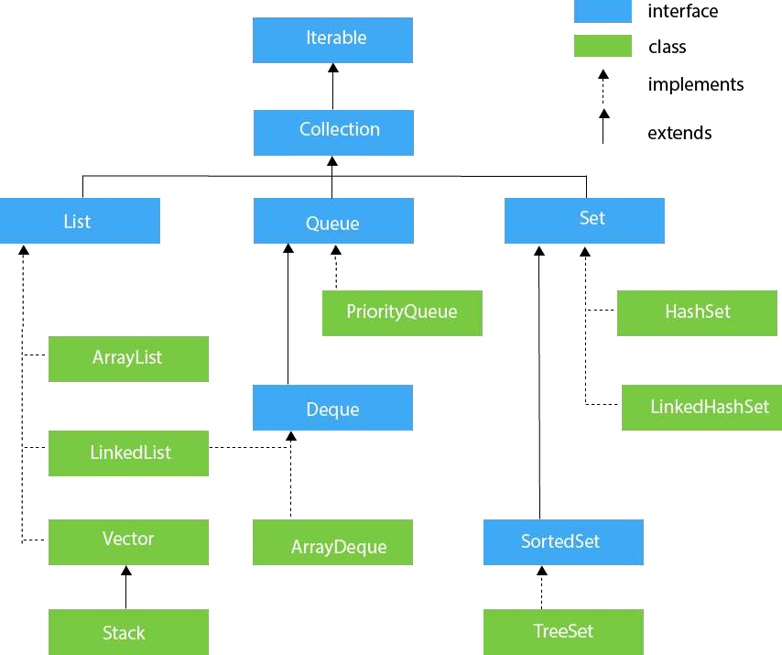
Hierarchy of Collection Framework
The java.util package contains all the classes and interfaces for the Collection framework

Slide 46
Methods of Collection interface
No. | Method | Description
1 | public booleanadd(E e) | It is used to insert an element in this collection.
2 | public booleanaddAll(Collection<? extends E> c) | It is used to insert the specified collection elements in the invoking collection.
3 | public booleanremove(Object element) | It is used to delete an element from the collection.
4 | public booleanremoveAll(Collection<?> c) | It is used to delete all the elements of the specified collection from the invoking collection.
5 | default booleanremoveIf(Predicate<? super E> filter) | It is used to delete all the elements of the collection that satisfy the specified predicate.
6 | public booleanretainAll(Collection<?> c) | It is used to delete all the elements of invoking collection except the specified collection.

Slide 47
7 | public int size() | It returns the total number of elements in the collection.
8 | public void clear() | It removes the total number of elements from the collection.
9 | public booleancontains(Object element) | It is used to search an element.
10 | public booleancontainsAll(Collection<?> c) | It is used to search the specified collection in the collection.
11 | public Iterator iterator() | It returns an iterator.
12 | public Object[] toArray() | It converts collection into array.
13 | public <T>T[] toArray(T[] a) | It converts collection into array. Here, the runtime type of the returned array is that of the specified array.

Slide 48
14 | public booleanisEmpty() | It checks if collection is empty.
15 | default Stream<E>parallelStream() | It returns a possibly parallel Stream with the collection as its source.
16 | default Stream<E>stream() | It returns a sequential Stream with the collection as its source.
17 | default Spliterator<E>spliterator() | It generates a Spliterator over the specified elements in the collection.
18 | public booleanequals(Object element) | It matches two collections.
19 | public int hashCode() | It returns the hash code number of the collection.

Slide 49
Iterator interface
Iterator interface provides the facility of iterating the elements in a forward direction only.
Methods of Iterator interface
There are only three methods in the Iterator interface. They are:
No. | Method | Description
1 | public booleanhasNext() | It returns true if the iterator has more elements otherwise it returns false.
2 | public Object next() | It returns the element and moves the cursor pointer to the next element.
3 | public void remove() | It removes the last elements returned by the iterator. It is less used.

Slide 50
Iterable Interface
The Iterable interface is the root interface for all the collection classes. The Collection interface extends the Iterable interface and therefore all the subclasses of Collection interface also implement the Iterable interface.
It contains only one abstract method. i.e.,
1. Iterator<T> iterator()
It returns the iterator over the elements of type T.

Slide 51
Collection Interface
The Collection interface is the interface which is implemented by all the classes in the collection framework. It declares the methods that every collection will have. In other words, we can say that the Collection interface builds the foundation on which the collection framework depends.
Some of the methods of Collection interface are Boolean add ( Objectobj),
Boolean addAll ( Collection c),
void clear(), etc.
which are implemented by all the subclasses of Collection interface.

Slide 52
List Interface
List interface is the child interface of Collection interface. It inhibits a list type data structure in which we can store the ordered collection of objects. It can have duplicate values.
List interface is implemented by the classes ArrayList, LinkedList, Vector, and Stack. To instantiate the List interface, we must use :
List <data-type> list1= new ArrayList();
List <data-type> list2 = new LinkedList();
List <data-type> list3 = new Vector();
List <data-type> list4 = new Stack();
There are various methods in List interface that can be used to insert, delete, and access the elements from the list.
The classes that implement the List interface are given below.

Slide 53
ArrayList
The ArrayList class implements the List interface. It uses a dynamic array to store the duplicate element of different data types. The ArrayList class maintains the insertion order and is non-synchronized. The elements stored in the ArrayList class can be randomly accessed. Consider the following example.
import java.util.*;
class TestJavaCollection1{
public static void main(String args[]){
ArrayList<String> list=new ArrayList<String>();//Creating arraylist

Slide 54
list.add("Ravi");//Adding object in arraylist
list.add("Vijay");
list.add("Ravi");
list.add("Ajay");
//Traversing list through Iterator
Iterator itr=list.iterator();
while(itr.hasNext()){
System.out.println(itr.next()); }
}
}
Output:
Ravi
Vijay
Ravi
Ajay

Slide 55
Method |  |  | Description
void add(int index, E element) |  |  | It is used to insert the specified element at the specified position in a list.
boolean | add(E e) |  | It is used to append the specified element at the end of a list.
boolean addAll(Collection<? extends E> c) |  |  | It is used to append all of the elements in the specified collection to the end of this list, in the order that they are returned by the specified collection's iterator.

Slide 56
boolean addAll(int index, Collection<? extends E> c) |  |  | It is used to append all the elements in the specified collection, starting at the specified position of the list.
void clear() |  |  | It is used to remove all of the elements from this list.

Slide 57
void ensureCapacity (int requiredCapacity) | It is used to enhance the capacity of an ArrayList instance.
Eget(int index) | It is used to fetch the element from the particular position of the list.
booleanisEmpty() | It returns true if the list is empty, otherwise false.
Iterator(), listIterator()
int lastIndexOf(Object o) | It is used to return the index in this list of the last occurrence of the specified element, or -1 if the list does not contain this element.

Slide 58
Object[] toArray() | It is used to return an array containing all of the elements in this list in the correct order.
<T>T[] toArray(T[] a) | It is used to return an array containing all of the elements in this list in the correct order.
Object clone() | It is used to return a shallow copy of an ArrayList.
booleancontains(Object o) | It returns true if the list contains the specified element

Slide 59
int indexOf(Object o) | It is used to return the index in this list of the first occurrence of the specified element, or -1 if the List does not contain this element.
E remove(int index) | It is used to remove the element present at the specified position in the list.

Slide 60
boolean remove(Object o) | It is used to remove the first occurrence of the specified element.
boolean removeAll(Collection<?> c) | It is used to remove all the elements from the list.
booleanremoveIf(Predicate<? super E> filter) | It is used to remove all the elements from the list that satisfies the given predicate.
protected void removeRange(int fromIndex, int toIndex) | It is used to remove all the elements lies within the given range.

Slide 61
void replaceAll(UnaryOperator<E> operator) | It is used to replace all the elements from the list with the specified element.
void retainAll(Collection<?> c) | It is used to retain all the elements in the list that are present in the specified collection.
E set(int index, E element) | It is used to replace the specified element in the list, present at the specified position.
void sort(Comparator<? super E> c) | It is used to sort the elements of the list on the basis of specified comparator.

Slide 62
Spliterator<E>spliterator() | It is used to create spliterator over the elements in a list.
List<E>subList(int fromIndex, int toIndex) | It is used to fetch all the elements lies within the given range.
int size() | It is used to return the number of elements present in the list.
void trimToSize() | It is used to trim the capacity of this ArrayList instance to be the list's current size.

Slide 63
Queue
Queue is a concept of Linear Data Structure that follows the concept of FIFO(First In First Out). Queues are majorly used to maintain the order of the elements to which they are added. In this article, we will learn to perform Queue Iteration in Java
Syntax with Examples
Iterator<String> it = queue.iterator();
while (it.hasNext()) {
// print elements
}

Slide 64
Example Program
// Java Program demonstrating
// Queue Iteration
import java.util.Iterator;
import java.util.LinkedList;
import java.util.Queue;
// Driver Class
public class Gfg {
// Main function
public static void main(String[] args) {
// Iterating Queue
Queue<String> studentQueue = new LinkedList<>();

Slide 65
// Inserting element in Queue
studentQueue.add("Shivansh");
studentQueue.add("Sohan");
studentQueue.add("Mohan");
studentQueue.add("Shivam");
studentQueue.add("Radha");
studentQueue.add("Rakesh");
// Initialising Iterator
Iterator<String> studentQueueIterator = studentQueue.iterator();
// Iterating Queue
while (studentQueueIterator.hasNext()) {
String name = studentQueueIterator.next();
System.out.println(name);
} } }

Slide 66
Set
The java.util.Set.iterator() method is used to return an iterator of the same elements as the set. The elements are returned in random order from what present in the set.
Syntax:
Iterator iterate_value = Set.iterator();
The function does not take any parameter.
The method iterates over the elements of the set and returns the values(iterators).

Slide 67
Example program
// Java code to illustrate iterator()
import java.util.*;
public class SetDemo {
public static void main(String args[])
{
// Creating an empty Set
Set<String> set = new HashSet<String>();
// Use add() method to add elements into the Set
set.add("Welcome");
set.add("To");
set.add(“II CSE");
set.add(“Section-2");
set.add(" PVPSIT ");

Slide 68
// Displaying the Set
System.out.println("Set: " + set);
// Creating an iterator
Iterator value = set.iterator();
// Displaying the values after iterating through the iterator
System.out.println("The iterator values are: ");
while (value.hasNext()) {
System.out.println(value.next());
}
} }

Slide 69
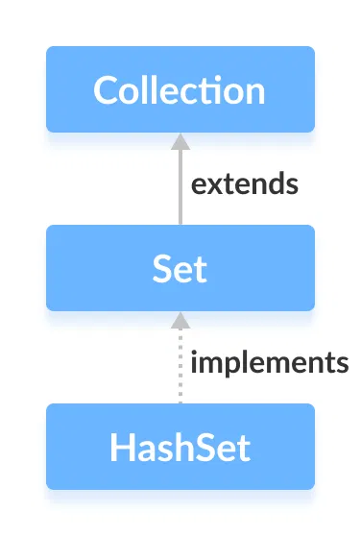
Hashset
The HashSet class of the Java Collections framework provides the functionalities of the hash table data structure.
It implements the Set interface.

Slide 70
Creating a HashSet
In order to create a hash set, we must import the java.util.HashSet package first.
Once we import the package, here is how we can create hash sets in Java.
// HashSet with 8 capacity and 0.75 load factor HashSet<Integer> numbers = new HashSet<>(8, 0.75);
Here, the first parameter is capacity, and the second parameter is loadFactor.

Slide 71
capacity - The capacity of this hash set is 8. Meaning, it can store 8 elements.
loadFactor - The load factor of this hash set is 0.6. This means, whenever our hash set is filled by 60%, the elements are moved to a new hash table of double the size of the original hash table.
// HashSet with default capacity and load factor HashSet<Integer> numbers1 = new HashSet<>();
By default,
the capacity of the hash set will be 16
the load factor will be 0.75

Slide 72
Methods of HashSet
add() - inserts the specified element to the set
addAll() - inserts all the elements of the specified collection to the set
remove() - removes the specified element from the set
removeAll() - removes all the elements from the set
iterator() - To access the elements of a hash set

Slide 73
Example Program
import java.util.HashSet;
class Main { public static void main(String[] args) { HashSet<Integer> evenNumber = new HashSet<>(); // Using add() method evenNumber.add(2); evenNumber.add(4);
evenNumber.add(6);
System.out.println("HashSet: " + evenNumber); HashSet<Integer> numbers = new HashSet<>();
// Using addAll() method numbers.addAll(evenNumber);
numbers.add(5);
System.out.println("New HashSet: " + numbers);
} }

Slide 74
Access HashSet Elements
import java.util.HashSet;
import java.util.Iterator;
class Main { public static void main(String[] args) {
HashSet<Integer> numbers = new HashSet<>(); numbers.add(2);
numbers.add(5);
numbers.add(6);
System.out.println("HashSet: " + numbers);
// Calling iterator() method
Iterator<Integer> iterate = numbers.iterator(); System.out.print("HashSet using Iterator: ");
// Accessing elements
while(iterate.hasNext())
{ System.out.print(iterate.next()); System.out.print(", ");
} } }

Slide 75
Priority Queue
A PriorityQueue is used when the objects are supposed to be processed based on the priority. It is known that a Queue follows the First-In-First-Out algorithm, but sometimes the elements of the queue are needed to be processed according to the priority, that’s when the PriorityQueue comes into play.
The PriorityQueue is based on the priority heap. The elements of the priority queue are ordered according to the natural ordering, or by a Comparator provided at queue construction time, depending on which constructor is used.

Slide 76
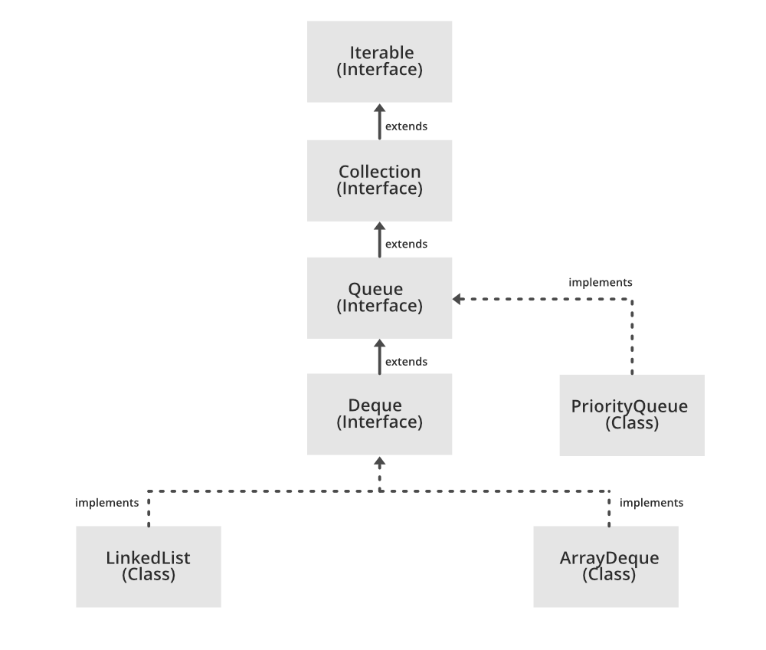

Slide 77
Declaration:
public class PriorityQueue<E> extends AbstractQueue<E> implements Serializable
where E is the type of elements held in this queue
The class implements Serializable, Iterable<E>, Collection<E>, Queue<E> interfaces.

Slide 78
Constructors:
1. PriorityQueue(): Creates a PriorityQueue with the default initial capacity (11) that orders its elements according to their natural ordering.
PriorityQueue<E> pq = new PriorityQueue<E>();
2. PriorityQueue(Collection<E> c): Creates a PriorityQueue containing the elements in the specified collection.
PriorityQueue<E> pq = new PriorityQueue<E>(Collection<E> c);

Slide 79
3. PriorityQueue(int initialCapacity): Creates a PriorityQueue with the specified initial capacity that orders its elements according to their natural ordering.
PriorityQueue<E> pq = new PriorityQueue<E>(int initialCapacity);
4. PriorityQueue(int initialCapacity, Comparator<E> comparator): Creates a PriorityQueue with the specified initial capacity that orders its elements according to the specified comparator.
PriorityQueue<E> pq = new PriorityQueue(int initialCapacity, Comparator<E> comparator);

Slide 80
5. PriorityQueue(PriorityQueue<E> c): Creates a PriorityQueue containing the elements in the specified priority queue.
PriorityQueue<E> pq = new PriorityQueue(PriorityQueue<E> c);
6. PriorityQueue(SortedSet<E> c): Creates a PriorityQueue containing the elements in the specified sorted set.
PriorityQueue<E> pq = new PriorityQueue<E>(SortedSet<E> c);

Slide 81
7. PriorityQueue(Comparator<E> comparator): Creates a PriorityQueue with the default initial capacity and whose elements are ordered according to the specified comparator.
PriorityQueue<E> pq = new PriorityQueue<E>(Comparator<E> c);

Slide 82
operations of the priority queue
boolean add(E element): This method inserts the specified element into this priority queue.
public peek(): This method retrieves, but does not remove, the head of this queue, or returns null if this queue is empty.
public poll(): This method retrieves and remo

Slide 83
// Java program to demonstrate the
// working of PriorityQueue
import java.util.*;
class PriorityQueueDemo {
// Main Method
public static void main(String args[])
{
// Creating empty priority queue
PriorityQueue<Integer> pQueue = new PriorityQueue<Integer>();
// Adding items to the pQueue using add()
pQueue.add(10);
pQueue.add(20);
pQueue.add(15);

Slide 84
// Printing the top element of PriorityQueue
System.out.println(pQueue.peek());
// Printing the top element and removing it
// from the PriorityQueue container
System.out.println(pQueue.poll());
// Printing the top element again
System.out.println(pQueue.peek());
}
}

