Slide 1
Unit – 2
Classes and Objects
Constructor and Methods
String Handling

Slide 2
Classes and Objects
TOPICS :
Introduction
Class Declaration and Modifiers
Class Members
Declaration of Class Objects
Assigning One Object to Another

Slide 3
CLASS - Intoduction
Definition : A class is a group of objects which have common properties.
It is a template or blueprint from which objects are created. It is a logical entity. It can't be physical.
A Class does not consume any Space
A Class consists of
  Data Members ( Variables)
  Methods ( Member Functions) etc

Slide 4
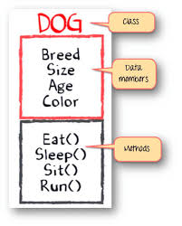
Syntax :
class <class_name>
{
fields(variables);
methods;
}
Eg:
class dog
{
String Breed;
int age;
int size;
String color;
Void eat();
Boolean Sleep(), Sit(), Run();
}

Slide 5
Instance Variables :
A variable which is created inside the class but outside the method is known as an instance variable.
Instance variable doesn't get memory at compile time.
It gets memory at runtime when an object or instance is created. That is why it is known as an instance variable.

Slide 6
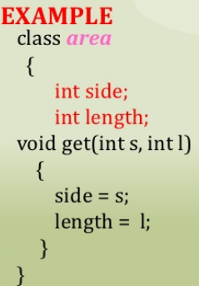
Methods : In Java, a method is like a function which is used to expose the behavior of an object.
Syntax :
type method_name( Parameters_List)
{
//body
}

Slide 7
OBJECTS IN JAVA
Definition : An entity that has state and behavior is known as an object
Eg : chair, bike, marker, pen, table, car etc.
It can be physical or logical
Objects get memory in Heap Memory Area
For Example, Pen is an object. Its name is Reynolds; color is white, known as its state. It is used to write, so writing is its behavior.

Slide 8
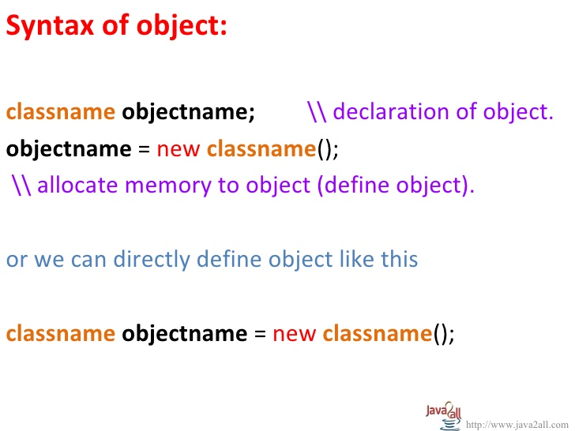
An Object in java essentially a Block of Memory that contains a Space to store all the Instance Variables.
Objects in Java created using ‘new‘ operator.
The new Operator dynamically allocates memory for an Object .

Slide 9
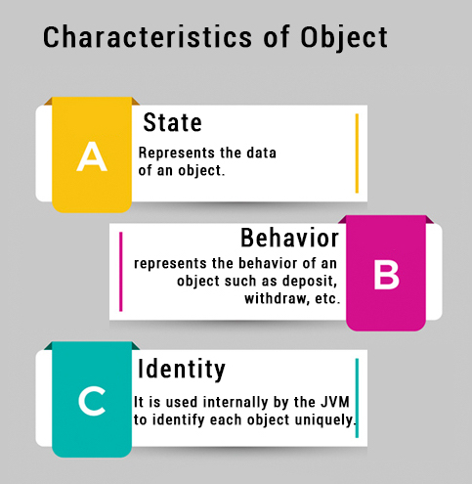

Slide 10
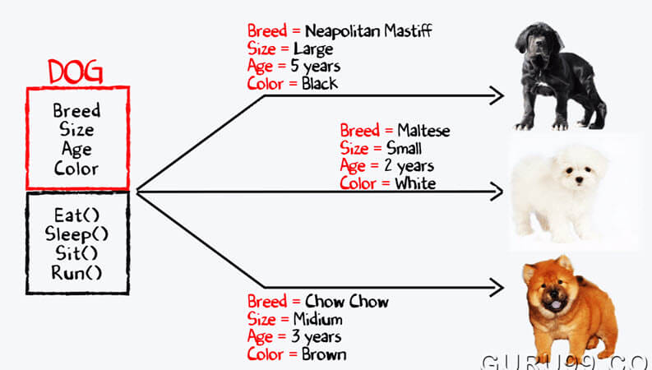
Eg: /* real world example of Class and Object*/

Slide 11
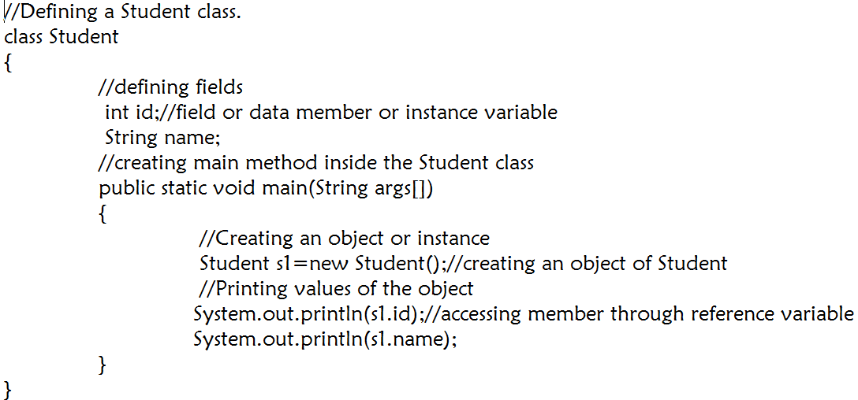
Eg-1 : /*Object and Class Example: main within the class */
O/P :
0
NULL

Slide 12
Eg-2 : /*Object and Class Example: main out side the class */
In real time development, we create classes and use it from another class.
It is a better approach than previous one. we are having main() method in another class.
We can have multiple classes in different java files or single java file. If we define multiple classes in a single java source file, it is a good idea to save the file name with the class name which has main() method.

Slide 13
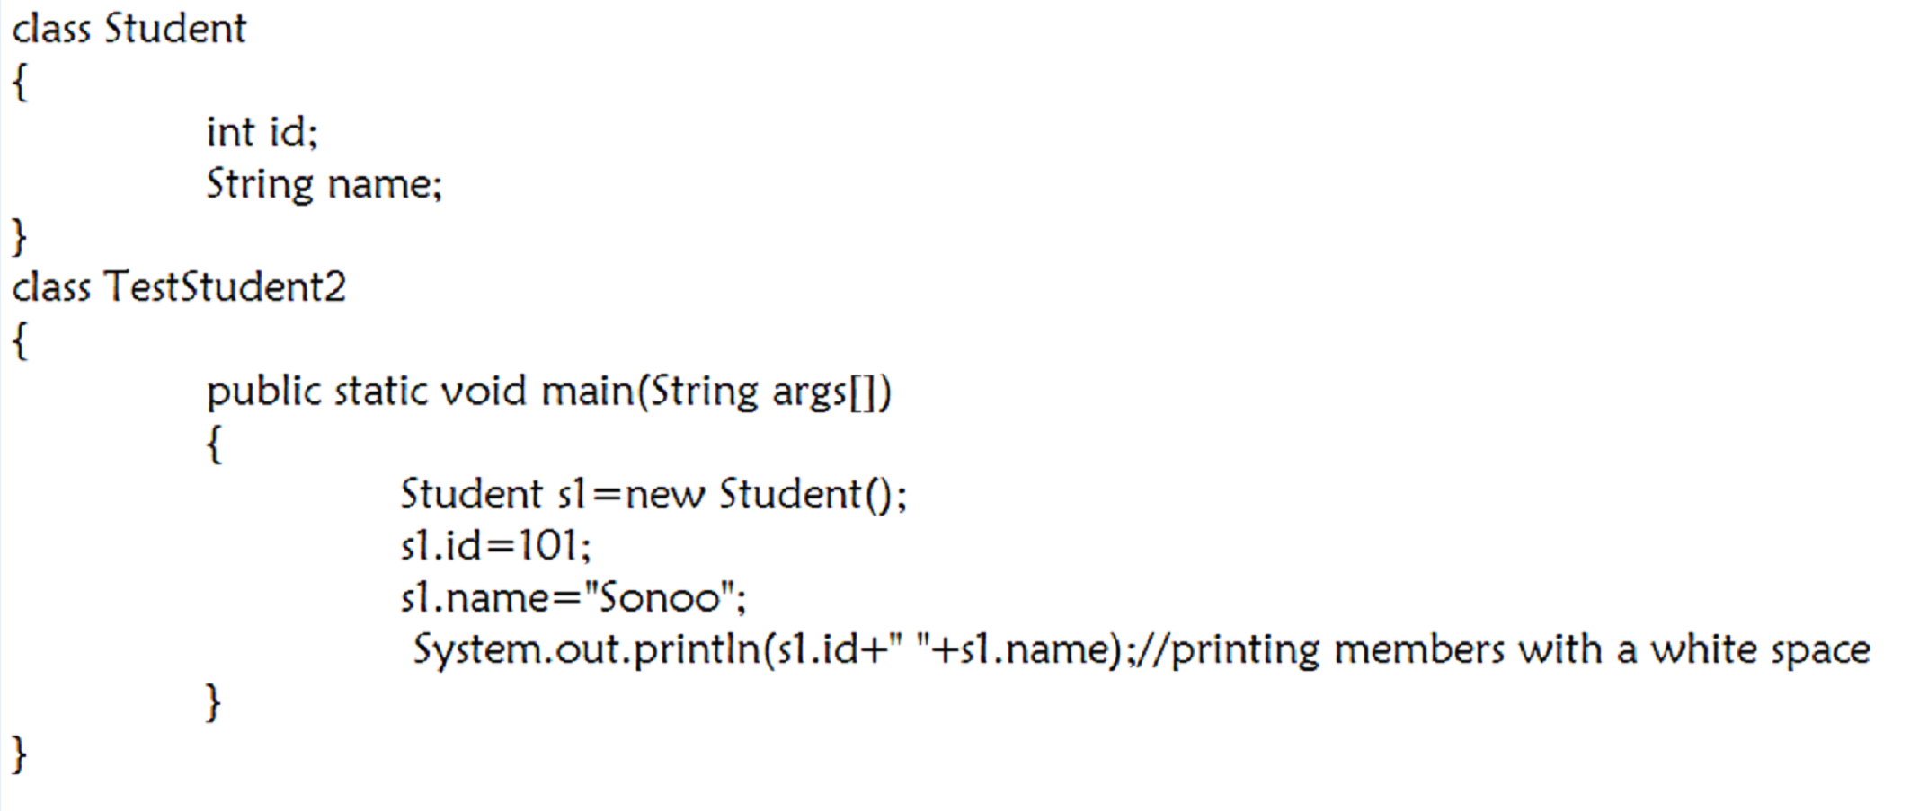
Eg-3 : /*Initialization through Reference Variable*/
O/P :
101
Sonoo

Slide 14
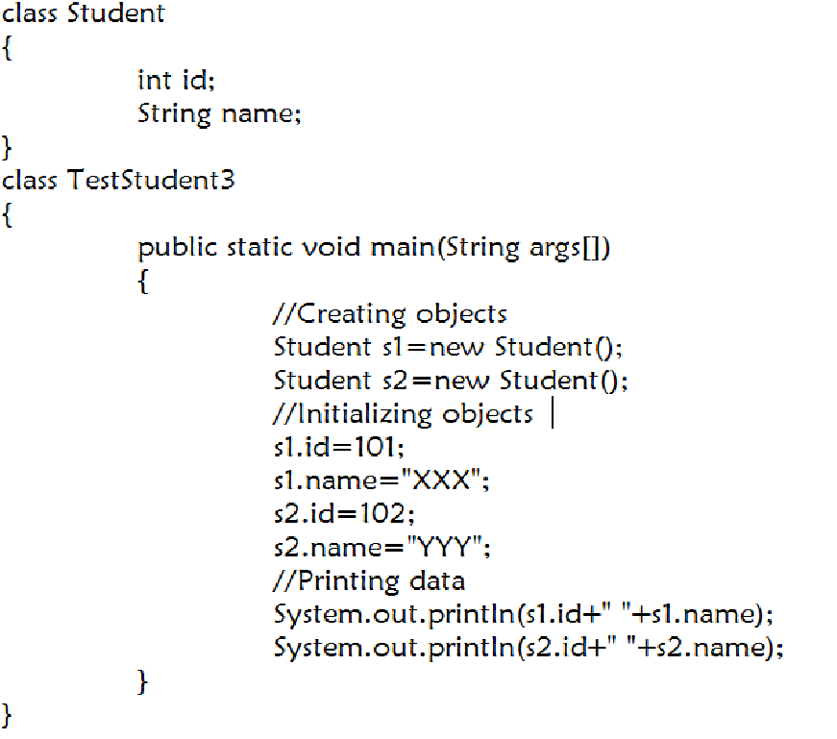
Eg-4 : /* create multiple objects and store information in it through reference variable. */
O/P :
101 XXX
102 YYY

Slide 15
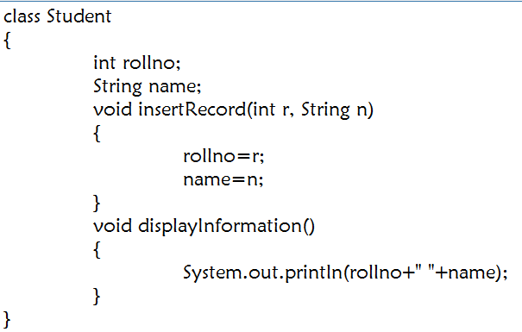
Eg-5 : /* Initialization through Method*/

Slide 16
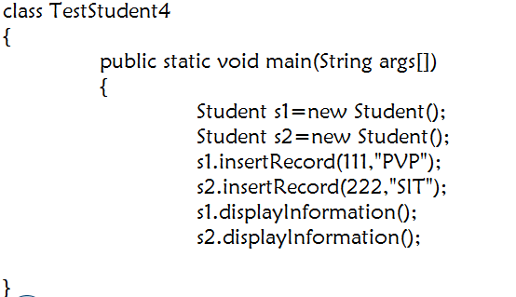
Contd…
O/P :
PVP
222 SIT

Slide 17
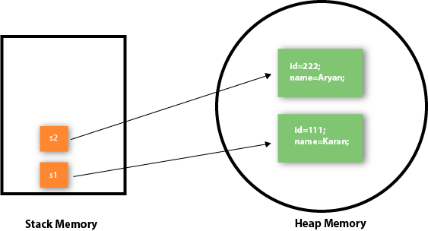
Objects get memory in Heap Memory Area

Slide 18
Assigning One Object to Another
Assign one instance of an object to another instance of another object, as long as both objects are of the same class or a class that is derived from the class of the first object.
This is typically done using the assignment operator (=) or a constructor that takes another object as an argument.

Slide 19
Example Program
class test
{
int id;
String name;
void display(int id, String name)
{
System.out.println("ID is: "+id);
System.out.println("Name is : "+name);
}
}

Slide 20
Continue..
public class objectassign
{
public static void main(String[] args)
{
test t1=new test();
test t2=t1;
t1.id=111;
t1.name="ABC";
System.out.println("t1 Object values: ");
t1.display(t1.id,t1.name);

Slide 21
Continue..
System.out.println();
System.out.println("t2 Object values: ");
t2.display(t2.id,t2.name);
t2.id=222; t2.name="XYZ";
System.out.println("t1 Object values after updating t2 object: ");
t1.display(t1.id,t1.name);
System.out.println("t2 Object values after updating t2 object: ");
t2.display(t2.id,t2.name); } }

Slide 22
Constructor and Methods
Topics:
Introduction, Defining Methods, Overloaded Methods, Constructors, Overloaded Constructor Methods , Class Objects as Parameters in Methods, Access Control, Accessing Private Members of Class, Recursive Methods, final method, Passing Arguments by Value and by Reference, Keyword this, final and static, Nested classes

Slide 23
Methods - Introduction
A method is a block of code which only runs when it is called.
We can pass data, known as parameters, into a method.
Methods are used to perform certain actions, and they are also known as functions.
Why use methods? To reuse code: define the code once, and use it many times.

Slide 24
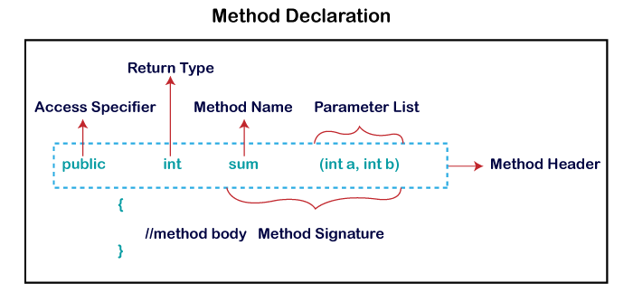
Method Declaration
The method declaration provides information about method attributes, such as visibility, return-type, name, and arguments. It has six components that are known as method header

Slide 25
Method Declaration
Access Specifier: Access specifier or modifier is the access type of the method. It specifies the visibility of the method. Java provides four types of access specifier:
Public: The method is accessible by all classes when we use public specifier in our application.
Private: When we use a private access specifier, the method is accessible only in the classes in which it is defined.
Protected: When we use protected access specifier, the method is accessible within the same package or subclasses in a different package.
Default: When we do not use any access specifier in the method declaration, Java uses default access specifier by default. It is visible only from the same package only.

Slide 26
Method Declaration
Return Type: Return type is a data type that the method returns. It may have a primitive data type, object, collection, void, etc. If the method does not return anything, we use void keyword.
Method Name: It is a unique name that is used to define the name of a method. It must be corresponding to the functionality of the method. Suppose, if we are creating a method for subtraction of two numbers, the method name must be subtraction(). A method is invoked by its name.

Slide 27
Method Declaration
Parameter List: It is the list of parameters separated by a comma and enclosed in the pair of parentheses. It contains the data type and variable name. If the method has no parameter, left the parentheses blank.
Method Body: It is a part of the method declaration. It contains all the actions to be performed. It is enclosed within the pair of curly braces.

Slide 28
Method Declaration
Java provides some pre-defined methods, such as System.out.println(), but we can also create our own methods to perform certain actions
Example: Creation of a method inside Main (class):
public class Main
{
static void myMethod()
{
// code to be executed
}
}

Slide 29
Call a Method
To call a method in Java, write the method's name followed by two parentheses () and a semicolon;
In the following example, myMethod() is used to print a text (the action), when it is called:
Example
Inside main, call the myMethod() method:
public class Main
{
static void myMethod()
{
System.out.println("I just got executed!");
}
public static void main(String[] args) {
myMethod(); // Method calling } }

Slide 30
Methods - Example
class sum {
// create a method
public int addNumbers(int a, int b) {
int sum = a + b;
// return value
return sum;
}
public static void main(String[] args) {
int num1 = 25;
int num2 = 15;
// create an object of sum
sum obj = new sum();
// calling method
int result = obj.addNumbers(num1, num2);
System.out.println("Sum is: " + result);
}
}

Slide 31
Overloaded Methods
If a class has multiple methods having same name but different in parameters, it is known as Method Overloading.
Method overloading in Java is also known as Compile-time Polymorphism, Static Polymorphism, or Early binding.
Method overloading increases the readability of the program.
There are two ways to overload the method in java
By changing number of arguments
By changing the data type
Example: 1. changing no. of arguments
we have created two methods, first add() method performs addition of two numbers and second add method performs addition of three numbers.

Slide 32
Overloaded Methods –Example Progrm
class Adder{
static int add(int a,int b) {
return a+b; }
static int add(int a,int b,int c){
return a+b+c; }
}
class TestOverloading1{
public static void main(String[] args){
System.out.println(Adder.add(11,11));
System.out.println(Adder.add(11,11,11)); } }

Slide 33
Overloaded Methods – Example Program
Example : 2. changing data type of arguments
we have created two methods that differs in data type. The first add method receives two integer arguments and second add method receives two double arguments.
class Adder{
static int add(int a, int b) {
return a+b; }
static double add(double a, double b) {
return a+b; }
}
class TestOverloading2{
public static void main(String[] args){
System.out.println(Adder.add(11,11));
System.out.println(Adder.add(12.3,12.6)); } }

Slide 34
CONSTRUCTORS
Definition : Constructor is a Special Member Function of a class that is used to create objects of that class.
It is a special type of method which is used to initialize the object.
  Syntax :
  class MyClass
  {
  MyClass()
  {
  // Group of Statements
  }
  }

Slide 35
Rules for creating constructor
There are Several rules defined for the constructor. Those are :
Constructor name must be the same as its class name
A Constructor cannot have any return type not even void.
A Java constructor cannot be abstract, static, final.
Constructors can not be Inherited.

Slide 36
Types of constructors
There are three types of constructors in Java:
  1. Default constructor (no-arg constructor)
  2. Parameterized Constructor
  3. Copy Constructors

Slide 37
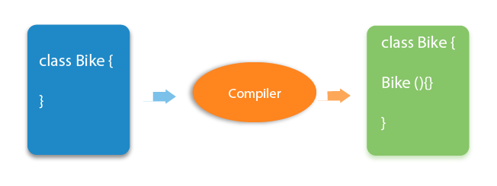
1.Default Constructor : constructor is called "Default Constructor" when it doesn't have any parameter.
If there is no constructor in a class, Compiler automatically creates a Default Constructor.

Slide 38
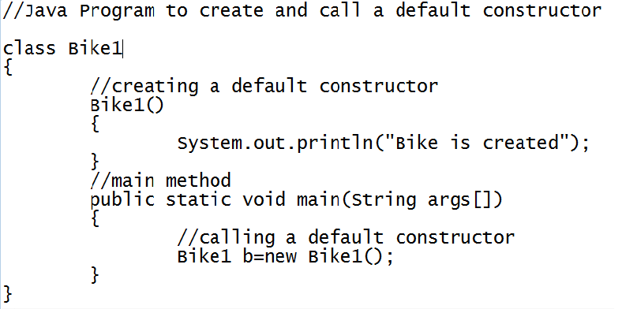
Eg-1:
O/P : Bike is Created.

Slide 39
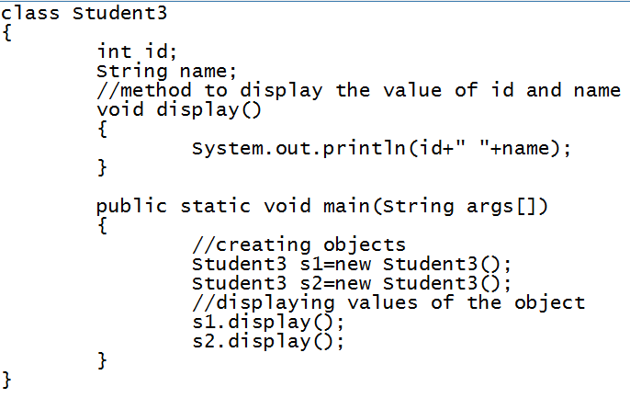
Eg-2: /* default constructor displays default values */
O/P : 0 NULL
0 NULL

Slide 40
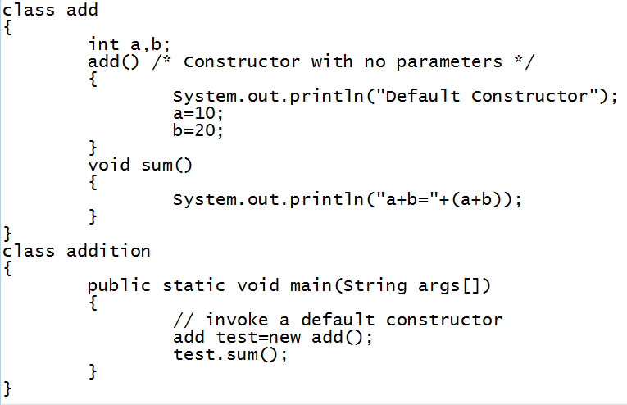
Eg-3: /*default constructor that displays the addition of two numbers*/
O/P : Default Constructor
a+b=30

Slide 41
2. Parameterized Constructor :
A constructor which has a specific number of parameters is called a parameterized constructor.
The parameterized constructor is used to provide different values to the distinct objects.

Slide 42
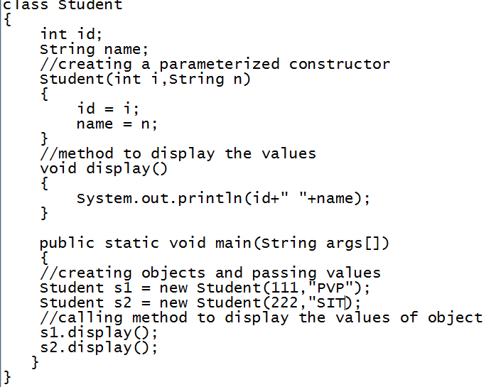
Eg-1: /* Parameterized constructor Example */
O/P : 111 PVP
222 SIT

Slide 43
Difference between Method and Constructor
Java Constructor | Java Method
A constructor is used to initialize the state of an object. | A method is used to expose the behavior of an object.
A constructor must not have a return type. | A method must have a return type.
The constructor is invoked implicitly. | The method is invoked explicitly.
The Java compiler provides a default constructor if you don't have any constructor in a class. | The method is not provided by the compiler in any case.
The constructor name must be same as the class name. | The method name may or may not be same as class name.

Slide 44
Copy constructor
A copy constructor is a special type of constructor that creates an object using another object of the same Java class.
It returns a duplicate copy of an existing object of the class.
Use of Copy Constructor
We can use the copy constructor if we want to:
Create a copy of an object that has multiple fields.
Generate a deep copy of the heavy objects.
Avoid the use of the Object.clone() method.

Slide 45
Example Program
// Java Program to Illustrate Copy Constructor
// Class 1
class Complex {
// Class data members
private double re, im;
// Constructor
public Complex(double re, double im)
{
// this keyword refers to current instance itself
this.re = re;
this.im = im;
} }

Slide 46
Continue…
// Class 2
// Main class
public class Main{
// Main driver method
public static void main(String[] args)
{
// Creating object of above class
Complex c1 = new Complex(10, 15);
// Note: compiler error here
Complex c2 = new Complex(c1);
}
}

Slide 47
Overloaded Constructor Methods
Constructor overloading in Java refers to the practice of defining multiple constructors within a class, each with a different set of parameters.
These parameters can vary in terms of their number, data types, and order.
The purpose of constructor overloading is to provide multiple ways to initialize objects in a class, catering to different scenarios and requirements.
Constructor overloading is based on the concept of polymorphism.

Slide 48
Overloaded Constructor Methods – Example Program
public class Student {
//instance variables of the class
int id;
String name;
Student(){
System.out.println("this a default constructor");
}
Student(int i, String n){
id = i;
name = n;
}

Slide 49
Overloaded Constructor Methods – Example Program
public static void main(String[] args) {
//object creation
Student s = new Student();
System.out.println("\nDefault Constructor values: \n");
System.out.println("Student Id : "+s.id + "\nStudent Name : "+s.name);
System.out.println("\nParameterized Constructor values: \n");
Student student = new Student(10, ”ABC”);
System.out.println("Student Id : "+student.id + "\nStudent Name : "+student.name);
}
}

Slide 50
Class Objects as Parameters in Methods
When a primitive type is passed to a method, it is done by use of call-by-value . Objects are implicitly passed by use of call-by-reference.
This means when we pass primitive data types to method it will pass only values to function parameters so any change made in parameter will not affect the value of actual parameters.
Whereas Objects in java are reference variables, so for objects a value which is the reference to the object is passed. Hence the whole object is not passed but its referenced gets passed. All modification to the object in the method would modify the object in the Heap.

Slide 51
Class Objects as Parameters in Methods
class Add {
int a; int b;
Add(int x, int y) // parametrized constructor
{ a = x; b = y; }
void sum(Add A1) // object 'A1' passed as parameter in function 'sum'
{ int sum1 = A1.a + A1.b;
System.out.println("Sum of a and b :" + sum1); } }
public class Main {
public static void main(String arg[]) {
Add A = new Add(5, 8); /* Calls the parametrized constructor A.sum(A);
}
}

Slide 52
Access Control
There are four types of Java access modifiers:
Public: The access level of a public modifier is everywhere. It can be accessed from within the class, outside the class, within the package and outside the package.
Private: The access level of a private modifier is only within the class. It cannot be accessed from outside the class.
Protected: The access level of a protected modifier is within the package and outside the package through child class. If you do not make the child class, it cannot be accessed from outside the package.
Default: The access level of a default modifier is only within the package. It cannot be accessed from outside the package. If you do not specify any access level, it will be the default.
There are many non-access modifiers, such as static, abstract, synchronized, native, volatile, transient, etc. Here, we are going to learn the access modifiers only.

Slide 53
Access modifiers in a simple table
Access Modifier | within class | within package | outside package by subclass only | outside package
Private | Y | N | N | N
Default | Y | Y | N | N
Protected | Y | Y | Y | N
Public | Y | Y | Y | Y

Slide 54
public
//save by A.java
package pack;
public class A{
public void msg(){System.out.println("Hello");}
}
//save by B.java
package mypack;
import pack.*;
class B{
public static void main(String args[]){
A obj = new A();
obj.msg();
}
}
The public access modifier is accessible everywhere. It has the widest scope among all other modifiers.

Slide 55
private
class A{
private int data=40;
private void msg()
{ System.out.println("Hello java");}
}
public class Simple{
public static void main(String args[]){
A obj=new A();
System.out.println(obj.data);//Compile Time Error
obj.msg();//Compile Time Error
}
}
In this example, we have created two classes A and Simple. A class contains private data member and private method. We are accessing these private members from outside the class, so there is a compile-time error.

Slide 56
Role of Private Constructor
If we make any class constructor private, you cannot create the instance of that class from outside the class.
For example:
class A{
private A(){}//private constructor
void msg(){System.out.println("Hello java");}
}
public class Simple{
public static void main(String args[]){
A obj=new A();//Compile Time Error
}
}

Slide 57
protected
The protected access modifier is accessible within package and outside the package but through inheritance only.
The protected access modifier can be applied on the data member, method and constructor. It can't be applied on the class.
It provides more accessibility than the default modifer.
//save by A.java
package pack;
public class A{
protected void msg(){System.out.println("Hello");}
}
//save by B.java
package mypack;
import pack.*;
class B extends A{
public static void main(String args[]){
B obj = new B();
obj.msg();
}
}

Slide 58
default
If you don't use any modifier, it is treated as default by default. The default modifier is accessible only within package. It cannot be accessed from outside the package. It provides more accessibility than private. But, it is more restrictive than protected, and public.
//save by A.java
package pack;
class A{
void msg(){System.out.println("Hello");}
}
//save by B.java
package mypack;
import pack.*;
class B{
public static void main(String args[]){
A obj = new A();//Compile Time Error
obj.msg();//Compile Time Error
}
}
we have created two packages pack and mypack. We are accessing the A class from outside its package, since A class is not public, so it cannot be accessed from outside the package.

Slide 59
Recursive methods
public class Main {
public static void main(String[] args)
{
int result = sum(10);
System.out.println(result); }
public static int sum(int k)
{ if (k > 0)
{ return k + sum(k - 1); }
else
{ return 0; }
}
}

Slide 60
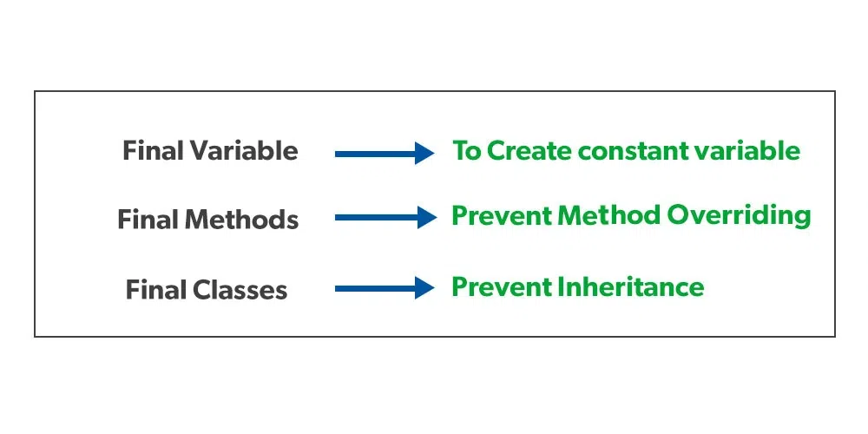
final
The final keyword in Java is used as a non-access modifier applicable only to a variable, a method, or a class. It is used to restrict a user in Java.
The following are different contexts where the final is used:
Variable
Method
Class

Slide 61
final variable
public class ConstantExample {
public static void main(String[] args) {
// Define a constant variable PI
final double PI = 3.14159;
// Print the value of PI
System.out.println("Value of PI: " + PI);
}
}
Note: If we try to change the value of PI it raises an error.

Slide 62
Find the output for the following code snippet
class Bike{
final int speedlimit=90;//final variable
void run(){
speedlimit=400;
}
public static void main(String args[]){
Bike obj=new Bike();
obj.run();
}
}
o/p: compile time error
Bike.java:4: error: cannot assign a value to final variable speedlimit speedlimit=400;

Slide 63
final method
If you make any method as final, you cannot override it.
class Bike{
final void run(){System.out.println("running");}
}
class Honda extends Bike{
void run(){System.out.println("running safely with 100kmph");}
public static void main(String args[]){
Honda honda= new Honda();
honda.run();
}
} o/p: Compile time error

Slide 64
final class
If you make any class as final, you cannot extend it.
final class Bike{}
class Honda1 extends Bike{
void run(){System.out.println("running safely with 100kmph"); }
public static void main(String args[]){
Honda1 honda= new Honda1();
honda.run();
}
} o/p: compile time error

Slide 65
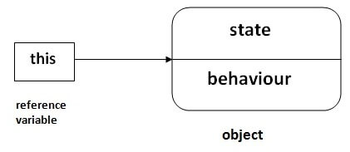
THIS Keyword
Definition : this Keyword is a reference variable that refers to the current object.

Slide 66
1. this: to refer current class instance variable :
The this keyword can be used to refer current class instance variable. If there is ambiguity between the instance variables and parameters, this keyword resolves the problem of ambiguity.

Slide 67
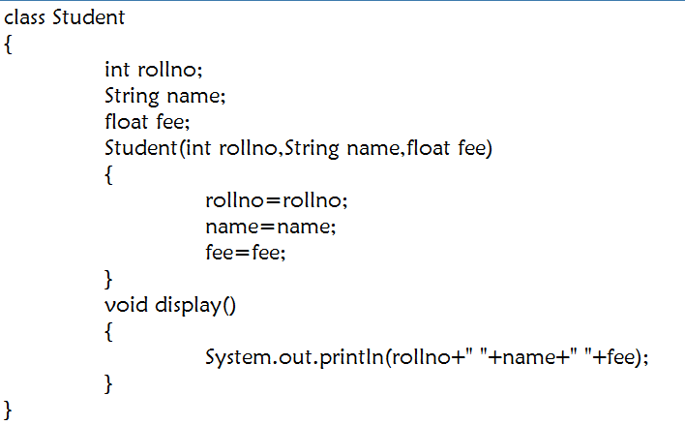
Eg-1:Problem with out using this Keyword :

Slide 68
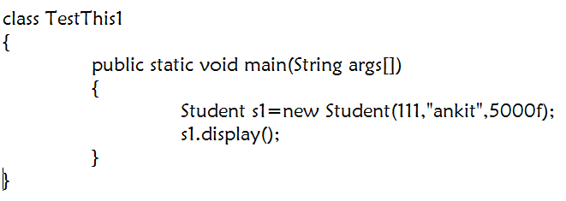
Cont…
O/P : 0 NULL 0.0
In the above example, parameters(formal arguments) and instance variables are same. So, we are using this keyword to distinguish local variable and instance variable.

Slide 69
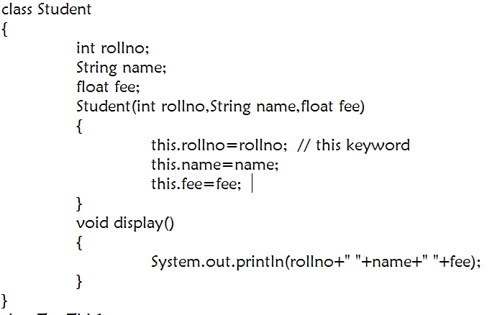
Eg-2:Problem Solving using this Keyword :

Slide 70
Cont…
O/P : 111, ankit, 5000f

Slide 71
2. this: to invoke current class method
We may invoke the method of the current class by using the this keyword.
If we don't use the this keyword, compiler automatically adds this keyword while invoking the method.

Slide 72
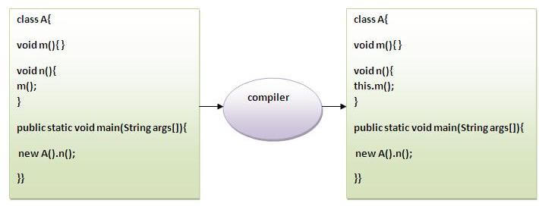

Slide 73
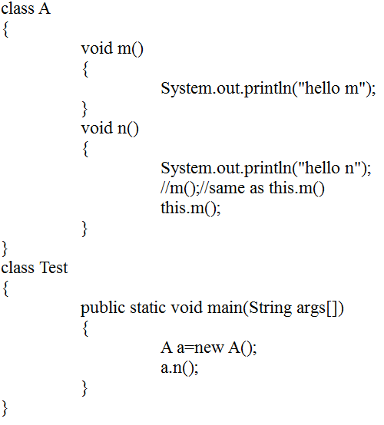
Eg-1:
O/P : hello n
hello m

Slide 74
Proving this keyword
Let's prove that this keyword refers to the current class instance variable.
In the example program, we are printing the reference variable and this, output of both variables are same.

Slide 75
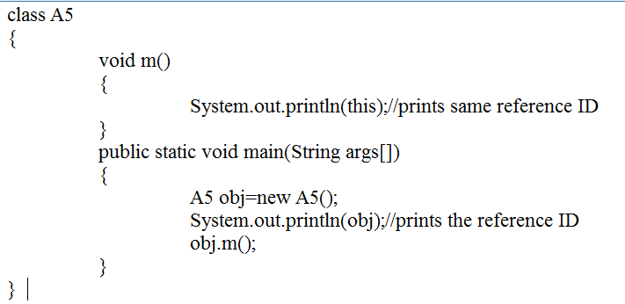
O/P :A5@22b3ea59
A5@22b3ea59

Slide 76
Static method
A static method is a part of the class itself rather than an instance of a class.
The method is available to each instance of the class.
The method is available to each class instance. They have access to class variables (static variables) (instance) without requiring the class's object.
A static method has only access to static data. It cannot access dynamic data (instance variables).
Static methods can be accessed directly in non-static and static methods.

Slide 77
Static method
Syntax:
static return_type methodname(parameter)
{ //Code to be executed
}
Syntax to Call a Static Method
ClassName.methodName()
class Main {
static void print()
{ System.out.println("This the static method of the Main class");
}
public static void main(String[] args) {
Main.print(); }

Slide 78
// Java program to demonstrate both static and non-static methods, static methods are directly accessed.
import java.io.*;
public class staticMethodExample {
static int num = 50;
static String str = "PVP Siddhartha";
// This is Static method
static void display()
{
System.out.println("static number is " + num);
System.out.println("static string is " + str);
}

Slide 79
void nonstatic() // non-static method
{
// static method can accessed in non static method
display();
}
public static void main(String args[]) // main method
{
staticMethodExample obj = new staticMethodExample();
// object to call non static method
obj.nonstatic();
// static method can called directly without an object
display();
} }

Slide 80
Nested classes
A nested class is a class that is defined inside another class.
The nested class has access to the members of the outer class, including private members.
There are two types of nested classes in Java:
1. Static Nested Class: A static nested class is a nested class that is defined with the static keyword. It has access to the static members of the outer class, but not the instance members.
2. Inner Class: An inner class is a nested class that is not defined with the static keyword. It has access to all members of the outer class, including instance members.

Slide 81
Example Program
public class OuterClass
{
private int x = 10;
public static class StaticNestedClass
{
public void print()
{
System.out.println("Static Nested Class");
}
}
public class InnerClass
{
public void print()
{
System.out.println("Inner Class");
System.out.println("x = " + x);
}
}

Slide 82
public static void main(String[] args)
{
OuterClass.StaticNestedClass staticNestedClass = new OuterClass.StaticNestedClass();
staticNestedClass.print();
OuterClass outerClass = new OuterClass(); OuterClass.InnerClass innerClass = outerClass.new InnerClass(); innerClass.print();
}
}

Slide 83
STRINGS
Definition : Generally, String is a sequence of characters enclosed within double quotes (" ") is known as String.
But in Java, string is an object that represents a sequence of characters.
The java.lang.String class is used to create a string object.
In java, string is an immutable object. Immutable simply means un modifiable or unchangable

Slide 84
Once string object is created its data or state can't be changed but a new string object is created.
Whenever we change any string, a new instance is created.
Creating a String :There are Two ways to create a String
  String Literal
  By using new Keyword.

Slide 85
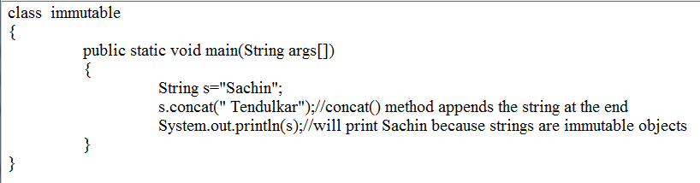
  1. String Literal : Java String literal is created by using double quotes.
  Ex: String s=“Welcome”;
O/P : Sachin

Slide 86
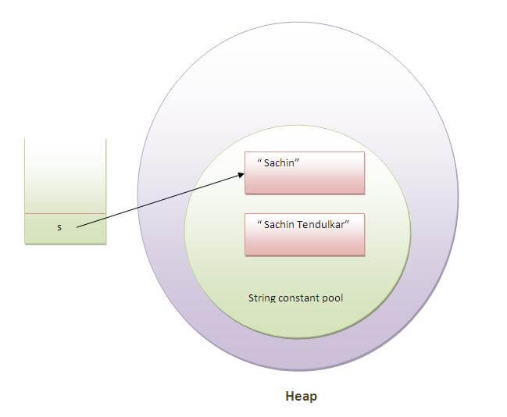

Slide 87
String Constant Pool :
Java String pool refers to collection of Strings which are stored in heap memory.
In this, whenever a new object is created, String pool first checks whether the object is already present in the pool or not.
If it is present, then same reference is returned to the variable
Otherwise new object will be created in the String pool and the respective reference will be returned.

Slide 88
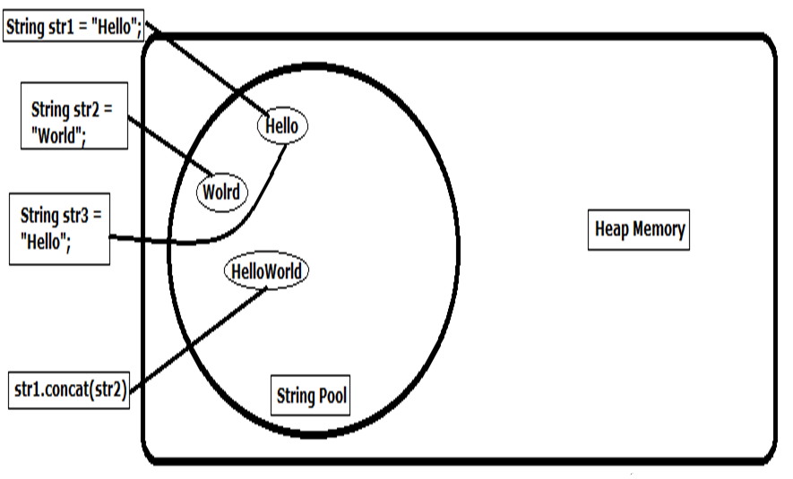

Slide 89
2. Use of new Keyword : Java String is created by using a keyword “new”.
Eg : Strings=new String(“Welcome”);
As we saw above that when we tried to assign the same string object to two different literals, compiler only created one object and made both of the literals to point the same object.

Slide 90
To overcome that approach we can create strings like this:
Ex : String str1 = new String("Welcome");
String str2 = new String("Welcome");
In this Example we Create Two Objects stored in Heap Memory not in String Constant Pool

Slide 91
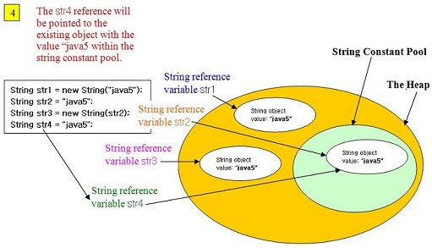
Difference between String Literal & use of new keyword*/

Slide 92
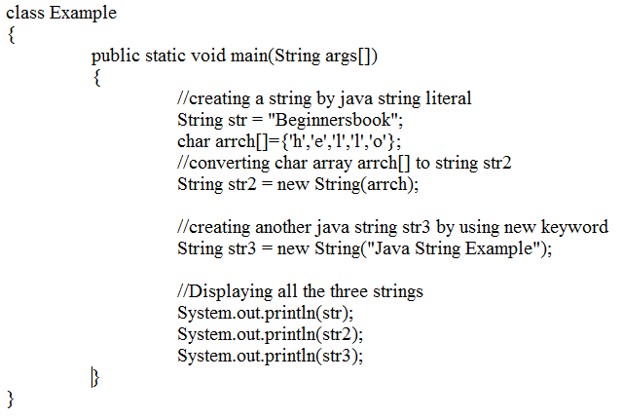
Eg : /* Program using String Literal & new keyword */
O/P : Beginnersbook
hello
Java String Example

Slide 93
JAVA STRING METHODS :There are so many string functions are available in Java .
String Comparision
String Length
String Concatenation
String Upper Case
String Lower Case etc…..

Slide 94
1. String Comparision : We can compare string in java on the basis of content and reference.
There are three ways to compare string in java:
    By equals() method
    By = = operator

Slide 95
a) Compare by equals() method :
The String equals() method compares the original content of the string. It compares values of string for equality.
String class provides two methods:
public boolean equals(Object another) : compares this string to the specified object.
public boolean equalsIgnoreCase(String another) : compares this String to another string, ignoring case

Slide 96
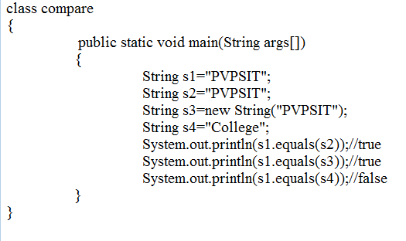
Eg-1: /* String Comparison by using equals() method */

Slide 97
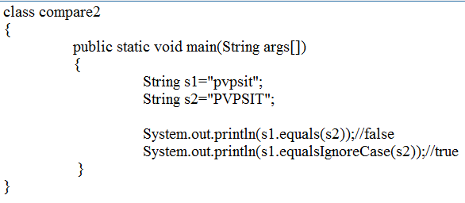
Eg-2: /* String Comparison by using equals() and equalsIgnoreCase()*/

Slide 98
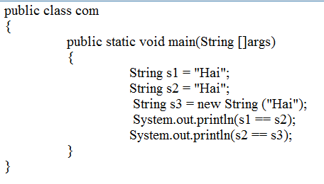
b. compare by == operator: use == (equality operator) to compare these strings .
because they compare the reference of the string, i.e. whether they are the same object or not.
O/P : true
false

Slide 99
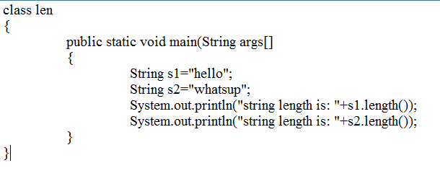
2. String Length() : This method tells the length of the string. It returns count of total number of characters present in the String.
O/P : s1 : 5
s2: 7

Slide 100
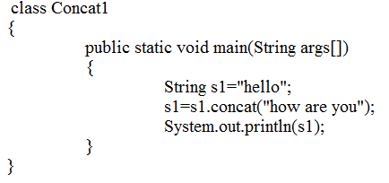
3. String Concatenation : This method combines a specific string at the end of another string and ultimately returns a combined string.
O/P : hellohow are you

Slide 101
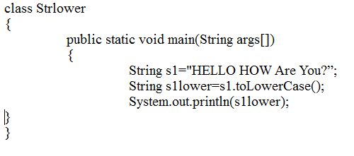
4. String Lower Cases : The java string toLowerCase() method converts all the characters of the String to lower case
O/P : hello how are you

Slide 102
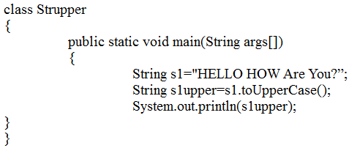
5. String Upper Cases : The java string toUpperCase() method converts all the characters of the String to Upper Case
O/P : HELLO HOW ARE YOU

Slide 103
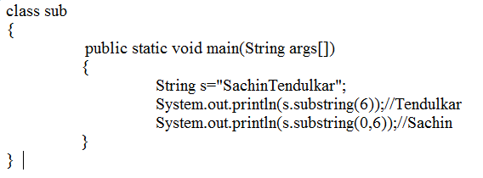
6. String substring : A part of string is called substring.
There are 2 methods . Those are
1.public String substring(int startIndex)
2. public String substring(int startIndex, int endIndex)

Slide 104
STRING BUFFER CLASS
Definition : Java StringBuffer class is used to create mutable (modifiable) string.
The StringBuffer class in java is same as String class except it is mutable i.e. it can be changed.
Every String Buffer Class is capable for storing a Number of Characters specified by its Capacity.
If the Capacity of the String Buffer exceeded the Capacity is automatically expanded to accommodate the additional Characters.

Slide 105
StringBuffer Constructors :
StringBuffer() : It is a default Constructor to create StringBuffer with no Characters in it and the Initial Capacity is 16 Characters.
StringBuffer(String str) : It takes a string argument to create a StringBuffer containing the characters of the argument. The Initial Capacity is the number of argument in the string argument + 16.

Slide 106
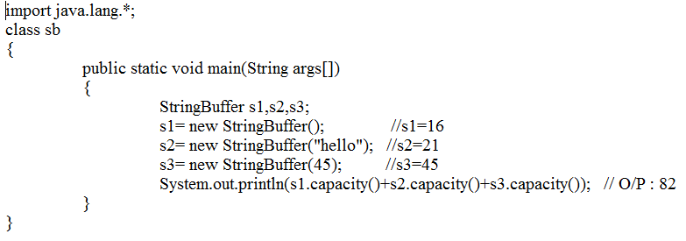
  Eg-1: /* String Buffer Class */

Slide 107
METHODS OF StringBuffer Class :There are so many StringBuffer functions are available in Java .
int length()
void setLength(int length)
append()
char charAt(int where)
void setCharAt(int where, char ch)
StringBuffer reverse() …..etc

Slide 108
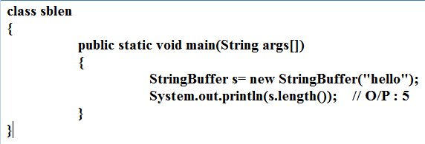
1. int length(): it returns the number of Characters in a StringBuffer.

Slide 109
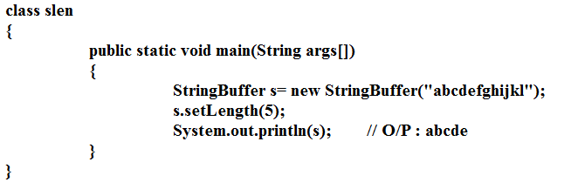
2.void setLength(int len): it increase or decrease the length of StringBuffer.

Slide 110
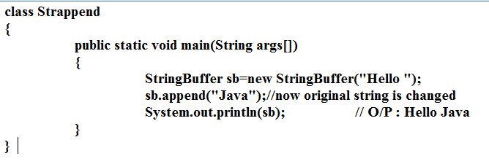
3.append(): it concatenates the given argument with the string.

Slide 111
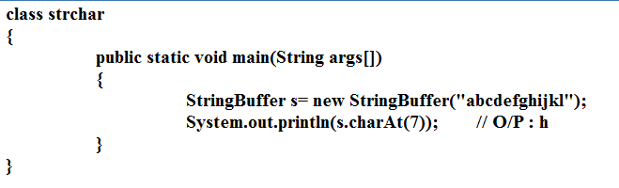
4.char charAt(int where): it returns a character at the specified position.

Slide 112
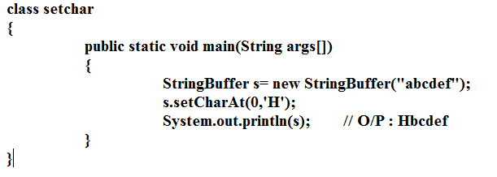
5.void setChar(int where, char ch): it takes an integer and a character argument and sets the character at the specified position of the character argument.

Slide 113
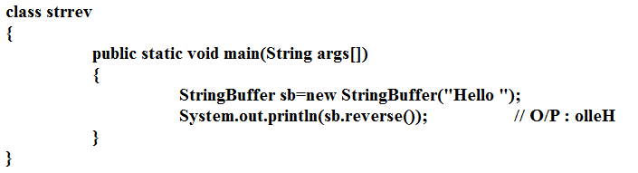
6.StringBuffer reverse(): it returns the reverse contents of the StringBuffer.

Slide 114
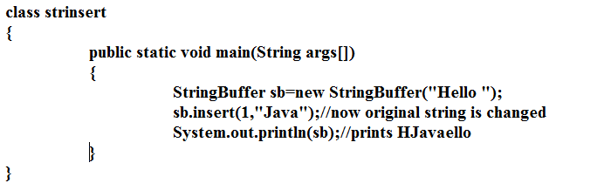
7.insert(): This method inserts the given string with this string at the given position.

Slide 115
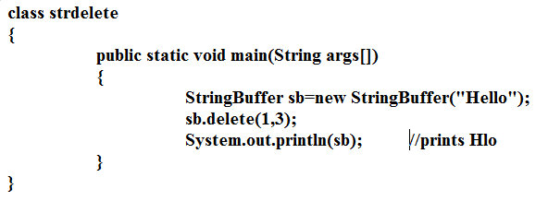
8.delete(): This method deletes the given string the specified beginIndex to endIndex.

Slide 116
STRING TOKENIZER CLASS
Definition : In Programming Languages statements are divided into Individual Pieces like identifiers, keywords, etc… called Tokens.
Java provides the StringTokenizer Class that breaks a string into its component tokens.
This class is available in java.util.* package.

Slide 117
StringTokenizer Constructors:
StringTokenizer(String str)
StringTokenizer(String str, String delimiters)
Methods :
int countTokens() :
boolean hasMoreTokens()

Slide 118
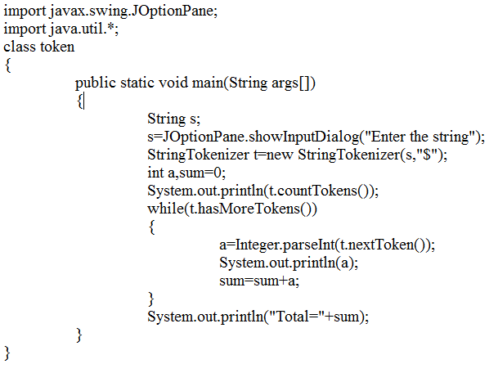
Eg-1 : /* StringTokenizer Class */
O/P : Enter the String : 1$2$3
3
1
2
3
Total : 6

Slide 119
STRING TOKENIZER CLASS
Definition : In Programming Languages statements are divided into Individual Pieces like identifiers, keywords, etc… called Tokens.
Java provides the StringTokenizer Class that breaks a string into its component tokens.
This class is available in java.util.* package.

Slide 120
StringTokenizer Constructors:
StringTokenizer(String str)
StringTokenizer(String str, String delimiters)
Methods :
int countTokens() :
boolean hasMoreTokens()

Slide 121
Eg-1 : /* StringTokenizer Class */
O/P : Enter the String : 1$2$3
3
1
2
3
Total : 6

Slide 122
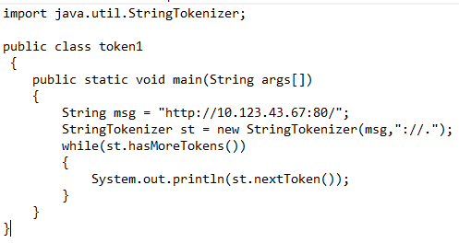
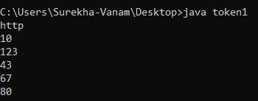
Eg-2 : /* StringTokenizer Class with multiple tokens */

Slide 123


Eg-3 : /* StringTokenizer Class with multiple tokens */

Slide 124

Eg-4 : /* StringTokenizer Class with multiple tokens using Scanner Class */

