Slide 1
Software Project Management

Slide 2
UNIT-1
Conventional software management
  Water Fall Model
  Conventional software Management Performance
Evolution of Software Economics
  Software Economics
  Pragmatic Software Cost Estimation

Slide 3
Improving Software Economics
  Reducing Software product size, improving software processes, improving team effectiveness, improving automation, Achieving required quality, peer inspections
The old way and The new way
  The principles of conventional software Engineering, principles of modern software management, transitioning to an iterative process.

Slide 4
introduction

Slide 5
Software Development can be split in two parts:
Software Creation
Software Project Management
Project:
A project is well-defined task, which is a collection of several operations done in order to achieve a goal. A Project can be characterized as:
Every project has a unique and distinct goal.
Project is not routine activity or day-to-day operations.
Project comes with a start time and end time.
Project ends when its goal is achieved hence it is a temporary phase in the lifetime of an organization.
Project needs adequate resources in terms of time, manpower, finance, material.

Slide 6
Software Project Management
Software comprises of number of activities, which contains planning of project, deciding scope of software product, estimation of cost in various terms, scheduling of tasks and events, and resource management.
Project management activities may include:
Project Planning
Scope Management
Project Estimation

Slide 7
Project Planning:
Software project planning is task, which is performed before the production of software actually starts.
Scope Management:
It defines the scope of project, this includes all the activities, process need to be done in order to make a deliverable software product.
During Project Scope management, it is necessary to -
Define the scope
Decide its verification and control
Divide the project into various smaller parts for ease of management.
Verify the scope

Slide 8
Project Estimation:
For an effective management accurate estimation of various measures is a must. With correct estimation managers can manage and control the project more efficiently and effectively.
Project estimation may involve the following:
Software size estimation
Effort estimation
Time estimation
Cost estimation

Slide 9
Conventional software management

Slide 10
Conventional software management refers to traditional, structured approaches (like the Waterfall Model) that sequence development into distinct phases (requirements, design, code, test), emphasizing upfront planning, strict documentation, and fixed processes, best for stable projects but often criticized for inflexibility and late discovery of issues, contrasting with modern, iterative methods.

Slide 11
Conventional software economics provides a benchmark of performance for conventional software management principles.
The best thing about software is its flexibility
  It can be programmed to do almost anything.
The worst thing about software is also its flexibility
  The "almost anything" characteristic has made it difficult to plan, monitors, and control software development.

Slide 12
Three important analyses of the state of the software engineering industry are
1. Software development is still highly unpredictable. Only about 10% of software projects are delivered successfully within initial budget and schedule estimates.
2. Management discipline is more of a discriminator in success or failure than are technology advances.
3. The level of software scrap and rework is indicative of an immature process.

Slide 13
THE WATERFALL MODEL
Most software engineering texts present the waterfall model as the source of the "conventional" software process
It provides an insightful and concise summary of conventional software management

Slide 14
The Waterfall Model was the first Process Model to be introduced.
It is also referred to as a linear-sequential life cycle model.
It is very simple to understand and use.
In a waterfall model, each phase must be completed before the next phase can begin and there is no overlapping in the phases.
The Waterfall model is the earliest SDLC approach that was used for software development.
The waterfall Model illustrates the software development process in a linear sequential flow.
This means that any phase in the development process begins only if the previous phase is complete. In this waterfall model.

Slide 15
The Waterfall Model – In Theory
Three main primary points are
There are two essential steps common to the development of computer programs: analysis and coding.
Analysis and coding both involve creative work that directly contributes to the usefulness of the end product.
Waterfall Model part 1: The two basic steps to building a program
Analysis and coding both involve creative work that directly contributes to the usefulness of the end product
Analysis
Coding

Slide 16
2. In order to manage and control all of the intellectual freedom associated with software development, one must introduce several other "overhead" steps, including system requirements definition, software requirements definition, program design, and testing. These steps supplement the analysis and coding steps

Slide 17
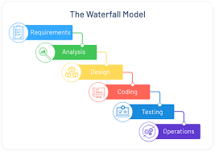

Slide 18
      The basic framework described in the waterfall model is risky and invites failure.
        The testing phase that occurs at the end of the development cycle is the first event for which timing, storage, input/output transfers, etc., are experienced as distinguished from analyzed.

Slide 19
        The resulting design changes are likely to be so disruptive that the software requirements upon which the design is based are likely violated. Either the requirements must be modified or a substantial design change is warranted.

Slide 20
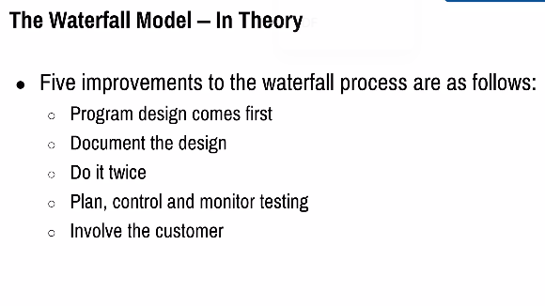

Slide 21
Five necessary improvements for waterfall model are:-
Program design comes first .
Insert a preliminary program design phase between the software requirements phase and the analysis phase.
2. Document the design.
The amount of documentation required on most software programs is quite a lot, certainly much more than most programmers, analysts, or program designers are willing to do if left to their own devices

Slide 22
3. Do it twice.
If a computer program is being developed for the first time, arrange matters so that the version finally delivered to the customer for operational deployment is actually the second version in so far as critical design/operations are concerned
4) Plan, control, and monitor testing. Without question, the biggest user of project resources-manpower, computer time, and/or management judgment-is the test phase.
  This is the phase of greatest risk in terms of cost and schedule. It occurs at the latest point in the schedule, when backup alternatives are least available
5) Involve the customer. It is important to involve the customer in a formal way so that he has committed himself at earlier points before final delivery.

Slide 23
Waterfall Model – Application
Every software developed is different and requires a suitable SDLC approach to be followed based on the internal and external factors.
Requirements are very well documented, clear and fixed.
Product definition is stable.
Technology is understood and is not dynamic.
There are no ambiguous requirements.
The project is short.

Slide 24
Waterfall Model - Advantages
Simple and easy to understand and use
Easy to manage due to the design of the model. Each phase has specific deliverables and a review process.
Phases are processed and completed one at a time.
Works well for smaller projects where requirements are very well understood.
Clearly defined stages.
Well understood milestones.
Easy to arrange tasks.
Process and results are well documented.

Slide 25
Disadvantages
The major disadvantages of the Waterfall Model are as follows
No working software is produced until late during the life cycle.
High amounts of risk and uncertainty.
Not a good model for complex and object-oriented projects.
Poor model for long and ongoing projects.
Not suitable for the projects where requirements are at a moderate to high risk of changing. So, risk and uncertainty is high with this process model.
It is difficult to measure progress within stages.
Cannot accommodate changing requirements.
Adjusting scope during the life cycle can end a project.

Slide 26
    IN PRACTICE
Some software projects still practice the conventional software management approach.
It is useful to summarize the characteristics of the conventional process as it has typically been applied, which is not necessarily as it was intended.
Projects destined for trouble frequently exhibit the following symptoms:
  Protracted integration and late design breakage.
  Late risk resolution.
  Requirements-driven functional decomposition.
  Adversarial (conflict or opposition) stakeholder relationships.
  Focus on documents and review meetings.

Slide 27
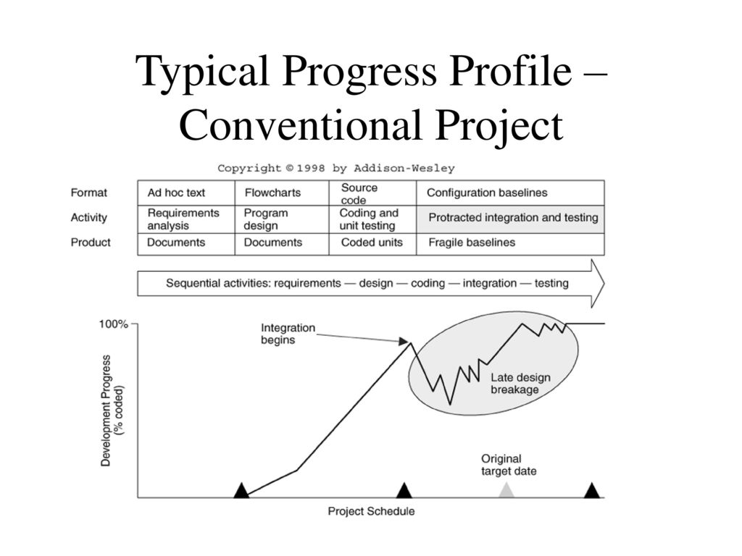

Slide 28
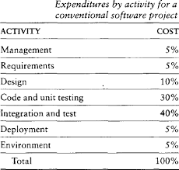
Table 1-1 provides a typical profile of cost expenditures across the spectrum of software activities.

Slide 29
Late risk resolution
A serious issue associated with the waterfall lifecycle was the lack of early risk resolution.
Figure 1.3 illustrates a typical risk profile for conventional waterfall model projects.
It includes four distinct periods of risk exposure, where risk is defined as the probability of missing a cost, schedule, feature, or quality goal.

Slide 30
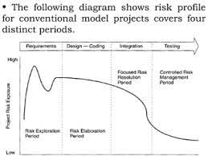
Figure 1.3

Slide 31
Requirements-Driven Functional Decomposition:
This approach depends on specifying requirements completely and unambiguously before other development activities begin.
It naively treats all requirements as equally important, and depends on those requirements remaining constant over the software development life cycle.
These conditions rarely occur in the real world. Specification of requirements is a difficult and important part of the software development process.

Slide 32
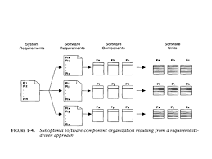
Figure 1-4 illustrates the result of requirements-driven approaches: a software structure that is organized around the requirements specification structure.

Slide 33
Adversarial Stakeholder Relationships
The following sequence of events was typical for most contractual software efforts:
      The contractor prepared a draft contract-deliverable document that captured an intermediate artifact and delivered it to the customer for approval.
      The customer was expected to provide comments (typically within 15 to 30 days).
      The contractor incorporated these comments and submitted (typically within 15 to 30 days) a final version for approval.
This one-shot review process encouraged high levels of sensitivity on the part of customers and contractors.

Slide 34
Focus on Documents and Review Meetings:
The conventional process focused on producing various documents that attempted to describe the software product, with insufficient focus on producing tangible increments of the products themselves.
Contractors were driven to produce literally tons of paper to meet milestones and demonstrate progress to stakeholders, rather than spend their energy on tasks that would reduce risk and produce quality software

Slide 35
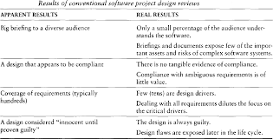

Slide 36
  CONVENTIONAL SOFTWARE MANAGEMENT PERFORMANCE
Barry Boehm's Industrial Software Metrics Top 10 List
Finding and fixing a software problem after delivery costs 100 times more than finding and fixing the problem in early design phases.
We can compress software development schedules 25% of nominal, but no more.
For every $1 you spend on development, you will spend $2 on maintenance.(Iron law of s/w development)
Software development and maintenance costs are primarily a function of the number of source lines of code.

Slide 37
5. Variations among people account for the biggest differences in software productivity
6. The overall ratio of software to hardware costs is still growing. In 1955 it was 15:85; in 1985, 85:15.
7. Only about 15% of software development effort is devoted to programming.
8. Software systems and products typically cost 3 times as much per SLOC as individual software programs. Software-system products (i.e., system of systems) cost 9 times as much.
9. Walkthroughs catch 60% of the errors
10. 80% of the contribution comes from 20% of the contributors.
.

Slide 38
Evolution of software economics
  The evolution of software economics in Software Project Management (SPM) moved from early, craft-based methods (1960s-70s) focused on SLOC to more structured models (1980s-90s) like COCOMO, incorporating process, personnel, environment, and quality (PPEQ) factors, culminating in modern practices (2000s+) using integrated tools, component reuse, and risk-aware estimation
  Most software cost models can be abstracted into a function of five basic parameters:
  Size, Process, Personnel
  Environment and
  Required Quality

Slide 39
The size of the end product (in human-generated components), which is typically quantified in terms of the number of source instructions or the number of function points required to develop the required functionality
The process used to produce the end product, in particular the ability of the process to avoid non- value- adding activities (rework, bureaucratic delays, communications overhead)
    The capabilities of software engineering personnel, and particularly their experience with the computer science issues and the applications domain issues of the project

Slide 40
The environment, which is made up of the tools and techniques available to support efficient software development and to automate the process
The required quality of the product, including its features, performance, reliability, and adaptability
The relationships among these parameters and the estimated cost can be written as follows:
Effort = (Personnel) (Environment) (Quality)(Size^{process})

Slide 41
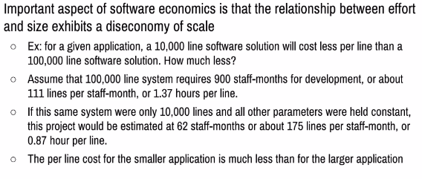

Slide 42
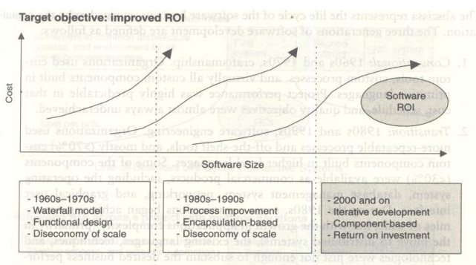
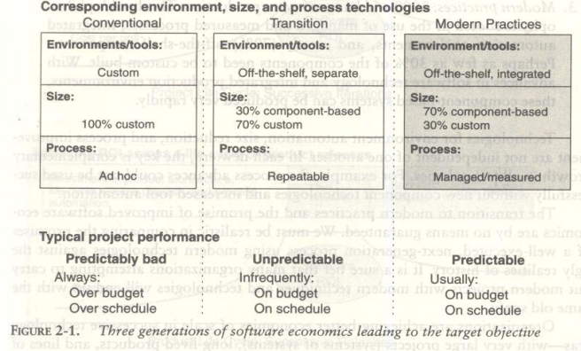
Figure 2-1 shows three generations of basic technology advancement in tools, components, and processes.

Slide 43
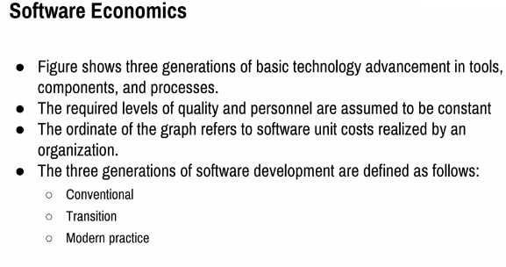

Slide 44
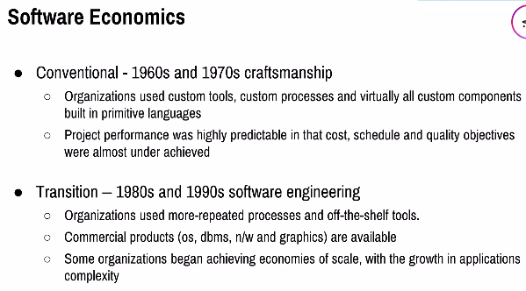
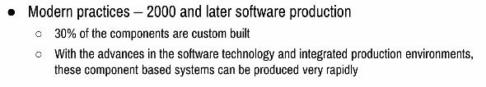

Slide 45
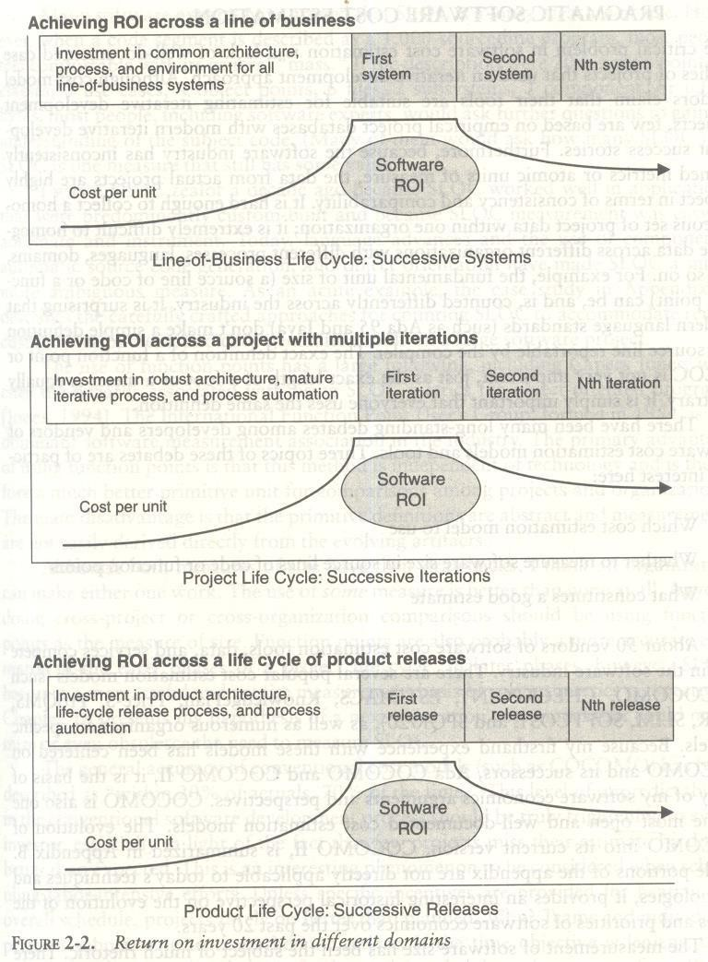
Figure 2-2 provides an overview of how a return on investment (ROI) profile can be achieved in subsequent efforts across life cycles of various domains.

Slide 46
Pragmatic Software Cost Estimation
Pragmatic software cost estimation is a realistic, data-driven approach to predicting project costs by combining historical data, proven models (like Function Points, COCOMO), considering risks, involving the actual development team, and comparing internal (inside view) with external (outside view/reference class) data to avoid common over optimism (planning fallacy). It focuses on transparency, auditable assumptions, and stakeholder alignment for achievable, not just theoretical, budgets, incorporating process improvements and known risk factors.

Slide 47
Pragmatic Software Cost Estimation
One critical problem in software cost estimation is a lack of well-documented case studies of projects that used an iterative development approach.
Software industry has inconsistently defined metrics or atomic units of measure.
It is hard enough to collect a homogeneous set of project data within one organization; it is extremely difficult to homogenize data across different organizations with different processes, languages, domains, and so on.
There have been many debates among developers and vendors of software cost estimation models and tools.
Three topics of these debates are of particular interest here:
1. Which cost estimation model to use?
2. Whether to measure software size in source lines of code or function points?
3. What constitutes a good estimate?

Slide 48
There are several popular cost estimation models (such as COCOMO, CHECKPOINT, ESTIMACS, KnowledgePlan, Price-S, ProQMS, SEER, SLIM, SOFTCOST, and SPQR/20), CO COMO is also one of the most open and well-documented cost estimation models.
The general accuracy of conventional cost models (such as COCOMO) has been described as "within 20% of actuals, 70% of the time."
Most real-world use of cost models is bottom-up rather than top-down.
The software project manager
defines the target cost of the software, and then manipulates the parameters and sizing until the target cost can be justified.

Slide 49
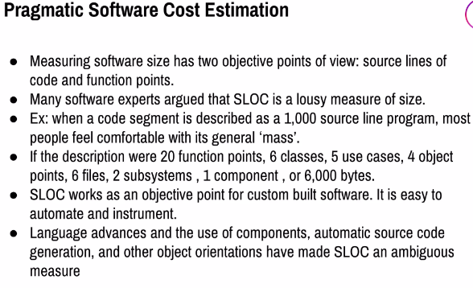

Slide 50
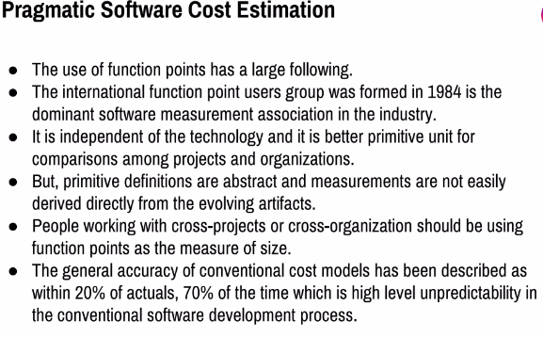

Slide 51
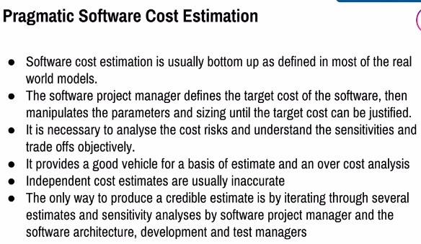

Slide 52
A good software cost estimate has the following attributes:
It is conceived and supported by the project manager, architecture team, development team, and test team accountable for performing the work.
It is accepted by all stakeholders as ambitious but realizable.
It is based on a well-defined software cost model with a credible basis.
It is based on a database of relevant project experience that includes similar processes, similar technologies, similar environments, similar quality requirements, and similar people.
It is defined in enough detail so that its key risk areas are understood and the probability of success is objectively assessed.
An ideal estimate would be derived from a mature cost model with an experience base that reflects multiple similar projects done by the same team with the same mature processes and tools.

Slide 53
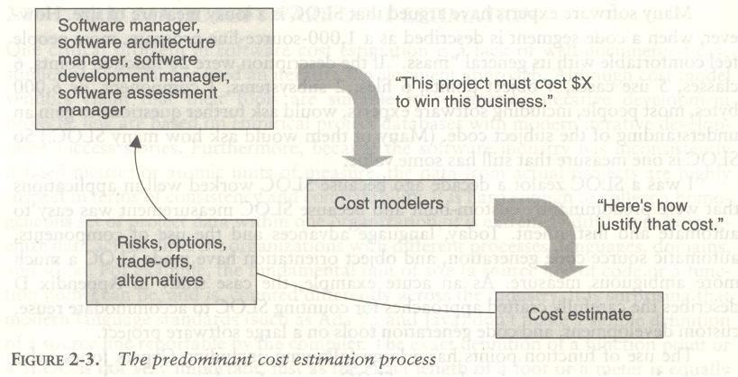

COCOMO is also one of the most open and well-documented cost estimation models.

Slide 54
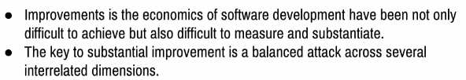
Improving Software Economics
Five basic parameters of the software cost model are
  Reducing the size or complexity of what needs to be developed.
  Improving the development process.
  Using more-skilled personnel and better teams
  Using better environments (tools to automate the process).
  Trading off or backing off on quality thresholds.

Slide 55
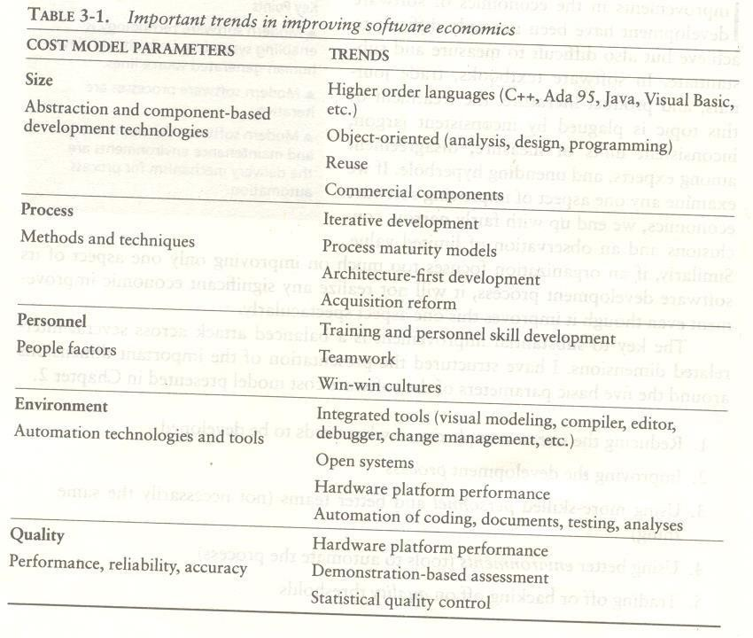

Slide 56
  REDUCING SOFTWARE PRODUCT SIZE
Languages
Object Oriented method and visual modeling
Reuse
Commercial components

Slide 57
Languages
Universal function points (UFPs¹) are useful estimators for language-independent, early life-cycle estimates.
The basic units of function points are external user inputs, external outputs, internal logical data groups, external data interfaces, and external inquiries.
SLOC metrics are useful estimators for software after a candidate solution is formulated and an implementation language is known.
Substantial data have been documented relating SLOC to function points.

Slide 58
LANGUAGES | SLOC per UFP
Assembly | 320
C | 128
FORTAN77 | 105
COBOL85 | 91
Ada83 | 71
C++ | 56
Ada95 | 55
Java | 55
Visual Basic | 35

Slide 59
OBJECT-ORIENTED METHODS AND VISUAL MODELING
Object-oriented programming languages appear to benefit both software productivity and software quality.
The fundamental impact of object-oriented technology is in reducing the overall size of what needs to be developed.
People like drawing pictures to explain something to others or to themselves.

Slide 60
Booch described three reasons that certain object oriented succeed
An object-oriented model of the problem and its solution encourages a common vocabulary between the end users of a system and its developers, thus creating a shared understanding of the problem being solved.
The use of continuous integration creates opportunities to recognize risk early and make incremental corrections without destabilizing the entire development effort.
An object-oriented architecture provides a clear separation of concerns among disparate elements of a system, creating firewalls that prevent a change in one part of the system from rending the fabric of the entire architecture.

Slide 61
Booch also summarized five characteristics of a successful object-oriented project
A ruthless focus on the development of a system that provides a well understood collection of essential minimal characteristics.
The existence of a culture that is centered on results, encourages communication, and yet is not afraid to fail.
The effective use of object-oriented modeling.
The existence of a strong architectural vision.
The application of a well-managed iterative and incremental development life cycle.

Slide 62
    REUSE
Reusing existing components and creating reusable components have been integral parts of software engineering since the early advancements in programming languages
With reuse in order to minimize development costs while achieving all the other required attributes of performance, feature set, and quality.
Most truly reusable components of value are transitioned to commercial products supported by organizations with the following characteristics:
  They have an economic motivation for continued support.
  They take ownership of improving product quality, adding new features, and transitioning to new technologies.
  They have a sufficiently broad customer base to be profitable.

Slide 63
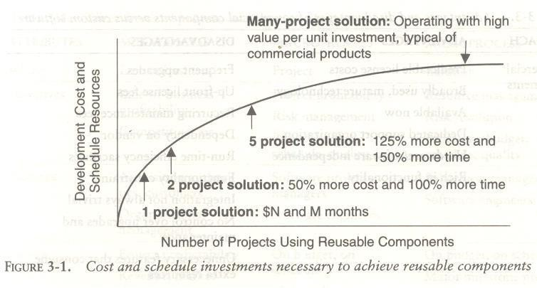

Slide 64
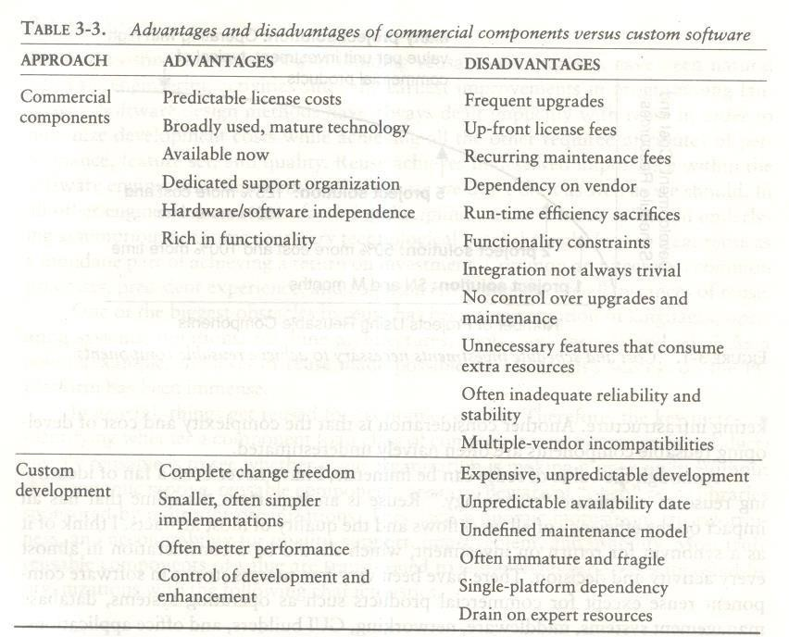
    COMMERCIAL COMPONENTS
the use of commercial components is certainly desirable as a means of reducing custom development, it has not proven to be straightforward in practice.

Slide 65
  IMPROVING SOFTWARE PROCESSES
Three distinct process perspectives are.
Metaprocess: an organization's policies, procedures, and practices for pursuing a software-intensive line of business.
  The focus of this process is on organizational economics, long-term strategies, and software ROI.
Macroprocess: a project's policies, procedures, and practices for producing a complete software product within certain cost, schedule, and quality constraints.
  The focus of the macro process is on creating an adequate instance of the Meta process for a specific set of constraints.

Slide 66
Microprocess: a project team's policies, procedures, and practices for achieving an artifact of the software process.
  The focus of the micro process is on achieving an intermediate product baseline with adequate quality and adequate functionality as economically and rapidly as practical.

Slide 67
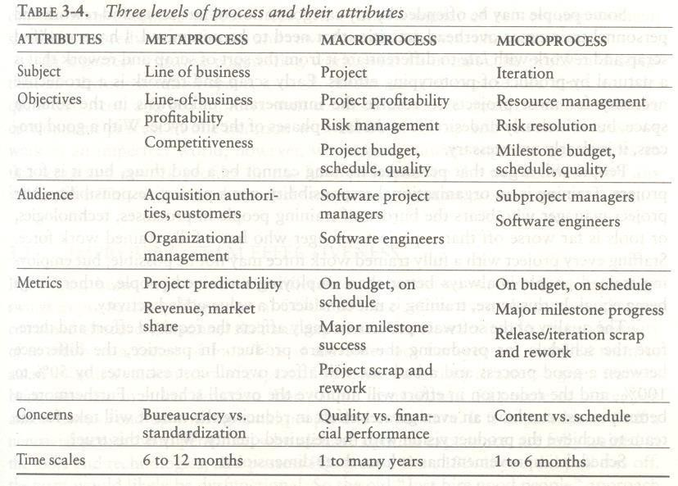

Slide 68
  IMPROVING TEAM EFFECTIVENESS
Teamwork outweighs individual contributions. A project manager should balance solid talent with skilled individuals in key roles.
Some maxims of team management include the following:
A well-managed project can succeed with a nominal engineering team.
A mismanaged project will almost never succeed, even with an expert team of engineers.
A well-architected system can be built by a nominal team of software builders.
A poorly architected system will flounder even with an expert team of builders.

Slide 69
Boehm five staffing principles are
The principle of top talent: Use better and fewer people
The principle of job matching: Fit the tasks to the skills and motivation of the people available.
The principle of career progression: An organization does best in the long run by helping its people to self-actualize.
The principle of team balance: Select people who will complement and harmonize with one another
The principle of phase-out: Keeping a misfit on the team doesn't benefit anyone

Slide 70
The following are some crucial attributes of successful software project managers that deserve much more attention:
Hiring skills.
  Few decisions are as important as hiring decisions.
  Placing the right person in the right job seems obvious but is surprisingly hard to achieve.
Customer-interface skill.
  Avoiding adversarial relationships among stakeholders is a prerequisite for success.
Decision-making skill.
  We all know a good leader when we run into one, and decision-making skill seems obvious despite its intangible definition.

Slide 71
Team-building skill.
  Teamwork requires that a manager establish trust,
  motivate progress
  exploit eccentric prima donnas
  transition average people into top performers
  eliminate misfits and
  consolidate diverse opinions into a team direction.
Selling skill.
  Successful project managers must sell all stakeholders (including themselves) on decisions and priorities
  sell candidates on job positions
  sell changes to the status quo in the face of resistance and
  sell achievements against objectives

Slide 72
  IMPROVING AUTOMATION THROUGH SOFTWARE ENVIRONMENTS
The tools and environment used in the software process generally have a linear effect on the productivity of the process.
Planning tools, requirements management tools, visual modeling tools, compilers, editors, debuggers, quality assurance analysis tools, test tools, and user interfaces provide crucial automation support for evolving the software engineering artifacts.

Slide 73
Round-trip engineering
  It describes the key capability of environments that support iterative development.
  Maintaining different information repositories for the engineering artifacts, we need automation support to ensure efficient and error-free transition of data from one artifact to another.
Forward engineering is the automation of one engineering artifact from another, more abstract representation.
  For example, compilers and linkers have provided automated transition of source code into executable code.
Reverse engineering is the generation or modification of a more abstract representation from an existing artifacts

Slide 74
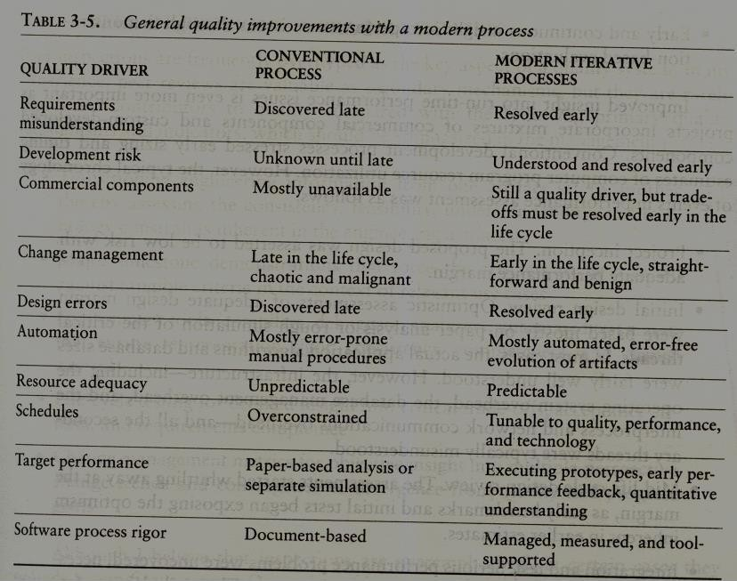

Slide 75
For example, it is easy to find statements such as the following from companies in a particular tool.
Requirements analysis and evolution activities consume 40% of life-cycle costs.
Software design activities have an impact on more than 50% of the resources.
Coding and unit testing activities consume about 50% of software development effort and schedule.
Test activities can consume as much as 50% of a project's resources..

Slide 76
Configuration control and change management are critical activities that can consume as much as 25% of resources on a large-scale project.
Documentation activities can consume more than 30% of project engineering resources.
Project management, business administration, and progress assessment can consume as much as 30% of project budgets

Slide 77
ACHIEVING REQUIRED QUALITY
Key practices that improve overall software quality include the following:
Focusing on driving requirements and critical use cases early in the life cycle
Focusing on requirements completeness and traceability late in the life cycle
focusing throughout the life cycle on a balance between requirements evolution, design evolution, and plan evolution
Using metrics and indicators to measure the progress and quality of an architecture as it evolves from a high-level prototype into a fully compliant product

Slide 78
Providing integrated life-cycle environments that support early and continuous configuration control, change management, rigorous design methods, document automation, and regression test automation
Using visual modeling and higher level languages that support architectural control, abstraction, reliable programming, reuse, and self-documentation
Early and continuous insight into performance issues through demonstration-based evaluations

Slide 79
Project inception. The proposed design was asserted to be low risk with adequate performance margin.
Initial design review.
Mid-life-cycle design review. The assessments started whittling away at the margin, as early benchmarks and initial tests began exposing the optimism inherent in earlier estimates.
Integration and test. Serious performance problems were uncovered, necessitating fundamental changes in the architecture

Slide 80
  PEER INSPECTIONS: A PRAGMATIC VIEW
Transitioning engineering information from one artifact set to another, thereby assessing the consistency, feasibility, understandability, and technology constraints inherent in the engineering artifacts
Major milestone demonstrations that force the artifacts to be assessed against tangible criteria in the context of relevant use cases
Environment tools (compilers, debuggers, analyzers, automated test suites) that ensure representation rigor, consistency, completeness, and change control

Slide 81
Life-cycle testing for detailed insight into critical trade-offs, acceptance criteria, and requirements compliance
Change management metrics for objective insight into multiple-perspective change trends and convergence or divergence from quality and progress goals

Slide 82
THE OLD WAY AND THE NEW WAY
THE PRINCIPLES OF CONVENTIONAL SOFTWARE ENGINEERING
Make quality
High-quality software is possible
Give products to customers early
Determine the problem before writing the requirements
Evaluate design alternatives
Use an appropriate process model.
Use different languages for different phases
Minimize intellectual distance.
Put techniques before tools
Get it right before you make it faster.

Slide 83
11 . Inspect code
12. Good management is more important than good technology
13. People are the key to success
14. Follow with care
15. Take Responsibility
16. Understand the customer priorities
17. The more they see, The more they need
18.Plan to throw one away
19.Design for change
20.Design without Documentation is not design

Slide 84
21. Use tools, but be realistic
22.Avoid Tricks
23 Encapsulate
24. Use Coupling and Cohesion
25. Use the McCabe complexity measure
26.Don’t Test your own software
27. Analyze Causes for Errors
28. Realize that Software's entropy increases
29. People and Time are not Interchangeable
30. Expect Excellence

Slide 85
  THE PRINCIPLES OF MODERN SOFTWARE MANAGEMENT
Base the process on an architecture-first approach
Establish an iterative life-cycle process that confronts risk early
Transition design methods to emphasize component-based development
Establish a change management environment.
Enhance change freedom through tools that support round-trip engineering.
Capture design artifacts in rigorous, model-based notation
Instrument the process for objective quality control and progress assessment.
Use a demonstration-based approach to assess intermediate artifacts.
Plan intermediate releases in groups of usage scenarios with evolving levels of detail
Establish a configurable process that is economically scalable.

Slide 86
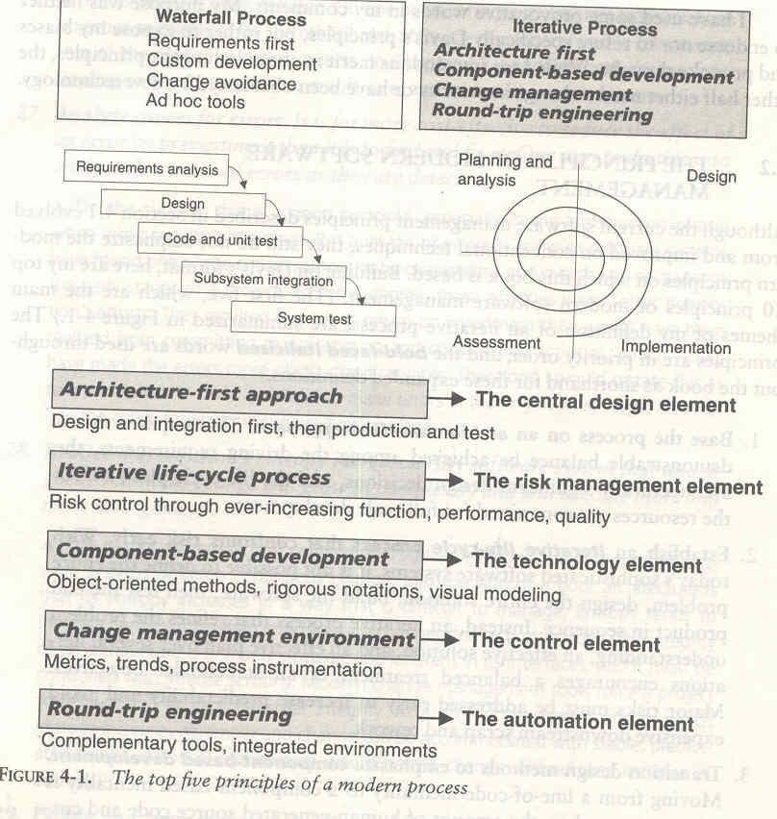

Slide 87
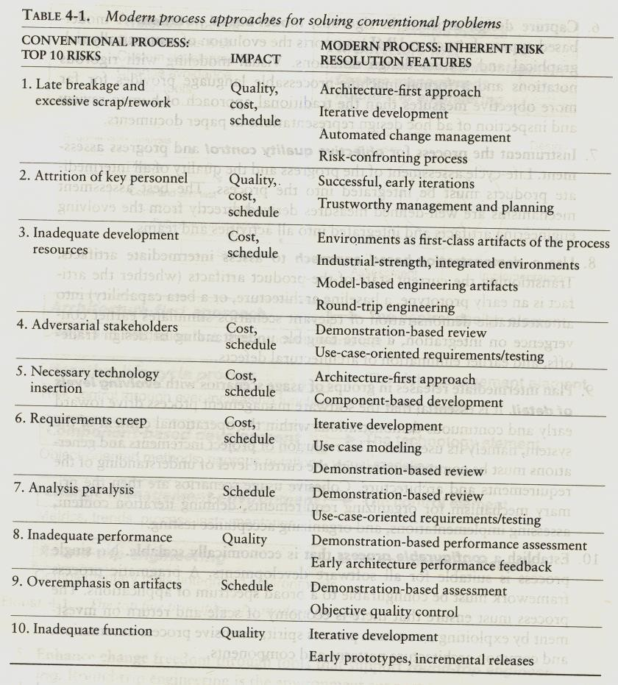

Slide 88
  TRANSITIONING TO AN ITERATIVE PROCESS
The following map the process exponent parameters of COCOMO II to top 10 principles of a modern process.
Application precedentedness
Process flexibility.
Architecture risk resolution.
Team cohesion
Software process maturity.

