Slide 1
Knowledge Representation
Post-Doctoral Researcher at Federal University of Ceará, Brazil
Visiting Post-Doc Fellow-Dongguk University, South Korea.
Visiting Post-Doc Fellow- Sejong University, South Korea.
Associate Professor,
Department of Computer Science and Engineering,
Prasad V. Potluri Siddhartha Institute of Technology,
Vijayawada-520007, Andhra Pradesh
Honorary Member- London Journal Press
Life Member-Computer Society of India
Life Member-IAENG
Life Member-International Association of Engineers
Life Member-Engineering Research and Publications
Member-Indian Academicians and Research Associates
Mobile:+91-9000595535

Slide 2
Topics
Logical Agents
Knowledge Based Agents
Logic
Propositional logic
First order logic
Syntax and Semantics in First order Logic
Inference in first order logic
propositional vs. First order inference
Unification and Lifting
Forward chaining, Backward chaining
Resolution

Slide 3
Knowledge Based Agents
An intelligent agent needs knowledge about the real world for taking decisions and reasoning to act efficiently.
Knowledge-based agents are those agents who have the capability of maintaining an internal state of knowledge, reason over that knowledge, update their knowledge after observations and take actions. These agents can represent the world with some formal representation and act intelligently.
Knowledge based agents give the current situation in the form of sentences. They have complete knowledge of current situation of mini-world and its surroundings. These agents manipulate knowledge to infer new things at “Knowledge level”.

Slide 4
Knowledge Based Agents
A knowledge-based agent must able to do the following:
An agent should be able to represent states, actions, etc.
An agent Should be able to incorporate new percepts.
An agent can update the internal representation of the world.
An agent can deduce the internal representation of the world.
An agent can deduce appropriate actions.

Slide 5
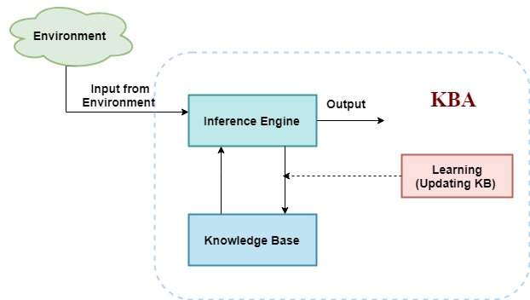
Knowledge Based Agents Architecture

Slide 6
Types of Agents
Declarative Approach: In this beginning from an empty knowledge base, the agent can TELL sentences one after another till the agent has knowledge of how to work with its environment. This is known as the declarative approach. It stores required information in empty knowledge-based system.
Procedural Approach: This converts required behaviors directly into program code in empty knowledge-based system. It is a contrast approach when compared to Declarative approach. In this by coding behavior of system is designed .

Slide 7
Logic
Logic is the basis of all mathematical reasoning, and of all automated reasoning. The rules of logic specify the meaning of mathematical statements. These rules help us understand and reason with statements such as –
Which in Simple English means “There exists an integer that is not the sum of two squares”. Importance of Mathematical Logic The rules of logic give precise meaning to mathematical statements. These rules are used to distinguish between valid and invalid mathematical arguments. Apart from its importance in understanding mathematical reasoning, logic has numerous applications in Computer Science, varying from design of digital circuits, to the construction of computer programs and verification of correctness of programs.

Slide 8
Propositional Logic
A proposition is the basic building block of logic. It is defined as a declarative sentence that is either True or False, but not both. The Truth Value of a proposition is True(denoted as T) if it is a true statement, and False(denoted as F) if it is a false statement. For Example,
The sun rises in the East and sets in the West.
1 + 1 = 2
'b' is a vowel.

Slide 9
Basic Terminology
Propositional logic is also called Boolean logic as it works on 0 and 1.
In propositional logic, we use symbolic variables to represent the logic, and we can use any symbol for a representing a proposition, such A, B, C, P, Q, R, etc.
Propositions can be either true or false, but it cannot be both.
Propositional logic consists of an object, relations or function, and logical connectives.
These connectives are also called logical operators.
A proposition formula which is always true is called tautology, and it is also called a valid sentence.
A proposition formula which is always false is called Contradiction.

Slide 10
Propositional logic
Logical constants: true, false
Propositional symbols: P, Q, S, ... (atomic sentences)
Wrapping parentheses: ( … )
Sentences are combined by connectives:
∧ ...and [conjunction]
∨ ...or [disjunction]
⇒...implies [implication / conditional]
⇔..is equivalent [biconditional]
¬ ...not [negation]
Literal: atomic sentence or negated atomic sentence

Slide 11
Continued…
S := <Sentence> ;
<Sentence> := <AtomicSentence> | <ComplexSentence> ;
<AtomicSentence> := "TRUE" | "FALSE" |
"P" | "Q" | "S" ;
<ComplexSentence> := "(" <Sentence> ")" |
<Sentence> <Connective> <Sentence> |
"NOT" <Sentence> ;
<Connective> := "NOT" | "AND" | "OR" | "IMPLIES" | "EQUIVALENT" ;

Slide 12
Examples of Propositional Logic sentences
P means “It is hot.”
Q means “It is humid.”
R means “It is raining.”
(P ∧ Q) → R
“If it is hot and humid, then it is raining”
Q → P
“If it is humid, then it is hot”

Slide 13
Continued…
A simple language useful for showing key ideas and definitions
User defines a set of propositional symbols, like P and Q.
User defines the semantics of each propositional symbol:
P means “It is hot”
Q means “It is humid”
R means “It is raining”
A sentence (well formed formula) is defined as follows:
A symbol is a sentence
If S is a sentence, then ¬S is a sentence
If S is a sentence, then (S) is a sentence
If S and T are sentences, then (S ∨ T), (S ∧ T), and (S → T), are sentences

Slide 14
Continued…
A valid sentence or tautology is a sentence that is True under all interpretations, no matter what the world is actually like or how the semantics are defined. Example: “It’s raining or it’s not raining.”
An inconsistent sentence or contradiction is a sentence that is False under all interpretations. The world is never like what it describes, as in “It’s raining and it’s not raining.”
P entails Q, written P |= Q, means that whenever P is True, so is Q. In other words, all models of P are also models of Q.

Slide 15
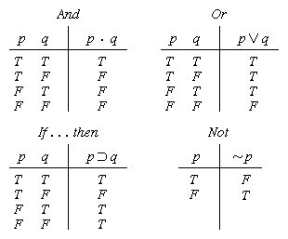
Truth tables

Slide 16
Truth tables II
The five logical connectives:
A complex sentence:

Slide 17
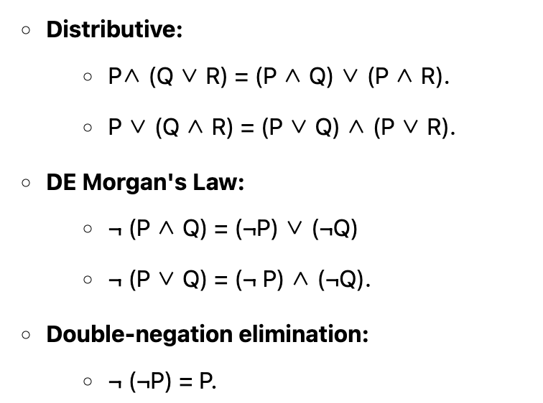
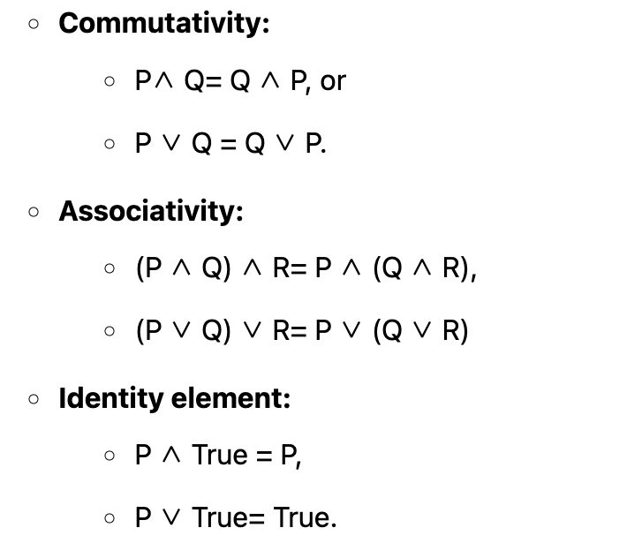
Properties of Operators

Slide 18
Inference
Inference is the process of deriving new sentences from old
Sound inference derives true conclusions given true premises
Complete inference derives all true conclusions from a set of premises

Slide 19
Advantages Vs Limitations
Advantages
Simple KR language sufficient for some problems
Lays the foundation for higher logics (e.g., FOL)
Reasoning is decidable, though NP complete, and efficient techniques exist for many problems
Limitations
Not expressive enough for most problems
Even when it is, it can very “un-concise”

Slide 20
PL is a weak KR language
Hard to identify “individuals” (e.g., Mary, 3)
Can’t directly talk about properties of individuals or relations between individuals (e.g., “Bill is tall”)
Generalizations, patterns, regularities can’t easily be represented (e.g., “all triangles have 3 sides”)
First-Order Logic (FOL) is expressive enough to represent this kind of information using relations, variables and quantifiers, e.g.,
Every elephant is gray: ∀ x (elephant(x) → gray(x))
There is a white alligator: ∃ x (alligator(X) ^ white(X))

Slide 21
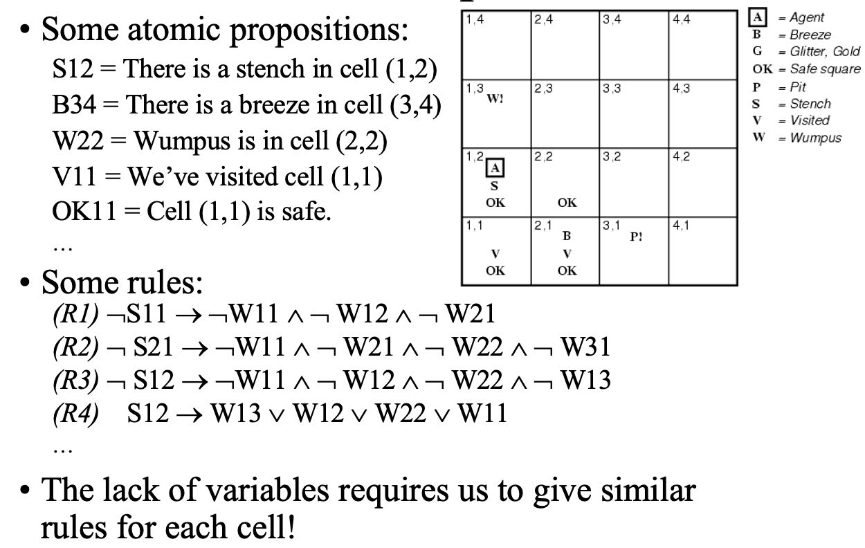
Hunt the Wumpus domain

Slide 22
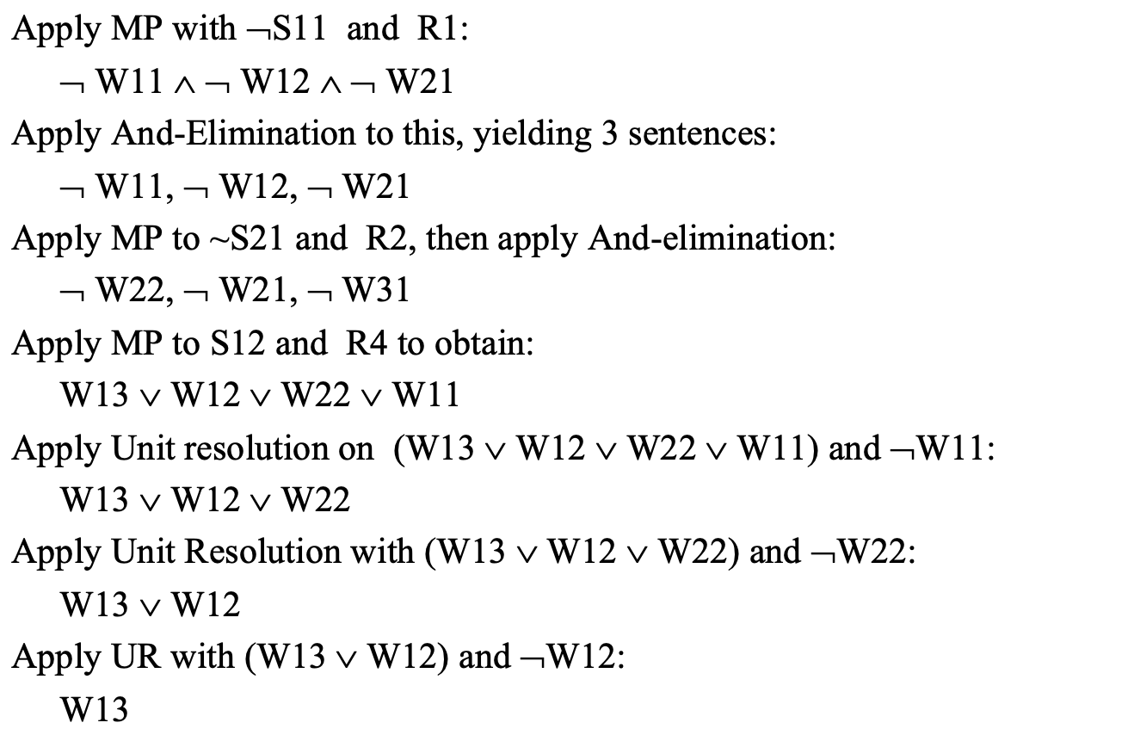
Proving Wumpus in W13

Slide 23
First-order logic
First-order logic (FOL) models the world in terms of
Objects, which are things with individual identities
Properties of objects that distinguish them from other objects
Relations that hold among sets of objects
Functions, which are a subset of relations where there is only one “value” for any given “input”
Examples:
Objects: Students, lectures, companies, cars ...
Relations: Brother-of, bigger-than, outside, part-of, has-color, occurs-after, owns, visits, precedes, ...
Properties: blue, oval, even, large, ...
Functions: father-of, best-friend, second-half, one-more-than ...

Slide 24
Elements of FOL
Variable symbols
E.g., x, y, foo
Connectives
Same as in PL: not (¬), and (∧), or (∨), implies (→), if and only if (biconditional ↔)
Quantifiers
Universal ∀x or (Ax)
Existential ∃x or (Ex)

Slide 25
Quantifiers
Universal quantification
(∀x)P(x) means that P holds for all values of x in the domain associated with that variable. Universal quantifiers are often used with “implies” to form “rules”:
E.g., (∀x) dolphin(x) → mammal(x)
Existential quantification
(∃ x)P(x) means that P holds for some value of x in the domain associated with that variable. Existential quantifiers are usually used with “and” to specify a list of properties about an individual
E.g., (∃ x) mammal(x) ∧ lays-eggs(x)
Permits one to make a statement about some object without naming it

Slide 26
Quantifier Scope

Slide 27
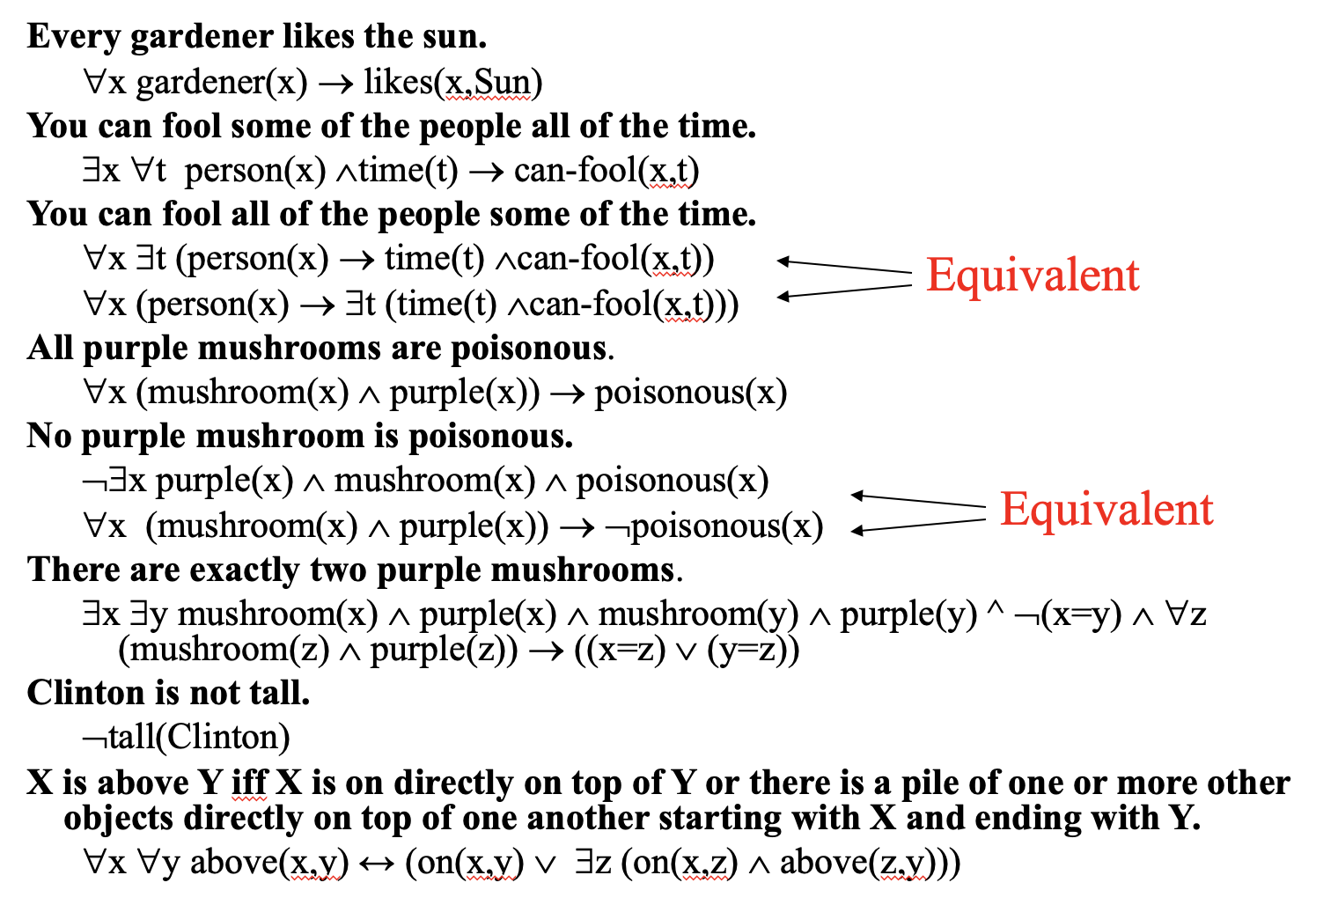
Translating English to FOL

Slide 28
Propositional Logic Vs FOL
Propositional Logic converts a complete sentence into a symbol and makes it logical whereas in First-Order Logic relation of a particular sentence will be made that involves relations, constants, functions, and constants.
The limitation of PL is that it does not represent any individual entities whereas FOL can easily represent the individual establishment that means if you are writing a single sentence then it can be easily represented in FOL.
PL does not signify or express the generalization, specialization or pattern for example ‘QUANTIFIERS’ cannot be used in PL but in FOL users can easily use quantifiers as it does express the generalization, specialization, and pattern.

Slide 29
Propositional Logic | Predicate Logic
Propositional logic is the logic that deals with a collection of declarative statements which have a truth value, true or false. | Predicate logic is an expression consisting of variables with a specified domain. It consists of objects, relations and functions between the objects.
It is the basic and most widely used logic. Also known as Boolean logic. | It is an extension of propositional logic covering predicates and quantification.
A proposition has a specific truth value, either true or false. | A predicate’s truth value depends on the variables’ value.
Scope analysis is not done in propositional logic. | Predicate logic helps analyze the scope of the subject over the predicate. There are three quantifiers : Universal Quantifier (∀) depicts for all, Existential Quantifier (∃) depicting there exists some and Uniqueness Quantifier (∃!) depicting exactly one.
Propositions are combined with Logical Operators or Logical Connectives like Negation(¬), Disjunction(∨), Conjunction(∧), Exclusive OR(⊕), Implication(⇒), Bi-Conditional or Double Implication(⇔). | Predicate Logic adds by introducing quantifiers to the existing proposition.
It is a more generalized representation. | It is a more specialized representation.
It cannot deal with sets of entities. | It can deal with set of entities with the help of quantifiers.

Slide 30
Inference in First-Order Logic
Inference in First-Order Logic is used to deduce new facts or sentences from existing sentences.
Substitution:
Substitution is a fundamental operation performed on terms and formulas. It occurs in all inference systems in first-order logic. The substitution is complex in the presence of quantifiers in FOL. If we write F[a/x], so it refers to substitute a constant "a" in place of variable "x".
Equality: First-Order logic does not only use predicate and terms for making atomic sentences but also uses another way, which is equality in FOL. For this, we can use equality symbols which specify that the two terms refer to the same object.
Example: Brother (a) = b.
The equality symbol can also be used with negation to represent that two terms are not the same objects.
Example: ￢(a=b) which is equivalent to a ≠ b.

Slide 31
Continued…
Universal Generalization:
Universal generalization is a valid inference rule which states that if premise P(c) is true for any arbitrary element c in the universe of discourse, then we can have a conclusion as ∀ x P(x).
It can be represented as: .
Example: Let's represent, P(c): "A byte contains 8 bits", so for ∀ x P(x) "All bytes contain 8 bits.", it will also be true.
Universal Instantiation:
UI is a valid inference rule. It can be applied multiple times to add new sentences.
we can infer any sentence obtained by substituting a ground term for the variable. The rule state that we can infer any sentence P(c) by substituting a ground term c (a constant within domain x) from ∀ x P(x) for any object in the universe of discourse.
It can be represented as:
IF "Every person like ice-cream"=> ∀x P(x) so we can infer that "John likes ice-cream" => P(c)

Slide 32
Continued…
Existential Instantiation: Existential instantiation is a valid inference rule in first-order logic.
It can be applied only once to replace the existential sentence.
The restriction with this rule is that c used in the rule must be a new term for which P(c ) is true.
It can be represented as:
∃x Crown(x) ∧ OnHead(x, John),
So we can infer: Crown(K) ∧ OnHead( K, John), as long as K does not appear in the knowledge base.
Existential introduction
An existential introduction is also known as an existential generalization, which is a valid inference rule in first-order logic.
This rule states that if there is some element c in the universe of discourse which has a property P, then we can infer that there exists something in the universe which has the property P.
It can be represented as:
Example: Let's say that, "Priyanka got good marks in English.” "Therefore, someone got good marks in English."

Slide 33
Unification
Unification is a process of making two different logical atomic expressions identical by finding a substitution. Unification depends on the substitution process.
It takes two literals as input and makes them identical using substitution.
Let Ψ₁ and Ψ₂ be two atomic sentences and 𝜎 be a unifier such that, Ψ₁𝜎 = Ψ₂𝜎, then it can be expressed as UNIFY(Ψ₁, Ψ₂).

Slide 34
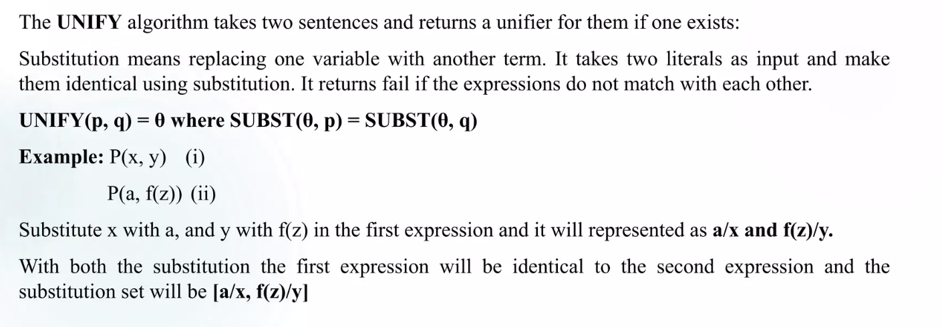
Continued…

Slide 35
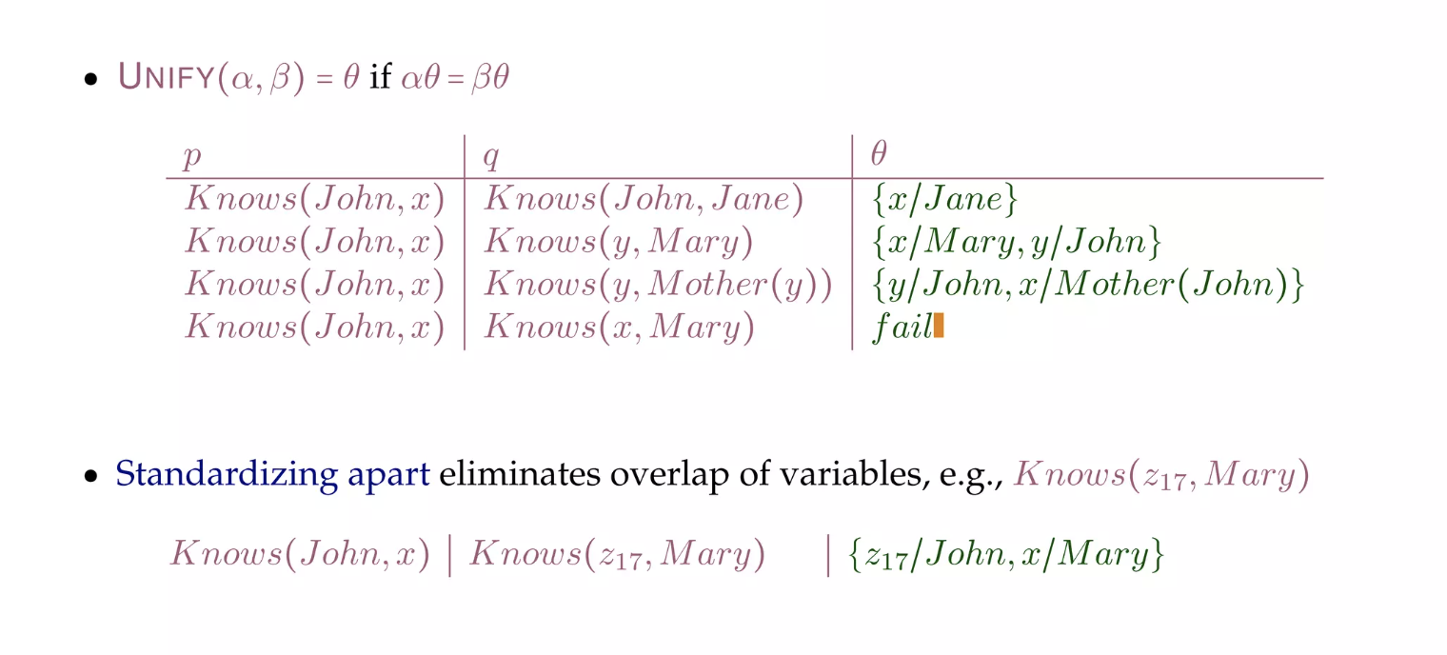
Example

Slide 36
Find the unification of {p(b, X, f(g(Z))) and p(Z, f(Y), f(Y))}
Here, Ψ₁ = p(b, X, f(g(Z))) , and Ψ₂ = p(Z, f(Y), f(Y))
S₀ => {p(b, X, f(g(Z))) ; p( Z, f(Y), f(Y) ) } SUBST θ={b/Z}
S₁=>{p(b, X, f(g(b)));p(b, f(Y), f(Y))} SUBST θ={f(Y) /X}
S₂ => { p(b, f(Y), f(g(b))); p(b, f(Y), f(Y))}SUBST θ= {g(b) /Y}
S₂ => { p(b, f(g(b)), f(g(b)); p(b, f(g(b)), f(g(b))} Unified Successfully. And Unifier = { b/Z, f(Y) /X , g(b) /Y}.

Slide 37
Resolution
Resolution is a theorem proving technique that proceeds by building refutation proofs, i.e., proofs by contradictions. Resolution is used, if there are various statements are given, and we need to prove a conclusion of those statements. Unification is a key concept in proofs by resolutions. Resolution is a single inference rule which can efficiently operate on the conjunctive normal form
Clause: Disjunction of literals (an atomic sentence) is called a clause. It is also known as a unit clause.
Conjunctive Normal Form: A sentence represented as a conjunction of clauses is said to be conjunctive normal form or CNF.

Slide 38
Steps for Resolution
Conversion of facts into first-order logic
Convert FOL statements into CNF
Negate the statement which needs to prove (proof by contradiction)
Draw resolution graph (unification)

Slide 39
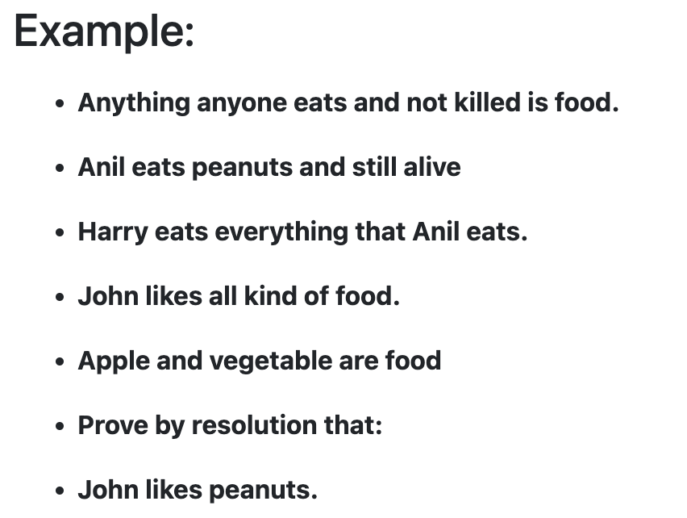
Example
Fact
All hounds howl at night.
John likes all kind of food.
John likes peanuts.

Slide 40
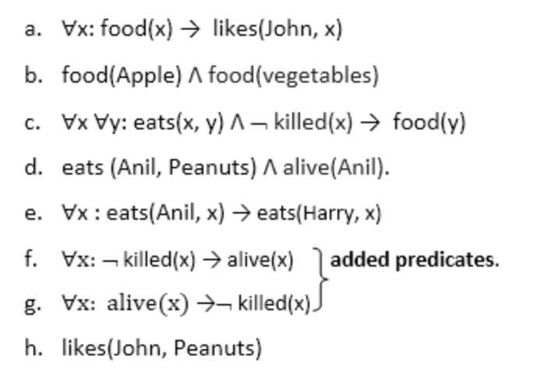
Step-1: Conversion of facts into first-order logic
∀x (HOUND(x) → HOWL(x))
∀x ¬ food(x) → likes(John, x)
likes(John, Peanuts)

Slide 41
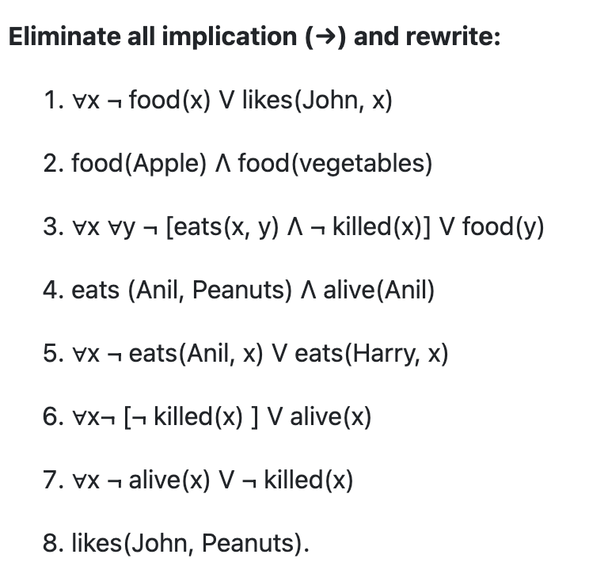
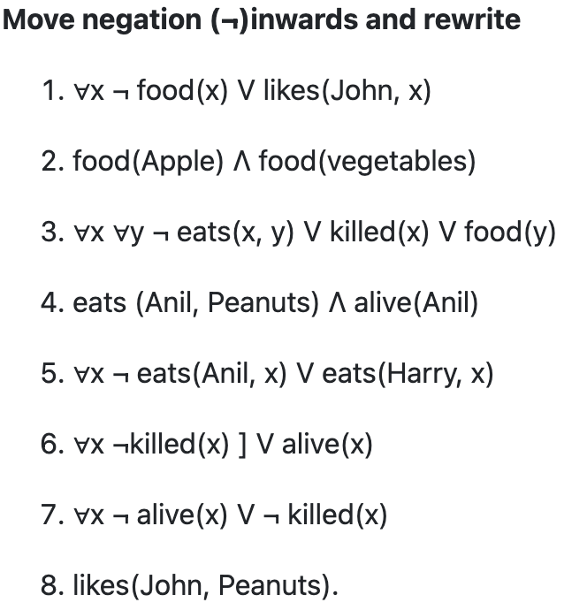
Step-2: Conversion of FOL into CNF
Eliminate all implication (→) and rewrite:
∀x ¬ HOUND(x) ∨ HOWL(x)
∀x ¬ food(x) V likes(John, x)
likes(John, Peanuts)
Move negation (¬)inwards and rewrite
∀x ¬ HOUND(x) ∨ HOWL(x)
∀x ¬ food(x) V likes(John, x)
likes(John, Peanuts)

Slide 42
Step-2 Continued…
Rename variables or standardize variables
¬ HOUND(x) ∨ HOWL(x)
∀x ¬ food(x) V likes(John, x)
likes(John, Peanuts)
Eliminate existential instantiation quantifier by elimination (Skolemization)
¬ HOUND(x) ∨ HOWL(x)
∀x ¬ food(x) V likes(John, x)
likes(John, Peanuts)

Slide 43
Step-2 Continued…
Drop Universal quantifiers
¬ HOUND(x) ∨ HOWL(x)
¬ food(x) V likes(John, x)
likes(John, Peanuts)

Slide 44
Step-3: Negate the statement which needs to prove
In this statement, we will apply negation to the conclusion statements
¬ HOUND(x) ∨ HOWL(x)
¬ food(x) V likes(John, x)
¬ likes(John, Peanuts)

Slide 45
Step-4: Draw Resolution graph
First step: ¬likes(John, Peanuts) , and likes(John, x) get resolved(canceled) by substitution of {Peanuts/x}, and we are left with ¬ food(Peanuts)

Slide 46
Horn Clause and Definite clause
Definite clause: A clause which is a disjunction of literals with exactly one positive literal is known as a definite clause or strict horn clause.
Horn clause: A clause which is a disjunction of literals with at most one positive literal is known as horn clause. Hence all the definite clauses are horn clauses.
Example: (¬ p V ¬ q V k). It has only one positive literal k.
It is equivalent to p ∧ q → k.

Slide 47
Forward Chaining and backward chaining
The inference engine is an artificial intelligence component that applies logical principles to the knowledge base to infer new information from known facts. The expert system included the first inference engine. Inference engines often operate in two modes:
Forward chaining
Backward chaining

Slide 48
Forward chaining
Forward chaining is also known as a forward deduction or forward reasoning method when using an inference engine. Forward chaining is a form of reasoning which start with atomic sentences in the knowledge base and applies inference rules in the forward direction to extract more data until a goal is reached.
It is a bottom-up approach for drawing the inferences.
It is a process of making a conclusion based on known facts or data, by starting from the initial state and reaches the goal state. And is also called as data-driven

Slide 49
Forward Chaining Example
"As per the law, it is a crime for an American to sell weapons to hostile nations. Country A, an enemy of America, has some missiles, and all the missiles were sold to it by Robert, who is an American citizen.”
Robert is criminal.

Slide 50
Facts Conversion into FOL
It is a crime for an American to sell weapons to hostile nations.
(Let's say p, q, and r are variables)
American (p) ∧ weapon(q) ∧ sells (p, q, r) ∧ hostile(r) → Criminal(p) ...(1)
Country A has some missiles.
?p Owns(A, p) ∧ Missile(p).
It can be written in two definite clauses by using Existential Instantiation, introducing new Constant T1. Owns(A, T1) ......(2) Missile(T1) ......(3)

Slide 51
Continued…
All of the missiles were sold to country A by Robert. ?p Missiles(p) ∧ Owns (A, p) → Sells (Robert, p, A) ......(4)
Missiles are weapons. Missile(p) → Weapons (p) .......(5)
Enemy of America is known as hostile. Enemy(p, America) →Hostile(p) ........(6)
Country A is an enemy of America. Enemy (A, America) .........(7)
Robert is American Criminal(Robert). ..........(8)

Slide 52
Forward Chaining Proof
Step 1
Step 2

Slide 53
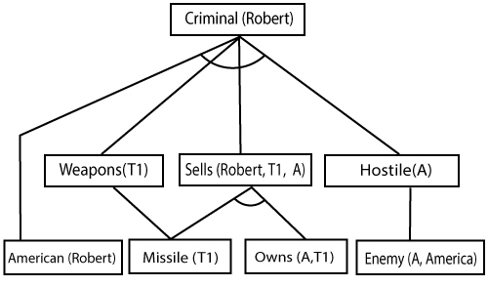
Continued…
Step 3

Slide 54
Backward Chaining
Backward-chaining is also known as a backward deduction or backward reasoning method when using an inference engine. A backward chaining algorithm is a form of reasoning, which starts with the goal and works backward, chaining through rules to find known facts that support the goal.
It is known as a top-down approach.
In backward chaining, the goal is broken into sub-goal or sub-goals to prove the facts true.
It is called a goal-driven approach, as a list of goals decides which rules are selected and used.

Slide 55
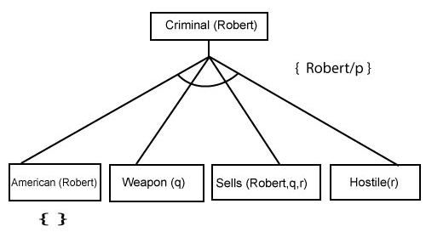
Backward Chaining
Step-1:
Step-2:

Slide 56
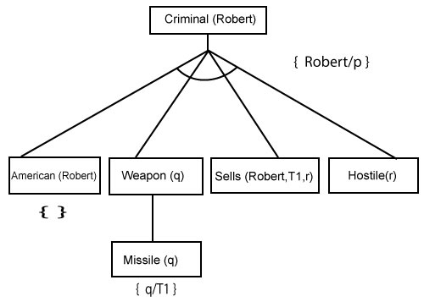
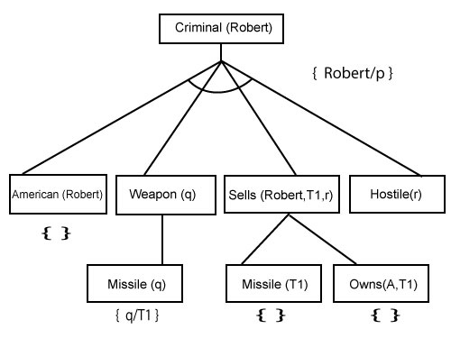
Continued…
Step-3:
Step-4:

Slide 57
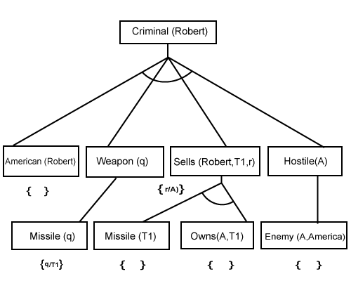
Continued…

