Slide 3
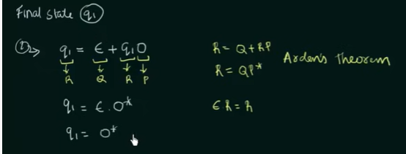

Slide 4
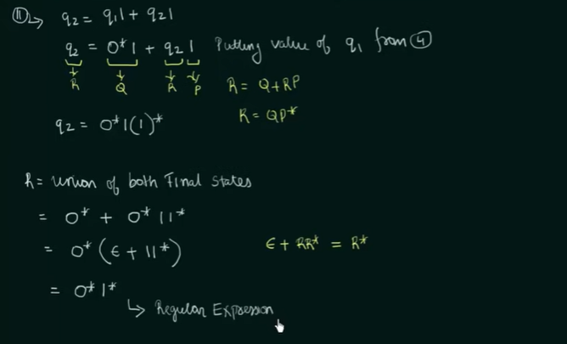

Slide 8
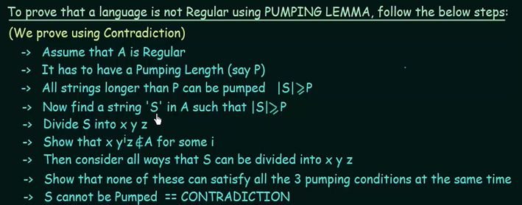

Slide 9
Example 1

Slide 10
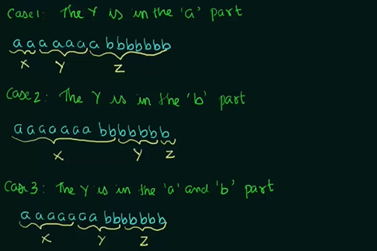

Slide 11
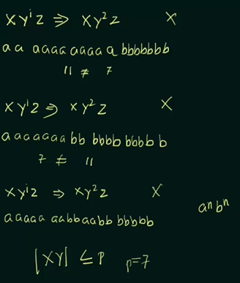

Slide 17
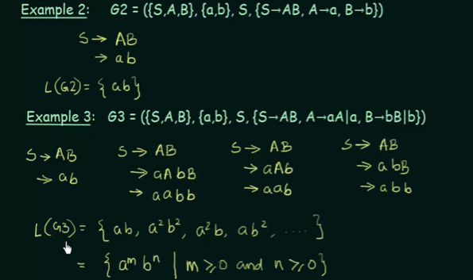

Slide 18
Context-Free Grammar (CFG)
CFG stands for context-free grammar.
It is a formal grammar which is used to generate all possible patterns of strings in a given formal language.
Context-free grammar G can be defined by four tuples as:
G = (V, T, P, S)
Where,
G is the grammar, which consists of a set of the production rule. It is used to generate the string of a language.
T is the final set of a terminal symbol. It is denoted by lower case letters.
V is the final set of a non-terminal symbol. It is denoted by capital letters.
P is a set of production rules, which is used for replacing non-terminals symbols(on the left side of the production) in a string with other terminal or non-terminal symbols(on the right side of the production).
S is the start symbol which is used to derive the string. We can derive the string by repeatedly replacing a non-terminal by the right-hand side of the production until all non-terminal have been replaced by terminal symbols.

Slide 20
Example 1: Construct the CFG for the language having any number of a's over the set ∑= {a}.
Solution:
As we know the regular expression for the above language is
r.e. = a*
Production rule for the Regular expression is as follows:
S → aS rule 1
S → ε rule 2

Slide 21
Now if we want to derive a string "aaaaaa", we can start with start symbols.
S
aS
aaS rule 1
aaaS rule 1
aaaaS rule 1
aaaaaS rule 1
aaaaaaS rule 1
aaaaaaε rule 2
aaaaaa
The r.e. = a* can generate a set of string {ε, a, aa, aaa,.....}. We can have a null string because S is a start symbol and rule 2 gives S → ε.

Slide 22
Example 2: Construct a CFG for the regular expression (0+1)*
Solution:
Production rule (P):
S → 0S | 1S
S → ε
The rules are in the combination of 0's and 1's with the start symbol. Since (0+1)* indicates {ε, 0, 1, 01, 10, 00, 11, ....}. In this set, ε is a string, so in the rule, we can set the rule S → ε.

Slide 23
Example 3: Construct a CFG for a language L = {wcwR | where w € (a, b)*}.
Solution:
The string that can be generated for a given language is {aacaa, bcb, abcba, bacab, abbcbba, ....}
The grammar could be:
S → aSa rule 1
S → bSb rule 2
S → c rule 3

Slide 24
Now if we want to derive a string "abbcbba", we can start with start symbols.
S → aSa
S → abSba from rule 2
S → abbSbba from rule 2
S → abbcbba from rule 3
Thus any of this kind of string can be derived from the given production rules.

Slide 25
Example 4: Construct a CFG for the language L = a^{n}b^{2n} where n>=1.
Solution:
The string that can be generated for a given language is {abb, aabbbb, aaabbbbbb....}.
The grammar could be:
S → aSbb | abb
Now if we want to derive a string "aabbbb", we can start with start symbols.
S → aSbb
S → aabbbb

Slide 26
Derivation
Derivation is a sequence of production rules.
It is used to get the input string through these production rules.
During parsing, we have to take two decisions. These are as follows:
We have to decide the non-terminal which is to be replaced.
We have to decide the production rule by which the non-terminal will be replaced.
We have two options to decide which non-terminal to be placed with production rule.

Slide 27
1. Leftmost Derivation:
In the leftmost derivation, the input is scanned and replaced with the production rule from left to right. So in leftmost derivation, we read the input string from left to right.
Example:
Production rules:
E = E + E
E = E - E
E = a | b
Input
a - b + a
The leftmost derivation is:
E = E + E
E = E - E + E
E = a - E + E
E = a - b + E
E = a - b + a

Slide 28
2. Rightmost Derivation:
In rightmost derivation, the input is scanned and replaced with the production rule from right to left. So in rightmost derivation, we read the input string from right to left.
Example
Production rules:
E = E + E
E = E - E
E = a | b
Input
a - b + a
The rightmost derivation is:
E = E - E
E = E - E + E
E = E - E + a
E = E - b + a
E = a - b + a

Slide 29
Example 1:
Derive the string "abb" for leftmost derivation and rightmost derivation using a CFG given by,
S → AB | ε
A → aB
B → Sb

Slide 30
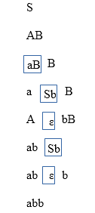
Leftmost derivation:

Slide 31
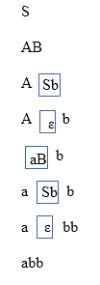
Rightmost derivation:

Slide 32
Example 2:
Derive the string "aabbabba" for leftmost derivation and rightmost derivation using a CFG given by,
S → aB | bA
A → a | aS | bAA
B→ b | bS | aBB

Slide 33
Leftmost derivation:
S
aB S → aB
aaBB B → aBB
aabB B → b
aabbS B → bS
aabbaB S → aB
aabbabS B → bS
aabbabbA S → bA
aabbabba A → a

Slide 34
Rightmost derivation:
S
aB S → aB
aaBB B → aBB
aaBbS B → bS
aaBbbA S → bA
aaBbba A → a
aabSbba B → bS
aabbAbba S → bA
aabbabba A → a

Slide 35
Example 3:
Derive the string "00101" for leftmost derivation and rightmost derivation using a CFG given by,
S → A1B
A → 0A | ε
B → 0B | 1B | ε

Slide 36
Leftmost derivation:
S
A1B
0A1B
00A1B
001B
0010B
00101B
00101

Slide 37
Rightmost derivation:
S
A1B
A10B
A101B
A101
0A101
00A101
00101

Slide 39
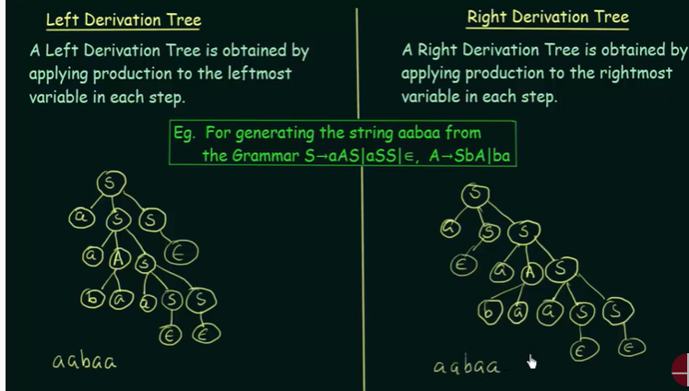

Slide 40
Obtain the string “aabbabba” for left most derivation and rightmost derivation using a CFG given by
S→Ab|Ba
A→a|aS|Baa
B→b|bS|aBB

Slide 41
Construct leftmost and rightmost derivations for the strings, for the language
S-->AS| ɛ,
A-->aa|ab|ba|bb
Strings: a) aabbba b) baabab c) aaabbb

