Slide 3
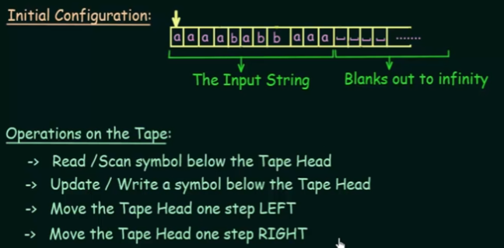

Slide 4
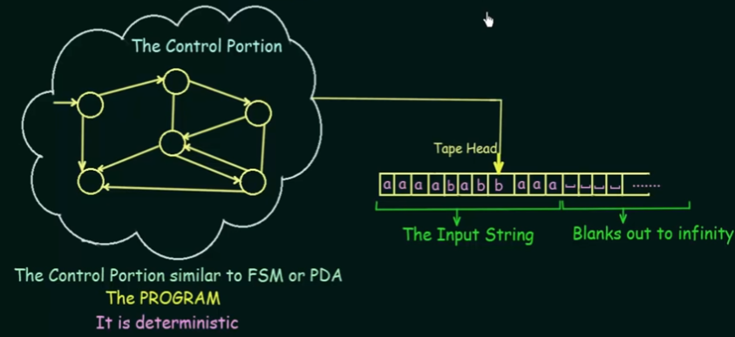

Slide 13
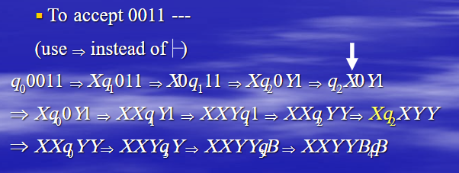

Slide 16
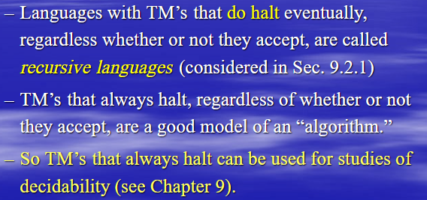

Slide 17
Example 1

Slide 19
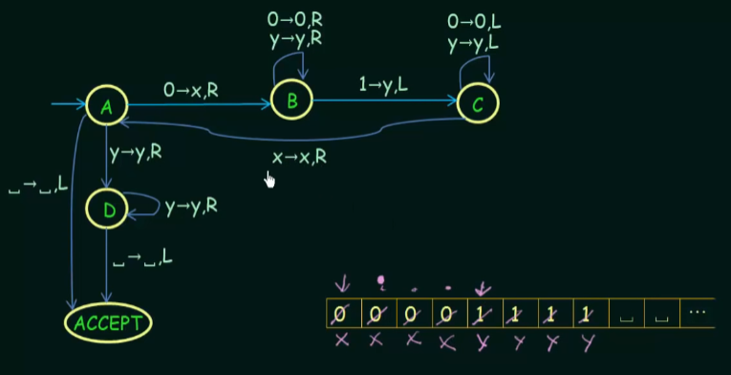

Slide 20
WW^{r}

Slide 21
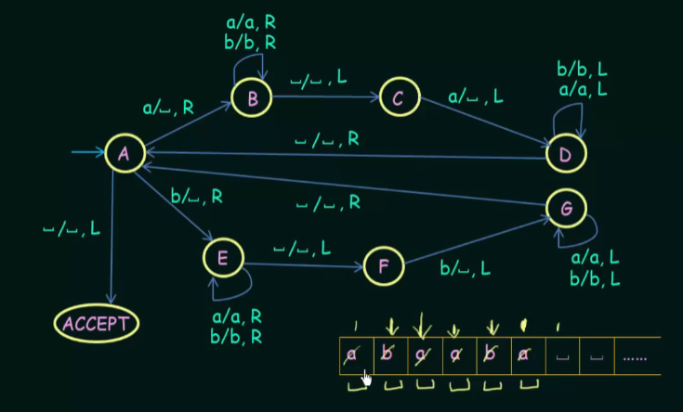

Slide 22
TM for addition
Examples – (2 + 3) will be given as 0 0 c 0 0 0:
Input : 0 0 c 0 0 0 // 2 + 3
Output : 0 0 0 0 0 // 5
Input : 0 0 0 0 c 0 0 0 // 4 + 3
Output : 0 0 0 0 0 0 0 // 7

Slide 23
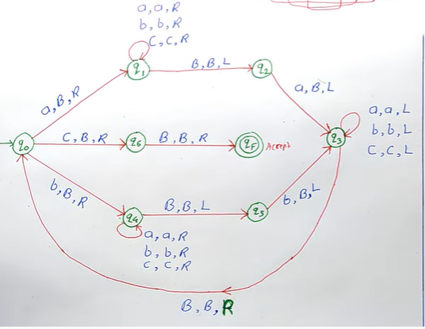
WCW^{r} -Odd length palindromes

Slide 24
