Slide 1
UNIT-III (Evaluating Hypothesis)

Slide 2
Topics :
Estimating Hypothesis Accuracy
Sample Error and
True Error

Slide 3
Estimating Hypothesis Accuracy
Hypothesis is used to classify the future instances.
In this classification we need to estimate the accuracy of this Hypothesis.
For Eg: In the Class, we are having 60 Students. Among 60 students, we have 30 students boys and 30 students girls.
Here, we have assumed hypothesis. i.e., 30 boys and 30 girls. Is it true? Up to 90% true or 80% true etc.
Ie, here we need to evaluate the hypothesis .
Finally we conclude that we have to find the accuracy to all the learning examples.

Slide 4
Contd..
Evaluating the hypothesis , we can mainly focus on 3 Questions:
1. Hypothesis is accurate over limited sample of data, then what about additional data.
2. we have 2 hypothesis – one is better than other when used on sample of data.
3. When we have limited data , what is the best way to use this data for both learning and estimating hypothesis.
So, here we can use this Probable Error, which is used to compute the Accuracy.(i.e, what error bars to associate with this Estimate).

Slide 5
Motivation
Sometimes, very precise hypothesis is required. In that cases estimating the accuracy is very important.
Eg: Medical Treatment.

Slide 6
Estimating Hypothesis Accuracy
Let us make some assumptions:
There is some space of possible instances “X” over which various target functions may be defined.
Different instances will have the different instances. Based on the frequency , each instance in ‘x1,x2---xn’ will have some unknown probability.
Eg: Rolling a Die. Rolling ‘1’ for 10 times.
Ie, here the probability is unknown.
So here Trainer will teach the machine about the training examples of “Target Function”.

Slide 7
Contd..
So , here trainer will teach the particular instance, “xi”. Ie, one particular instance for the set of instances.
Suppose here the target function is f(x)= x²
So, in this target function , the output is generated
F(x) = (0,1).
So, here classifies , each instance into different categories based on requirement.
Now, after classification, what is the Probable error in this estimation made.

Slide 8
Contd..
Errors are 2 types : 1. Sample Error 2. True Error
Sample Error: The error rate of hypothesis over a sample of data.
Ie, Estimate of true error calculated on a data sample.

Slide 9
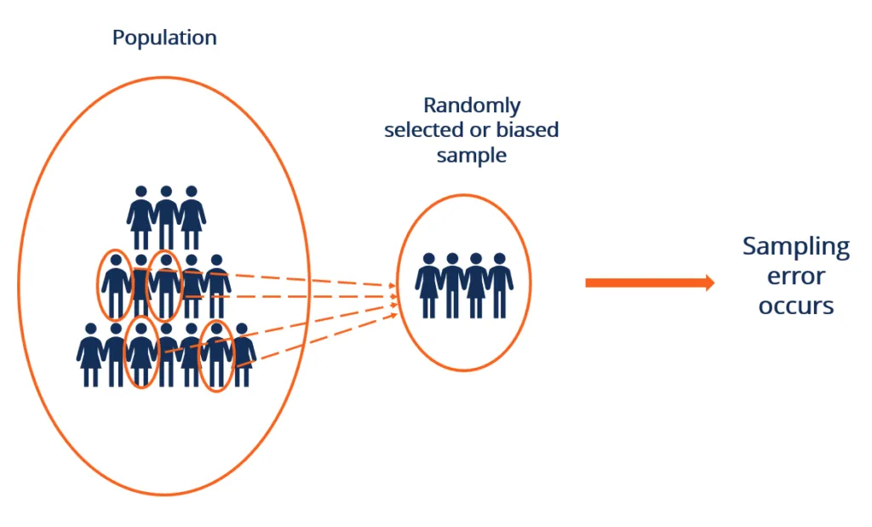
Contd..
Here, f(x) = Learned Target Function
h(x) = Predicted Function by the Hypothesis
Sample Error is the error Calculated w.r.t Data Sample Set S.

Slide 10
Contd..
Categories of Sample Errors:
1. Population Specification Error – Happens when the analysts do not understand who to survey.
For example, for a survey of breakfast cereals, the population can be the mother, children, or the entire family.
2. Sample Frame Error – Occurs when a sample is selected from the wrong population data.

Slide 11
Contd..
2. True Error:
For Eg: True Error is the error Calculated with respect to Data Distribution D. Here we can see that Sample Error is 0.2 (i.e 1 out of 5) from the OUR SAMPLE circle & True Error is 0.5 (i.e 10 out of 20) from all the DATA DISTRIBUTION

Slide 12
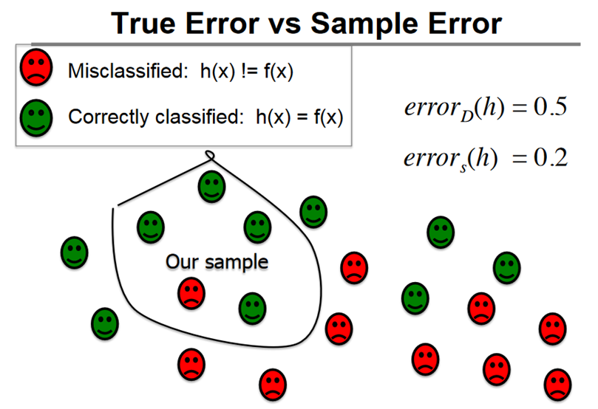
Contd..

Slide 13
THANK YOU

