Slide 2
Data Science is the most sought after job of the twenty first century!
Data is the new Oil and Data Science is its combustion engine!
Data Science is the Future!
But what exactly is Data Science!

Slide 3
Learning Objectives
What exactly is Data Science?
Why is it such a sought after job description?
What does a Data Scientist actually do?
How important are mathematics and programming skills for a data scientist?
How does Data Science relate to other buzz words like ML,DL,AI and DM?

Slide 4
Course Organization
Very broadly, the course contain four parts:
Part I) Data Cleaning
Part II) Data Processing
Part III) Data Modelling
Part IV) Data Evaluation

Slide 5
Pre-requisites
20BS1204 - Probability and Statistics

Slide 6
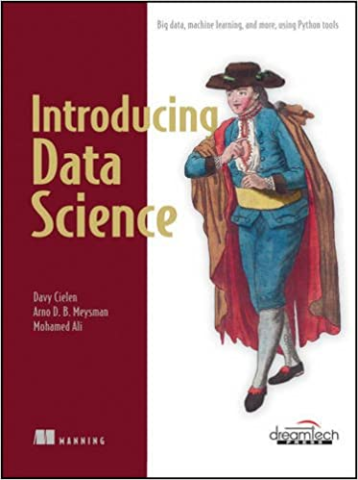
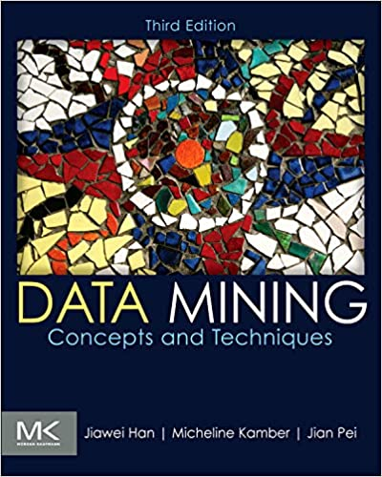
Text Books
Introducing Data Science, David Cielen, Arno D. B. Meysman, and Mohamed Ali, 2016, Manning Publications.
Data Mining: Concepts and Techniques, Jiawei Han, Micheline Kamber and Jian Pei, Third edition, Morgan Kaufmann.

Slide 7
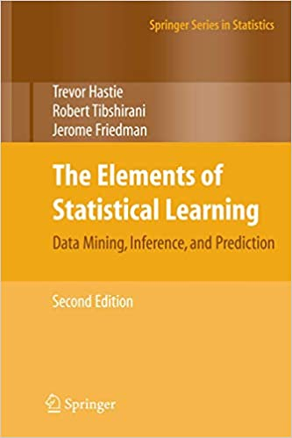
The Elements of Statistical Learning, Trevor Hastie, Robert Tibshirani, Jerome Friedman, Second Edition, Springer.

Slide 8
Course Outcomes
CO1: Understand the life cycle process of data science.
CO2: Apply different data pre-processing techniques for
improving data quality.
CO3: Apply statistical methods to evaluate the data.
CO4: Apply Statistical Learning techniques for model building.

Slide 9
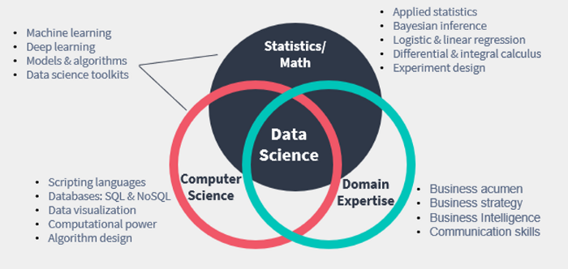
Data Science is Multidisciplinary

Slide 10
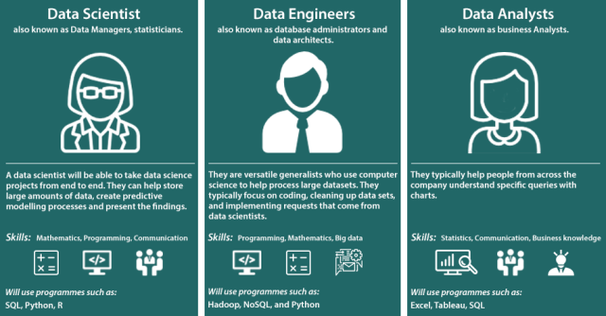
Data Team

Slide 11
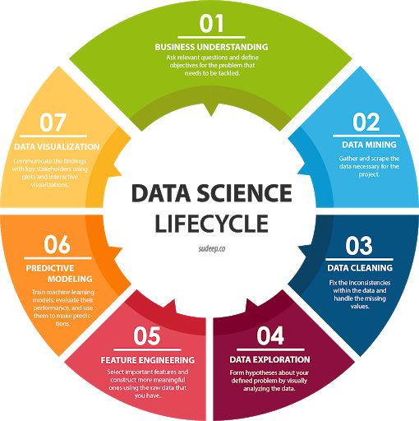
Data Science
Data Science is the amalgamation of two fields – Data and Science.
Data
Science

Slide 12
Why Data Science is so popular today?
Data is everywhere
Personal devices
Sensors
Transactional data (digital revolution)
Devices have become powerful and cheaper
Bulk Storage
Specialized Hardware (GPUs)
Democratization of software and hardware
Popular open source frameworks (Pytorch and Tensorflow)
Cloud compute

