Slide 1
Linear methods for Regression
UNIT-4

Slide 2
Contents
Introduction, Linear Regression models, Least Squares, Multiple Regression. Linear methods for Classification: Introduction, Linear discriminative analysis, Logistic Regression.

Slide 3
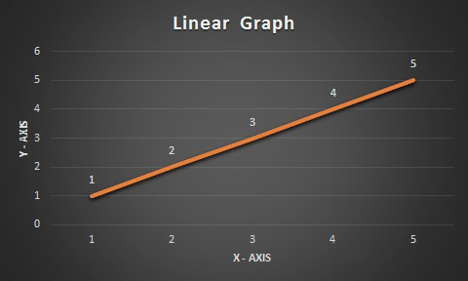
Linear Regression & Least Square Regression …
Linear Regression is a predictive algorithm which provides a Linear relationship between Prediction (Call it ‘Y’) and Input (Call is ‘X’). The Output type distinction led to two prediction tasks.
Regression -- predicts Quantitative outputs
Classification -- Predicts Qualitative outputs
(Input) X = 1,2,3,4,5
(Prediction) Y = 1,2,3,4,5
Linear Straight Line graph
The equation of a straight line is written using the y = mx + b, where m is the slope (Gradient) and b is y-intercept (where the line crosses the Y axis).

Slide 4
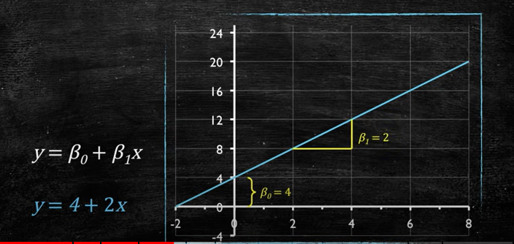
Regression
To establish the relationship between two variables.
Establish statistical relationship between the two.
Example Income and spending ,wage and gender, student height and exam scores.
Forecast new observations
Can we use the relationship to forecast the unobserved values.
Example: what will be sales for next quarter?
Variable Roles
Dependent variable: whose values we want to explain or forecast. Its value depend on something denoted by y.
Independent variable: that explains the other one. Its value are independent
y = mx + b in stats we use different notation
y = β₀+ β₁x

Slide 5
Regression

Slide 6
Example
X | 1 | 2 | 3 | 4 | 5 | 6 | 7
Y | 1.5 | 3.8 | 6.7 | 9.0 | 11.2 | 13.6 | 16
Calculate Ʃ X, Ʃ Y, Ʃ XY, Ʃ X²
Y=mX+b ,
Also Y = mb1+ b0
m= n Ʃ XY- Ʃ X Ʃ Y / n Ʃ X² -(Ʃ X)²
b= Ʃ Y – m Ʃ X / n
Y=2.14 X-0.83
Calculate the Y values for X=1,2,3,4,5,6,7
https://www.youtube.com/watch?v=P8hT5nDai6A&t=399s

Slide 7
Regression
We have an input vector X^{T} = (X₁, X₂,... ,Xp), and want to predict a real-valued output Y . The linear regression model has the form.
The linear model either assumes that the regression function E(Y |X) is linear, or that the linear model is a reasonable approximation.
Here the βj ’s are unknown parameters or coefficients, and the variables X_{j} can come from different sources:
• quantitative inputs;
• transformations of quantitative inputs, such as log, square-root or square;
• basis expansions, such as X₂ = X² ₁ , X3 = X³ ₁ , leading to a polynomial representation;
• numeric or “dummy” coding of the levels of qualitative inputs.
For example, if G is a five-level factor input, we might create Xj , j = 1,... , 5, such that Xj = I(G = j). Together this group of Xj represents the effect of P G by a set of level-dependent constants, since in j , one of the Xj s is one, and the others are zero.
• interactions between variables, for example, X₃ = X₁ · X₂ .

Slide 8
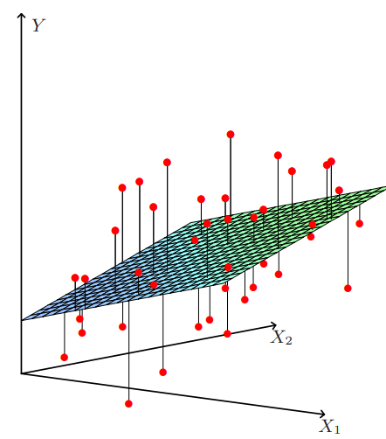
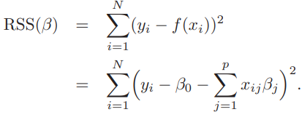
Regression
we have a set of training data (x₁,y₁)...(x_{N} ,y_{N} ) from which to estimate the parameters β. The most popular estimation method is least squares, in which we pick the coefficients β = (β₀,β₁,... ,βp) ^{T} to minimize the residual sum of squares

Slide 9
Multiple Linear Regression

Slide 10
Multiple Linear Regression

Slide 11
Multiple Linear Regression

Slide 12
Multiple Linear Regression

Slide 13
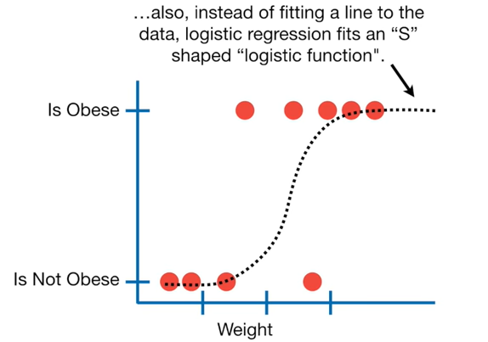
Logistic Regression

Slide 14
Logistic Regression

Slide 15
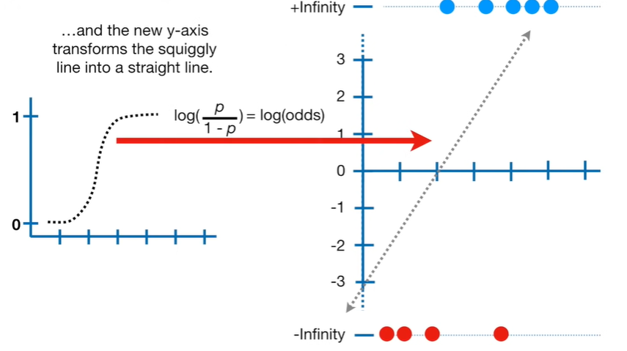
Logistic Regression

Slide 16
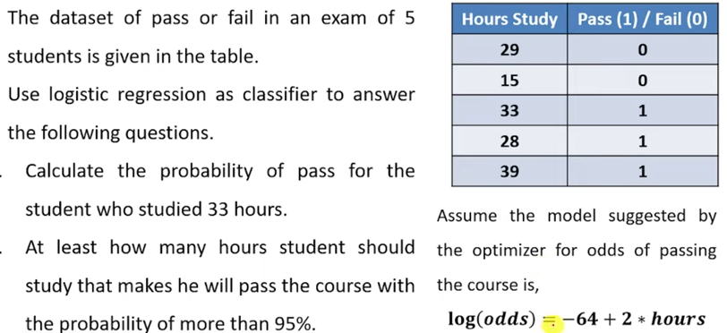
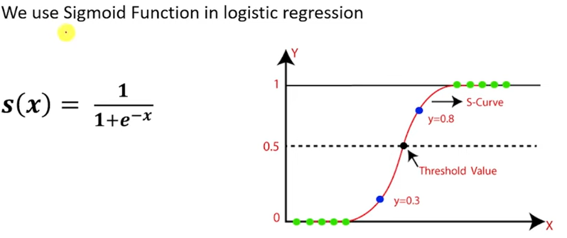
Logistic Regression

Slide 17
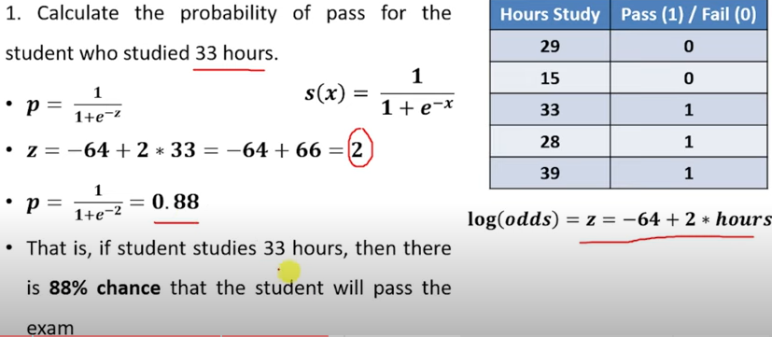
Logistic Regression

Slide 18
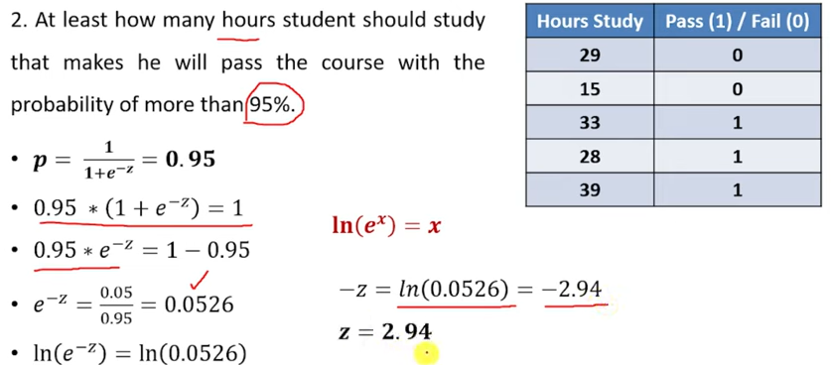
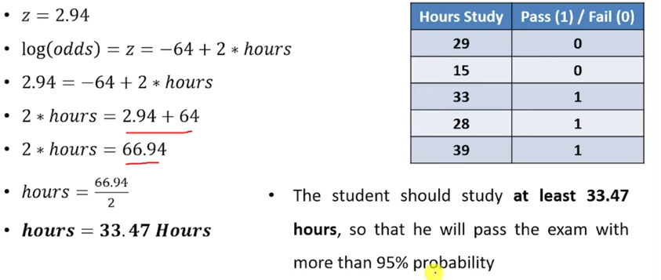
Logistic Regression

Slide 19
Logistic Regression
If the logit score (linear predictor) is given by –2.4 + 1.5 X₁ + 2 X₂, find the estimated P(Y = 1) for each of the following combination of the IDVs: X₁: 0 1.5 2 3 -2 -2.5 X₂: 1 0 1.5 -1 2 2.5 Solution: P(Y=1|X₁: 0, X₂: 1)=-2.4+1.5*0+2*1=-4.4 Find estimated P(Y=1) Similar to all X (X₁,X₂) values

Slide 20
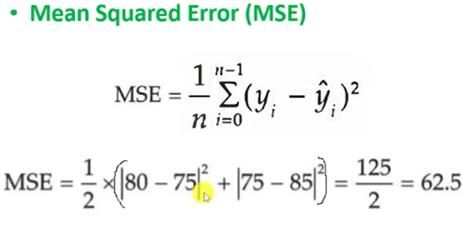
Linear Regression Metrics

Slide 21
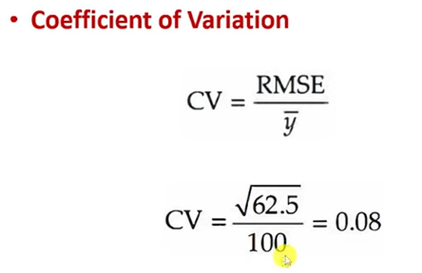
Linear Regression Metrics

