Slide 1
UNIT-IV (Support Vector Machine)

Slide 2
Topics :
Support Vector Machine
Introduction to Support Vector Machines
Linear Support Vector Machines.
Non Linear Support Vector Machines

Slide 3
Support Vector Machine
Support Vector Machine or SVM is one of the most popular Supervised Learning algorithms, which is used for Classification as well as Regression problems.
primarily, it is used for Classification problems in Machine Learning.
The objective of SVM algorithm is to find a hyperplane in an N-dimensional space that distinctly classifies the data points.
Here, The dimension of the hyperplane depends upon the number of features.

Slide 4
Contd..
The goal of the SVM algorithm is to create the best line or decision boundary that can segregate n-dimensional space into classes.
so that we can easily put the new data point in the correct category in the future.
This best decision boundary is called a hyperplane.
If the number of input features is two, then the hyperplane is just a line.
If the number of input features is three, then the hyperplane becomes a 2-D plane. It becomes difficult to imagine when the number of features exceeds three.

Slide 5
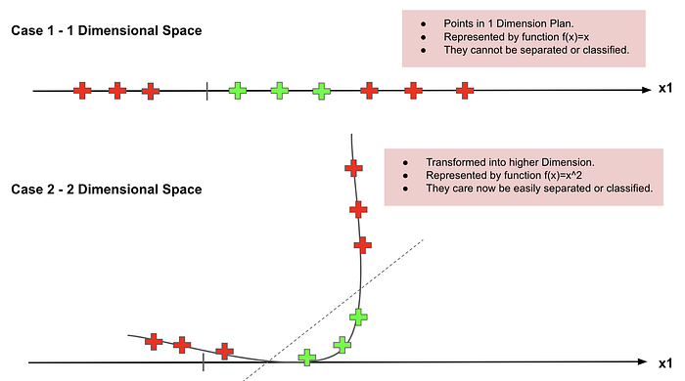
Contd..

Slide 6
Contd..
SVM chooses the extreme points/vectors that help in creating the hyperplane.
These extreme cases are called as support vectors, and hence algorithm is termed as Support Vector Machine.
Here, Value of each feature is also the value of the specific coordinate. Then, we find the ideal hyperplane that differentiates between the two classes.
Support vectors are special because they are the training points that define the maximum margin of the hyperplane to the data set and they therefore determine the shape of the hyperplane

Slide 7
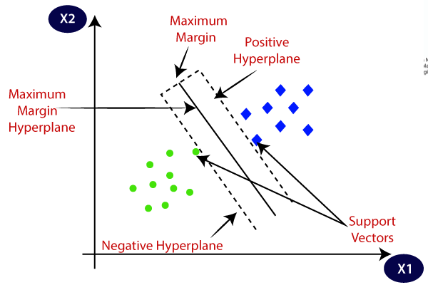
Contd..
Consider the below diagram in which there are two different categories that are classified using a decision boundary or hyperplane:

Slide 8
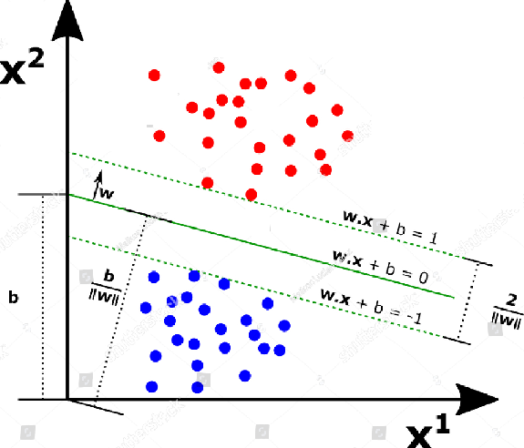
Contd..

Slide 9
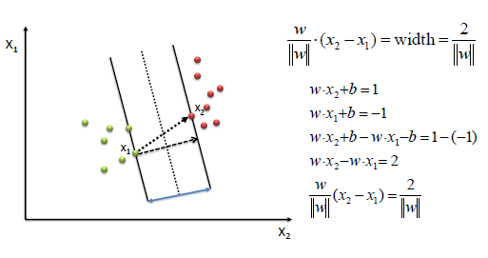
Contd..
To define an optimal hyperplane we need to maximize the width of the margin (w).

Slide 10
Example
Imagine the labelled training set are two classes of data points (two dimensions): Alice and Cinderella.
To separate the two classes, there are so many possible options of hyperplanes that separate correctly.
As shown in the graph below, we can achieve exactly the same result using different hyperplanes (L1, L2, L3).

Slide 11
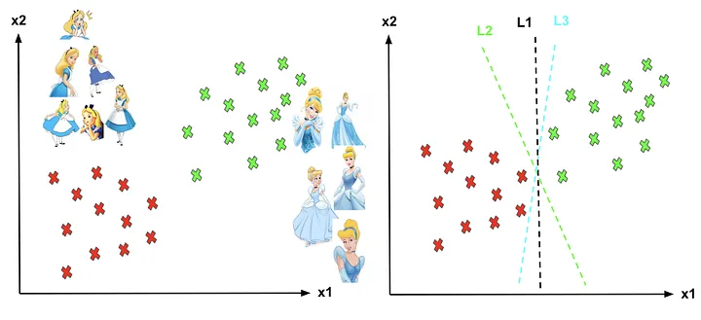
Contd..
Different hyperplanes (L1, L2, L3).

Slide 12
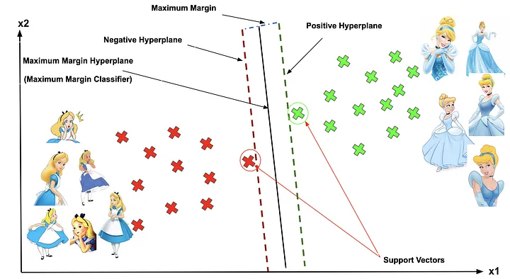
Contd..
Q: How can we decide a separating line for the classes? Which hyperplane shall we use?

Slide 13
Contd..
The vector points closest to the hyperplane are known as the support vector points because only these two points are contributing to the result of the algorithm, and other points are not.
If a data point is not a support vector, removing it has no effect on the model. On the other hand, deleting the support vectors will then change the position of the hyperplane.

Slide 14
Contd..
The distance of the vectors from the hyperplane is called the margin, which is a separation of a line to the closest class points.
We would like to choose a hyperplane that maximizes the margin between classes. The graph below shows what good margin and bad margin are.

Slide 15
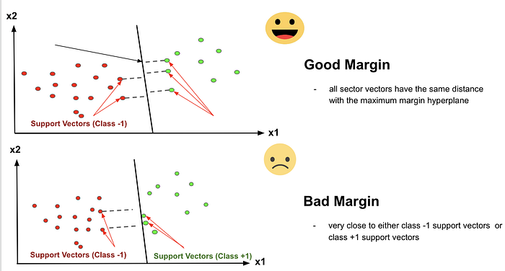
Contd..

Slide 16
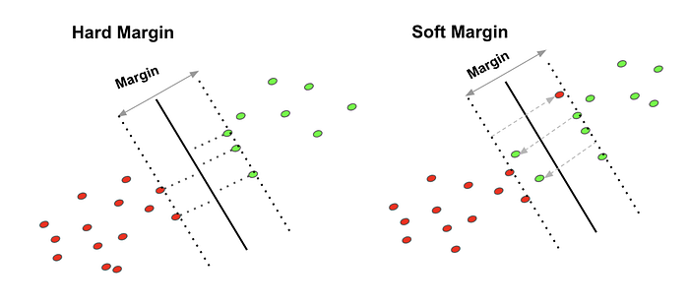
Contd..

Slide 17
Contd..
We try to fit a linear line that can separate the two classes and make the distances from either class is maximized.
The line is represented with
w*x + b = 0
For label 1, w*x + b ≥ 1
For label -1, w*x + b ≤ -1
The distances of the gap in-between two classes is 2/|w|
we want to maximize this distance.
If we want to find a line that perfectly separates the two classes, we call this type of SVM cost function as Hard-Margin cost function.

Slide 18
Types of SVM
SVM can be of two types:
Linear SVM: Linear SVM is used for linearly separable data, which means if a dataset can be classified into two classes by using a single straight line, then such data is termed as linearly separable data, and classifier is used called as Linear SVM classifier.
Non-linear SVM: Non-Linear SVM is used for non-linearly separated data, which means if a dataset cannot be classified by using a straight line, then such data is termed as non-linear data and classifier used is called as Non-linear SVM classifier.

Slide 19
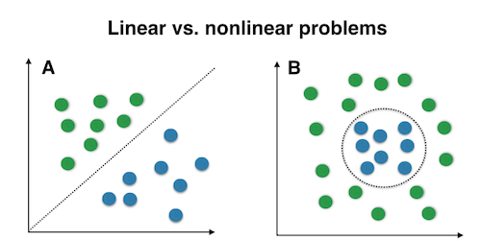
Contd..

Slide 20
Advantages
SVM works very well with higher-dimensional datasets.
SVM is one of the most memory-efficient classification algorithms.
The clearer the margin of separation between the categories, the better the SVM works.
Effective on datasets with multiple features, like financial or medical data.

Slide 21
Disadvantages
SVM does not perform very well when the data set has more noise i.e. target classes are overlapping.

Slide 22
Applications
Hand Written Detection
Image Classification
Face Detection
Bioinformatics
Cancer Detection
Sentimental Analysis
Spam Detection

Slide 23
Example
In the Given Dataset, we have 4 are positively labeled data sets and 4 are negatively labeled data sets.

Slide 24
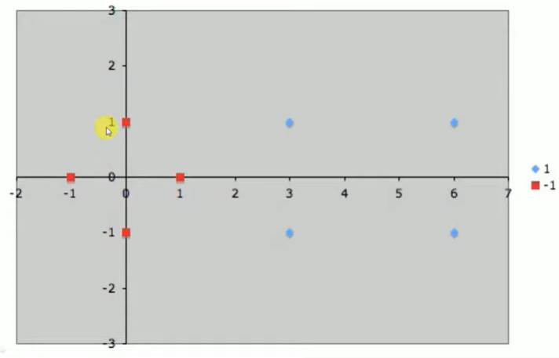
Contd..
Next ,we need to plot the data points

Slide 25
Contd..
Next, We need to identify the nearest data points on both the sides of these classes.

Slide 26
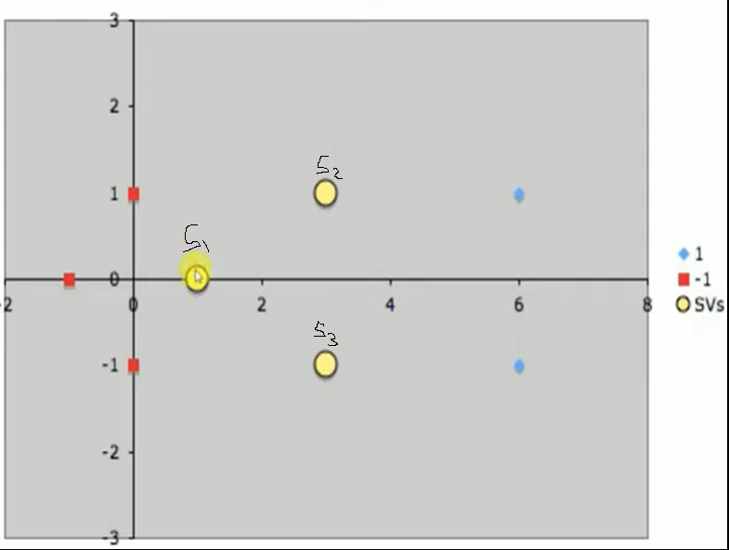
Contd..
Here, S1 is Negatively labeled data set. And S2 and S3 are Positively Labeled Data sets.

Slide 27
Contd..
Next we need to write the Hyper plane, we the bias=1 for wx+b Equation.

Slide 28
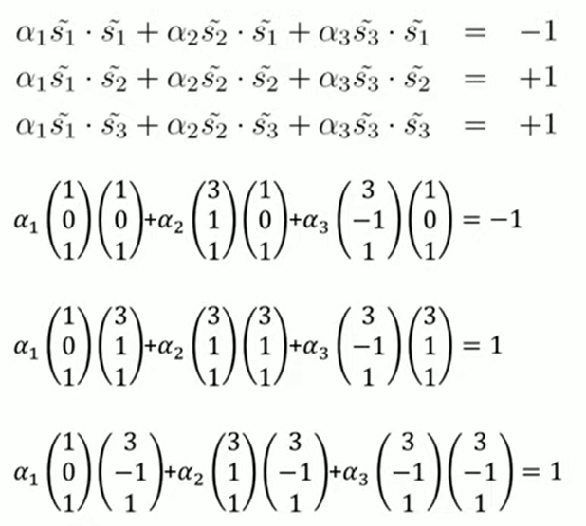
We need to calculate the 3 Variables. ie, α1, α2, α3.
Which will be used to calculate the Weight Vector.

Slide 29
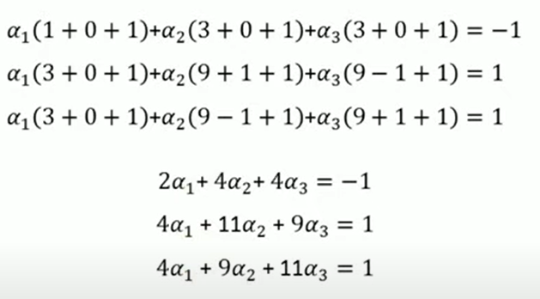
We can simplify this Equation.
Here we will Apply the DOT Product to simplify the Equation

Slide 30
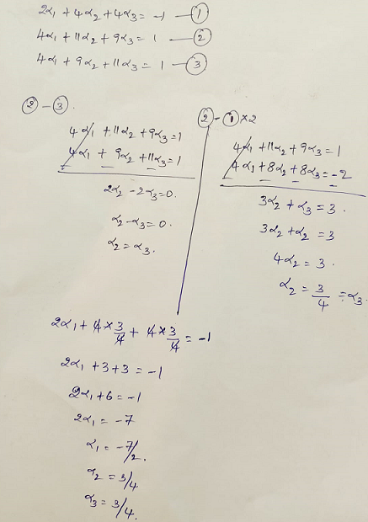
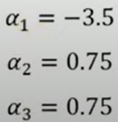

Slide 31
Once we get the 3 variables, after that we need to calculate the Weight Vector.

Slide 32
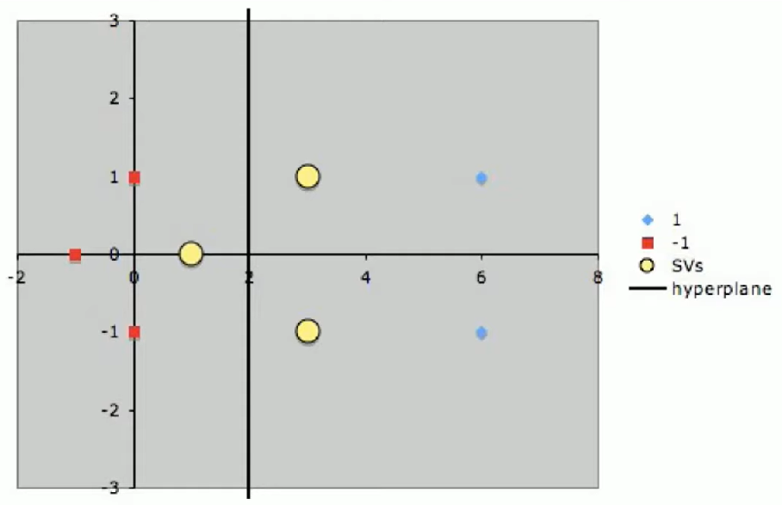
Here we get, the line is (1,0) ie, the line is parallel to Y- Axis.
Suppose , If the Line is (0,1) ie, the line is parallel to X- Axis.
If the line is (1,1) , ie, the line is parallel to 45 Degrees.

Slide 33
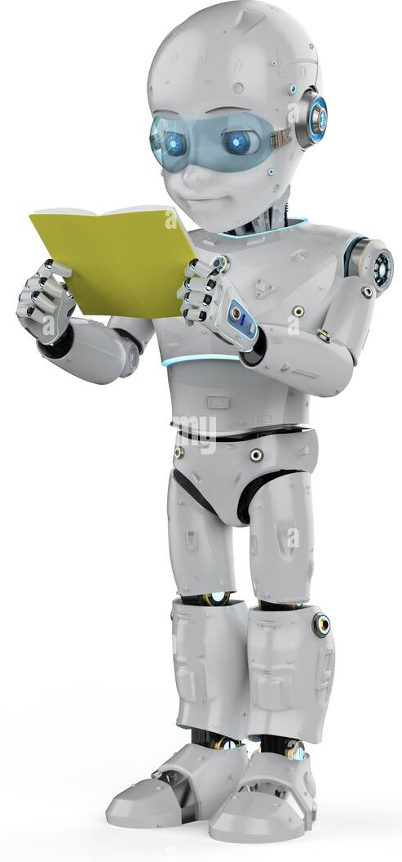
THANK YOU

