Slide 1
UNIT-I (Perspectives & Issues in ML)

Slide 2
Machine Learning
Topics :
Perspectives and Issues in ML

Slide 3
Perspectives in ML
Perspectives of Machine Learning involves searching very large space of possible hypothesis , to determine one that best fits the observed data and any prior knowledge held be learner by using various learning Algorithms.
Machine Learning is used in various applications such as email filtering, speech recognition, computer vision, self-driven cars, Amazon product recommendation, etc.
It can be seen in every industry, such as healthcare, education, finance, automobile, marketing, shipping, infrastructure, automation, etc.

Slide 4
Contd..
Almost all big companies like Amazon, Facebook, Google, Adobe, etc., are using various machine learning techniques to grow their businesses.
Machine Learning is the study of learning algorithms using past experience and making future decisions. Although, Machine Learning has a variety of models.
Here is a list of the most commonly used machine learning algorithms by all data scientists and professionals in today's world.

Slide 5
Contd..
The List of Various Algorithms are:
1. Regression
2. Decision Tree
3. Bayes Theorem and Naïve Bayes Classification
4. Support Vector Machine (SVM) Algorithm
5. K-Nearest Neighbor (KNN) Algorithm
6. K-Means etc.

Slide 6
Issues in ML
Similarly, Machine Learning offers great opportunities, but some issues need to be solved.
A career in the Machine learning domain offers job satisfaction, excellent growth, high salary, but it is a complex and challenging process.
There are a lot of challenges that machine learning professionals face to inculcate ML skills and create an application from various tools.
The major challenges faced by machine learning professionals are:

Slide 7
Contd..
1. What Algorithms should be used ?
2. Which Algorithm perform best for which types of problems?
3. How much Training Data is Sufficient ?
4. What kind of methods should be used?
5. For which type of data , which methods should be used? And also the remaining issues are:

Slide 8
Contd..
1. Poor Quality Data: Data plays a significant role in the machine learning process. One of the significant issues that machine learning professionals face is the absence of good quality data.
Noisy data, incomplete data, inaccurate data, and unclean data lead to less accuracy in classification and low-quality results.
Hence, data quality can also be considered as a major common problem while processing machine learning algorithms.

Slide 9
Contd..
Hence the quality of data is essential to enhance the output.
Therefore, we need to ensure that the process of data preprocessing which includes removing outliers, filtering missing values, and removing unwanted features, is done with the utmost level of perfection.

Slide 10
Contd..
2. Inadequate Training Data: The most important task you need to do in the machine learning process is to train the data to achieve an accurate output. Less amount training data will produce inaccurate or too biased predictions.
Example: Consider a machine learning algorithm similar to training a child. One day you decided to explain to a child how to distinguish between an apple and a watermelon. You will take an apple and a watermelon and show him the difference between both based on their color, shape, and taste. In this way, soon, he will attain perfection in differentiating between the two.

Slide 11
Contd..
But on the other hand, a machine-learning algorithm needs a lot of data to distinguish.
For complex problems, it may even require millions of data to be trained. Therefore we need to ensure that Machine learning algorithms are trained with sufficient amounts of data.

Slide 12
Contd..
3.Under fitting of Training Data: Your model is underfitting the training data when the model performs poorly on the training data.
This is because the model is unable to capture the relationship between the input examples (often called X) and the target values (often called Y).
How to avoid underfitting:
By increasing the training time of the model.
By increasing the number of features.

Slide 13
Contd..
3. Overfitting of Training Data: Overfitting is one of the most common issues faced by Machine Learning engineers and data scientists. Whenever a machine learning model is trained with a huge amount of data, it starts capturing noise and inaccurate data into the training data set.
It negatively affects the performance of the model.

Slide 14
Contd..
Let’s consider a model trained to differentiate between a cat, a rabbit, a dog, and a tiger. The training data contains 1000 cats, 1000 dogs, 1000 tigers, and 4000 Rabbits.
Then there is a considerable probability that it will identify the cat as a rabbit.
hence the prediction was negatively affected.

Slide 15
Contd..
To Overcome this Issue:
1. Increase training data in a dataset.
2. Reduce the noise
3. Reduce the number of unnecessary attributes in
training data.
4. Remove outliers in the training data.
5. Cross – Validation
6. Ensembling

Slide 16
Contd..
4. Machine Learning is a Complex process: The machine learning industry is young and is continuously changing. Rapid hit and trial experiments are being carried on.
It includes analyzing the data, training data, applying complex mathematical calculations, and a lot more. Hence it is a really complicated process which is another big challenge for Machine learning professionals.

Slide 17
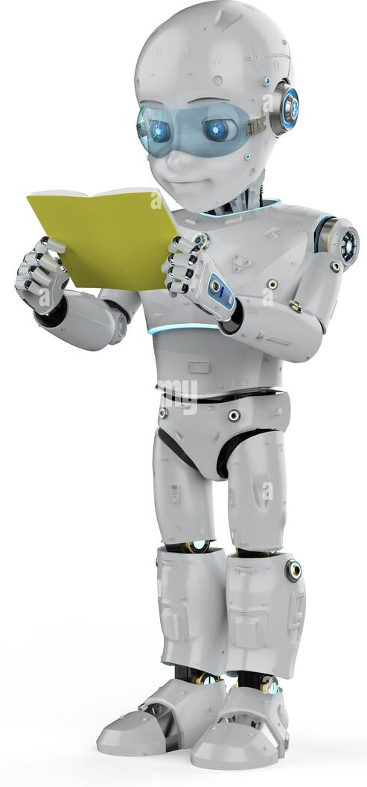
THANK YOU

