Slide 1
DATA SCIENCE
What is Data?
What is Information?
What is Science?
Why Data Science is so popular today?

Slide 2
Examples
Each student's test score is data.
The number of likes on a social media post is a single element of data.
At a restaurant, a single customer’s bill amount is data.
The history of temperature readings all over the world for the past 100 years is data.

Slide 3
Data
Data is a raw material.
Data is a collection of individual facts or statistics.
Data can come in the form of text, observations, figures, images, numbers, graphs, or symbols.

Slide 4
Information
Information is processed, organized and structured data.

Slide 5
Examples
Restaurant owners collect and interpret multiple bills over a range of time.
The average score of a class or of the entire school is information that can be derived from the given data.
When that data is combined with other social media engagement statistics, like followers, comments, and shares, a company can intuit which social media platforms perform the best and which platforms they should focus on to more effectively engage their audience.

Slide 6
Science
Science is a quest to reach good explanations about the world.
Systematic study of world both physical and natural.

Slide 7
Why Data Science is so popular today?
Data is everywhere
Personal devices
Sensors
Transactional data (digital revolution)
Devices have become powerful and cheaper
Bulk Storage
Specialized Hardware (GPUs)
Democratization of software and hardware
Popular open source frameworks (Pytorch and Tensorflow)
Cloud compute

Slide 8
Data Never Sleeps

Slide 9
Data science applications and use cases
Banking (Machine Learning Algorithms)
Management of customer data
Fraud detection
Risk management
Predictive maintenance
Customer segmentation
Finance (Natural Language Processing Algorithms)
Risk analysis
Predictive analysis
Manufacturing (Internet of Things-Reinforcement Learning)
logistics and supply chain management
Transport

Slide 10
Data science applications and use cases
Health
Natural Language Processing
Medical diagnosis
Image recognition
E-Commerce ( Sentiment Analysis)
Stock trading
Targeted advertising
Website personalization
Customer service
Cyber security
Speech recognition

Slide 11
Phases of Data Science

Slide 12
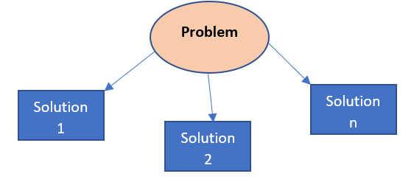
Business Understanding and Problem Definition
What is the goal of the project?
What application we are building?
What results are we expecting?
Which tasks we need to perform?
What approach can we use?

Slide 13
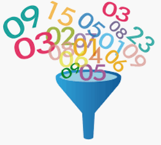
Data Collection
Structured Data
Unstructured Data

Slide 14
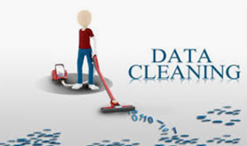
Data Cleaning and Preparation
Select the relevant data
Integrate the data
Clean the data
Treat the missing values by either remove/impute
Remove erroneous data
Check the outliers

Slide 15
Exploratory Data Analysis

Slide 16
Feature Engineering
introducing new and important features that did not exist before

Slide 17
Machine Learning

Slide 18
Model Evaluation
Hold-Out: split the dataset into a ‘train’ and ‘test’ set.
Cross-Validation:Cross-validation or ‘k-fold cross-validation’ is when the dataset is randomly split up into ‘k’ groups

Slide 19
Hyperparameter Optimization
Hyperparameters tuning is crucial as they control the overall behavior of a machine learning model.
A right combination of hyperparameters that maximizes the model performance.
Running multiple trials in a single training process.
The set of hyperparameter values that are best suited for the model to give optimal results.
Optimizer Hyperparameters:
Learning Rate: adjust the weights of our neural network
Mini-Batch Size:controls the number of training samples to work
Number of Training Iteration or Epochs: It is one complete pass through the training data.
Model Hyperparameters:
Number of Layers:Input layer, hidden layer and output layer.
Hidden Units:Number of hidden layers in a neural network
Model Specific parameters for the architectures like RNN: how deep the model is?

Slide 20
Data Visualization
Process of transforming the data into graphs, charts, and images
Know the patterns and trends in the data
Telling story from the data is an art

Slide 22
Engineering Data Science Systems

Slide 23
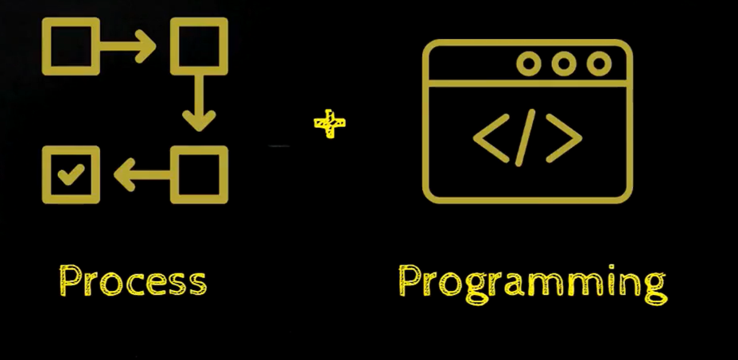
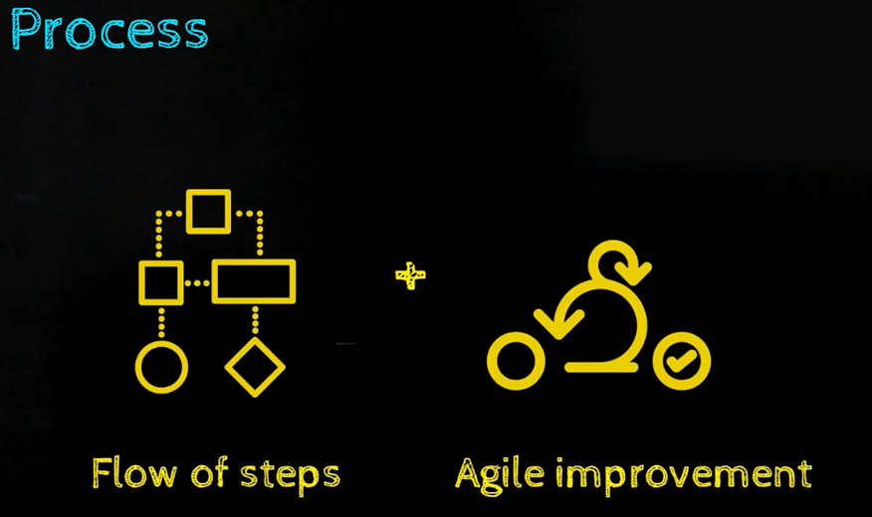
Components
Process
Programming

Slide 24
CRISP-DM
The Cross Industry Standard Process for Data Mining

Slide 25
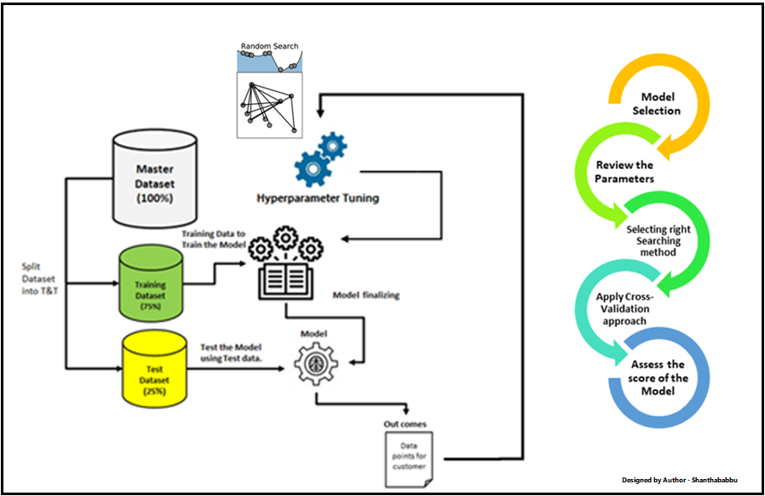
ML/DL Model

Slide 26
Data Science Projects
Detecting Parkinson’s Disease
Leaf Disease Detection
Speech Emotion Recognition
Driver Drowsiness detection in Python
Image Caption Generator Project in Python

