Slide 6
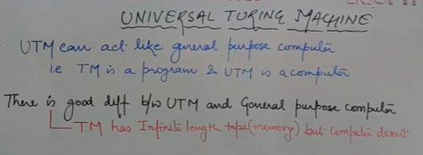

Slide 11
Ex-2
Let’s try understanding this by taking two lists A and B
A=[aa, bb, abb] and B=[aab, ba, b]
1, 2, 1, 3

Slide 12
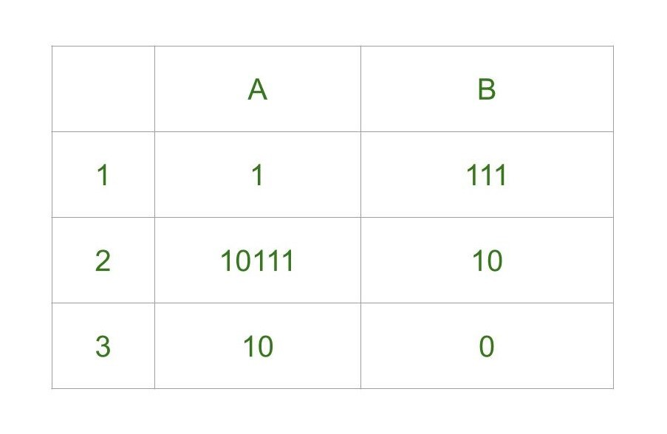
Ex-3

Slide 13
2 1 1 3

Slide 14
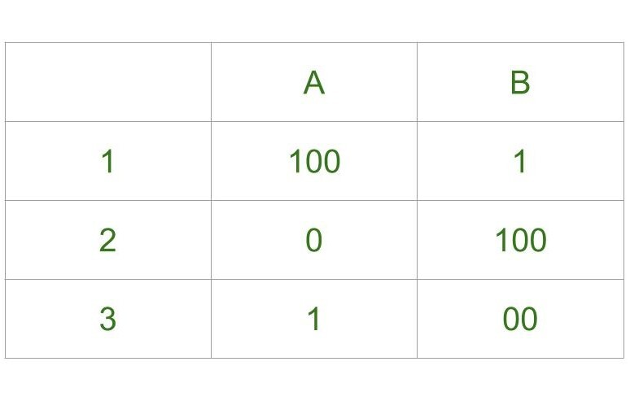
Ex-4

Slide 16
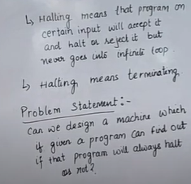
Halting problem

Slide 17
