Slide 7
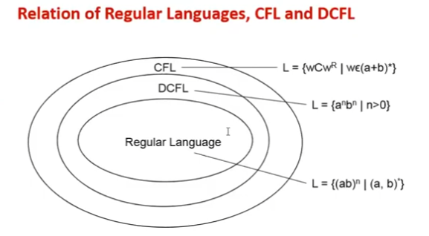

Slide 8
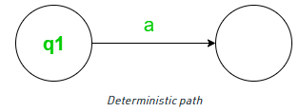
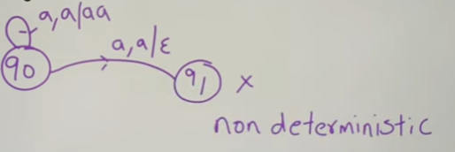
DPDA
DPDA: For every input with the current state, there is only one move.
M = (Q,∑,Γ,q0, Z,F ,δ)
δ: Q*∑*Γ→Q*Γ

Slide 9
NDPA is more powerful than DPDA because we can add more transitions to it.
We can construct DPDA there exist an NPDA but there are some languages that are accepted by NPDA but are not by DPDA.

