Slide 1
Model Assessment and Selection
UNIT-5

Slide 2
Contents
Introduction, Bias, Variance and Model complexity, Bias-Variance decomposition, Optimism of the training error rate, Estimates of in-sample prediction error, Effective number of parameters, Minimum description length, Holdout sets, and cross-validation

Slide 3
Model Evaluation and Assessment …
Model evaluation: In this step, Evaluate the performance of different models on a given dataset. Several metrics are used to evaluate a model's performance, including accuracy, precision, recall, F1-score, and ROC-AUC.
Model selection: In this step, select the best model based on its performance on the evaluation metrics. Several techniques are used to select the best model, including cross-validation, grid search, and regularization
Model evaluation is the process of assessing the performance of different models on a given dataset. The choice of evaluation metric depends on the task at hand.
For classification tasks, we typically use metrics such as accuracy, precision, recall, F1-score, and ROC-AUC.
For regression tasks , we typically use metrics such as mean squared error (MSE), mean absolute error (MAE), and R-squared.
Accuracy: Accuracy is the most commonly used metric for classification tasks. It measures the proportion of correctly classified instances out of the total number of instances.

Slide 4
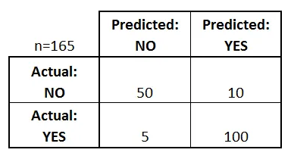
Classification Tasks Metrics
Confusion Matrix gives us a matrix as output and describes the complete performance of the model.
Lets assume we have a binary classification problem. We have some samples belonging to two classes : YES or NO. Also, we have our own classifier which predicts a class for a given input sample. On testing our model on 165 samples ,we get the following result.
There are 4 important terms :
True Positives : predicted YES and the actual output YES.
True Negatives : predicted NO and the actual output NO.
False Positives : predicted YES and the actual output NO.
False Negatives : predicted NO and the actual output YES.
AUC is the area under the curve of plot False Positive Rate vs True Positive Rate at different points in [0, 1]

Slide 5
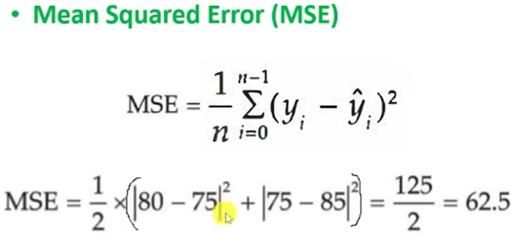
Linear Regression Metrics

Slide 6
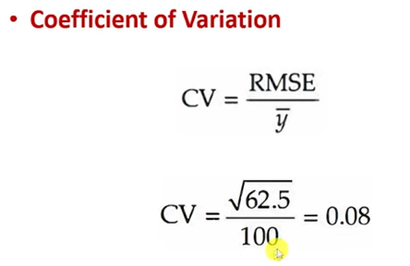
Linear Regression Metrics

Slide 7
Bias and Variance
The best approach is to randomly divide the dataset into three parts: a training set, a validation set, and a test set.
The training set is used to fit the models;
the validation set is used to estimate prediction error for model selection;
the test set is used for assessment of the generalization error of the final chosen model.
Ideally, the test set should be kept in a “vault,” and be brought out only at the end of the data analysis.

Slide 8
Bias and Variance
Bias refers to the error that occurs when a model makes assumptions about the underlying relationship between the features and the target variable, leading to systematic errors in the predictions.
Models with high bias tend to be oversimplified and are often referred to as underfitting the data
Variance refers to the error that occurs when a model is too complex and tries to fit to the noise in the data, resulting in highly sensitive and unstable predictions. Models with high variance are often referred to as overfitting the data.
Model complexity refers to the number of features and the degree of the polynomial in the model, which can be adjusted to balance bias and variance.
The bias-variance tradeoff is a key concept in machine learning, as it describes the relationship between the complexity of a model and its ability to generalize to new data.
The Bias-Variance decomposition is a useful tool for understanding this tradeoff. It breaks down the error of a model into two components: the bias and the variance.
Mathematically, the expected to mean squared error (MSE) of a model can be expressed as:
Expected MSE = Bias^2 + Variance + Irreducible error
where the irreducible error represents the noise that any model cannot reduce.
Test error, also referred to as generalization error, is the prediction error over an independent test sample ErrT = E[L(Y, ˆf(X))|T ]

Slide 9
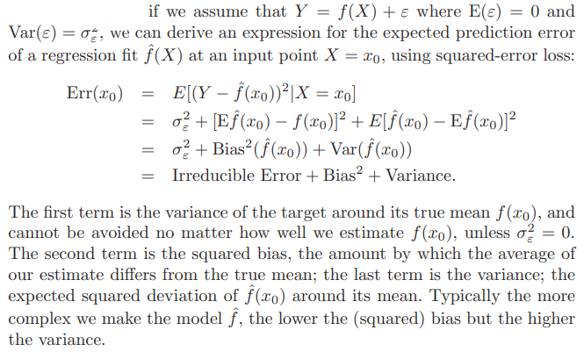
Bias and Variance Decomposition

Slide 10
The optimism of the training error rate
refers to the tendency of a model to perform better on the training data than on new, unseen data.
The training error rate is the error rate obtained by evaluating the model on the same data used to train it.
The difference between the training error rate and the expected error rate of the model on new data.
it affects the ability of the model to generalize to new data.
If the optimism of the training error rate is high, the model may overfit the training data, but poorly on new data.
On the other hand, if the optimism of the training error rate is low, the model is more likely to generalize well to new data.
use a validation set, which is a subset of the data that is held out from the training process and used to estimate the expected error rate of the model on new data.
Training error
Generalization error of a model ˆf
In-sample error
optimism
expected error

Slide 11
Estimates of in-sample prediction error
Model’s performance:
Measure the prediction error on a data set that was not used for training the model.
This set of data is called the test set, and the prediction error measured on this set is known as the test error.
To split the available data into two parts: the training and validation sets.
The model is trained on the training set, and the validation set is used to estimate the test error. This method is called holdout validation.
Another method to estimate the test error is k-fold cross-validation, where the available data is divided into k disjoint subsets (folds), and the model is trained on k-1 folds and validated on the remaining fold.
This process is repeated k times with a different validation fold.
The test error is then estimated as the average of the validation errors obtained in each iteration.
In-sample error is not usually of direct interest since future values of the features are not likely to coincide with their training set values.

Slide 12
The effective number of parameters
Consider a linear model with p input features and a bias term. The number of non-zero weights determines the model's complexity, as these parameters can change the model's output.
The effective number of parameters can be used to select the optimal model complexity, for example, by selecting the principal components in principal component analysis (PCA) or the number of hidden units in a neural network.
By selecting the optimal model complexity, we can avoid overfitting, which occurs when the model is too complex and fits the noise in the training data, leading to poor generalization performance on new data.
Another method to estimate the effective number of parameters is using the Bayesian information criterion (BIC). The BIC penalizes the number of parameters in the model
The effective number of parameters measures the number of such redundant parameters.

Slide 13
Holdout sets and Cross validation
Model Assessment
Used for estimating the performance of a predictive model.
A Holdout set
is a model assessment method
splitting the dataset into two subsets - a training set and a testing set.
The model is trained on the training set and then evaluated on the testing set.
The advantage of this method is that it provides an unbiased estimate of the model's performance on unseen data.
However, the disadvantage is that it may result in high variance, as the performance estimate may depend heavily on which instances end up in the training and testing sets.

Slide 14
Holdout sets and Cross validation
Model Assessment
Used for estimating the performance of a predictive model.
Cross-validation
dividing the data into k-folds (or subsets) of approximately equal size.
trained on k-1 folds and then evaluated on the remaining fold.
This process is repeated k times, with each of the k folds being used as the testing set once.
The model's performance is then estimated as the average of the k-test set performance measures.
The advantage of this method is that it provides a more robust estimate of the model's performance than the holdout set method.
The disadvantage is that it can be computationally expensive for large datasets and complex models.

Slide 15
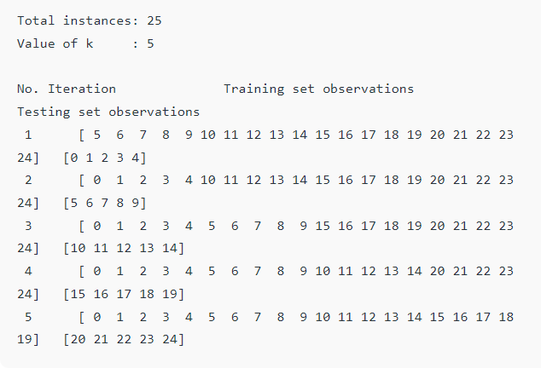
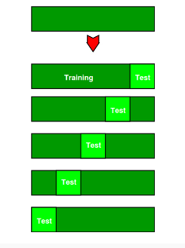
Cross validation

