Slide 1
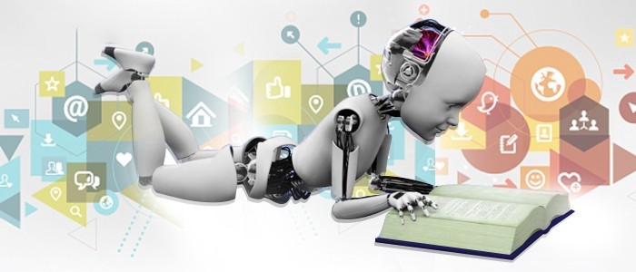
UNIT-I (Applications of Machine Learning)

Slide 2
Machine Learning
Topics :
Applications of Machine Learning

Slide 3
APPLICATIONS OF MACHINE LEARNING
Machine learning is a buzzword for today's technology, and it is growing very rapidly day by day.
We are using machine learning in our daily life even without knowing it such as Google Maps, Google assistant, Alexa, etc.
Below are some most trending real-world applications of Machine Learning:

Slide 4
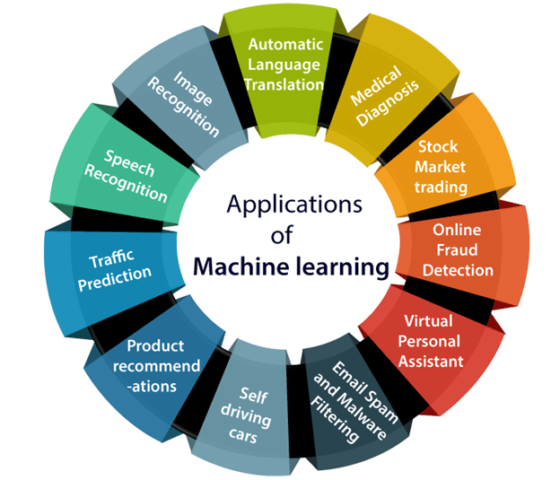
Contd..

Slide 5
1. IMAGE RECOGNITION
Best example of Image Recognition is “Face Detection”.
It is used to identify objects, persons, places, digital images, etc.
Face Recognition is a biometric software application capable of uniquely identifying or verifying a person by comparing and analyzing patterns based on the person’s facial expressions.
Facial Expression is mostly used for security purposes.
USES:
Confirming student identity during online exams
In sports stadiums and nightclubs around the world to identify people on banned lists
Unlocking your phone or computer.

Slide 6
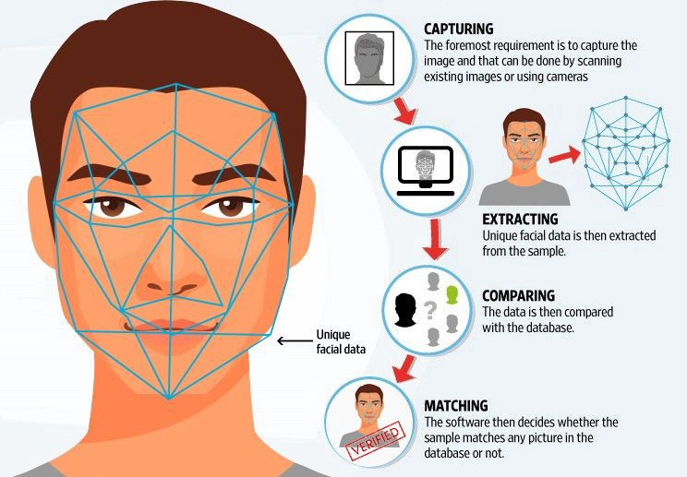
Contd..

Slide 7
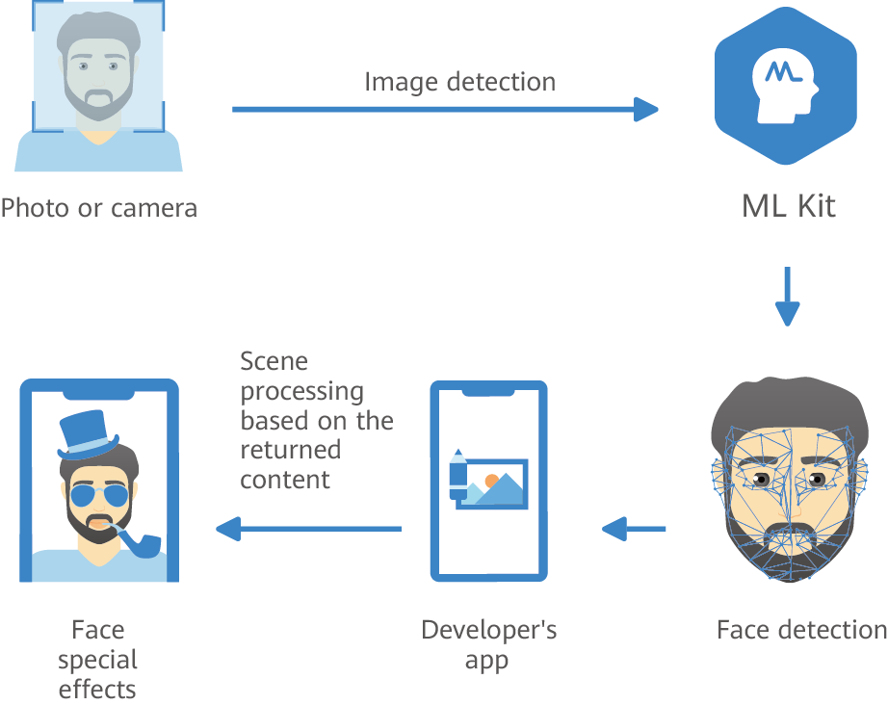
Contd..
Huawei ML Kit-Face Detection works in a below fashion to detect the Human face.

Slide 8
Contd..
Huawei ML Kit — Face Detection detects few key points on the face and measure the results accordingly.
Supported key points are as follows:
0: center of the right eye.
1: center of the left eye.
2: nose tip.
3: right mouth corner where the lips meet.
4: left mouth corner where the lips meet.

Slide 9
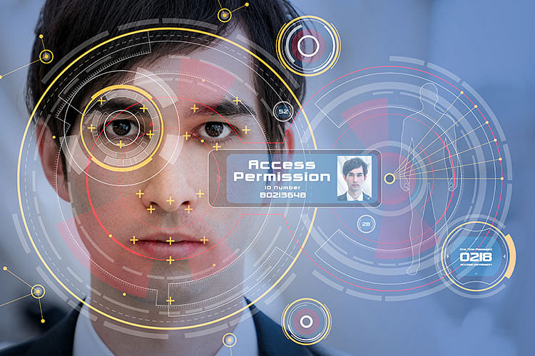

Slide 10
Contd..
USE CASE: The popular use case of image recognition and face detection is, Automatic friend tagging suggestion:
Facebook provides us a feature of auto friend tagging suggestion.
Whenever we upload a photo with our Facebook friends, then we automatically get a tagging suggestion with name, and the technology behind this is machine learning's face detection and recognition algorithm.
It is based on the Facebook project named "Deep Face," which is responsible for face recognition and person identification in the picture.

Slide 11
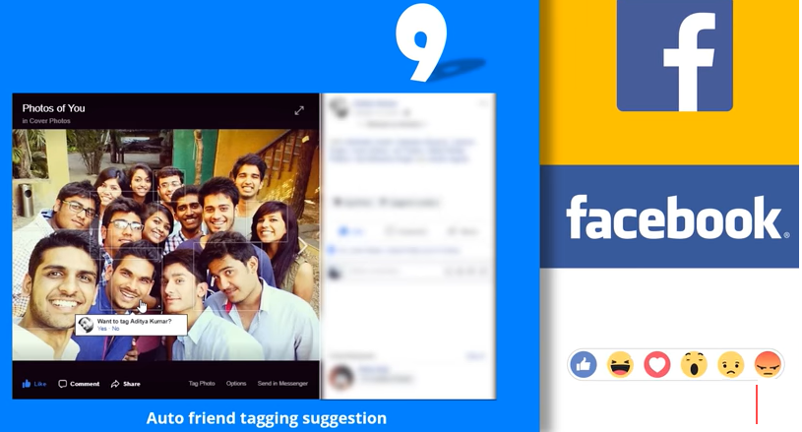
Contd..

Slide 12
2. SPEECH RECOGNITION
While using Google, we get an option of "Search by voice," it comes under speech recognition, and it's a popular application of machine learning.
Speech recognition is a process of converting voice instructions into text, and it is also known as "Speech to text", or "Computer speech recognition."
At present, machine learning algorithms are widely used by various applications of speech recognition.
Google assistant, Siri, Cortana, and Alexa are using speech recognition technology to follow the voice instructions.

Slide 13
3. TRAFFIC PREDICTION
If we want to visit a new place, we take help of Google Maps, which shows us the correct path with the shortest route and predicts the traffic conditions.
It predicts the traffic conditions such as whether traffic is cleared, slow-moving, or heavily congested with the help of two ways:
1. Real Time location of the vehicle form Google Map app and sensors
2. Average time has taken on past days at the same time.

Slide 14
Contd..

Slide 15
Contd..
Machine learning algorithms monitor the location of our vehicles through the data transmitted by GPS navigation system installed within cars, trucks, and buses.
It then finds patterns and predicts the traffic congestion levels based on its learning.
Everyone who is using Google Map is helping this app to make it better.
It takes information from the user and sends back to its database to improve the performance.

Slide 16
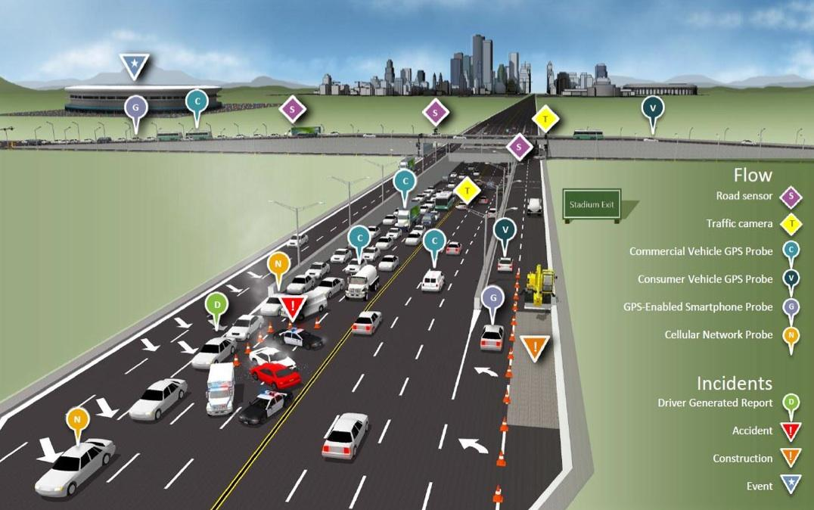
Contd..

Slide 17
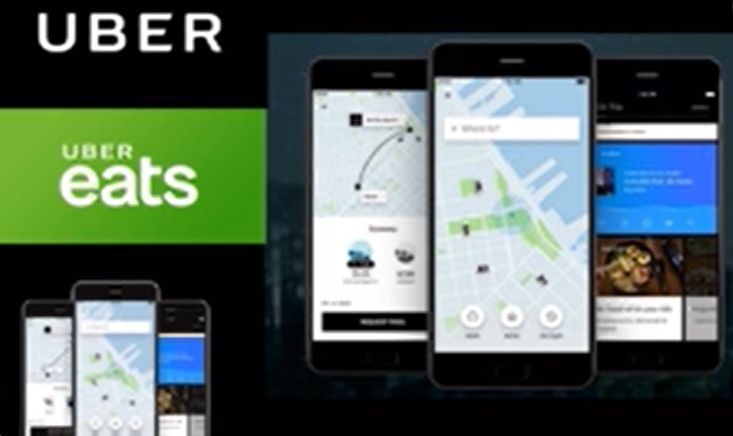
Contd..
USECASE: How UBER is using Machine Learning.
UBER is also using ML Algorithm based on Historical Data made more accurate estimated time to reach the destination.
UBER used Food Delivery System

Slide 18
4. PRODUCT RECOMMENDATION
Machine learning is widely used by various e-commerce and entertainment companies such as Amazon, Netflix, etc., for product recommendation to the user.
Whenever we search for some product on Amazon, then we started getting an advertisement for the same product while internet surfing on the same browser and this is because of machine learning.
Google understands the user interest using various machine learning algorithms and suggests the product as per customer interest.

Slide 19
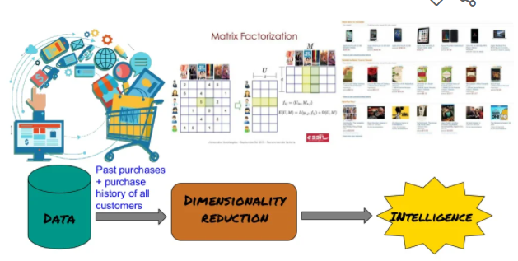
Contd..
As similar, when we use Netflix, we find some recommendations for entertainment series, movies, etc., and this is also done with the help of machine learning.

Slide 20
5. SELF DRIVING CARS
One of the most exciting applications of machine learning is self-driving cars.
Machine learning plays a significant role in self-driving cars.
A self-driving car (sometimes called an autonomous car or driverless car) is a vehicle that uses a combination of sensors, cameras, radar and artificial intelligence (AI) to travel between destinations without a human operator.
Tesla, the most popular car manufacturing company is working on self-driving car.

Slide 21
Contd..
It is using unsupervised learning method to train the car models to detect people and objects while driving.

Slide 22
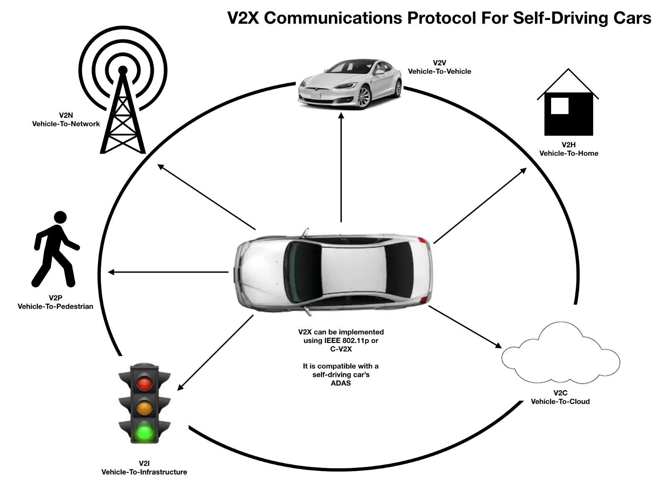

Slide 23
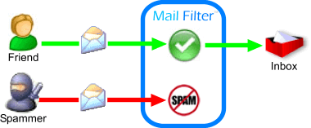
6. E-MAIL SPAM AND MALWARE FILTERING
Whenever we receive a new email, it is filtered automatically as important, normal, and spam.
We always receive an important mail in our inbox with the important symbol and spam emails in our spam box, and the technology behind this is Machine learning.
Below are some spam filters used by Gmail:
Content Filter
Header filter
General blacklists filter
Rules-based filters
Permission filters

Slide 24
Contd..
Some machine learning algorithms such as Multi-Layer Perceptron, Decision tree, and Naïve Bayes classifier are used for email spam filtering and malware detection.

Slide 25
7. VIRTUAL PERSONAL ASSISTANCE
We have various virtual personal assistants such as Google assistant, Alexa, Cortana, Siri.
As the name suggests, they help us in finding the information using our voice instruction.
These assistants can help us in various ways just by our voice instructions such as Play music, call someone, Open an email, Scheduling an appointment, etc.
These virtual assistants use machine learning algorithms as an important part.

Slide 26
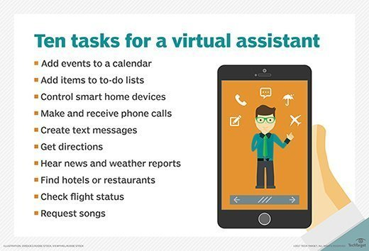
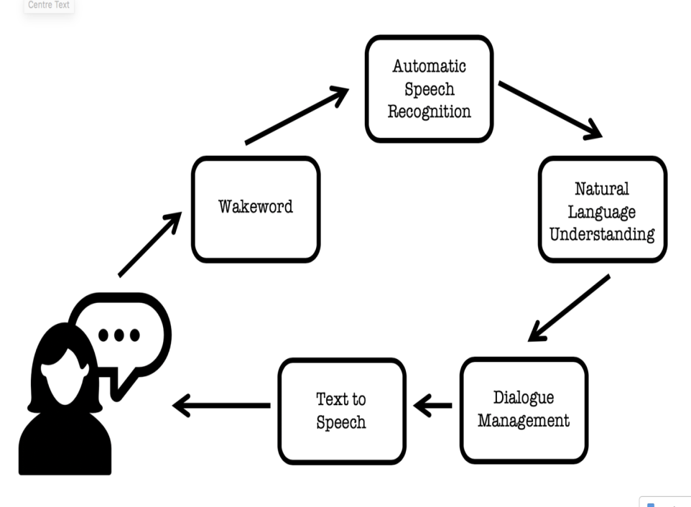
Contd..
These assistant record our voice instructions, send it over the server on a cloud, and decode it using ML algorithms and act accordingly.

Slide 27
8. ONLINE FRAUD DETECTION
Machine learning is making our online transaction safe and secure by detecting fraud transaction.
Whenever we perform some online transaction, there may be various ways that a fraudulent transaction can take place such as fake accounts, fake ids, and steal money in the middle of a transaction.
So to detect this, Feed Forward Neural network helps us by checking whether it is a genuine transaction or a fraud transaction.

Slide 28
Contd..
For each genuine transaction, the output is converted into some hash values, and these values become the input for the next round.
For each genuine transaction, there is a specific pattern which gets change for the fraud transaction hence, it detects it and makes our online transactions more secure.

Slide 29
9. STOCK MARKET TRADING
In the stock market, there is always a risk of up and downs in shares, so for this machine learning's long short term memory neural network is used for the prediction of stock market trends.

Slide 30
10. MEDICAL DIAGNOSIS
Medical diagnosis is a category of medical tests designed for disease or infection detection.
Machine learning in this field will improve patient’s diagnosis with minimum costs and high accuracies.
Use cases of Machine learning are making near-perfect diagnoses, recommend best medicines and identify high-risk patients.
these predictions are based on the past dataset of patient records and symptoms exhibited by a patient. Which make diagnosis easy for patients, doctors, and researchers.

Slide 31
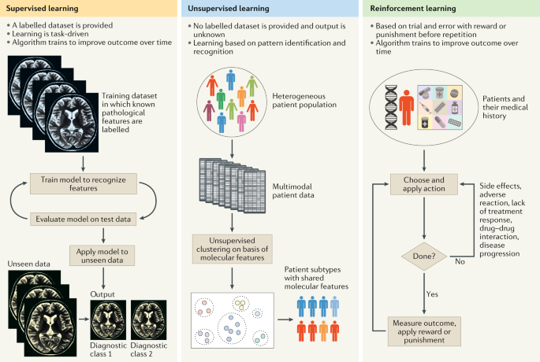
Contd..
It helps in finding brain tumors and other brain-related diseases easily.

Slide 32
10. AUTOMATIC LANGUAGE TRANSLATION
Nowadays, if we visit a new place and we are not aware of the language then it is not a problem at all, as for this also machine learning helps us by converting the text into our known languages.
Google's GNMT (Google Neural Machine Translation) provide this feature, which is a Neural Machine Learning that translates the text into our familiar language, and it called as Automatic Translation.
The technology behind the automatic translation is a sequence to sequence learning algorithm, which is used with image recognition and translates the text from one language to another language.

Slide 33
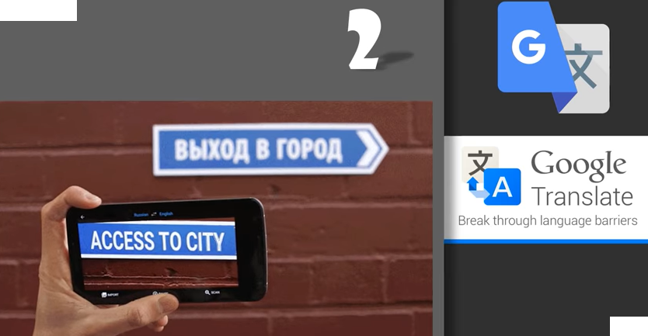
Contd..

Slide 34
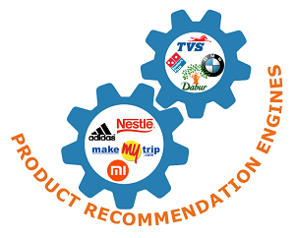
11. Marketing and Sales
Artificial Intelligence and Machine Learning have changed the way businesses interact with customers.
They are doing so by collecting online and offline customer data to measure their future actions.
All the gathered data allows businesses to target audiences with the appropriate message at the right time through the relevant marketing channel to create a buyer’s journey
Online Recommendation System is one of the
Best Application in Marketing and Sales.
(Eg: Amazon, Flip kart etc)

Slide 35
Contd..
Have you ever imagined the product recommendations you get on Google, Amazon and other search engines! There are various product recommendation algorithms that work behind these engines.
The product recommendation engines work based on the customer last purchase and suggests products relating to it. For example: if a customer purchases a laptop, then the recommendation engine would give recommendations like a laptop bag, laptop cover, a charger, and any other relating products.

Slide 36
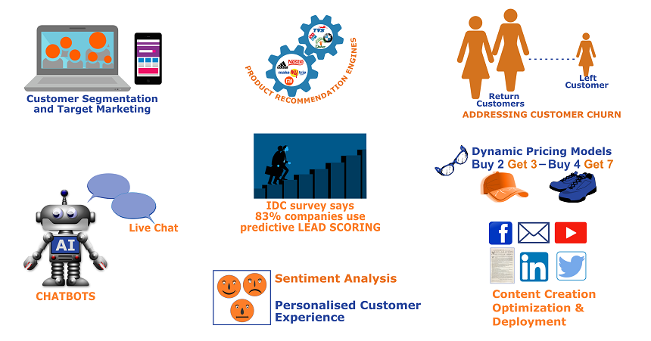
Contd..
Thus, the recommendation engines identify customer buying requirements and groups all the relating products in one category
So, Finally we can use the Unsupervised Learning Algorithm.

Slide 37
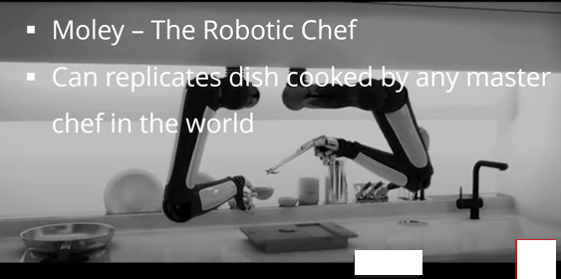
Moley (Robotic Chef)

Slide 38
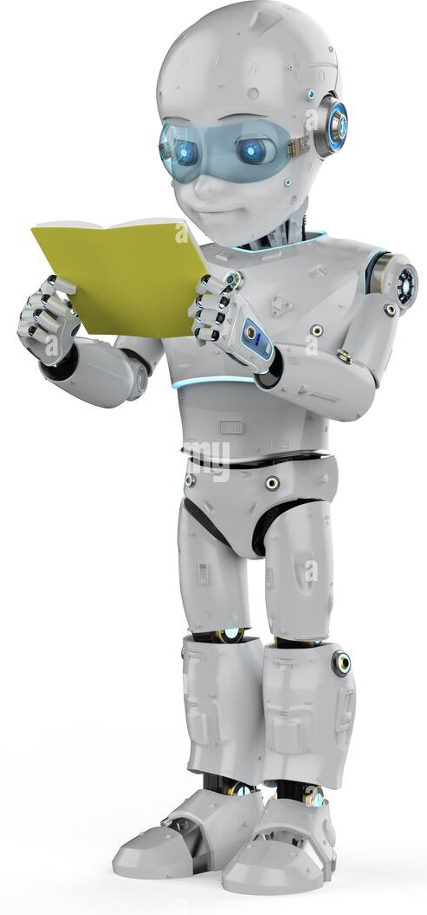
THANK YOU

