Slide 1
HTML FORM

Slide 3
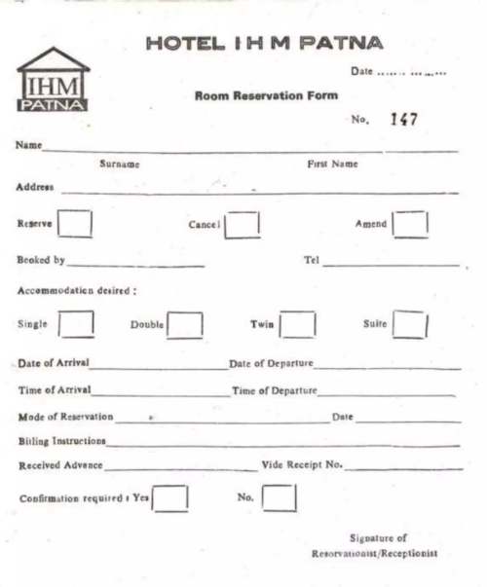
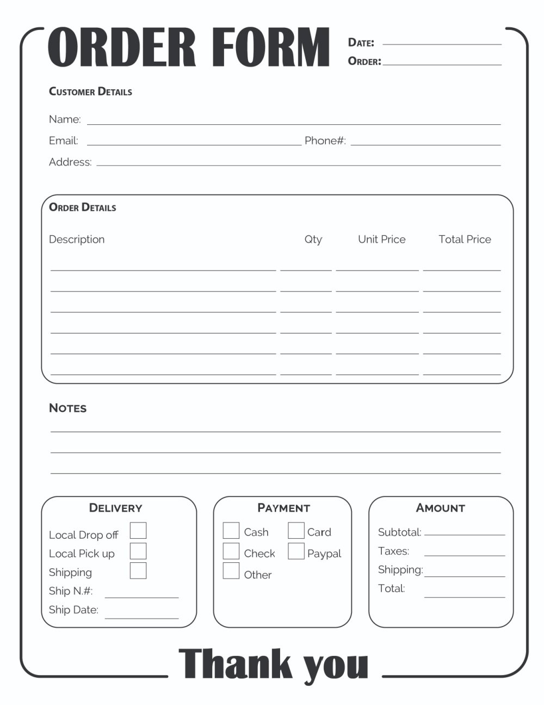
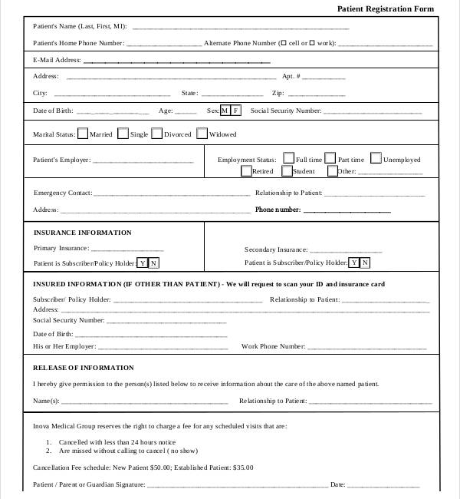
FORM

Slide 4
What is the purpose of Form?
1) Collects the data from person
2) Records the person details
Usage these Form?
1) Can contact person
2) Claims
3) Analysis

Slide 6
What is HTML Form?
Collects the data from user

Slide 7
How to create a Form in HTML ?
The HTML <form> element is used to create an HTML form for user input
<form>
form elements
</form>

Slide 8
The <form> element is a container for different types of input elements, such as: text fields, checkboxes, radio buttons, submit buttons, etc.
The <input> Element
An <input> element can be displayed in many ways, depending on the type attribute.
some examples:
<input type="text">
<input type="radio">
<input type="checkbox">
<input type="submit">
<input type="button">

Slide 9
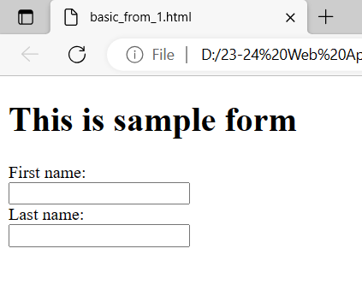
<!DOCTYPE html>
<html>
<body>
<h1>This is sample form </h1>
<form>
First name:<br>
<input type="text" name="firstname">
<br>
Last name:<br>
<input type="text" name="lastname">
</form>
</body>
</html>

Slide 10
The <label> tag is used to specify a label for an <input> element of a form.
It adds a label to a form control such as text, email, password, textarea etc.
It toggles the control when a user clicks on a text within the <label> element.

Slide 11
The <label> tag can be used in two ways:
Firstly, use <label> tag by providing the <input> and id attribute.
The <label> tag needs a for attribute whose value is the same as input id.
<label for="fname">First name:</label>
<input type="text" name="firstname" id="fname">
Alternatively, …………………………………………………………

Slide 12
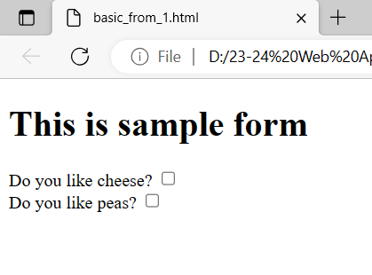
<!DOCTYPE html>
<html>
<body>
<h1>This is sample form </h1>
<form>
<label for="cheese">Do you like cheese?</label>
<input type="checkbox" name="cheese" id="cheese">
<br>
<label for="peas">Do you like peas?</label>
<input type="checkbox" name="peas" id="peas">
</form>
</body>
</html>

Slide 13
<!DOCTYPE html>
<html>
<body>
<h1>This is sample form </h1>
<form>
<label for="fname">First name:</label>
<input type="text" name="firstname" id="fname">
<br>
<label for="lname">Last name:</label>
<input type="text" name="lastname" id="lname">
</form>
</body>
</html>

Slide 14
<form>
<label for="fname">First name:</label>
<input type="text" name="firstname" id="fname">
<br>
<label for="lname">Last name:</label>
<input type="text" name="lastname" id="lname">
</form>

Slide 15
<form>
<label for="fname">First name:</label>
<input type="text" name="firstname" id="fname">
<br>
<label for="lname">Last name:</label>
<input type="text" name="lastname" id="lname">
</form>

Slide 16
<form>
<label for="fname">First name:</label>
<input type="text" name="firstname" id="fname">
<br>
<label for="lname">Last name:</label>
<input type="text" name="lastname" id="lname">
</form>

Slide 17
<form>
<label for="fname">First name:</label>
<input type="text" name="firstname" id="fname">
<br>
<label for="lname">Last name:</label>
<input type="text" name="lastname" id="lname">
</form>

Slide 18
The <label> tag can be used in two ways:
Firstly, use <label> tag by providing the <input> and id attribute.
The <label> tag needs a for attribute whose value is the same as input id.
<label for="fname">First name:</label>
<input type="text" name="firstname" id="fname">
Alternatively, …………………………………………………………

Slide 19
The <label> tag can be used in two ways:
Firstly, use <label> tag by providing the <input> and id attribute.
The <label> tag needs a for attribute whose value is the same as input id.
<label for="fname">First name:</label>
<input type="text" name="firstname" id="fname">
Alternatively, <input> tag use directly inside the <label> tag.
In this case, the for and id attributes are not needed because the association is implicit.
<label>First name:
<input type="text" name="firstname" id="fname">
</label>

Slide 20
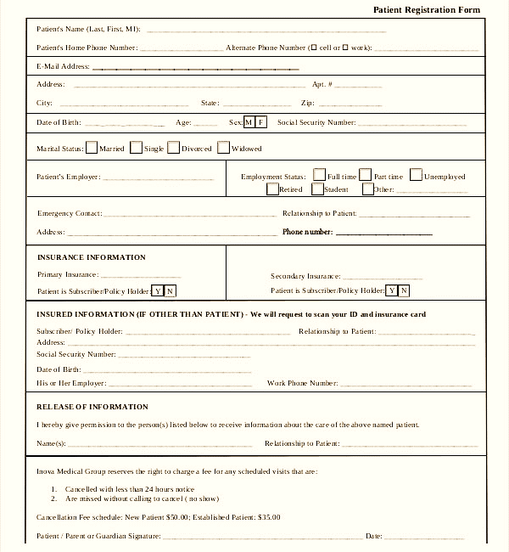

Slide 21
Form Attributes
The HTML <form> element contains several attributes for controlling data submission.
action
The action attributes define the action to be performed when the form is submitted.
It is usually the url for the server where the form data is to be sent.
<form action="/login">
<label for="email">Email:</label>
<input type="email" name="email"><br><br>
<label for="password">Password:</label>
<input type="password" name="password"><br><br>
<input type="submit" value="Submit">
</form>
In the above example, when the form is submitted, the data from the form is sent to /login.

Slide 22
method
The method attribute defines the HTTP method to be used when the form is submitted.
There are 3 possible values for the method attribute:
post - It is used to send data to a server to update a resource.
<form method = "post">
...
</form>
get: It is used to request data from a specified resource.
<form method = “get">
...
</form>

Slide 23
dialog: This method is used when the form is inside a <dialog> element. Using this method closes the dialog and sends a form-submit event.
Experiment on below attributes
target
enctype
name
novalidate

Slide 24
The HTML <form> Elements
<input type="button">
<input type="checkbox">
<input type="color">
<input type="date">
<input type="datetime-local">
<input type="email">
<input type="file">
<input type="hidden">
<input type="image">
<input type="month">
<input type="number">
<input type="password">
<input type="radio">
<input type="range">
<input type="reset">
<input type="search">
<input type="submit">
<input type="tel">
<input type="text">
<input type="time">
<input type="url">
<input type="week">
Text Box Input
Password Input
Text Area
Select Drop Down
Check Box
Radio Input
File Input
Button
<button>
<fieldset>
<legend>
<datalist>
<output>
<option>
<optgroup>
<progress>

