Slide 1
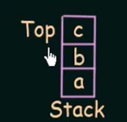
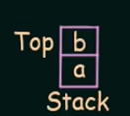

Slide 6
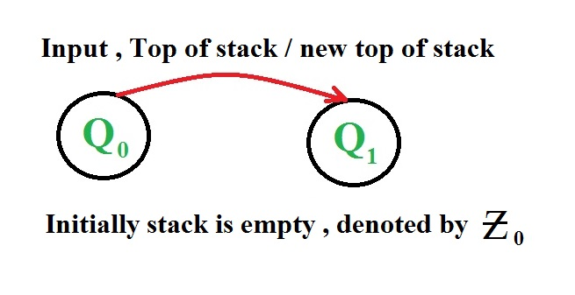
Representation of State Transition

Slide 7
Instantaneous description
The Instantaneous description is called as an informal notation, and explains how a Push down automata (PDA) computes the given input string and makes a decision that the given string is accepted or rejected.
A ID is a triple (q, w, α), where: 1. q is the current state. 2. w is the remaining input. 3.α is the stack contents, top at the left.

Slide 8
Turnstile notation
⊢ sign is called a “turnstile notation” and represents one move.
⊢* sign represents a sequence of moves. Eg- (p, b, T) ⊢ (q, w, α)
This implies that while taking a transition from state p to state q, the input symbol ‘b’ is consumed, and the top of the stack ‘T’ is replaced by a new string ‘α’

Slide 9
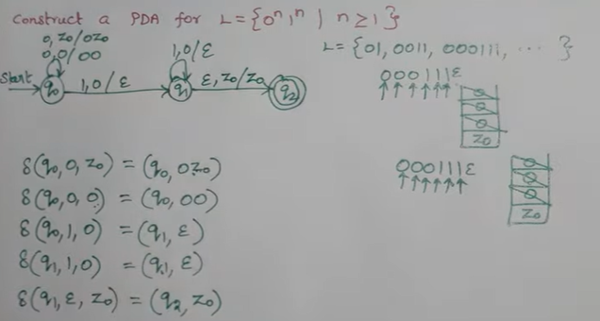
Example: 1

Slide 10
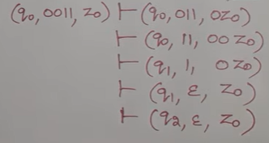

Slide 11
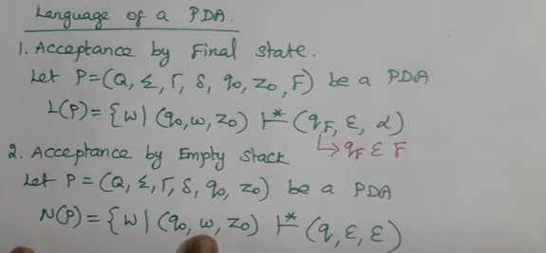

Slide 12
Final State Acceptability
In final state acceptability, a PDA accepts a string when, after reading the entire string, the PDA is in a final state. From the starting state, we can make moves that end up in a final state with any stack values. The stack values are irrelevant as long as we end up in a final state.
For a PDA (Q, ∑, S, δ, q₀, I, F), the language accepted by the set of final states F is −
L(PDA) = {w | (q₀, w, I) ⊢* (q, ε, x), q ∈ F}
for any input stack string x.
Empty Stack Acceptability
Here a PDA accepts a string when, after reading the entire string, the PDA has emptied its stack.
For a PDA (Q, ∑, S, δ, q₀, I, F), the language accepted by the empty stack is −
L(PDA) = {w | (q₀, w, I) ⊢* (q, ε, ε), q ∈ Q}

Slide 13
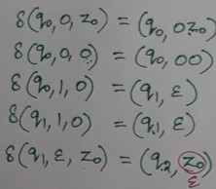
Acceptance by empty stack

Slide 14
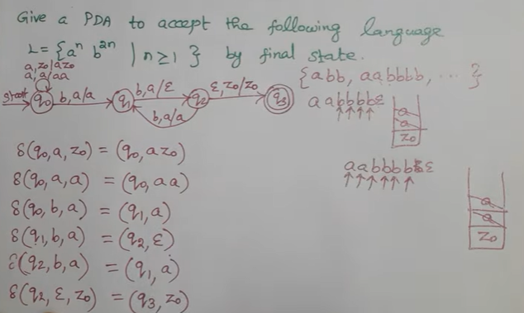
Example: 2

Slide 15
Example: 3

Slide 16
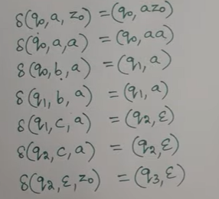

Slide 17
Example: 4

Slide 18
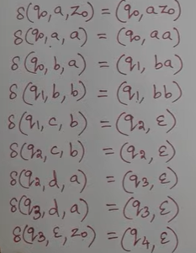
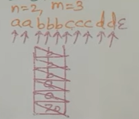

Slide 19
Example: 5

Slide 20
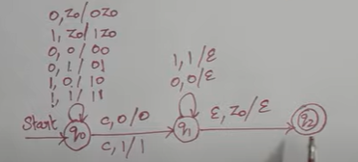

Slide 21
Example: 6

Slide 22
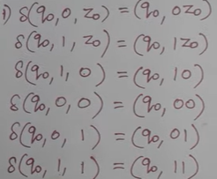

Slide 24
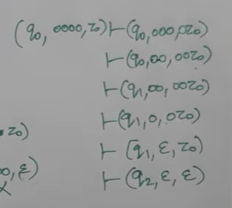
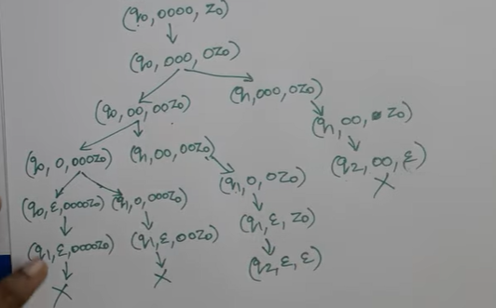

Slide 25
PDA design examples
a^{n}b^{n}c^{m} n,m>=1
a^{n} b^{m+n} c^{m} n,m>=1
a^{n}b^{m}c^{n+m} n,m>=1
0^{n}1^{m}2^{m}3^{n} n,m>=0
0^{n}1^{m}2^{m+n} n.m>=0

Slide 26
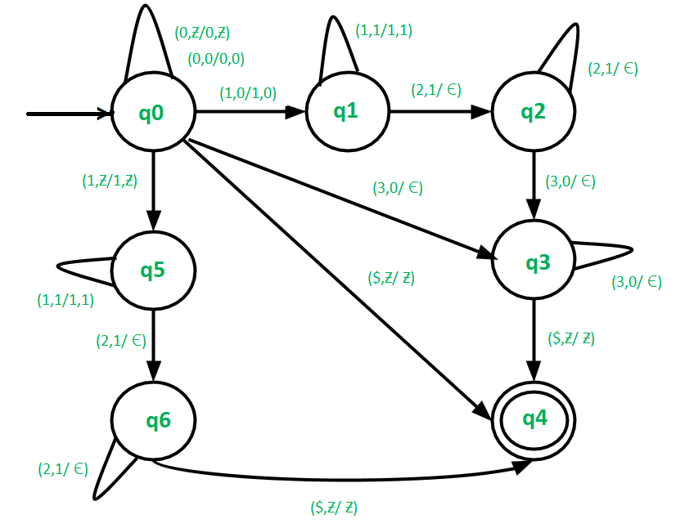

Slide 27
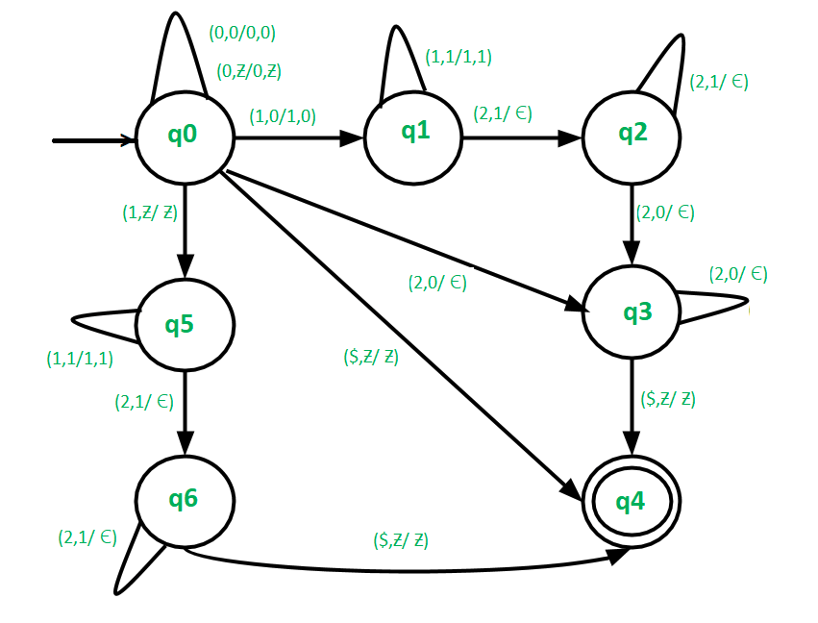

Slide 28
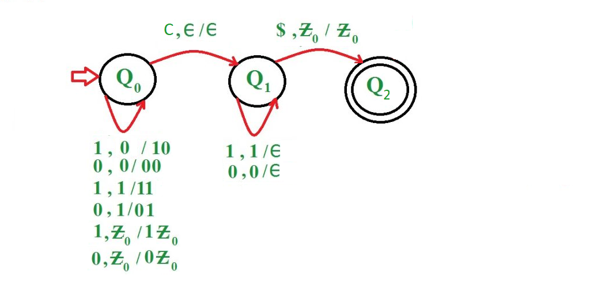
Construct a PDA for language L = {wcw’ | w={0, 1}*} where w’ is the reverse of w.

Slide 29
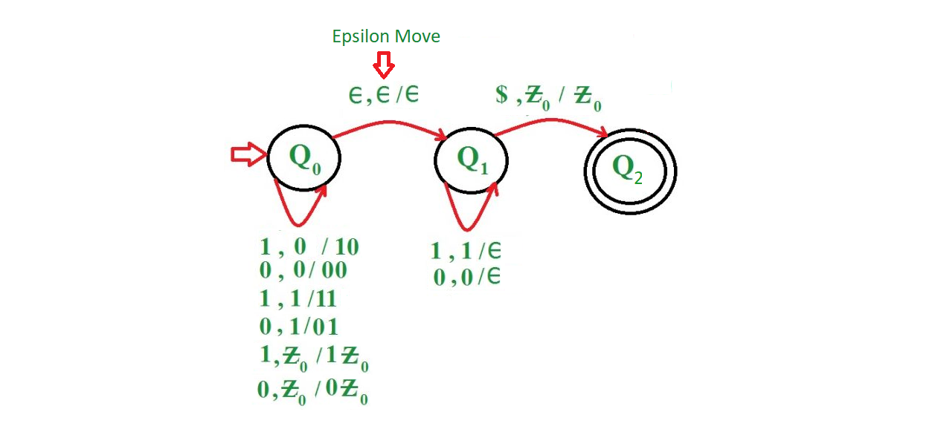
Construct a PDA for language L = {ww’ | w={0, 1}*} where w’ is the reverse of w.

Slide 30
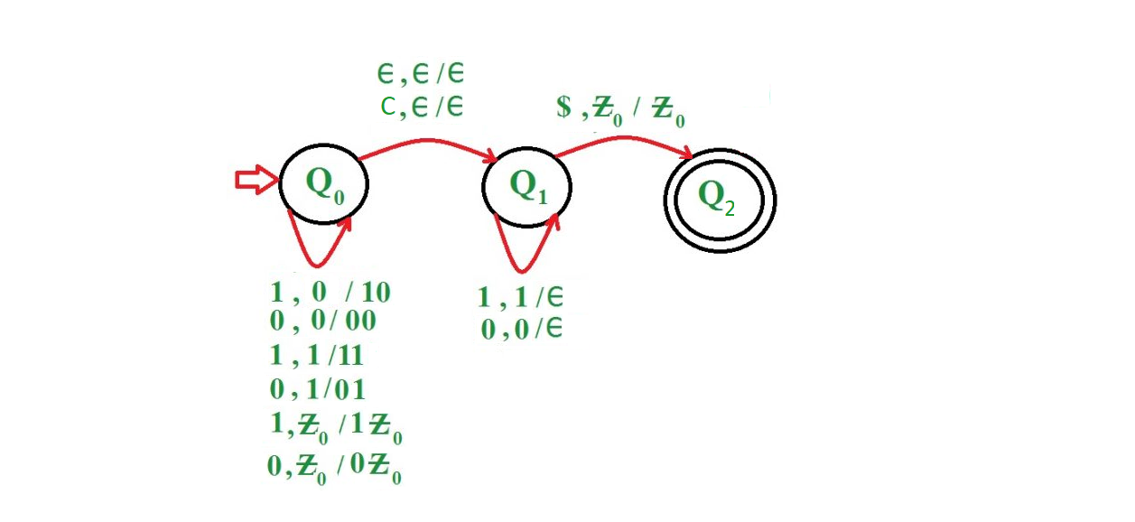
Construct a PDA for language L = {ww’ | wcw’, w={0, 1}*} where w’ is the reverse of w.

Slide 31
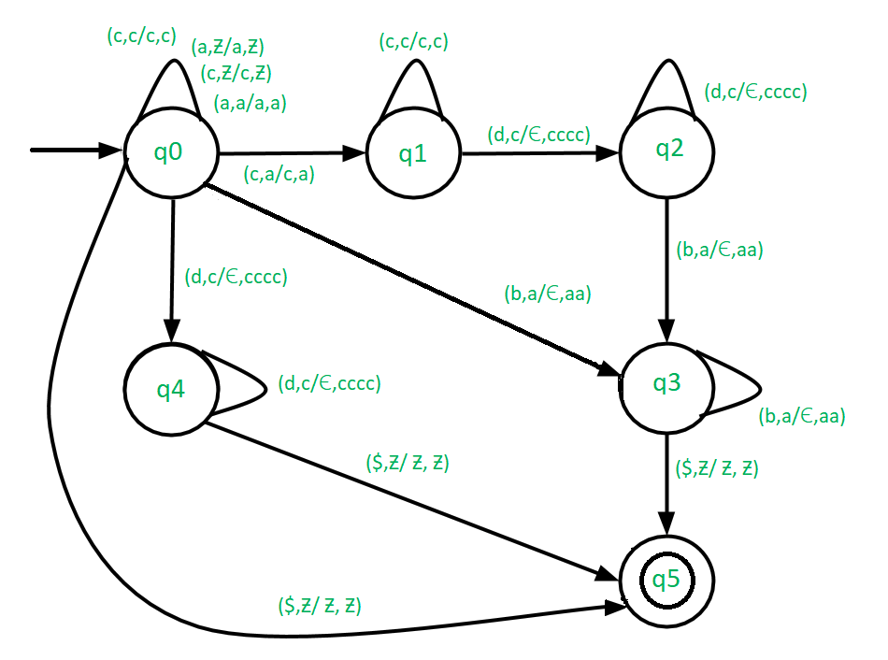
Construct Pushdown automata for L = {a^{(2*m)}c^{(4*n)}d^{n}b^{m} | m,n ≥ 0}

Slide 34
