Slide 1
(Machine Learning) III B.Tech II Sem (PVP-20)

Slide 2
Topics :
Introduction.
Differences b/w Human Intelligence and Artificial Intelligence
Learning Resources for this Course
Machine Learning – Formal Definition.
Why can we use Machine Learning?
How Machine Learning Works?
Features of Machine Learning.

Slide 3
Topics :
Differences b/w Traditional Programming and Machine Learning.
Types of Machine Learning.
Applications of Machine Learning
ML in Project Management
Learning Beyond Curriculum
Role of ML in Higher Studies
Tools and Libraries used in ML

Slide 4
INTRODUCTION to ML
Machine Learning is the Subset of Artificial Intelligence.
In AI, It is Science and uses Technology , finally it creates Magic.
ML, DL etc,

Slide 5
Contd..
Definition of AI: Artificial intelligence is a field of computer science which makes a computer system that can mimic human intelligence.
It is comprised of two words "Artificial" and "intelligence", which means a human-made thinking power.
No computer can yet match the complexity of human intelligence.
The key to this goal lies in Machine learning (ML) and Deep learning (DL).

Slide 6
Contd..
That's because these two technologies are able to analyze large amounts of data and make decisions and predictions based on it with as little human intervention as possible.
So that Machine Learning is the subset of Artificial Intelligence
Machine learning (ML) is a technology used to make pre- dictions about likely outcomes based on the processing of a large amount of collected data, thereby producing “probabilistic results” (Elish & Boyd, 2018)

Slide 7
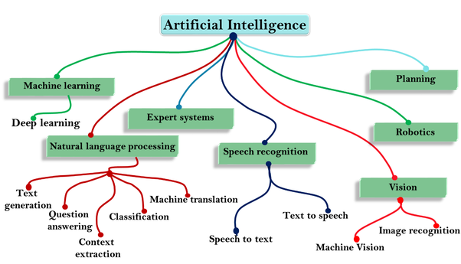

Slide 8
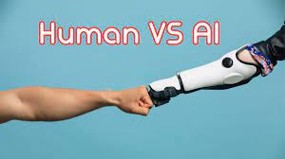
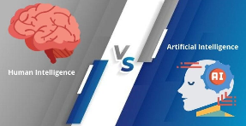
Differences between Human Intelligence and Artificial Intelligence
Faster Decisions
Reduction in Human Error
Available in 24X7
Speed
Memory

Slide 9
Prerequisites
Before learning about Machine Learning, you must have the fundamental knowledge of following so that you can understand the concepts easily:
A strong hold on Mathematics – namely Linear Algebra, Calculus, Statistics and probability.
A good amount of experience in programming languages like C, C++, Java, or Python.
Knows the Good Knowledge on Data Structures, to for organizing, processing, retrieving and storing data.
A strong hold in understanding and writing algorithms.

Slide 10
Course Outcomes
Upon successful completion of the course, the student will be able to
CO1 | Understand the basic concepts of Machine Learning.
CO2 | Apply Supervised Learning Algorithms for solving various problems
CO3 | Apply Unsupervised Learning and Reinforcement Learning Algorithms for solving various problems
CO4 | Analyze the given Application and use Suitable Machine Learning Algorithm

Slide 11
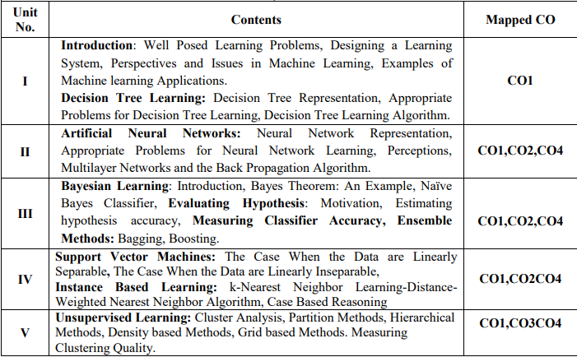
SYLLABUS

Slide 12
Learning Resources :
Text Books:
Machine Learning by Tom M. Mitchell, Indian Edition 2013, McGraw Hill Education.
Machine Learning by Saikat Dutt, Subramanian Chandramouli, Amit Kumar Das, First Edition,2019, Pearson Education
Data Mining Concepts and Techniques by Jiawei Han, Micheline Kamber, Jian Pei, Third Edition,2012

Slide 13
Learning Resources :
Reference Books:
Introduction to Machine Learning by ETHEM ALPAYDIN, Fourth Edition, Prentice Hall of India, MIT Press, 2020
C Bishop – Pattern Recognition and Machine Learning – Springer, 2006. Machine Learning, Anuradha Srinivasaraghavan , and Vincy Joseph ,Kindle Edition, September 2020, WILEY.
Machine Learning in Production: Developing and optimizing Data Science Workflows and Applications, Andrew Kelleher, Adam Kelleher, First Edition,2012,Pearson Education

Slide 14
Learning Resources :
Reference Books:
4. Introduction to Data Mining, Tan,Vipin Kumar,Michael Steinbach,Ninth Impression, Pearson, 2013
e- Resources and other Digital Material:
1.https://www.coursera.org/learn/machine-learning 2.https://nptel.ac.in/courses/106/106/106106139/

Slide 15
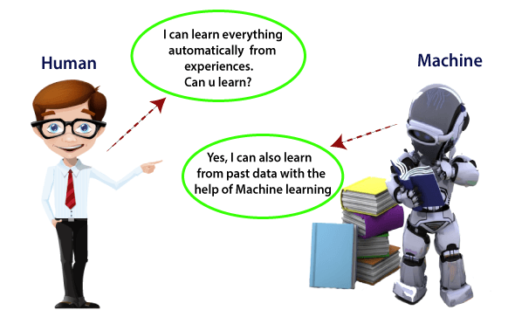
Machine Learning

Slide 16
Machine Learning
Machine Learning is subset of artificial intelligence that is involves the development of algorithms which allow a computer to learn from the data and past experiences on their own.
The term machine learning was first introduced by Arthur Samuel in 1959.
But Machine learning became very famous in the 1990s
introduced by Tom M. Mitchell.

Slide 17
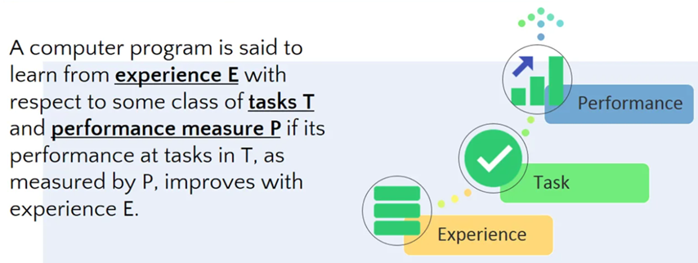
Formal Definition Machine Learning?

Slide 18
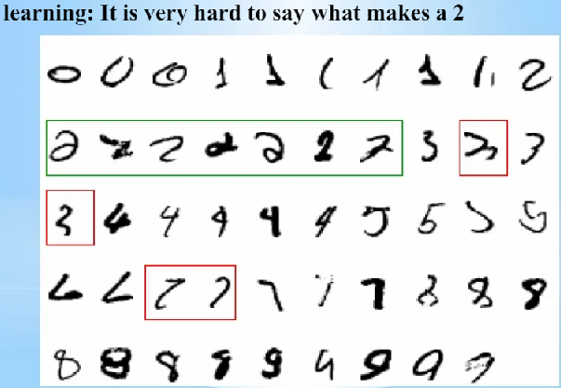
Contd..
Example-2: Hand Written Recognition

Slide 19
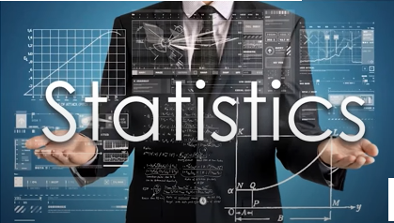
Why Machine Learning was Introduced

Slide 20
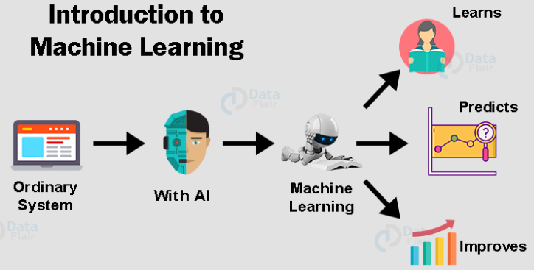
Why we use Machine Learning?

Slide 21
how Machine Learning works:
First we provide data to the system.
The system goes through the entire data and analyzes it to find patterns based on sizes, shapes, colors etc.
Now after figuring out patterns, the system takes decisions and starts separating items.
Once the work is done, the system learns from the result.

Slide 22
Features of Machine Learning
Machine learning uses data to detect various patterns in a given dataset.
It can learn from past data and improve automatically.
It is a data-driven technology.
Machine learning is much similar to data mining as it also deals with the huge amount of the data.

Slide 23
Terminology of machine learning
In ML, a target is called a Class Label. In statistics, a target is called a dependent variable.
A variable in statistics is called a feature in ML.
Example: In Linear Regression , we use
y= mx+c

Slide 24
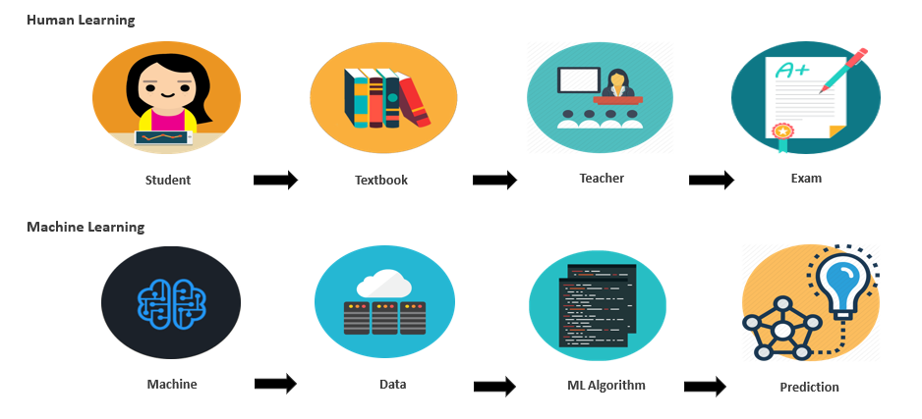
Difference b/w human learning and machine learning

Slide 25
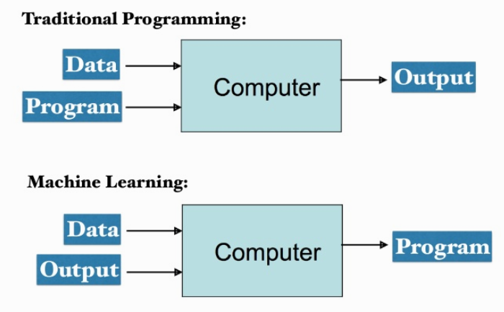
Differences b/w Traditional Programming and Machine Learning

Slide 26
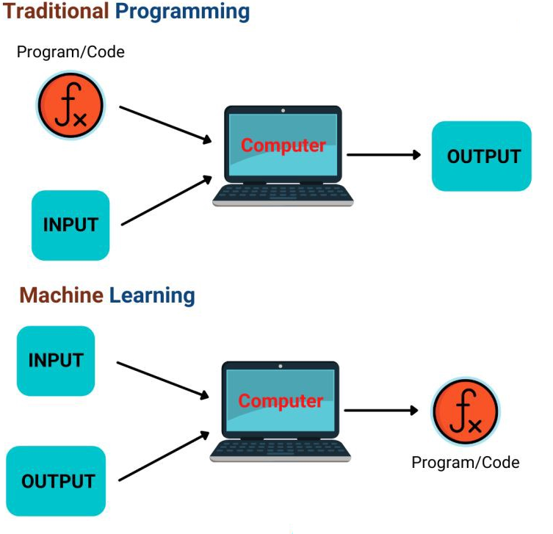
Example

Slide 28
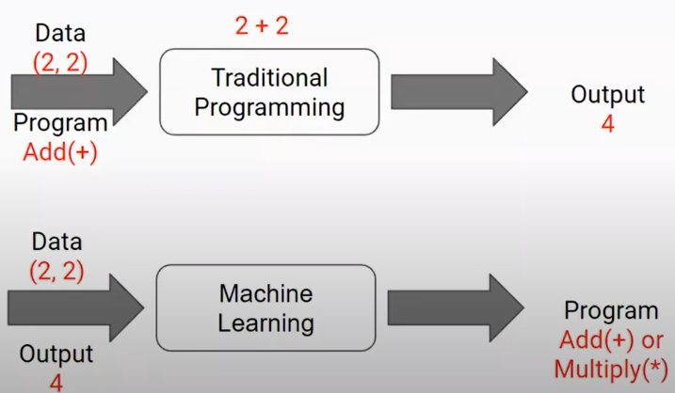
Example:

Slide 29
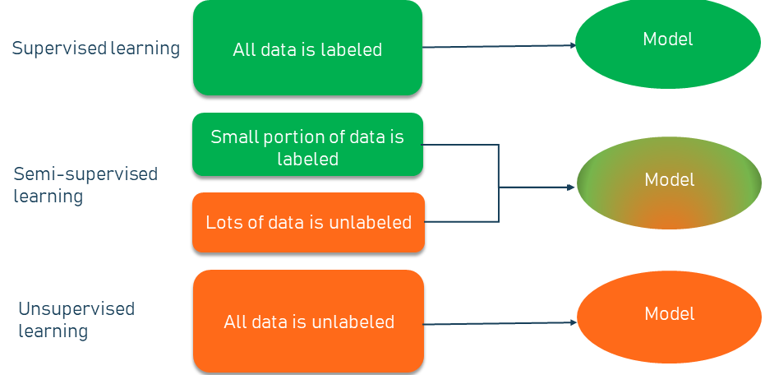
Types of Machine Learning

Slide 30
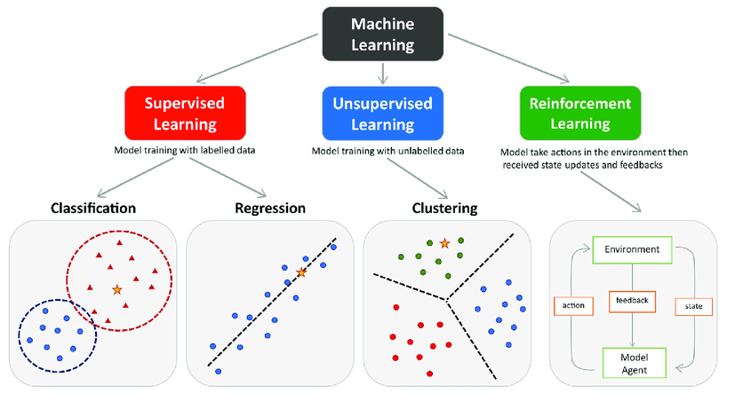
Types of Machine Learning

Slide 31
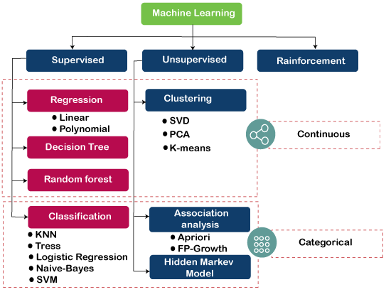
Types of Machine Learning

Slide 32
Contd..
1. Supervised Learning:
It is a method in which we teach the
machine using labelled data.
i.e, it is supervised by some one.
Types of Supervised Learning:
Classification Definition: If the label is categorical the model is known as a “classification”
Regression Definition : If the label is numeric, the model is known as a “regression”.

Slide 33
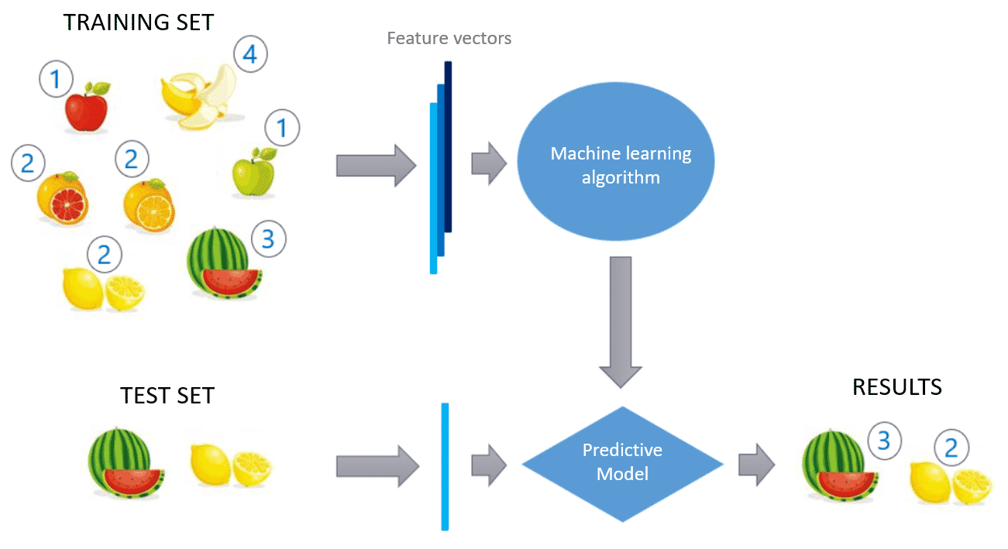
Contd..

Slide 34
Contd..

Slide 35
Contd..
2. Unsupervised Learning:
Unsupervised learning techniques
can be applied without having the
data labeled for training.
Types of Unsupervised Learning:
Dimensionality Reduction: Dimensionality reduction refers to techniques that reduce the number of input variables in a dataset.
Clustering: Clustering is the task of dividing the population or data points into a number of groups

Slide 36
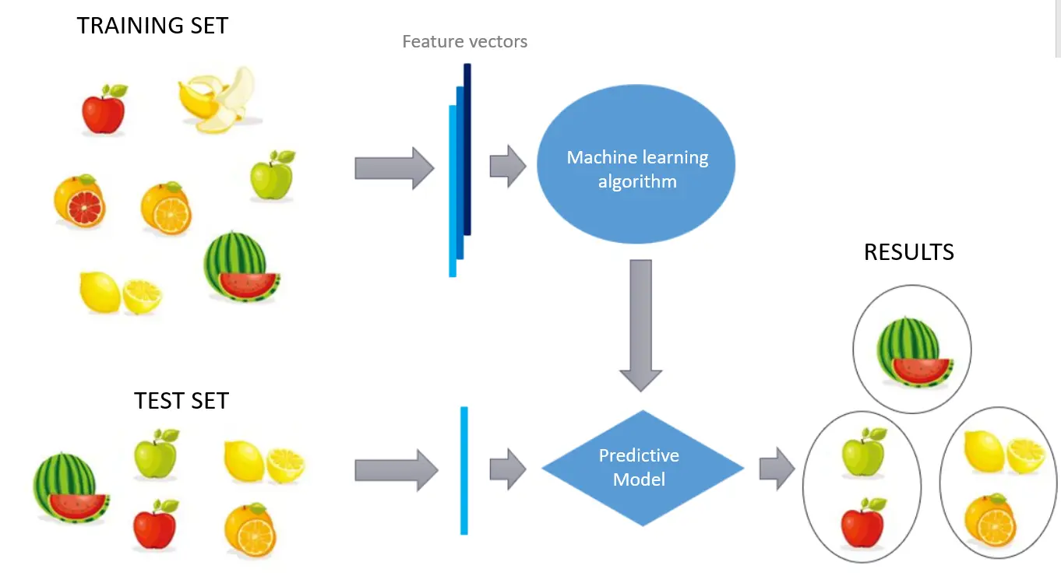
Contd..

Slide 37
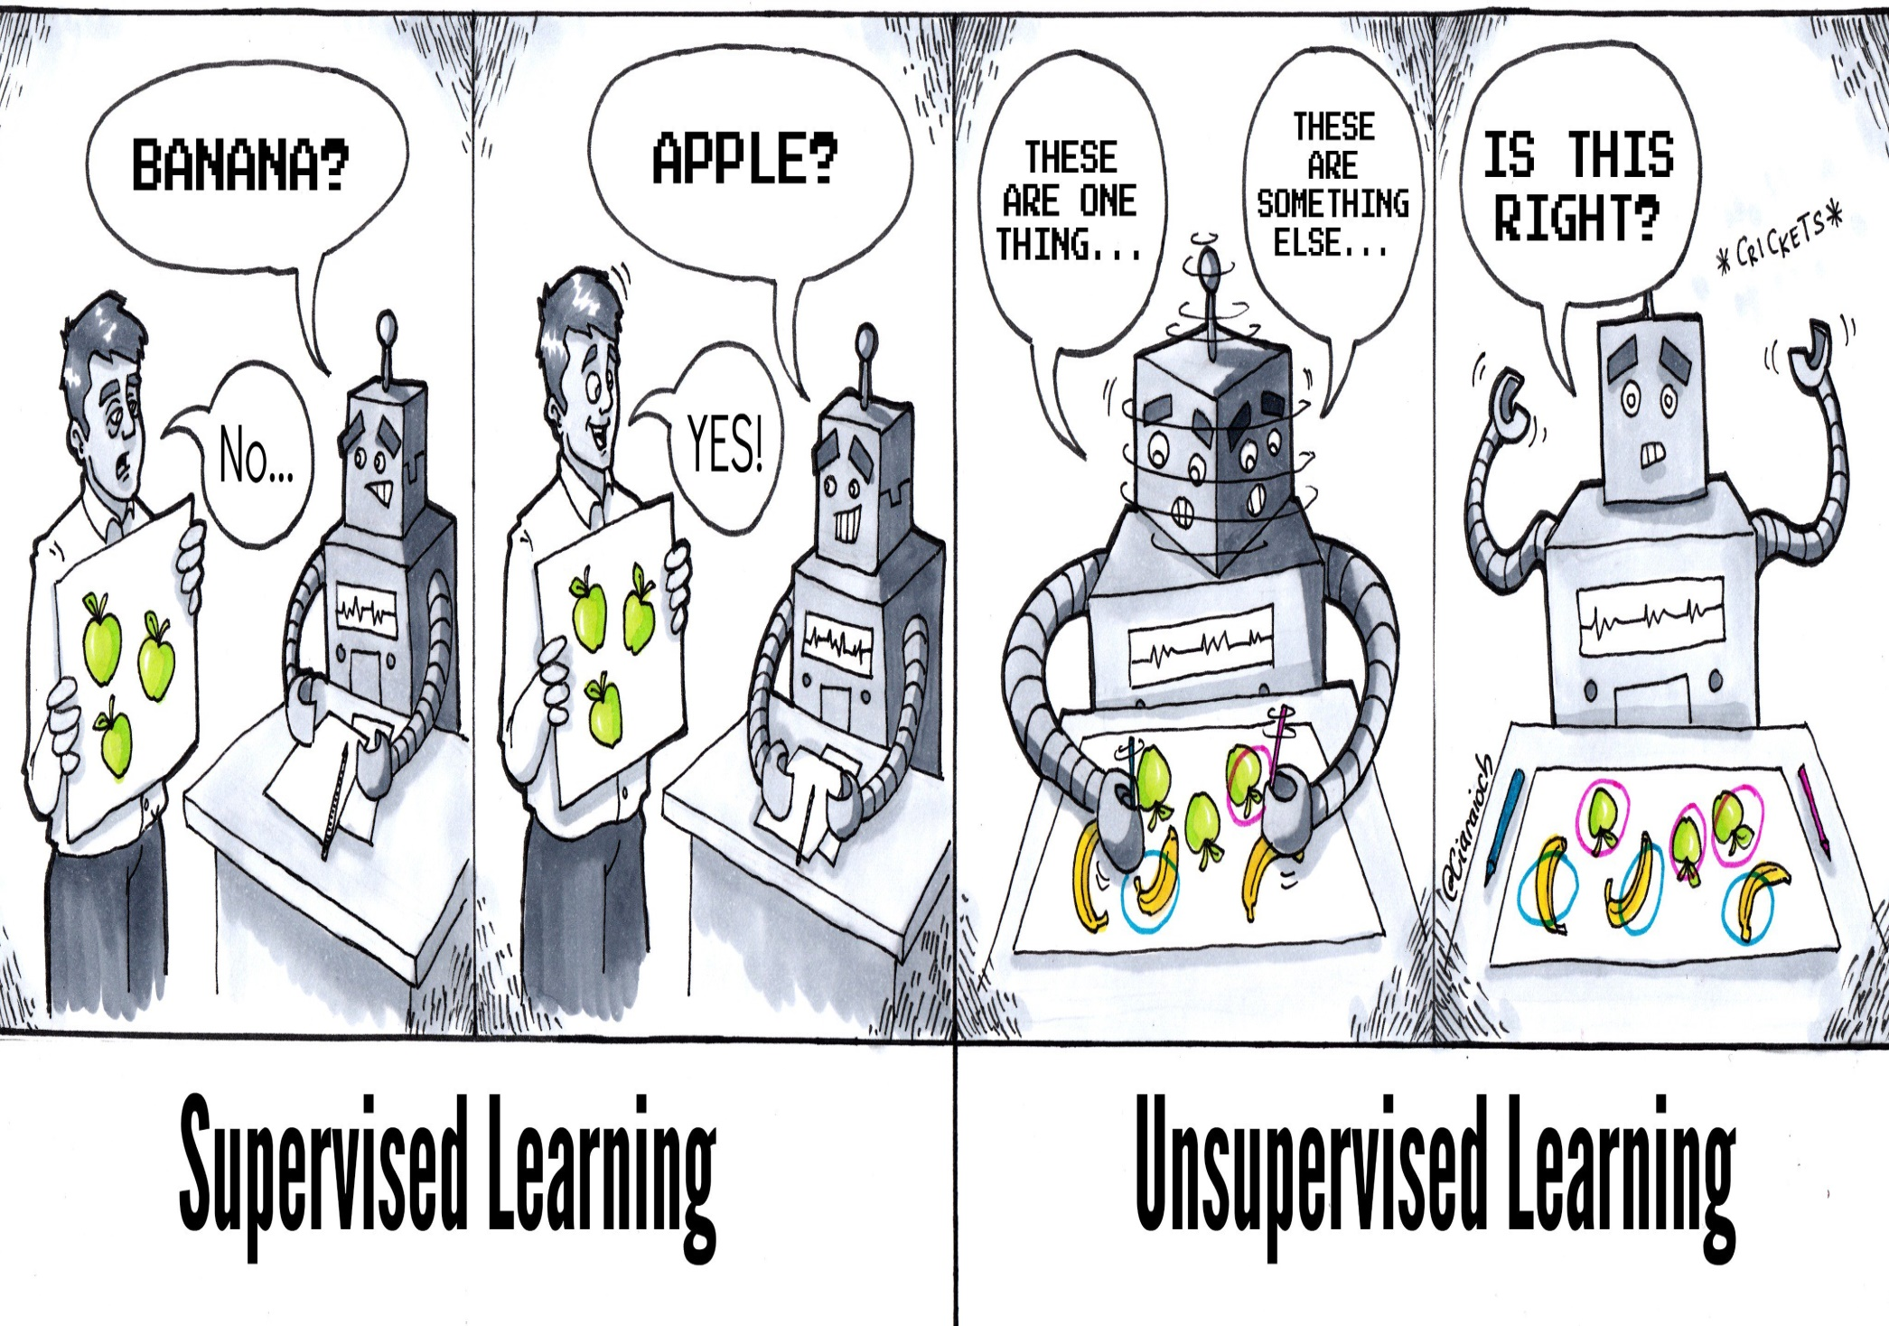
Contd..

Slide 38
Comparison of Supervised and Unsupervised Learning

Slide 39
Contd..
3. Reinforcement Learning:
In this Reinforcement Learning, the agent interacts with its environment by producing actions and
discover errors on rewards.

Slide 40
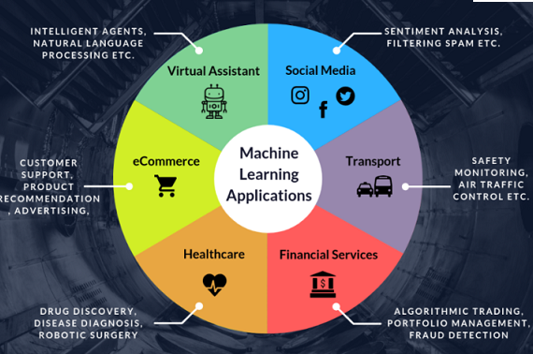
Applications of Machine Learning

Slide 41
ML in Project Management
Handwritten Digits Recognition
Optimal Path
Automatic Attendance System
Sentimental Analysis using Machine Learning
Classification of Iris Flowers
Gender and Age Prediction

Slide 42
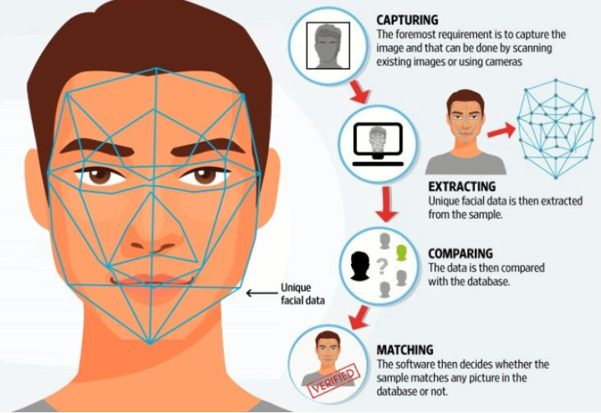
Face Recognition

Slide 43
Learning beyond Curriculum
1.Coursera
2.NPTEL
3.MIT Online Certification Courses

Slide 44
AI For Everyone
IBM Applied AI Professional Certificate
Machine Learning
Introduction to Artificial Intelligence (AI)
IBM AI Engineering Professional Certificate
Mathematics for Machine Learning Specialization
Advanced Machine Learning with Tensor Flow on Google Cloud Platform Specialization…… etc

Slide 45
1. Introduction to Artificial Intelligence
2. Introduction to Machine Learning -
IIT Kharagpur

Slide 46
Ethics of AI: Safeguarding Humanity.
Modeling and Optimization for Machine Learning.
Machine Learning for Healthcare.
Reinforcement Learning.
Advances in Imaging and Machine Learning: Medical, VR-AR, and Self-Driving Cars

Slide 47
Role of this course in Higher Studies
Higher Studies
India (M.Tech) / Overseas (MS):
Most IIT, IIM, IIIT & Universities
M. Tech - CSE
M. Tech – AI & ML

Slide 48
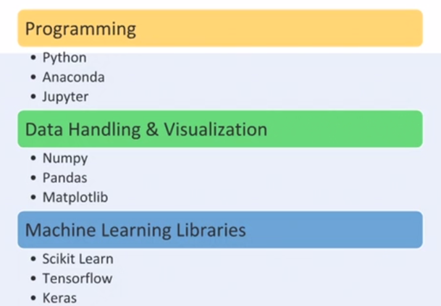
Tools used for Machine Learning

Slide 49
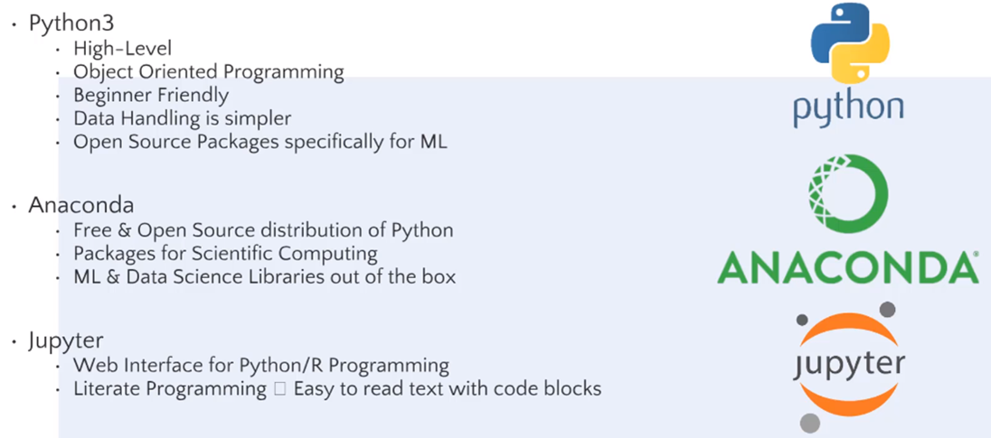
Programming Tools

Slide 50
Data Handling in Python

Slide 51
Machine Learning Libraries

Slide 52
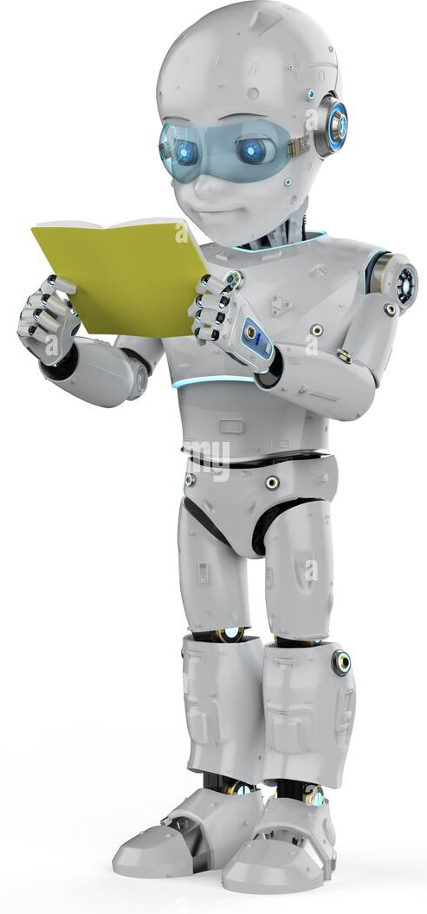
THANK YOU

