Slide 1
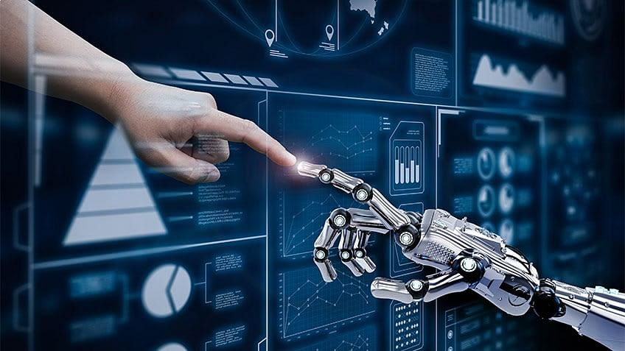
UNIT-I (Fundamentals of Deep Networks)

Slide 2
Deep Learning
Topics :
What is Deep Learning?
History of Deep Learning.
Reasons for using Deep Learning
Advantages and Disadvantages

Slide 3
INTRODUCTION
Deep learning is a type of machine learning and artificial intelligence (AI) that imitates the way humans gain certain types of knowledge.
Deep learning is an important element of data science, which includes statistics and predictive modeling.
It is extremely beneficial to data scientists who are tasked with collecting, analyzing and interpreting large amounts of data. deep learning makes this process faster and easier.

Slide 4
Contd..
Deep learning can be thought of as a way to automate predictive analytics. While traditional machine learning algorithms are linear, deep learning algorithms are stacked in a hierarchy of increasing complexity and abstraction.

Slide 5
Contd..
Most of us know Deep Learning to be a 21st Century invention, but believe it or not, it has been around since the 1940s.
A broader look at the history of Deep Learning reveals 3 major waves of advancements:
Cybernetics — During 1940–1960
Connectionism — During 1980–1990
Deep Learning — Since 2006

Slide 6
History of Deep Learning

Slide 7
Contd..

Slide 8
Contd..
1. Cybernetics: Is the earliest predecessor of modern Deep Learning, based on the idea of biological learning — how human brains learn. Advancements done in the name of cybernetics were based on the goal to replicate the working of a human/animal brain in a simpler computational model, which would help build systems that would start learning like actual brains and provide conclusions given some input.

Slide 9
Contd..
Cybernetics was kicked off by the development of the McCulloch-Pitts Neuron.
It was an attempt to mimic the biological neuron. It was based on a linear model that would take various inputs [X1, X2 …. Xn], for each input the model had some weights [W1, W2 … Wn] and the
output f(x,w) = X1W1 + X2W2 + …. + XnWn.
This model could only output True/False based on the inputs and weights.

Slide 10
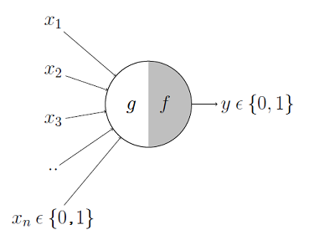
Contd..

Slide 11
Contd..

Slide 12
Contd..
Later in the 1950s, Perceptron was developed by Frank Rosenblatt, an American psychologist, that would learn the weights automatically.
Perceptron was initially designed to be an electrical machine rather than a program/software.
Frank built Perceptron for image recognition, it contained photocells(receivers) connected to multiple neurons which would classify the inputs captured by the photocells.

Slide 13
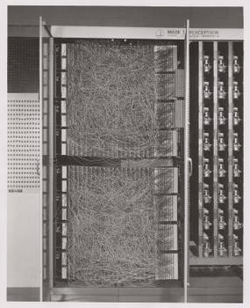
Contd..

Slide 14
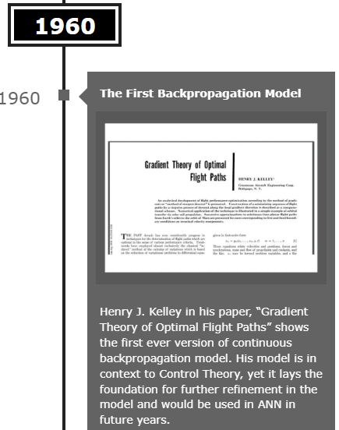
Contd..

Slide 15
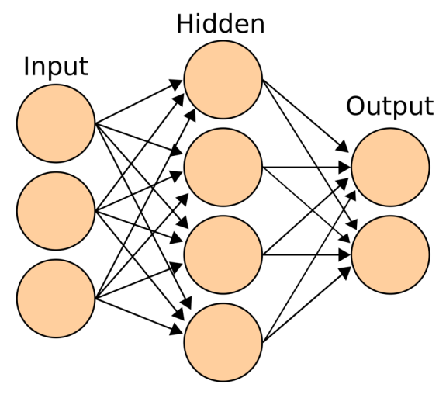
Contd..
2. Connectionism: Concept of Artificial Neural Network(ANNs) was introduced during this wave. The main idea behind ANNs was to develop a network of individual units that can be programmed to achieve intelligent behaviour. This was the first time the concept of hidden layers was introduced.

Slide 16
Contd..

Slide 17
Contd..

Slide 18
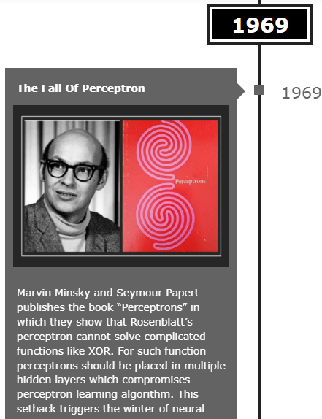
Contd..

Slide 19
Contd..

Slide 20
Contd..

Slide 21
Contd..

Slide 22
Contd..

Slide 23
Contd..

Slide 24
Contd..

Slide 25
Contd..

Slide 26
Contd..

Slide 27
Contd..

Slide 28
Contd..

Slide 29
Contd..

Slide 30
Contd..

Slide 31
Contd..

Slide 32
Contd..

Slide 33
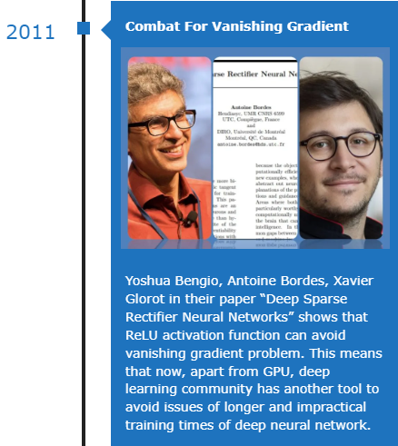
Contd..

Slide 34
Contd..

Slide 35
Contd..

Slide 36
Contd..

Slide 37
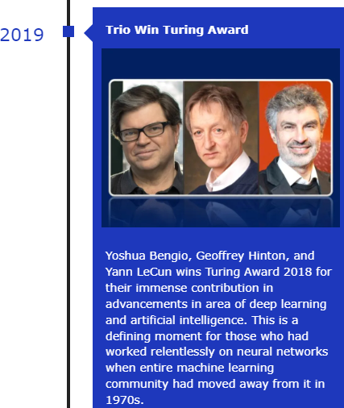
Contd..

Slide 38
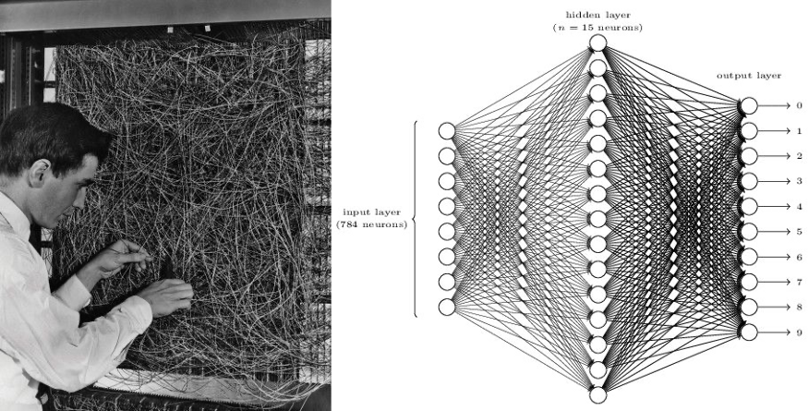
Real Time Scenario

Slide 39
Reasons for using Deep Learning
1. Analyzing unstructured data: Deep learning algorithms can be trained to look at text data by analyzing social media posts, news, and surveys to provide valuable business and customer insights.
2. Data labelling: Deep learning requires labeled data for training. Once trained, it can label new data and identify different types of data on its own.
3. Feature engineering: A deep learning algorithm can save time because it does not require humans to extract features manually from raw data.

Slide 40
Contd..
4. Efficiency: When a deep learning algorithm is properly trained, it can perform thousands of tasks over and over again, faster than humans.
5. Training: The neural networks used in deep learning have the ability to be applied to many different data types and applications. Additionally, a deep learning model can adapt by retraining it with new data.

Slide 41
Advantages and disadvantages
Advantages of Deep Learning :
No need for feature engineering.
DL solves the problem on the end-to-end basis.
Deep learning gives more accuracy.
Disadvantages of Deep Learning :
DL needs high-performance hardware.
DL needs much more time to train.
It is very difficult to assess its performance in real world applications.
It is very hard to understand.

Slide 42
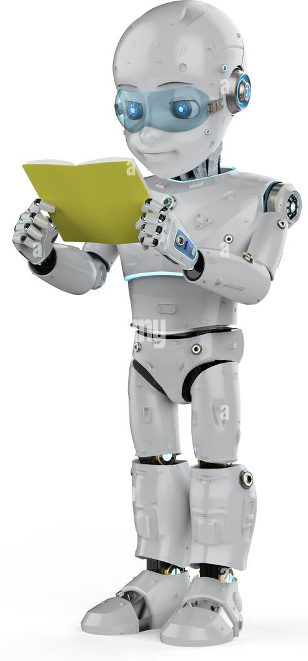
THANK YOU

