Slide 1
Working with Node Packages

Slide 2
What Are NPM?
Node Package Manager
Node Package Modules

Slide 3
What Are Node Packaged Modules?
Understanding the Node Package Registry
Using the Node Package Manager
Searching for Node Package Modules
Installing Node Packaged Modules
Using package.json
Creating a Node.js Application

Slide 4
Working with Node Packages
One of the most powerful features of the Node.js framework is the ability to easily extend it with additional Node Packaged Modules (NPMs) using the Node Package Manager (NPM).
What Are Node Packaged Modules?
A Node Packaged Module is a packaged library that can easily be shared, reused, and installed in different projects.
The Mongoose module provides an ODM (Operational Data Model) for MongoDB, Express extends Node’s HTTP capabilities, and so on
Node.js modules are created by various third-party organizations to provide the needed features that Node.js lacks out of the box.

Slide 5
Node Packaged Modules include a package.json file that defines the packages.
The package.json file includes informational metadata & control metadata
The informational metadata - name, version author, and contributors.
The control metadata, - dependencies and other requirements that the Node Package Manager uses when performing actions such as installation and publishing.

Slide 6
1) Understanding the Node Package Registry
The Node modules have a managed location called the Node Package Registry where packages are registered.
This allows you to publish your own packages in a location where others can use them as well as download packages that others have created.
The Node Package Registry is located at https://npmjs.com.

Slide 7
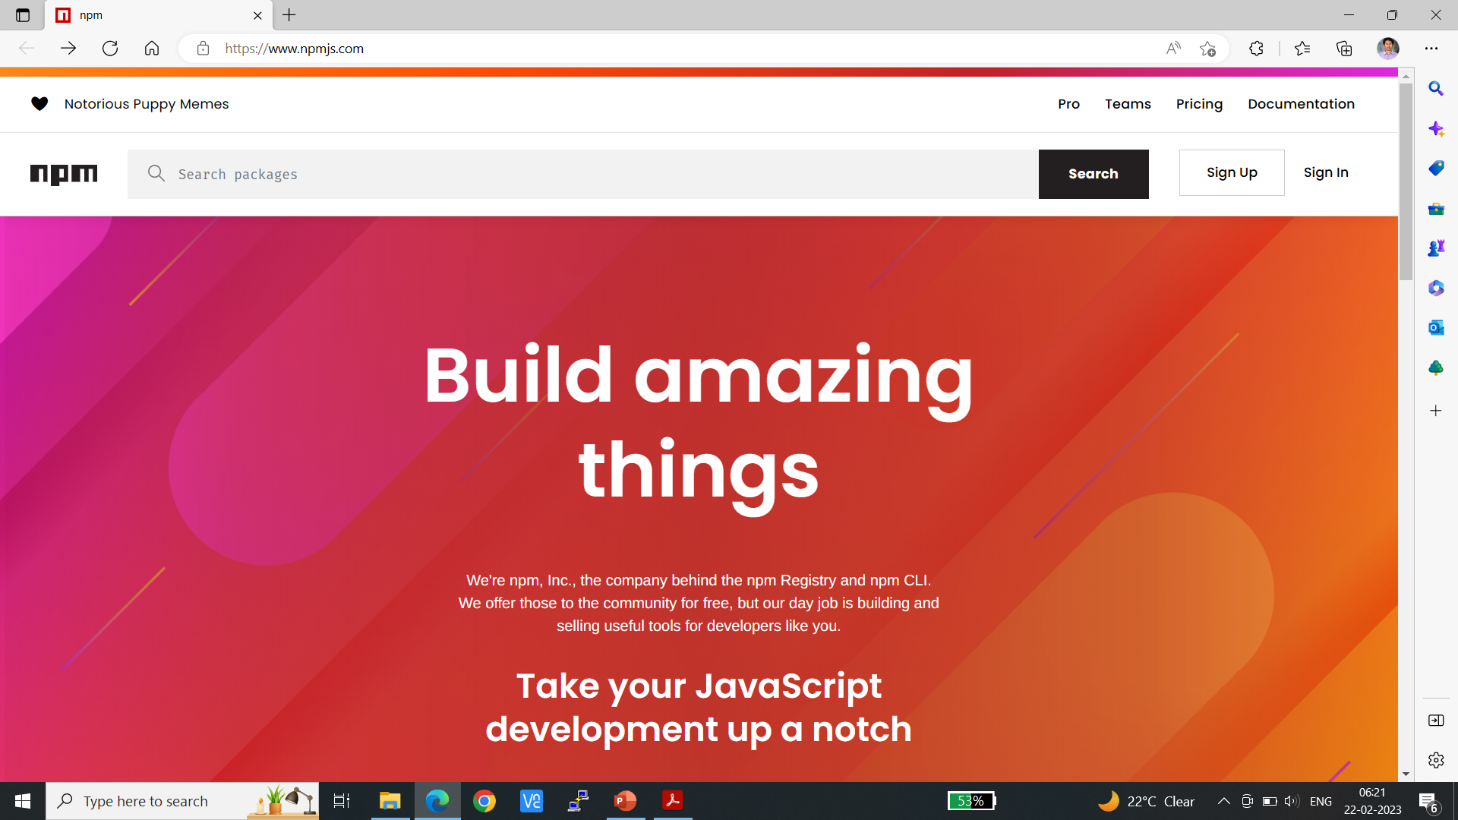

Slide 8
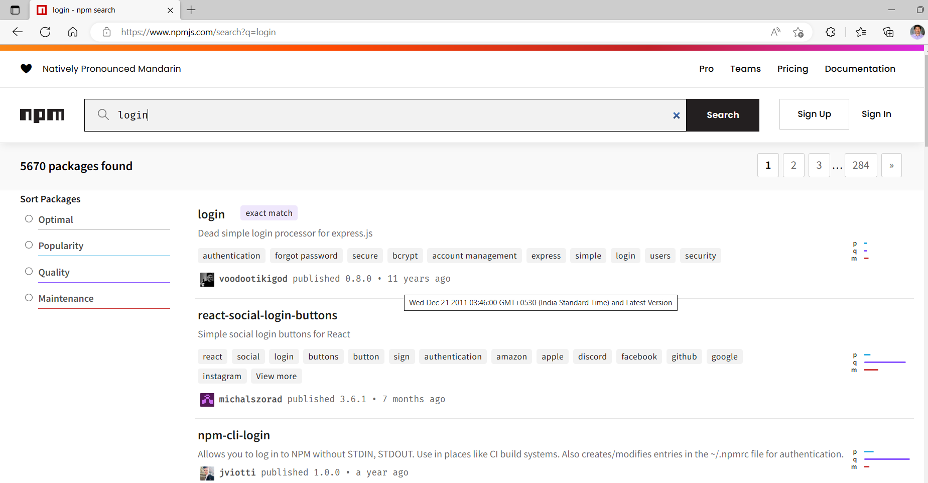

Slide 9
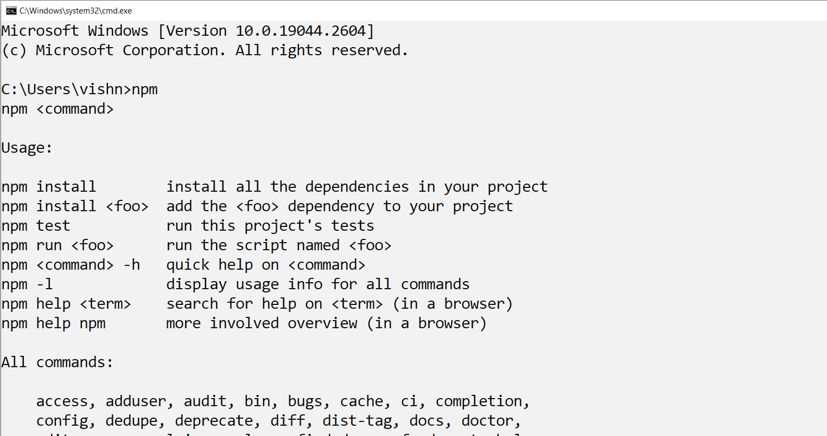
2) Using the Node Package Manager

Slide 10
Some of the Node Package Manager commands:

Slide 13
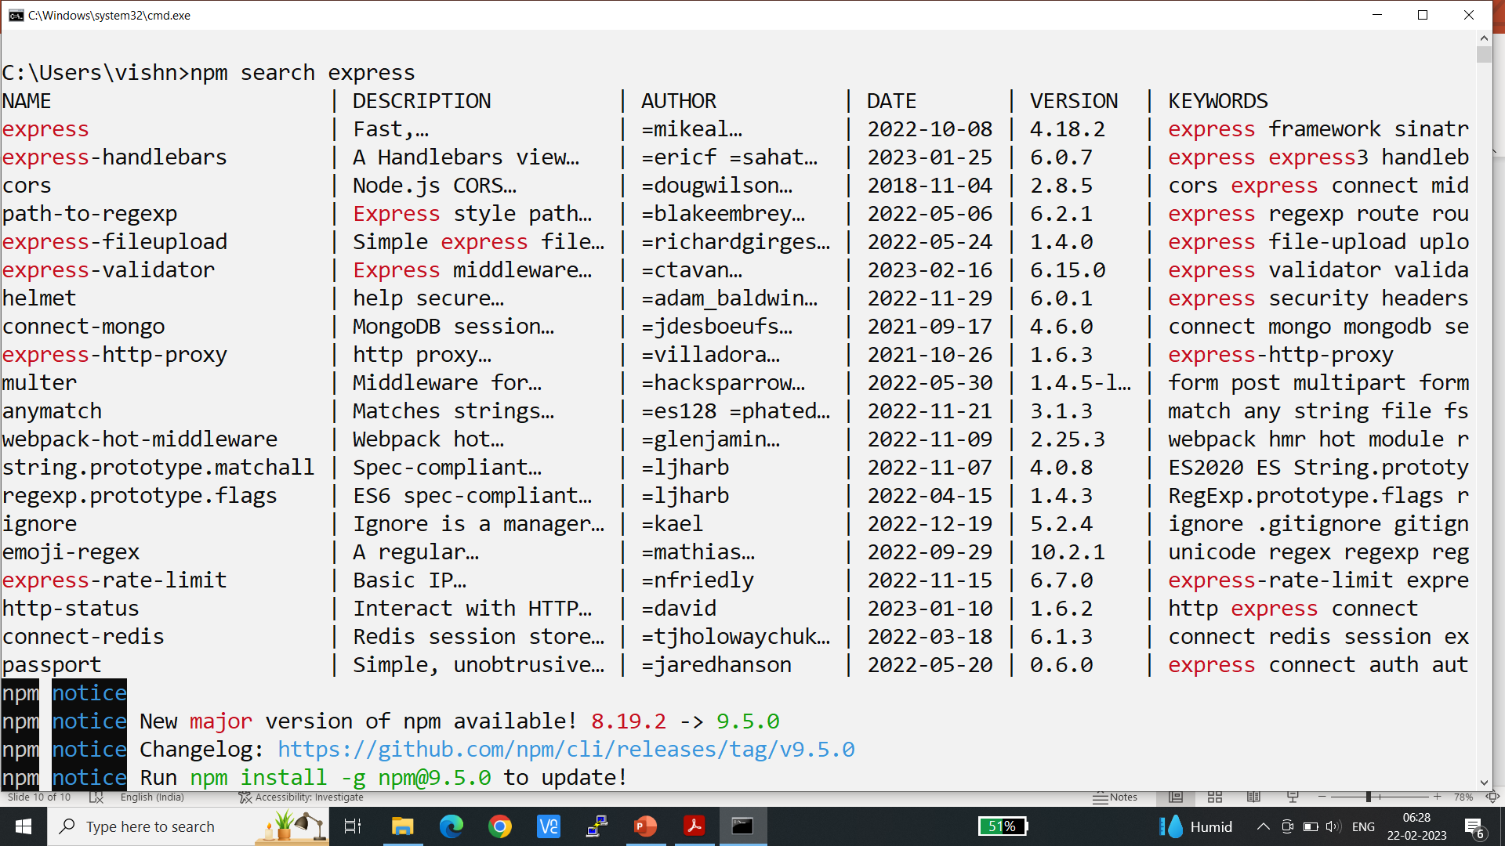
3) Searching for Node Package Module
You can also search for modules in the Node Package Registry directly from the command prompt using the npm search <search_string> command.

Slide 14
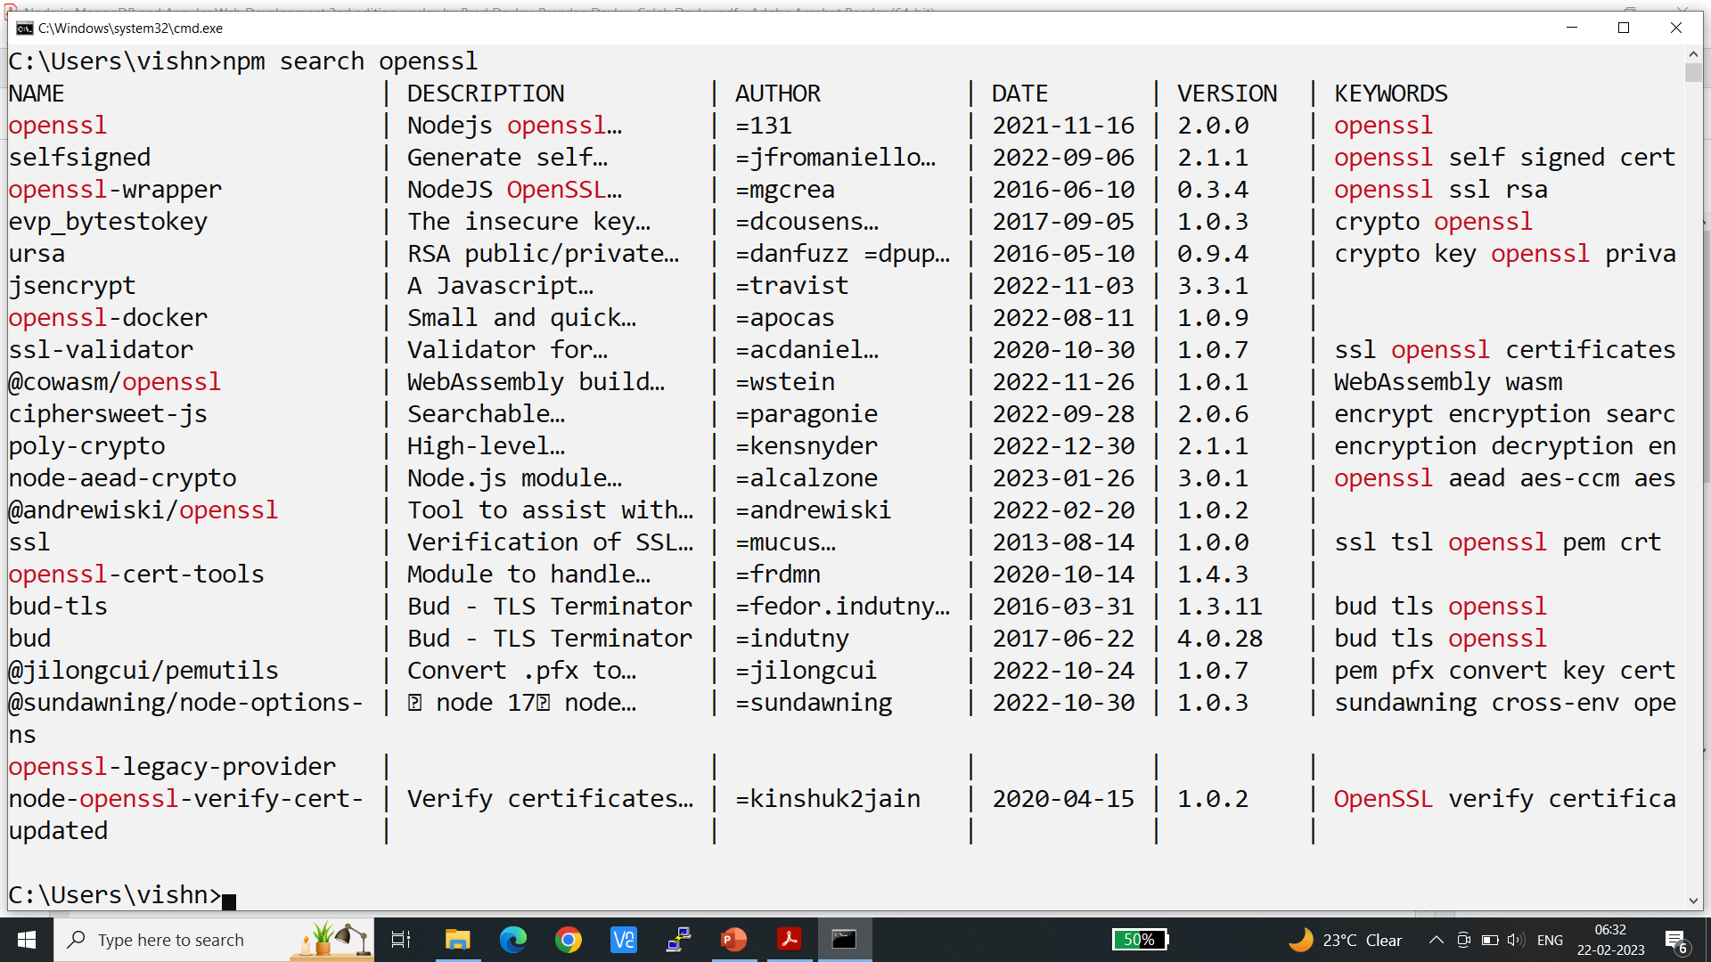

Slide 15
4) Installing Node Package Modules
To use a Node module in your applications, it must first be installed where Node can find it.
To install a Node module, use the npm install <module_name> command.
This downloads the Node module to your development environment and places it into the node_modules folder where the install command is run.

Slide 16
For example, the following command installs the express module:
npm install express

Slide 20
some of the methods Express requires are cookie-signature, range-parser, debug, fresh, cookie, and send modules.
Each of these was downloaded during the install.
Node.js has to be able to handle dependency conflicts.
For example, the express module requires cookie 0.3.1, but another module may require cookie 0.3.0.
To handle this situation, a separate copy for the cookie module is placed in each module’s folder under another node_modules folder.

Slide 21
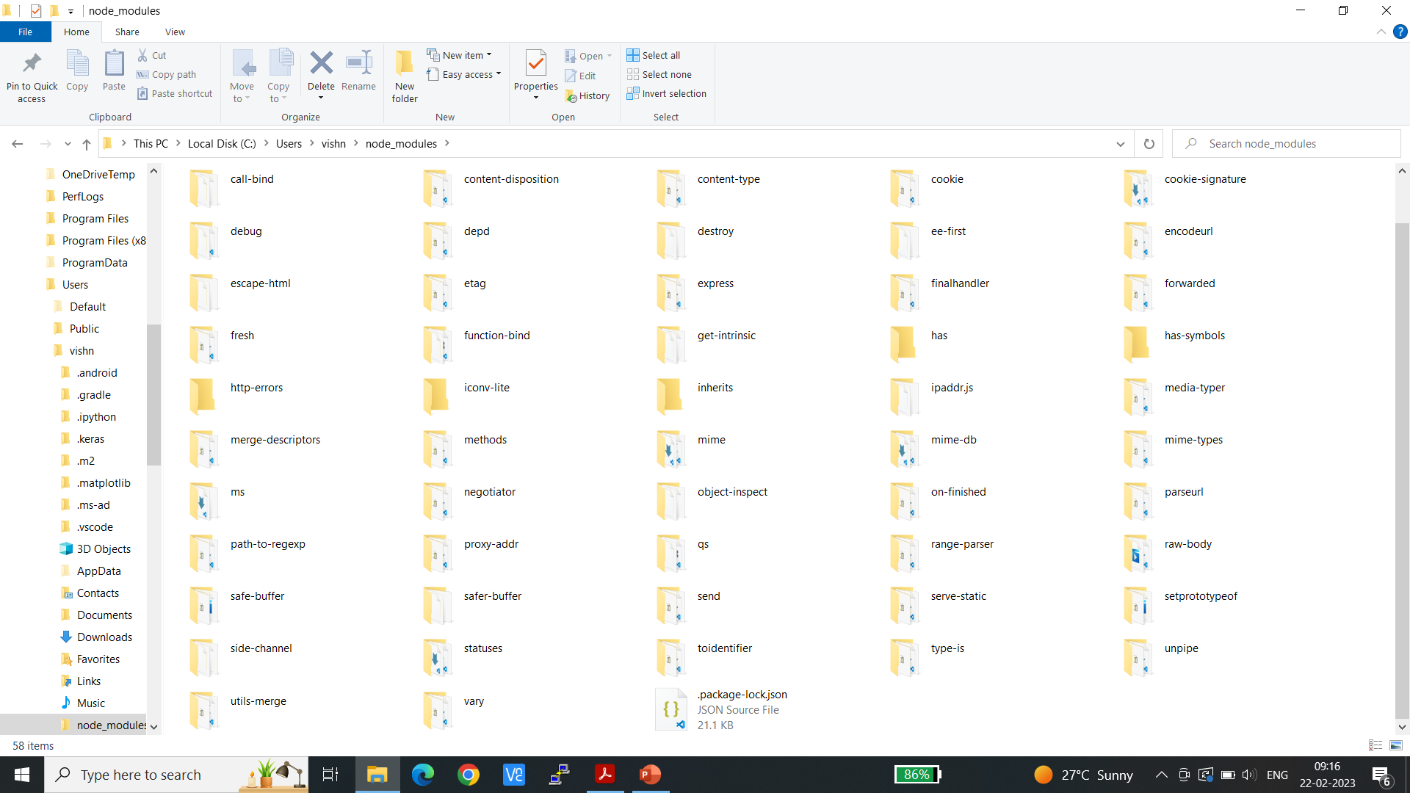
5) Using package.json
All Node modules must include a package.json file in their root directory.

Slide 22
The package.json file is a simple JSON text file that defines the module including dependencies.
The package.json file can contain a number of different directives to tell the Node Package Manager how to handle the module
The following is an example of a package.json file with a name, version, description, and dependencies:

Slide 24
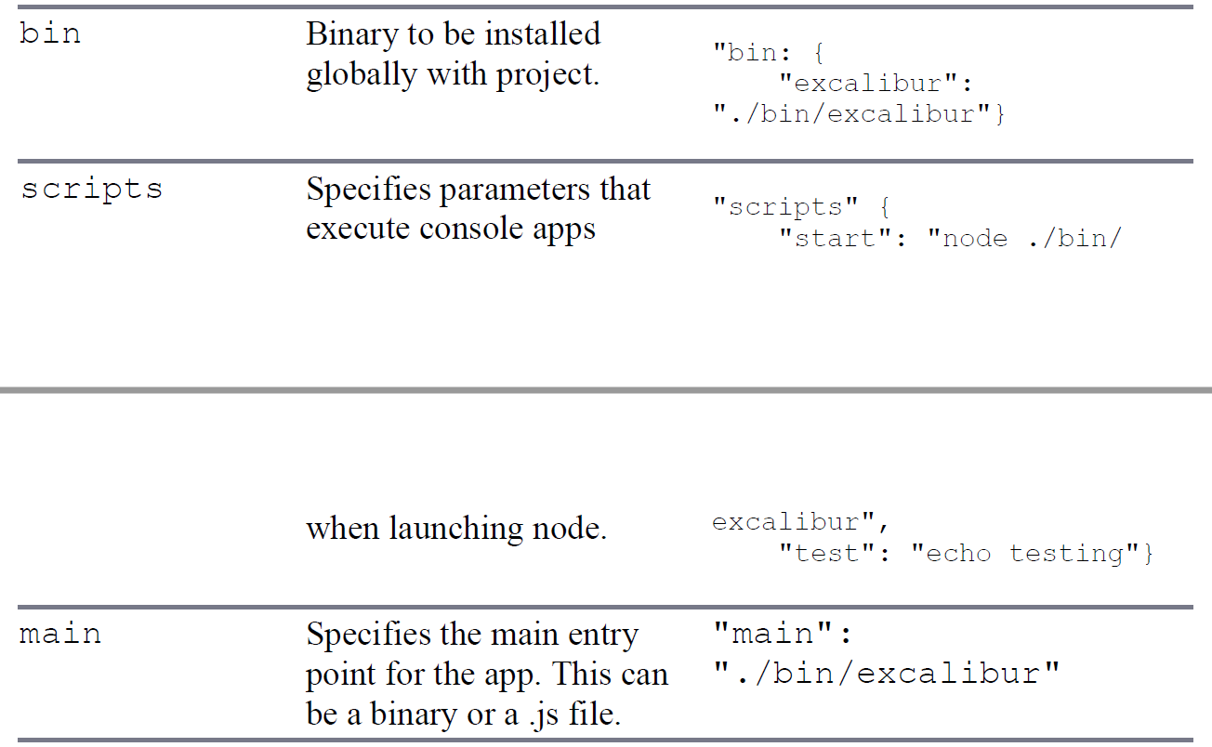

Slide 26
A great way to use package.json files is to automatically download and install the dependencies for your Node.js app.
All you need to do is create a package.json file in the root of your project code and add the necessary dependencies to it.

Slide 27
Then you run the following command from root of your package, and the express module is automatically installed.
npm install
Notice that no module is specified in the npm install. That is because npm
looks for a package.json file by default. Later, as you need additional modules, all you need to do is add those to the dependencies directive and then run npm install again.

Slide 28
6) Creating a Node.js Application
Create your own Node Packaged Module and then use that module as a library in a Node.js application
how to create a package, publish it, and then use it again.
6.1 Creating a Node.js Packaged Module
To create a Node.js Packaged Module you need to create the functionality in JavaScript
Define the package using a package.json file, and then either publish it to the registry or package it for local use

Slide 29
Writing Data to the Console
One of the most useful modules in Node.js during the development process is the console module.
This module provides a lot of functionality when writing debug and information statements to the console.
The console module allows you to control output to the console, implement time delta output, and write tracebacks and assertions to the console.

Slide 30
Lists the functions available in the console module

Slide 31
