Slide 1
Basic components of a Computer System

Slide 2
Basic components of a Computer System INPUT
Input: Any data or instruction entered into the memory of a computer
Example:
entering data/information into computer memory
Clicking on an area on the computer screen
Input Devices: Any hardware component allows user to enter data and instructions into a computer
Key board, Mouse, MIC, Web Camera, Touch pad,

Slide 3
Basic components of a Computer System Output
Output: The results of computation are sent to the outside world.
Example:
Displays result of a computation on a monitor
Plays a music on the speakers
Produces hard copy of the information
Output Devices: It supplies information and results of computation to the outside world.
Monitor, Printer, Speaker, Projector

Slide 4
Basic components of a Computer System C.P.U
The CU and ALU are jointly known as C.P.U
It is also knowns Mind/Brain of the computer.
Its main function is to execute the programs and to control the working of the entire system.
C.P.U has three parts
A.L.U
C.U
Memory

Slide 5
Basic components of a Computer System C.P.U
A.L.U
This unit uses arithmetic functions and logical operations on data.
It receives data from memory and returns the information after processing to the memory.
It contains an electronic unit that is capable of calculating binary arithmetic.
C.U
It controls and operates the functions of the hardware.
It controls Input , Output , Memory and A.L.U.
It obtains information from the memory to execute the program.
By converting instructions into Electric signals, it reaches the appropriate devices.

Slide 6
Basic components of a Computer System C.P.U
Memory: It stores the instructions received by Input Device in the computer.
Main Memory: Data is stored temporarily while program is running.
Main Memory are of two types: RAM & ROM
RAM: Memory that is used by the program in execution. If the computer turned off, RAM will lose all the data. (volatile)
ROM: Memory which we can only read but cannot write on. Used to store some firmware programs. (Non-volatile)

Slide 7
Basic components of a Computer System C.P.U
Secondary Memory: To store data for long-term, to preserve programs and data while not in use
It is the permanent memory of the system. More storage capacity.
Magnetic Disks: Floppy Disks, Hard Disks,
Optical Disks: CD-ROM, CD-R, CD-RW, DVD-ROM

Slide 8
Computer System Architecture
Computer system can be divided into four components:
Hardware – provides basic computing resources
Operating Systems – controls and coordinates use of hardware among various applications and users.
Application Programs – define the ways in which the system resources are used to solve the computing problems of the users. (MS-Word, Web Browsers, Video Games)
Users – People, Machines, other computers

Slide 9
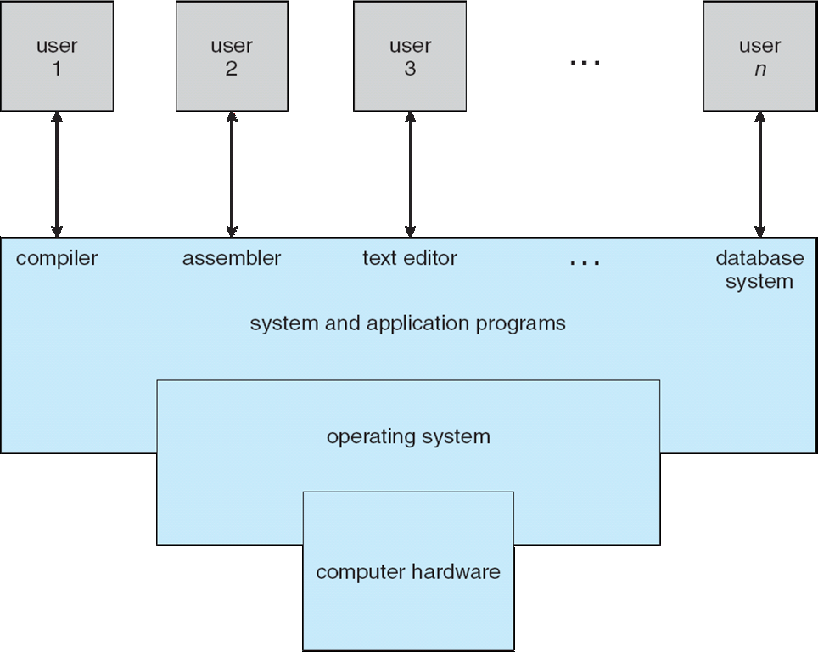
Four components of a Computer System Architecture

Slide 10
What is an Operating System ?
A program that acts as an intermediary between a user of a computer and the computer hardware
Operating system goals:
Execute user programs and make solving user problems easier
Make the computer system convenient to use
Use the computer hardware in an efficient manner

Slide 11
What Operating Systems Do
Depends on the point of view
Users want convenience, ease of use and good performance
Don’t care about resource utilization
But shared computer such as mainframe or minicomputer must keep all users happy
Users of dedicate systems such as workstations have dedicated resources but frequently use shared resources from servers
Handheld computers are resource poor, optimized for usability and battery life
Some computers have little or no user interface, such as embedded computers in devices and automobiles

Slide 12
Operating System Definition
OS is a resource allocator
Manages all resources
Decides between conflicting requests for efficient and fair resource use
OS is a control program
Controls execution of programs to prevent errors and improper use of the computer
The one program running at all times on the computer” is the kernel.
Everything else is either
a system program (ships with the operating system) , or
an application program.

Slide 13
Open-Source Operating Systems
Operating systems made available in source-code format rather than just binary closed-source
Counter to the copy protection and Digital Rights Management (DRM) movement
Started by Free Software Foundation (FSF), which has “copyleft” GNU Public License (GPL)
Examples include GNU/Linux and BSD UNIX (including core of Mac OS X), and many more
Can use VMM like VMware Player (Free on Windows), Virtualbox (open source and free on many platforms - http://www.virtualbox.com)
Use to run guest operating systems for exploration

Slide 14
Why should you learn about LINUX?
Linux is a collection of operating systems.
The generic term Linux describes any number of thousands of variations of Linux Operating Systems that all fit under umbrella.
Linux is used everywhere.
If you are using the internet at all, you are already using Linux in your daily life.
Most of the World Wide Web, banking systems, applications your are used to using are all powered by Linux.
Smart Televisions and Smart Systems that are integrated into your daily life, can have their foundation or even back-end systems such as Cloud services run within Linux Infrastructures.

Slide 15
Why should you learn about LINUX?
In the modern datacenter, Linux and MS Windows are the major players.
Some of the reasons to learn Linux are:
If you are a window’s person, you’ll need to interoperate with Linux.
If you are doing application development, it’s likely your application or its runtime will be hosted on Linux.
If you are working in the cloud, your cloud instances may be based on Linux.
If you are working with mobile applications or the Internet of Things (IoT), the chances are great that the operating system of your device will be based on Linux.

Slide 16
What makes Linux Great ?
Linux is open source software
Improvements are easier to make, enabling faster innovation.
Easy access to a powerful and scriptable command-line-interface (CLI)
This enables easier automation, deployment, and simplifies both local and remote system administration.
Linux is modular and operating system components can be easily replaced or removed
A Linux system can be a general-purpose development workstation, or an extremely stripped-down software appliance.

Slide 17
What is Open Source Software ?
Open source software is software with source code that anyone can use, study, modify, and share.
Source code is the set of human-readable instructions that are used to make a program. This may be interpreted as a script, or compiled into a binary executable which the computer runs directly.
All source code is copyrighted from the moment it is created. Whether it can be distributed as source or binary executables is under the control of the copyright holder. Therefore, software is provided to users under a software license.

Slide 18
What is Open Source Software ?
Some software has source code that only the person, team, or organization that created it can see, or change, or distribute. This is sometimes called "proprietary" or "closed source" software.
Typically the license only allows the end user to run the program, and provides no access, or tightly limited access, to the source.
Open source software is different. When the copyright holder provides software under an open source license, they grant the user the right to run the program and also to view, modify, compile, and redistribute the source royalty-free to others.
Open source promotes collaboration, sharing, transparency and rapid innovation because it encourages people beyond the original developers to make modifications and improvements to the software and to share it with others.

Slide 19
Open Source can be used for Commercial Purpose
Just because software is open source does not mean it is somehow not able to be used or provided commercially.
Open source is a critical part of many organizations' commercial operations.
Some open source licenses allow code to be reused in closed source products.
Open source code can be sold, but the terms of true open source licenses generally allow the customer to re-distribute the source code.
Most commonly, vendors like Red Hat can provide commercial help with deploying, supporting, and extending solutions based on open source products.

Slide 20
Benefits of Open Source Software?
Control: See what the code does and change it to make it better.
Training: Learn from real-world code and develop more effective applications.
Security: Inspect sensitive code, fix with or without the original developers' help.
Stability: Code can survive the loss of the original developer or distributor

Slide 21
Types of Open Source Licenses
Copyleft licenses: are designed to encourage keeping code open source.
anyone who distributes the source code, with or without changes, must also pass along the freedom for others to also copy, change and distribute the code.
Advantage: it helps to keep existing code and improvements to that code, open and add to the amount of open source code available.
Permissive licenses: that are designed to maximize code reusability
Users can use the source for any purpose as long as the copyright and license statements are preserved, including reusing the code under more restrictive or even proprietary licenses.
This make it very easy for this code to be reused, but at the risk of encouraging proprietary–only enhancements.

Slide 22
Who develops Open Source ?
Open Source Software is powered by the communities behind them.
Communities are compromised of individual users as well as enterprises who adapted that software alike. This leads to a large number of users who end up contributing to the codebase itself to ensure the stability and reusability of the products that they’re enhancing.
Many developers are paid by their organizations to work with open source projects to construct and contribute the enhancements they and their customers need.

Slide 23
Who develops Open Source ?

Slide 24
Who develops Open Source ?
You can see a list of companies that have made corporate contributions to Linux.
These companies are across all sectors, and see it in their interest to enhance the codebase that they run within their walls.
Companies like Red Hat enhances products like Red Hat Enterprise Linux. They share that enterprise level code with one and all who adopt the product.
You can see a large number of companies in this graph alone, who found it in their best interest to enhance different open source software and share those enhancements with the world at large.
All of these companies simultaneously benefit from the community of users outside their walls who are doing the same, enhancing and fixing bugs within the products they've adopted to run in their enterprise situations.

Slide 25
Who is Red Hat ?
Red Hat is the world's largest distribution in the enterprise sector called Red Hat Enterprise Linux. This software is used to power some of the world's largest Clouds, infrastructure, web-based servers, middleware, storage solutions, and virtualization technologies.
Red Hat's mission is to be the catalyst in communities of customers, contributors, and partners creating better technology the open source way.
Red Hat's role is to help customers connect with the open source community and our partners in order to effectively use open source software solutions.
Red Hat is most well-known for our participation in the Linux community and the Red Hat Enterprise Linux distribution

Slide 26
What is a Linux Distribution ?
A Linux distribution itself is an installable operating system constructed from a Linux Kernel and supporting user programs and libraries.
A complete Linux Operating system is not developed by a single organization, but by a collection of independent open source development communities working with individual software components.
The beginning of Linux distributions all started with the Kernel. The Kernel serves as the main brain of the operating system that any version of Linux would run. Kernel manages hardware, memory, and scheduling of running programs.
This Linux kernel could then be supplemented with other open source software, such as the utilities and programs from the GNU Project, the graphical interface from MIT's X Window System, and many other open source components such as the Sendmail mail server or the Apache HTTPD web server, in order to build a complete open source Unix-like operating system.

Slide 27
What is a Linux Distribution ?
Linus Torvalds is the creator of the very first Linux Kernel adapted from the existing Unix-like Kernels of its day.
However, one of the challenges for Linux users was to assemble all these pieces from many different sources. Very early in its history, Linux developers began working to provide a distribution of prebuilt and tested tools that users could download and use to quickly set up their Linux systems.
Many different Linux distributions exist, with differing goals and criteria for selecting and supporting the software provided by their distribution.
Some of the common characteristics of Linux Distribution:
A distribution consists of a Linux kernel and supporting user space programs.
A distribution may be small and single-purpose or include thousands of open source programs.
Some means of installing and updating the distribution and its components should be provided.
The vendor should support that software, and ideally be participating directly in the community developing that software.
Red Hat Enterprise Linux is Red Hat's commercially-supported Linux distribution

Slide 28
Red Hat Enterprise Linux ?
Development of Red Hat Enterprise Linux
Red Hat develops and integrates open source software into Red Hat Enterprise Linux through a multistage process.
Participate in supporting individual open source projects.
Sponsor and integrate open source projects into a community-driven Linux distribution , Fedora.
Stabilize the software to ensure that it’s ready for long term support and standardization and integrate into their enterprise-ready distribution, Red Hat Enterprise Linux
Red Hat Enterprise Linux is Red Hat’s enterprise – ready , commercially supported Linux Distribution.
Red Hat Enterprise Linux is provided through a subscription-based model. Since this is open source software, this is not a license fee. Instead, it pays for support, maintenance, updates, security patches, access to the Knowledgebase at Red Hat Customer Portal
n. The customer is paying for long-term support and expertise, commitment, and assistance when they need it.

Slide 29
Quiz
1. Which of the following are benefits of open source software for the user? (Choose two.)
The code can survive the loss of the original developer or distributor.
The sensitive portions of the code are protected and only available to the original developer.
You can learn from real-world code and develop more effective applications.
The code remains open as long as it is in a public repository but the license may change when included with closed source software.

Slide 30
Quiz
2. How does Red Hat develop their products for the future and interact with the community? (Choose two.)
Sponsor and integrate open source projects into the community driven Fedora project.
Develop specific integration tools only available in Red Hat distributions.
Participate in upstream projects.
Repackage and re-license community products

Slide 31
Quiz
3. Which statements describe benefits of Linux? (Choose two.)
Linux is developed entirely by volunteers making is a low cost operating system.
Linux is modular and can be configured as a full graphical desktop or a small appliance.
Linux is locked in a known state for a minimum of one year for each release making it easier to develop custom software.
Linux includes a powerful and scriptable command line interface enabling easier automation and provisioning.

