Slide 1
UNIT-V (Grid based Methods)

Slide 2
Topics :
Grid based Clustering Method
STING Algorithm

Slide 3
Grid based Clustering
Grid based Clustering using “Multi Resolution grid Data Structure”.
This is the approach in which we quantize the space into a finite number of cells that form a grid structure on which all of the operations for clustering is performed.
Partitioning the data space into a finite number of cells to form a grid structure.
Here we can find the Clusters(Dense Regions) from the cells in the grid structure.
Create a grid structure by dividing the data space into a fixed number of cells. from the grid's cells, identify clusters.

Slide 4
Grid based Clustering

Slide 5
Challenge
uneven data distribution is challenging to handle.
It is plagued by dimensionality, making it challenging to cluster high-dimensional data.

Slide 6
Grid Cell Hierarchy
The spatial area is divided into Rectangular Cells
Each cell forms a Hierarchical Structure.
This means that each cell at a higher level is further divided into 4 smaller cells in the lower cell.
In other words each cell at the ith Level(except the leaves) has 4 children in the i+1 Level
The union of the 4 children cells would back the parent cell in the level above them.
The size of the leaf level cells and the number of layers depends upon the how much granularity or High resolution cells of the user wants.

Slide 7
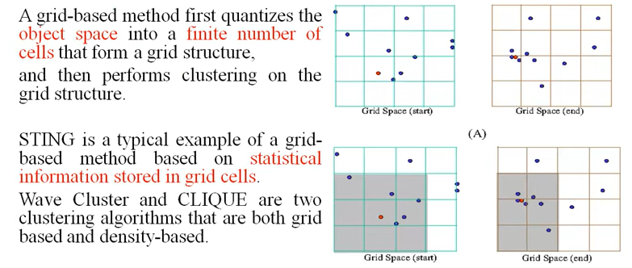
Contd..
There are several methods in Grid based Clustering Approach
STING ( a Statistical Information Grid approach)
CLIQUE ( both grid based and sub space clustering)

Slide 8
STING ( a Statistical Information Grid approach)
STING stands for Statistical Information Grid (STING) based Clustering.
It was developed by Wang et al in 1997 as a method for efficiently clustering large datasets with high-dimensional attributes.
The algorithm uses a grid-based approach to divide the dataset into smaller subspaces or cells based on the values of each attribute.

Slide 9
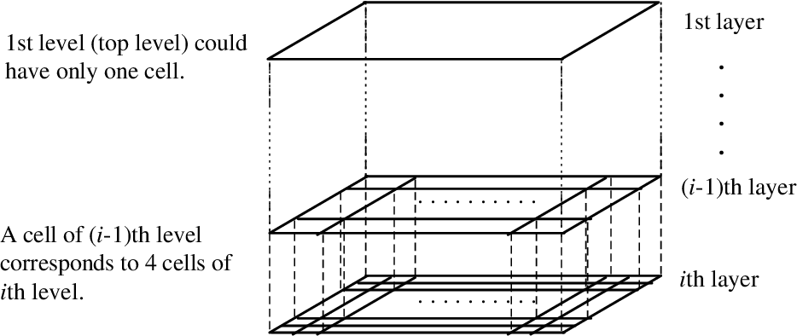
Contd..

Slide 10
Contd..
Each cell in each layer we have:
Attribute Independent Parameter
Eg: count: Number of records in this cell.
Attribute dependent Parameter
Eg: we are assuming that our attribute values are real numbers.

Slide 11
Contd..
Statistical Parameters: The parameters of higher-level cells can be easily calculated from parameters of lower-level cell.
For each attribute of each cell we store the following parameters:
M -> mean of all values of each attribute in this cell.
S -> Standard Deviation of all values of each attribute in this cell.
Min -> The Minimum value for each attribute in this cell.
Max -> The Maximum value for each attribute in this cell.
Distribution -> The type of the distribution that the attribute value in this cell follows: (Eg: normal, exponential etc.)

Slide 12
Contd..
Storing of Statistical Parameters: Statistical information regarding the attributes in each grid cell , for each layer are pre computed and stored before hand.
Here, The statistical parameters for the cells in the lowest layer is computed directly from the values that are present in the table.
The statistical info of each cell is calculated and stored beforehand and is used to answer queries. Here, The statistical parameters for the cells in all the other levels are computed from their respective children cells that are in the lower level.

Slide 13
Contd..
Then using a top-down approach we need to answer spatial data queries.
Then start from a pre-selected layer—typically with a small number of cells.
For each cell in the current level compute the confidence interval.
Now remove the irrelevant cells from further consideration.
When finishing examining the current layer, proceed to the next lower level.
Repeat this process until the bottom layer is reached.

Slide 14
How Does Sting Grid-Based Clustering Work?
STING grid-based clustering works by dividing the dataset into an n-dimensional grid of equal-sized rectangular cells based on their statistical properties, such as mean and standard deviation.
The number of dimensions depends on the number of attributes in the dataset.
Once divided into cells, each cell represents a subset of data points within its boundaries whose values fall within certain ranges for each attribute dimension considered during the partitioning process.

Slide 15
Contd..
The next step involves computing pairwise similarities between adjacent pairs of neighboring cells using the Pearson correlation coefficient or other suitable similarity measure depending upon the nature & type(s) present among analyzed variables.
These similarities are stored in an adjacency matrix, which is used to construct a hierarchical tree using HAC.
The Dendrogram shows the clustering hierarchy and can be cut at any level to obtain clusters of different sizes.

Slide 16
Contd..
Once the grid has been created, STING grid-based clustering uses two main steps to perform clustering:
Density Estimation: For each cell in the grid, calculate its density value based on how many data points fall within it compared to neighboring cells.
Cluster Formation: Starting with cells that have high-density values (i.e., dense regions), merge adjacent cells until no more merges are possible or until some stopping criterion is met (e.g., minimum cluster size).

Slide 17
Contd..
One advantage of STING grid-based clustering is its ability to identify patterns in the dataset quickly
By dividing the spatial area into rectangular cells based on statistical parameters, it becomes easier to see where clusters of similar values are located.

Slide 18
Contd..
For example, if a dataset contains information about crime rates in different neighborhoods within a city, STING grid-based clustering can help identify areas with higher-than-average crime rates.
STING's hierarchical approach also allows for the efficient processing of large datasets. Because each node in the tree corresponds to a cell in space and includes attribute-independent count data and attribute-dependent mean and standard deviation information.
It becomes possible to quickly calculate statistics across all nodes without scanning the entire database multiple times.

Slide 19
THANK YOU

