Slide 1
UNIT-II (Perceptron's)

Slide 2
Topics
Topics :
Perceptron's
Representation of power of Perceptron
Perceptron Training Rule
AND Gate using Perceptron Training Rule
OR Gate using Perceptron Training Rule

Slide 3
Perceptron
A Perceptron is an Artificial Neuron
Frank Rosenblatt (1928 – 1971) was an American psychologist notable in the field of Artificial Intelligence.
In 1957 , he "invented" a Perceptron program, on an IBM 704 computer at Cornell Aeronautical Laboratory.
The Neurons receive input from our senses by electrical signals and store information to make decisions based on previous input.
So, A Perceptron Unit is used to build the ANN System

Slide 4
Contd..
Perceptron is a Machine Learning algorithm for supervised learning of various binary classification tasks.
The original Perceptron was designed to take a number of binary inputs, and produce one binary output (0 or 1).

Slide 5
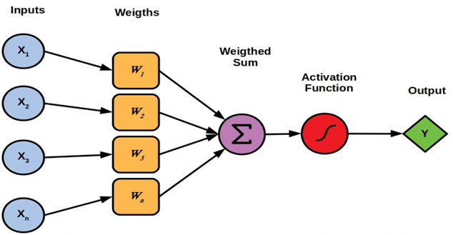
Architecture of the Perceptron
Mr. Frank Rosenblatt invented the perceptron model as a binary classifier.

Slide 6
Contd..
The idea was to use different weights to represent the importance of each input, and that the sum of the values should be greater than a threshold value before making a decision like true or false (0 or 1).

Slide 7
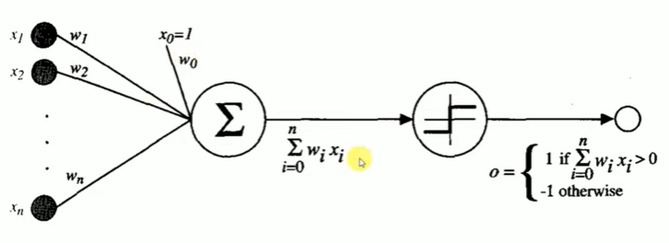

Slide 8
Contd..
More precisely, the given inputs x1 through xn, the output o1(x1,-------xn) computed by the perceptron is
The Perceptron receives multiple input signals, and if the sum of the input signals exceeds a certain threshold, it either outputs a signal or does not return an output.
In the context of supervised learning and classification, this can then be used to predict the class of a sample.

Slide 9
Perceptron Learning Algorithm
Frank Rosenblatt suggested this algorithm:
Step-1: Set a threshold value
Step-2: Multiply all inputs with its weights
Step-3: Sum all the results
Step-4: Activate the output

Slide 10
Working Principle
Here, First, multiply all input values with corresponding weight values and then add them to determine the weighted sum. Mathematically, we can calculate the weighted sum as follows:
∑wi*xi = x1*w1 + x2*w2 +…wn*xn
and that the sum of the values should be greater than a threshold value before making a decision like true or false (0 or 1).
Add a special term called bias 'b' to this weighted sum to improve the model's performance. ∑wi*xi + b

Slide 11
Contd..

Slide 12
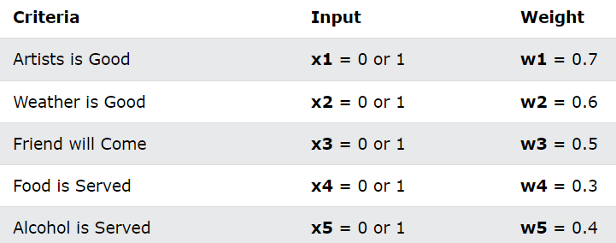
Example
Imagine a perceptron (in your brain).
The perceptron tries to decide if you should go to a concert.
Is the artist good?
Is the weather good?
What weights should these facts have?

Slide 13
Contd..

Slide 14
Contd..
Perceptron Terminology:
1. Inputs : Here Inputs called Nodes
In the above example, the node values are: 1, 0, 1, 0, 1
The binary input values (0 or 1) can be interpreted as (no
or yes) or (false or true).
2. Node Weights: Weights shows the strength of each node.
In the above example, the Weights are 0.7, 0.6, 0.5, 0.3, 0.4

Slide 15
Contd..
3. Activation Function: The activation functions maps the result (the weighted sum) into a required value like 0 or 1.
In the above Example, the activation function is simple: (sum > 1.5)
The binary output (1 or 0) can be interpreted as (yes or no) or (true or false).
Note: It is obvious that a decision is NOT made by one neuron alone.
Threshold Value: We have to define a reliable threshold for the classifier that clearly indicates the split between the two classes.

Slide 16
Contd..
Bias: Model bias refers to the presence of systematic errors in a model that can cause it to consistently make incorrect predictions.
These errors can arise from many sources, including the selection of the training data, the choice of features used to build the model, or the algorithm used to train the model.

Slide 17
Representation of power of perceptron
As we can see, it calculates a weighted sum of its inputs and thresholds it with a step function.
A single perceptron can be used to represent many Boolean functions.
The Boolean Functions , AND, OR, XOR can be solved the Perceptron.
Geometrically, this means the perceptron can separate its input space with a Hyper Plane.
That’s where the notion that a perceptron can only separate linearly separable problems .

Slide 18
Types of Perceptron's:
1. Single Layer Perceptron Model
2. Multi Layer Perceptron Model
1. Single Layer Perceptron Model: The main objective of the single-layer perceptron model is to analyze the linearly separable objects with binary outcomes.
Perceptrons can represent all of the Boolean Functions , AND, OR ,NAND,NOR can be solved the Perceptron
Single Layer perceptron , can only solve Linearly Separable Problems.

Slide 19
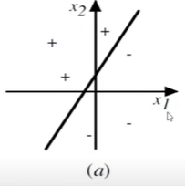
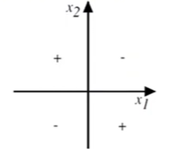
Some of the Boolean Functions cannot represent the Single Perceptron, Such as XOR function is not linearly separable, it really is impossible for a single hyper plane to separate it.
Linearly Separable
Not Linearly Separable

Slide 20
Contd..
2. Multi Layer Perceptron Model: Like a single-layer perceptron model, a multi-layer perceptron model also has the same model structure but has a greater number of hidden layers.
The multi-layer perceptron model is also known as the Back Propagation Algorithm.
Hence, a multi-layered perceptron model has considered as artificial neural networks having various layers in which activation function does not remain linear, similar to a single layer perceptron model.

Slide 21
Contd..
Instead of linear, activation function can be executed as sigmoid, TanH, ReLU, etc., for deployment.
A multi-layer perceptron model has greater processing power and can process linear and non-linear patterns.
Further, it can also implement logic gates such as AND, OR, XOR, NAND, NOT, XNOR, NOR.

Slide 22
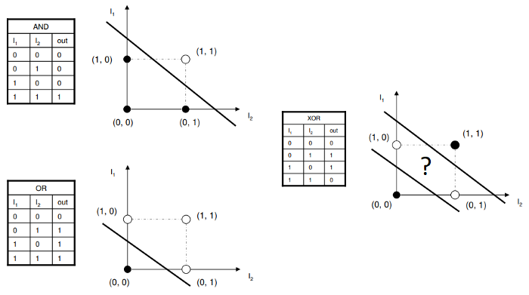
Representation of power of perceptron

Slide 23
Example

Slide 24
Contd..

Slide 25
Contd..
So , the Final weights, b= -0.8 , W1 = 0.7 , W2 = 0.7
By using these weights, All Classified Correctly.

Slide 26
Example

Slide 27
Contd..

Slide 28
Contd..

Slide 29
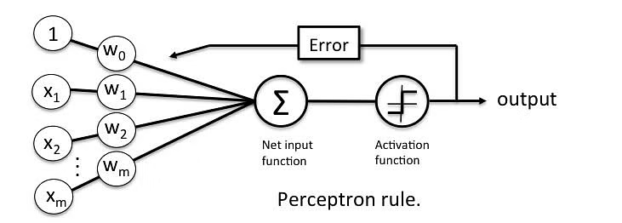
Perceptron Learning Rule
In this Rule, First begin with random weights, then iteratively apply the perceptron to each training example, modify the perceptron weights whenever it misclassifies an example.

Slide 30
Contd..
This process is repeated, iterating through the training examples as many times as needed until the perceptron classifies all training examples correctly
Here, Weights are modified at each step according to the Perceptron Training Rule.

Slide 31
Perceptron Learning Rule
This rule revises the weight, wi associated with the input xi according to the rule.
Here, t = Targeted Output
o = Actual Output
Learning Rate: The learning rate is a hyperparameter that controls how much to change the model in response to the estimated error each time the model weights are updated.

Slide 32
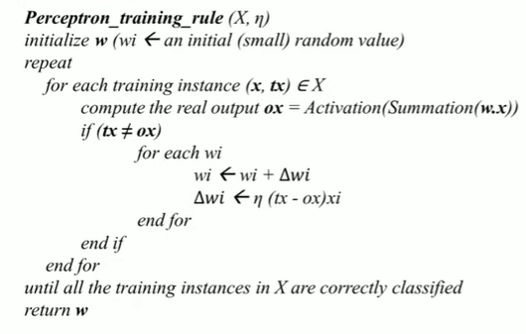
Algorithm

Slide 33
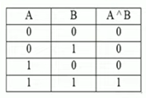
AND GATE Perceptron Training Rule
The Truth Table of AND Gate is :
To design the Perceptron Training Rule , we need to have Two Weights.

Slide 34
Contd..
Here, Target Output is “0” and Actual Output is “0”. So Both of them are same. So, there is no need of change the Weights.( no need of Weight Updation)
Here, Target Output is “0” and Actual Output is “0”. So Both of them are same. So, there is no need of change the Weights.( no need of Weight Updation)

Slide 35
Contd..
Here, Target Output is “0” and Actual Output is “1”. So Both of them are not same. So, we need to modify the Weights.
So the Weights are modified using the Perceptron Rule.
Where, η = learning Rate = 0.5 and
xi =(x1,x2) = (1,0)

Slide 36
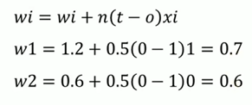
Contd..
So, we have to apply these values into Perceptron Rule.
These are the two modified Weights.
Now w1= 0.7 and w2= 0.6
So, again we have to apply this updated weights to all AND operations.
So, that here we can check whether these two weights classify these examples(AND Operations) correctly or Not.

Slide 37
Contd..
So, the modified weights are
Here, Target Output is “0” and Actual Output is “0”. So Both of them are same. So, there is no need of change the Weights.( no need of Weight Updation)

Slide 38
Contd..
Here, Target Output is “0” and Actual Output is “0.6”. This is not Greater than 1. So, there is no need of change the Weights.( no need of Weight Updation)
Here, Target Output is “0” and Actual Output is “0.7”. This is not Greater than 1. So, there is no need of change the Weights.( no need of Weight Updation)

Slide 39
Contd..
Here, Target Output is “1” and Actual Output is “1.3”. Both are Same. So, there is no need of change the Weights.( no need of Weight Updation)
So, classified all training examples correctly with
Hence, these are the final Learned Parameters w.r.to AND Gate Perceptron Training Rule.

Slide 40
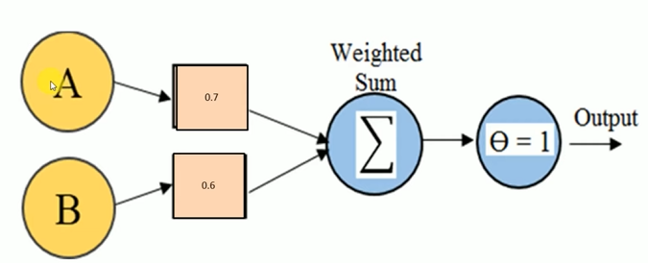
Contd..

Slide 41
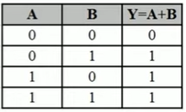
OR GATE Perceptron Training Rule
The Truth Table of OR Gate is :
To design the Perceptron Training Rule , we need to have Two Weights.

Slide 42
Contd..
Here, Target Output is “0” and Actual Output is “0”. So Both of them are same. So, there is no need of change the Weights.( no need of Weight Updation)
Here, Target Output is “1” and Actual Output is “0.6”. So Both of them are not same. So, we need to modify the Weights.

Slide 43
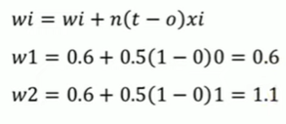
Contd..
So the Weights are modified using the Perceptron Rule.
Where, n = learning Rate = 0.5 and
xi =(x1,x2) = (0,1)
So, we have to apply these values into Perceptron Rule.
These are the two modified Weights.
Now w1= 0.6 and w2= 1.1

Slide 44
Contd..
So, again we have to apply this updated weights to all OR operations.
So, that here we can check whether these two weights classify these examples(OR Operations) correctly or Not.
So, the Updated Weights are

Slide 45
Contd..
Here, Target Output is “0” and Actual Output is “0”. So Both of them are same. So, there is no need of change the Weights.( no need of Weight Updation)
Here, Target Output is “1” and Actual Output is “1”. So Both of them are same. So, there is no need of change the Weights.( no need of Weight Updation)

Slide 46
Contd..
Here, Target Output is “1” and Actual Output is “0”. So Both of them are not same. So, we need to modify the Weights.

Slide 47
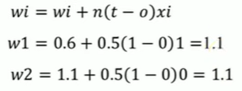
Contd..
So the Weights are modified using the Perceptron Rule.
Where, n = learning Rate = 0.5 and
xi =(x1,x2) = (1,0)
So, we have to apply these values into Perceptron Rule.
These are the two modified Weights.
Now w1= 1.1 and w2= 1.1

Slide 48
Contd..
So, again we have to apply this updated weights to all OR operations.
So, that here we can check whether these two weights classify these examples(OR Operations) correctly or Not.
So, the Updated Weights are

Slide 49
Contd..
Here, Target Output is “0” and Actual Output is “0”. So Both of them are same. So, there is no need of change the Weights.( no need of Weight Updation)
Here, Target Output is “1” and Actual Output is “1”. So Both of them are same. So, there is no need of change the Weights.( no need of Weight Updation)

Slide 50
Contd..
Here, Target Output is “1” and Actual Output is “1”. So Both of them are same. So, there is no need of change the Weights.( no need of Weight Updation)

Slide 51
Contd..
Here, Target Output is “1” and Actual Output is “1”. So Both of them are same. So, there is no need of change the Weights.( no need of Weight Updation)
So, classified all training examples correctly with
Hence, these are the final Learned Parameters w.r.to OR Gate Perceptron Training Rule.

Slide 52
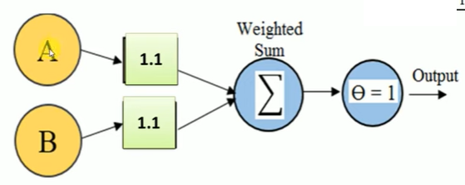
Contd..

Slide 53
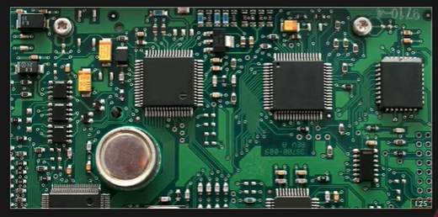
Real time Applications of Perceptron's
Any Digital Logic Circuit can be implemented by using Perceptron.

Slide 54
THANK YOU

