Slide 1
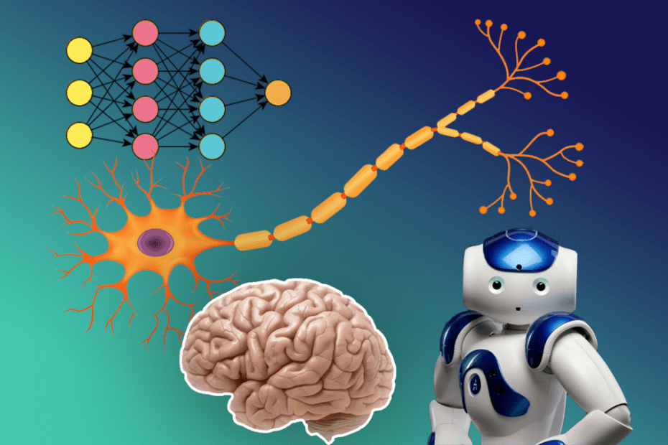
UNIT-II (Artificial Neural Networks)

Slide 2
Artificial Neural Networks
Topics :
Neural Network Representation
Differences between Biological and Neural Network

Slide 3
Artificial Neural Network
An Artificial Neural Network(ANN) may be defined as an information – processing model that is inspired by the Biological Nervous System , such as Brain.
The model tries to replicate only the most basic functions of the Brain.
An ANN is composed of a large no. of highly inter connected processing units (Neurons) working to solve the specific Problem.
Like Human Brain, ANN is also a Learn by Example.

Slide 4
Contd..
Ie, Just as we use our brains to identify patterns and classify different types of information
By using the Neural Networks, it allowing computers to observe, learn, and react to complex situations faster than humans.
An ANN is configured as different types of Applications, such as Face Recognition, Pattern Recognition etc. through a learning process.

Slide 5
How ANN Works?
Working procedure of Human Brain and ANN:
The term "Artificial Neural Network" is derived from Biological neural networks that develop the structure of a human brain.
Similar to the human brain that has neurons interconnected to one another. A neuron is the fundamental unit which is used for to is build the brain
A typical brain contains something like 100 billion microscopic cells called neurons. Each neuron is made up of a cell body (the central mass of the cell). ie, the sum of all inputs.

Slide 6
Contd..
There are over 100 billion neurons inside a human brain. Neurons are responsible for everything that we do. Our conscious & subconscious is controlled by these small power stations.
The Structure of Biological Neural Network is shown Below:

Slide 7
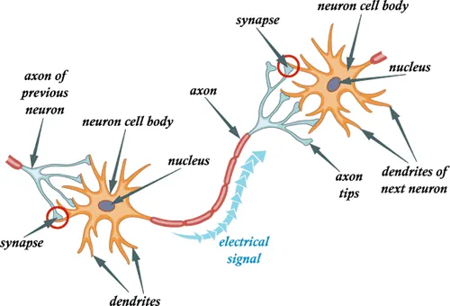
Contd..
Figure: Biological Neural Network

Slide 8
Contd..
Soma: This is also called the cell body. It is where the cell nucleus is located.
Dendrites: These are tree-like networks that are connected to the cell body. ie, it receives the signal from other Neurons.(Input)
Axon: Axon carries the signal from the cell body. It splits into strands (Chain or a single unit of a molecule such as DNA) and each strand ends in a bulb-like structure called synapse. (output)
ie, a single axon (the cell's output—carrying information away). Synapse is a junction between Two Neurons.

Slide 9
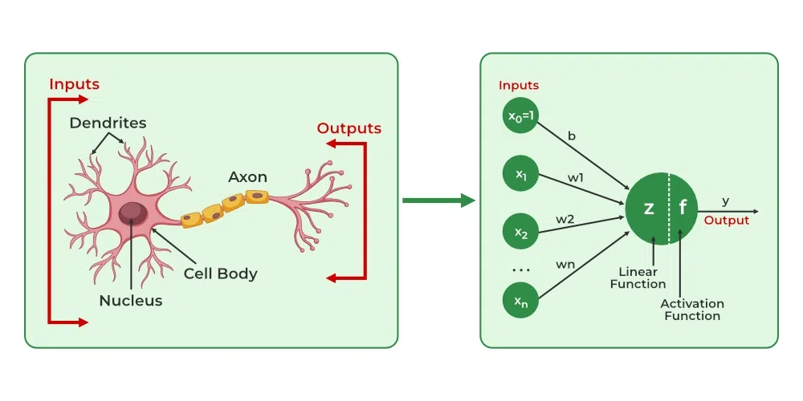
Contd..

Slide 10
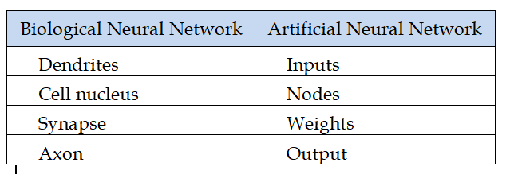
Contd..
Table: Terminology b/w Human Brain and ANN

Slide 11
Architecture of ANN
Artificial Neural Networks are processing elements either in the form of algorithms or hardware devices modeled.
Artificial Neural Network primarily consists of Three Layers:
1. Input Layer
2. Hidden Layer
3. Output Layer
Each Layer consists of more Neurons
The nodes of the Input Layer can take input data and perform operations on it and send the results of these operations to other neurons of the Hidden Layer.
The hidden layer sends data to the Output Layer.

Slide 12
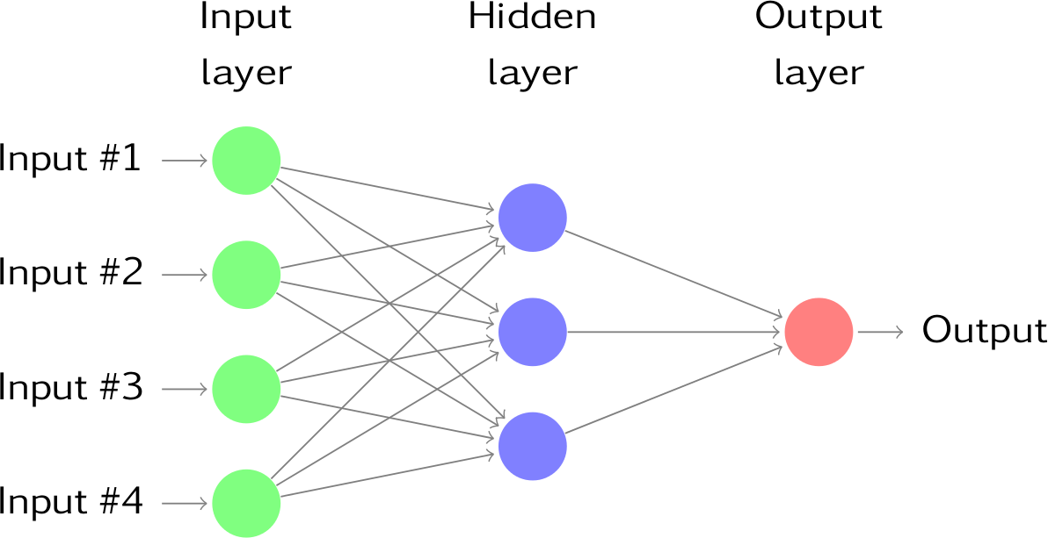
Contd..

Slide 13
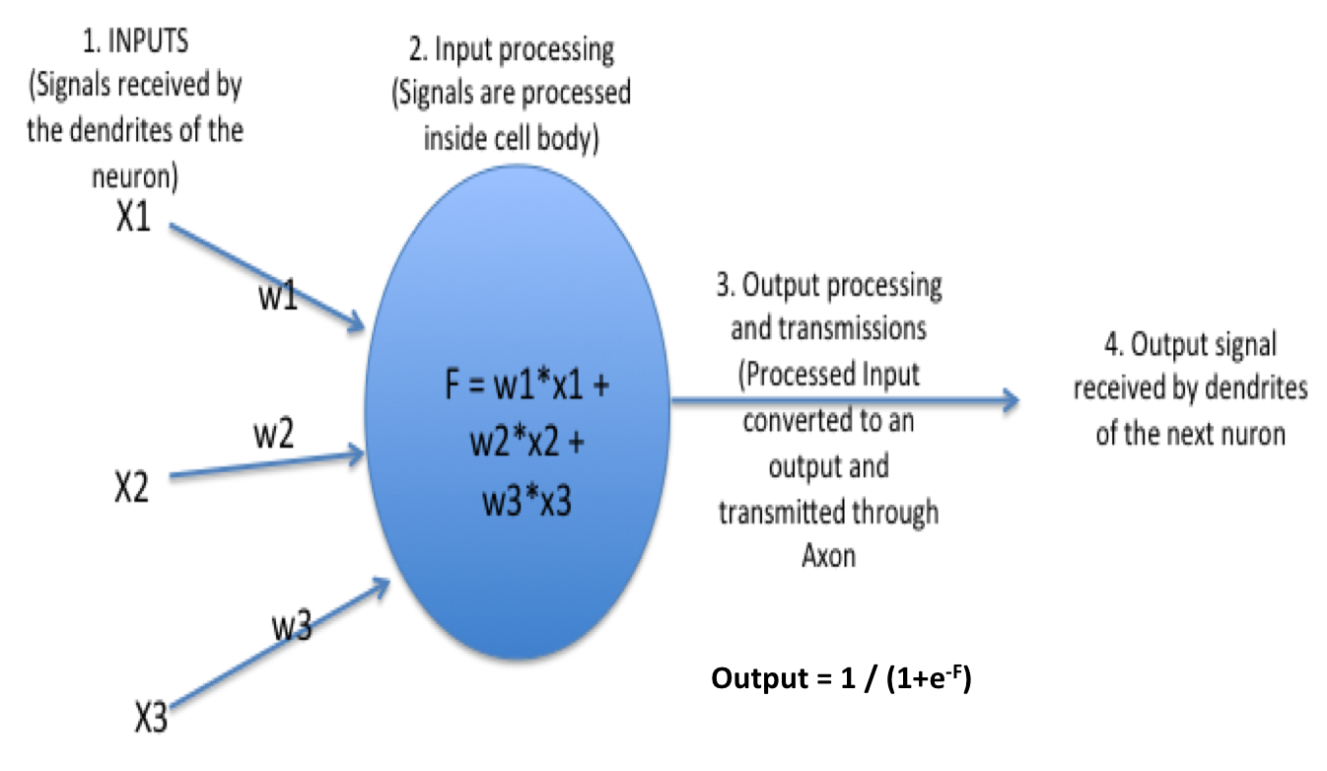
What happens inside the neuron

Slide 14
What happens inside the neuron

Slide 15
Bias in Neural Network
Bias is a systematic error that occurs due to wrong assumptions in the machine learning process.
Bias is simply defined as the inability of the model because of that there is some difference or error occurring between the model’s predicted value and the actual value.
These differences between actual or expected values and the predicted values are known as error or bias error or error due to bias.
Biases provide a critical additional layer of flexibility to neural networks. Biases are essentially constants associated with each neuron. Unlike weights, biases are not connected to specific inputs but are added to the neuron’s output.

Slide 16
Contd..
Biases provide a critical additional layer of flexibility to neural networks.
Biases are essentially constants associated with each neuron. Unlike weights, biases are not connected to specific inputs but are added to the neuron’s output.
It is used to adjust the output along the weighted sum of the inputs of the neuron.
This Bias Value allows you to shift the Activation Function to either Left or Right.

Slide 17
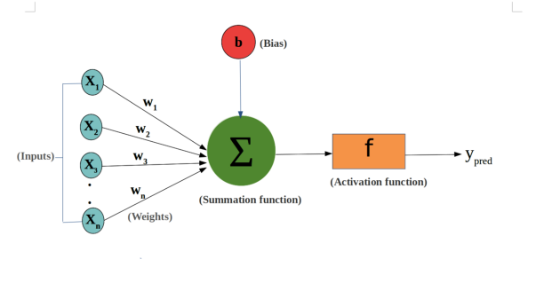
Contd..
output = sum (weights * inputs) + bias

Slide 18
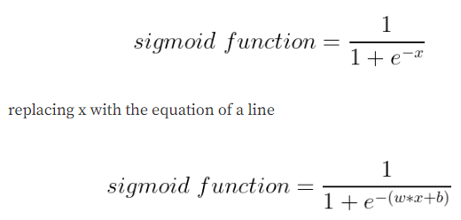
Contd..
we can represent the sigmoid activation function with the mathematical expression as

Slide 19
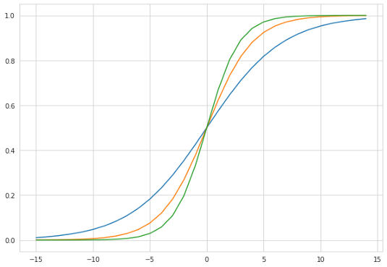
Contd..
Let us vary different values of w and fix the b value to 0
when the value of b =0 and
w = 0.3 — the blue line in the plot
w= 0.5 — the red line in the plot
w = 0.7 — the green line in the plot

Slide 20
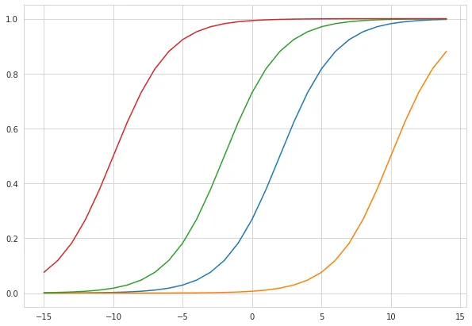
Contd..
2. Let us vary different values of b and fix w value to 0.5
b = -1 — the red line in the plot
b= -5 — the green line in the plot
b = 1 — the blue line in the plot
b = 5 — the yellow line in the plot

Slide 21
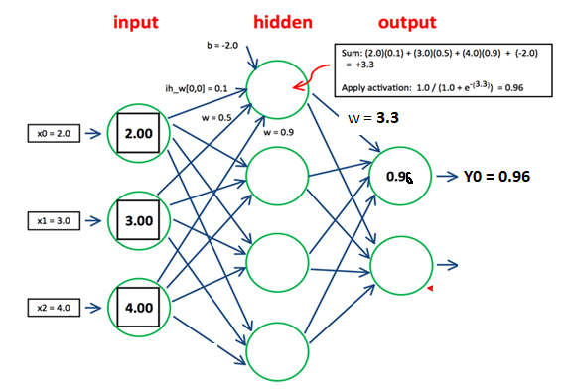
Example

Slide 22
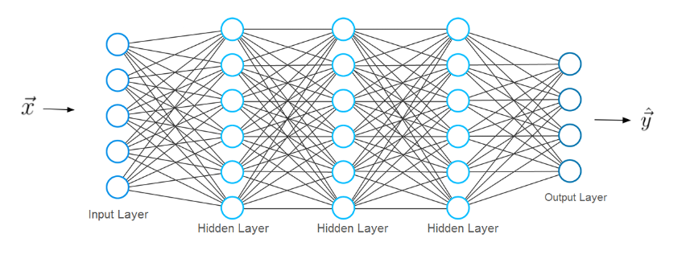
Layered Connection of Neural Network
Three basic components are used in ANN are
1.Components 2. Learning 3. Activation Function

Slide 23
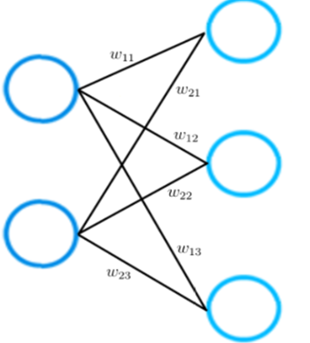
Explanation of Layers in ANN
The input layer has two input neurons, while the output layer consists of three neurons.

Slide 24
Contd..
Each connection between two neurons is represented by a different weight w. Each of these weight w has indices.
The first value of the indices stands for the number of neurons in the layer from which the connections originate.
The second value for the number of the neurons in the layer to which the connection leads.
All weights between two neural network layers can be represented by a matrix called the weight matrix.

Slide 25
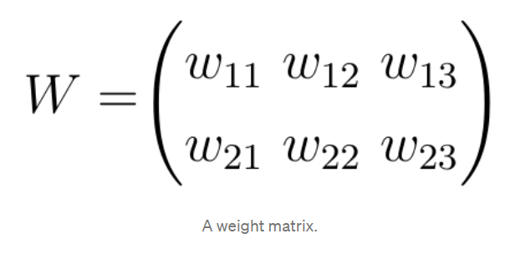
Contd..
In this particular example, the number of rows of the weight matrix corresponds to the size of the input layer which is two and the number of columns to the size of the output layer which is three.

Slide 26
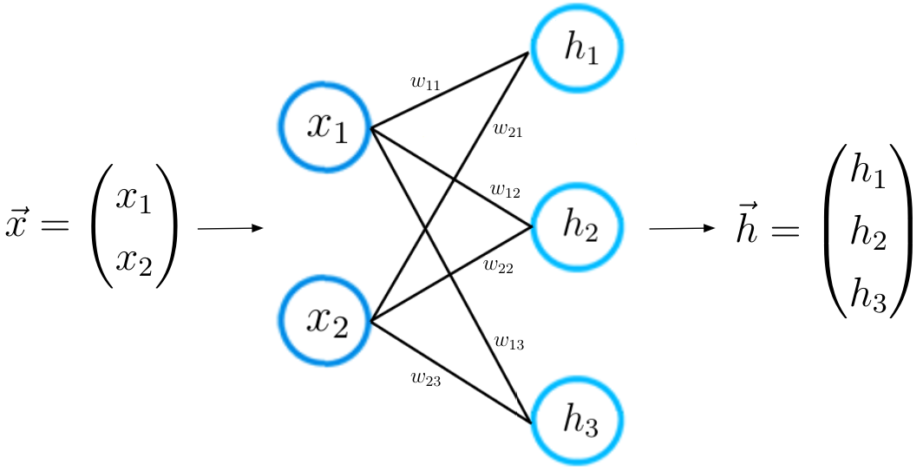
Learning Process of NN
For a given input feature vector x, the neural network calculates a prediction vector, which we call here as h.
Figure: Forward Propagation

Slide 27
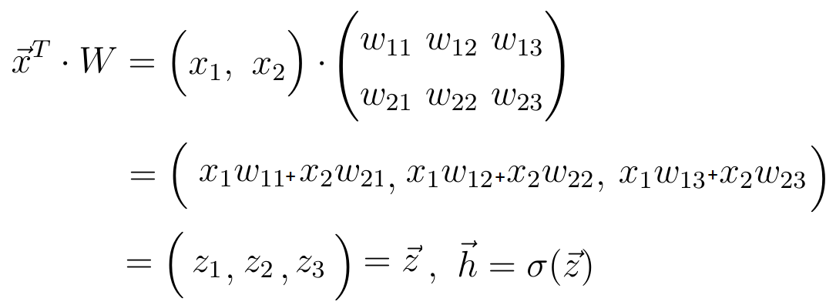
Contd..
This step is also referred to as the forward propagation. With the input vector x and the weight matrix W connecting the two neuron layers, we compute the dot product between the vector x and the matrix W. The result of this dot product is again a vector, which we call it as Z

Slide 28
Contd..
The final prediction vector h is obtained by applying a so-called activation function to the vector z. In this case, the activation function is represented by the letter Sigma.
Here neuron is simply a representation of a numeric value.

Slide 29
Contd..
ACTIVATION FUNCTION: It is also known as Transfer Function. It can also be attached with 2 neural networks. It is also a non linear Function.
Activation Functions are Mathematical Functions that determine the output of a Neural Network
The Activation Function is attached to each neuron in a neural network and determines whether neuron should be activated or not.

Slide 30
Contd..
The main purpose is to convert a input signal of a node in an ANN to an Output Signal.
It translates the input signals to output signals. It maps the output values on a range like 0 to 1 or -1 to 1.

Slide 31
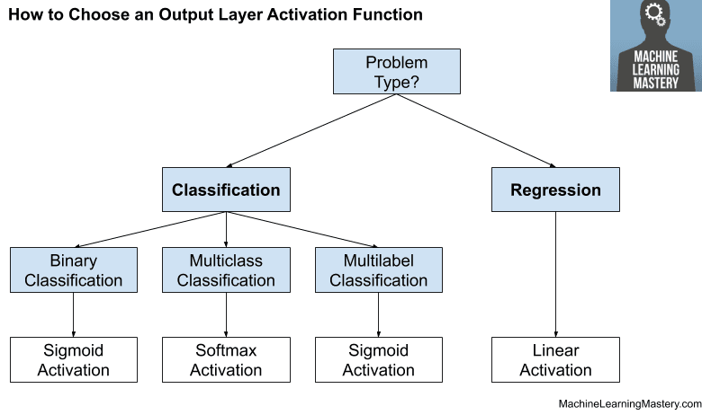
Contd..
Some of Different Activation Functions used in Machine Learning are:

Slide 32
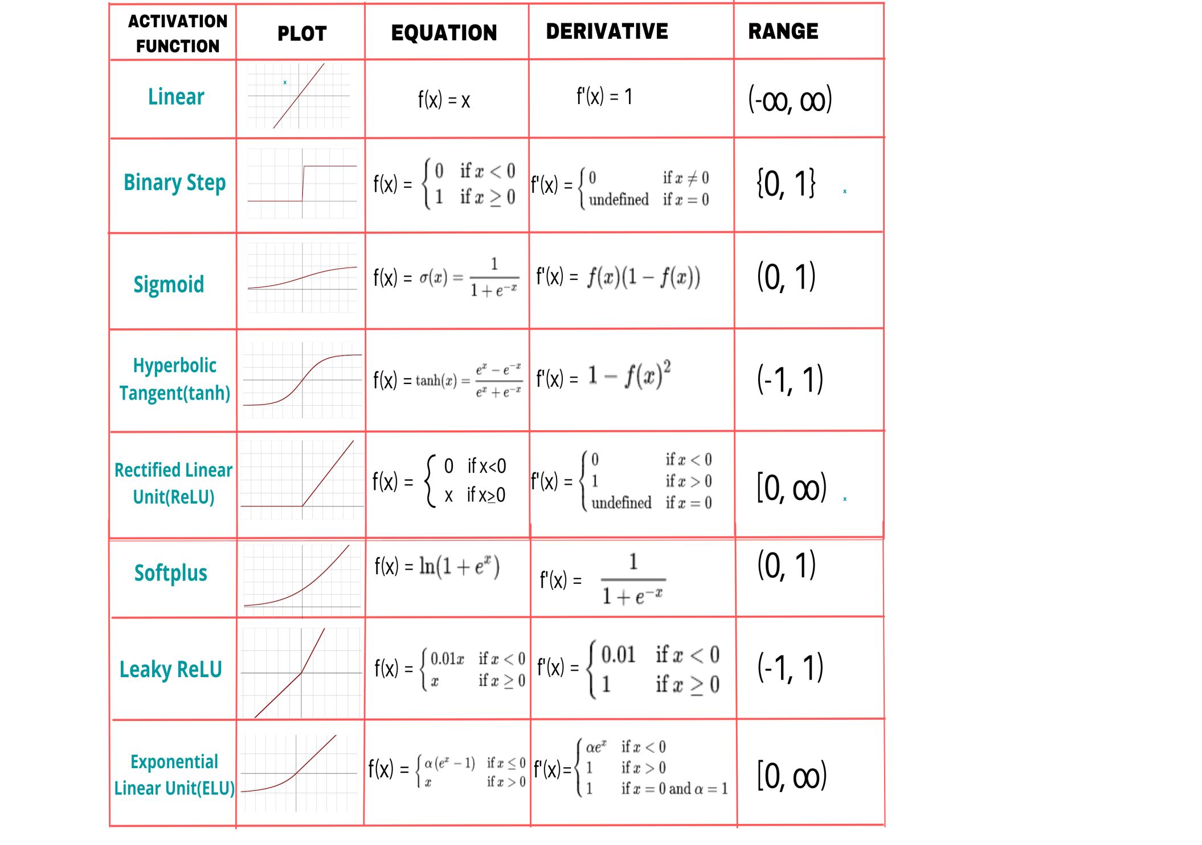
Contd..

Slide 33
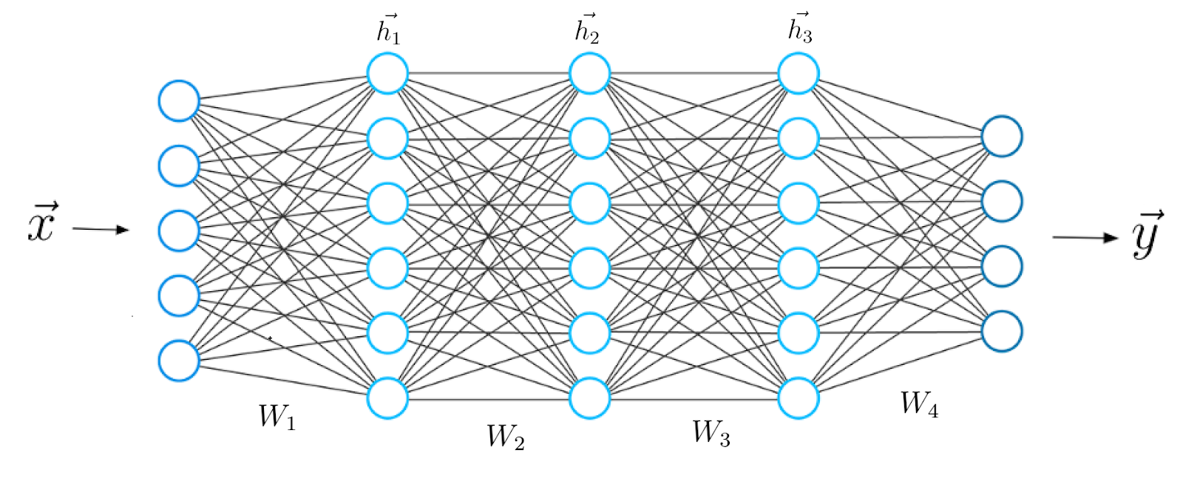
Contd..

Slide 34
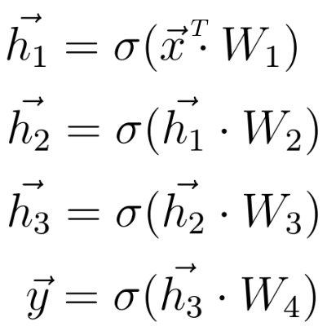
Contd..
we can extend our knowledge to a deeper architecture that consists of 5 layers.
h1 is now considered as the input for the upcoming third layer. The whole procedure from before is repeated until we obtain the final output y:

Slide 35
Criteria for Comparison
1. Speed of Operation
2. Way of Processing Data
3. Size and Complexity of the Neural Network
4. Storage Capacity or Memory
5. Fault Tolerance
6. Control System

Slide 36
Contd..
1. Speed of Operation: The Execution time of ANN is of the order of Nano Seconds.
But in case of Biological Neural Network (BNN) or Human Brain, execution time is of the order of MilliSeconds.
So ANN is faster than Brain.
2. Data Processing: In both Brain and ANN processing of data takes place parallelly.
i.e, Multiple Instructions are executed at the same time , Simultaneously.
But ANN is faster than Brain in data processing.

Slide 37
Contd..
3. Size and Complexity of the Network: Number of Neurons in the Brain about 10¹¹ and there are about 10¹⁵ inter connecting links.
But in ANN it can 10-1000 neurons are used and the complexity is reduced when compared to Humans
So, Brain is More Complex as compared to ANN

Slide 38
Contd..
4. Storage Capacity and Memory: In Human Brain, data is stored in its synaptic interconnections.
But in ANN, data is stored in specifically allotted memory locations
Storage Capacity of ANN is limited, But that of brain is Unlimited.
Data once stored in ANN can be retrieved easily at any time. But in case of Brain , Data loss can occur due to memory Failure.

Slide 39
Contd..
5. Fault Tolerance: In ANN, if one of the neurons or connecting links get damaged or disconnected. i.e, In the event of the system failure, Corrupted Data cannot be recovered.
But in Human Brain, if some of the Neuron Cells get damaged or Die, it doesn’t cause much damage to the nervous system.

Slide 40
Contd..
6. Control System : In ANN are modeled using computers and the main controlling unit is the Central Processing Unit(CPU)
But in Human Brain, control lies in the active chemicals present and the resultant chemical reactions taking place.

Slide 41
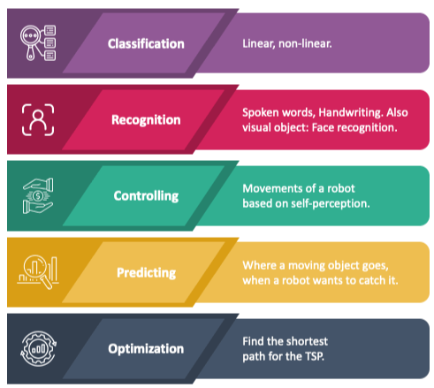
APPLICATIONS OF Artificial Neural Network

Slide 42
THANK YOU

