Slide 1
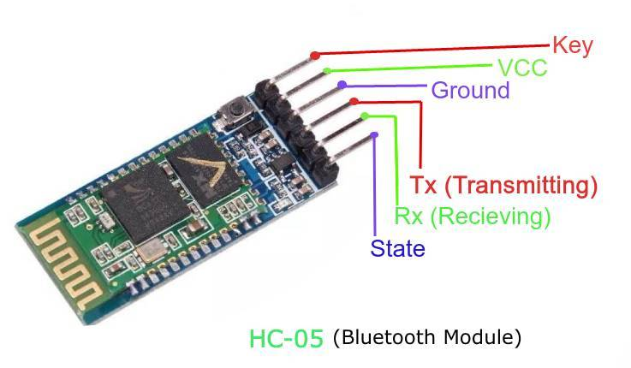
BLUETOOTH
HC-05 is a Bluetooth device used for wireless communication with Bluetooth enabled devices (like smartphone). It communicates with microcontrollers using serial communication (USART)

Slide 2
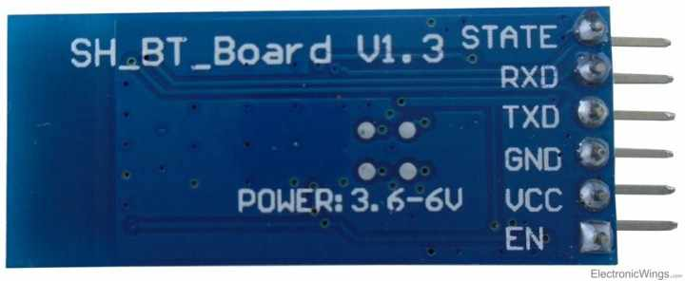
HC-05 Bluetooth Module Pin Diagram

Slide 3
Pin Configuration
STATE: The state pin is connected to on board LED, it can be used as a feedback to check if Bluetooth is working properly.
RXD: Receive data (input to module)
TXD: Transmit data (output from module)
GND: Ground
VCC: Power supply (3.6V to 6V)
EN: This pin is used to toggle between Data Mode (set low) and AT command mode (set high). By default it is in Data mode

Slide 4
Key Features
Bluetooth Specification: V2.0+EDR (Enhanced Data Rate)
Operating Voltage: 3.3V (Typically used with a 3.3V regulator for 5V systems)
Communication: Serial UART (Universal Asynchronous Receiver/Transmitter)
Baud Rate: Default 9600, can be adjusted
Range: Up to 10 meters
Default Password: 1234

Slide 5
Common Applications
Wireless Communication: For microcontrollers, Arduino, Raspberry Pi, etc.
Home Automation: Control devices like lights, fans, and appliances.
Robotics: Remote control for robots and drones.
Embedded Systems: Add wireless capabilities to embedded projects.

Slide 6
#include<SoftwareSerial.h>
//This line includes the Software Serial library, which allows the creation of serial communication on other digit
al pins of the Arduino, allowing for multiple serial ports.
SoftwareSerial bt(0,1); /* (Rx,Tx)
//This line creates an object named bt of the SoftwareSerial class. The parameters (0, 1) indicate the pins used for RX (receive) and TX (transmit), respectively.
void setup() { //is the setup function that runs once when the Arduino starts.

Slide 7
bt.begin(9600);
//initializes the bt SoftwareSerial object with a baud rate of 9600, which is the speed of communication.
Serial.begin(9600);
//initializes the default serial communication with a baud rate of 9600, allowing communication with the computer via the USB port.
void loop() { //is the main function that runs repeatedly after the setup function.
if (bt.available()) /* If data is available on serial port */
{
Serial.write(bt.read()); /* Print character received on to the serial monitor */
}
}

