Slide 1
Problem Solving Techniques
Dr. PARVATHANENI NAGA SRINIVASU [B.Tech, M.Tech, Ph.D.]
Associate Professor,
Department of Computer Science and Engineering,
Prasad V. Potluri Siddhartha Institute of Technology,
Vijayawada-520007, Andhra Pradesh
Visiting Post-Doc Fellow-Dongguk University, South Korea.
Visiting Post-Doc Fellow- Sejong University, South Korea.
Review Editor- Frontiers in Plant Science
Review Editor- Frontiers in Materials
Honorary Member- London Journal Press
Life Member-Computer Society of India
Life Member-IAENG
Life Member-International Association of Engineers
Life Member-Engineering Research and Publications
Member-Indian Academicians and Research Associates
Mobile:+91-9000595535

Slide 2
Topics
Solving Problems by Searching: Problem Solving Agents, Searching for Solutions.
Uninformed Search Strategies- Breadth first search, depth first Search
Informed (Heuristic) Search Strategies- Hill climbing, A* Algorithm, Alpha-Beta Pruning, Constraint Satisfaction Problem.

Slide 3
Problem-solving agents
Problem solving agents are goal-directed agents:
Goal Formulation: Set of one or more (desirable) world states (e.g. checkmate in chess).
Problem formulation: What actions and states to consider given a goal and an initial state.
Search for solution: Given the problem, search for a solution --- a sequence of actions to achieve the goal starting from the initial state.
4. Execution of the solution

Slide 4
Terminology
Search Space: Search space represents a set of possible solutions, which a system may have.
Start State: It is a state from where agent begins the search.
Goal test: It is a function which observe the current state and returns whether the goal state is achieved or not.
Search tree: A tree representation of search problem is called Search tree. The root of the search tree is the root node which is corresponding to the initial state.
Actions: It gives the description of all the available actions to the agent.
Path Cost: It is a function which assigns a numeric cost to each path.
Solution: It is an action sequence which leads from the start node to the goal node.
Optimal Solution: If a solution has the lowest cost among all solutions.

Slide 5
Uninformed Search Algorithms
Uninformed search is a kind of general-purpose search method that uses brute force to get results. Because uninformed search algorithms have no extra knowledge about the state or searching region beyond how to traverse the tree, it is sometimes referred to as blind search.
Breadth-first Search
Depth-first Search

Slide 6
Breadth-first search (BFS)
Breadth-first search is the most common search strategy for traversing a tree or graph. This algorithm searches breadthwise in a tree or graph, so it is called breadth-first search.
BFS algorithm starts searching from the root node of the tree and expands all successor node at the current level before moving to nodes of next level.

Slide 7
BFS Searching Technique
Advantages:
BFS will provide a solution if any solution exists.
If there are more than one solutions for a given problem, then BFS will provide the minimal solution which requires the least number of steps.
Disadvantages:
It requires lots of memory since each level of the tree must be saved into memory to expand the next level.
BFS needs lots of time if the solution is far away from the root node.

Slide 8
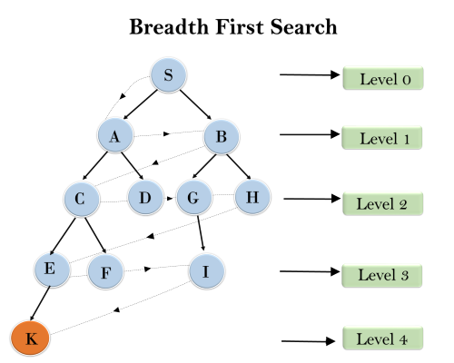
BFS- Working
S--->A--->B---->C--->D---->G--->H--->E---->F---->I---->K

Slide 9
Depth-first search (DFS)
Depth-first search isa recursive algorithm for traversing a tree or graph data structure.
It is called the depth-first search because it starts from the root node and follows each path to its greatest depth node before moving to the next path.
DFS uses a stack data structure for its implementation.
The process of the DFS algorithm is similar to the BFS algorithm.

Slide 10
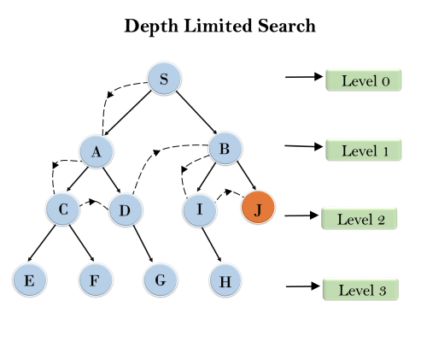
DFS Working

Slide 11
DFS Searching Technique
Advantage:
DFS requires very less memory as it only needs to store a stack of the nodes on the path from root node to the current node.
It takes less time to reach to the goal node than BFS algorithm (if it traverses in the right path).
Disadvantages:
There is the possibility that many states keep re-occurring, and there is no guarantee of finding the solution.
DFS algorithm goes for deep down searching and sometime it may go to the infinite loop.

Slide 12
Informed Search Algorithms
The informed search algorithm is more useful for large search space. Informed search algorithm uses the idea of heuristic, so it is also called Heuristic search.
Heuristics function: Heuristic is a function which is used in Informed Search, and it finds the most promising path. It takes the current state of the agent as its input and produces the estimation of how close agent is from the goal. The heuristic method, however, might not always give the best solution, but it guaranteed to find a good solution in reasonable time. Heuristic function estimates how close a state is to the goal.

Slide 13
Informed Search
Hill climbing
A* Algorithm
Alpha-Beta Pruning

Slide 14
Hill Climbing
Hill climbing algorithm is a local search algorithm which continuously moves in the direction of increasing elevation/value to find the peak of the mountain or best solution to the problem. It terminates when it reaches a peak value where no neighbour has a higher value.
Hill climbing algorithm is a technique which is used for optimizing the mathematical problems. One of the widely discussed examples of Hill climbing algorithm is Traveling-salesman Problem in which we need to minimize the distance traveled by the salesman.
It is also called greedy local search as it only looks to its good immediate neighbor state and not beyond that.

Slide 15
Features of Hill Climbing
Generate and Test variant: Hill Climbing is the variant of Generate and Test method. The Generate and Test method produce feedback which helps to decide which direction to move in the search space.
Greedy approach: Hill-climbing algorithm search moves in the direction which optimizes the cost.
No backtracking: It does not backtrack the search space, as it does not remember the previous states.

Slide 16
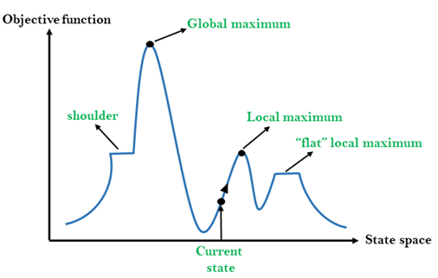
Hill Climbing
Local Maximum: Local maximum is a state which is better than its neighbour states, but there is also another state which is higher than it.
Global Maximum: Global maximum is the best possible state of state space landscape. It has the highest value of objective function.
Current state: It is a state in a landscape diagram where an agent is currently present.
Flat local maximum: It is a flat space in the landscape where all the neighbour agents of current states have the same value.

Slide 17
Hill Climbing Algorithm

Slide 18
4-Queens
States: 4 queens in 4 columns (256 states)
Neighborhood Operators: move queen in column
Evaluation / Optimization function: h(n) = number of attacks
Goal test: no attacks, i.e., h(G) = 0
Initial state (guess).
Local search: Because we only consider local changes to the state
at each step. We generally make sure that series of local changes
can reach all possible states.

Slide 20
Types of Hill Climbing techniques
Simple Hill Climbing
Steepest-Ascent hill-climbing
Stochastic hill Climbing

Slide 21
Simple Hill Climbing
Simple hill climbing is the simplest way to implement a hill climbing algorithm. It only evaluates the neighbour node state at a time and selects the first one which optimizes current cost and set it as a current state.
It only checks it's one successor state, and if it finds better than the current state, then move else be in the same state.
Less time consuming
Less optimal solution and the solution is not guaranteed

Slide 22
Algorithm
Step 1: Evaluate the initial state, if it is goal state then return success and Stop.
Step 2: Loop Until a solution is found or there is no new operator left to apply.
Step 3: Select and apply an operator to the current state.
Step 4: Check new state:
If it is goal state, then return success and quit.
Else if it is better than the current state then assign new state as a current state.
Else if not better than the current state, then return to step2.
Step 5: Exit.

Slide 23
Steepest-Ascent hill-climbing
The steepest-Ascent algorithm is a variation of simple hill climbing algorithm. This algorithm examines all the neighbouring nodes of the current state and selects one neighbour node which is closest to the goal state. This algorithm consumes more time as it searches for multiple neighbours.

Slide 24
Algorithm
Step 1: Evaluate the initial state, if it is goal state then return success and stop, else make current state as initial state.
Step 2: Loop until a solution is found or the current state does not change.
Let SUCC be a state such that any successor of the current state will be better than it.
For each operator that applies to the current state:
Apply the new operator and generate a new state.
Evaluate the new state.
If it is goal state, then return it and quit, else compare it to the SUCC.
If it is better than SUCC, then set new state as SUCC.
If the SUCC is better than the current state, then set current state to SUCC.
Step 5: Exit.

Slide 25
Algorithm
Stochastic hill climbing does not examine for all its neighbour before moving. Rather, this search algorithm selects one neighbour node at random and decides whether to choose it as a current state or examine another state.

Slide 26
A* Searching Algorithm
It is a searching algorithm that is used to find the shortest path between an initial and a final point.
It searches for shorter paths first, thus making it an optimal and complete algorithm. An optimal algorithm will find the least cost outcome for a problem, while a complete algorithm finds all the possible outcomes of a problem.
Another aspect that makes A* so powerful is the use of weighted graphs in its implementation. A weighted graph uses numbers to represent the cost of taking each path or course of action. This means that the algorithms can take the path with the least cost, and find the best route in terms of distance and time.

Slide 27
Working of A*
A* Algorithm works as-
It maintains a tree of paths originating at the start node.
It extends those paths one edge at a time.
It continues until its termination criterion is satisfied.
A* Algorithm extends the path that minimizes the following function-
f(n) = g(n) + h(n)
‘n’ is the last node on the path
g(n) is the cost of the path from start node to node ‘n’
h(n) is a heuristic function that estimates cost of the cheapest path from node ‘n’ to the goal node

Slide 28
Algorithm for A*
The implementation of A* Algorithm involves maintaining two lists- OPEN and CLOSED.
OPEN contains those nodes that have been evaluated by the heuristic function but have not been expanded into successors yet.
CLOSED contains those nodes that have already been visited.

Slide 29
Algorithm continued…
Step-01:
Define a list OPEN.
Initially, OPEN consists solely of a single node, the start node S.
Step-02:
If the list is empty, return failure and exit.
Step-03:
Remove node n with the smallest value of f(n) from OPEN and move it to list CLOSED.
If node n is a goal state, return success and exit.
Step-04:
Expand node n.

Slide 30
Algorithm Continued…
Step-05:
If any successor to n is the goal node, return success and the solution by tracing the path from goal node to S.
Otherwise, go to Step-06.
Step-06:
For each successor node,
Apply the evaluation function f to the node.
If the node has not been in either list, add it to OPEN.
Step-07:
Go back to Step-02.

Slide 31
Graph that we will work on… A is Initial and J is final state

Slide 32
Problem Example
Step-01:
We start with node A.
Node B and Node F can be reached from node A.
A* Algorithm calculates f(B) and f(F).
f(B) = 6 + 8 = 14
f(F) = 3 + 6 = 9
Since f(F) < f(B), so it decides to go to node F.
Path- A → F

Slide 33
Problem Example
Node G and Node H can be reached from node F.
A* Algorithm calculates f(G) and f(H).
f(G) = (3+1) + 5 = 9
f(H) = (3+7) + 3 = 13
Since f(G) < f(H), so it decides to go to node G.
Path- A → F → G

Slide 34
Alpha-Beta Pruning
Alpha-beta pruning is a modified version of the minimax algorithm. It is an optimization technique for the minimax algorithm.
As we have seen in the minimax search algorithm that the number of game states it has to examine are exponential in depth of the tree. Since we cannot eliminate the exponent, but we can cut it to half. Hence there is a technique by which without checking each node of the game tree we can compute the correct minimax decision, and this technique is called pruning. This involves two threshold parameter Alpha and beta for future expansion, so it is called alpha-beta pruning. It is also called as Alpha-Beta Algorithm.

Slide 35
Alpha-Beta Pruning
Alpha-beta pruning can be applied at any depth of a tree, and sometimes it not only prune the tree leaves but also entire sub-tree.
The two-parameter can be defined as:
Alpha: The best (highest-value) choice we have found so far at any point along the path of Maximizer. The initial value of alpha is -∞.
Beta: The best (lowest-value) choice we have found so far at any point along the path of Minimizer. The initial value of beta is +∞.

Slide 36
Alpha-Beta Pruning

Slide 37
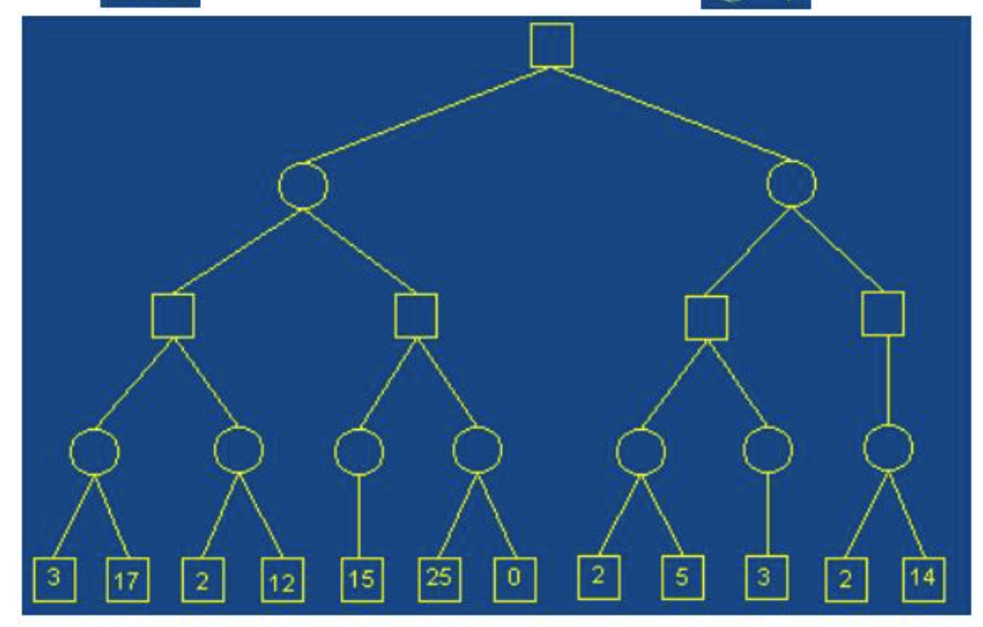
Working of Alpha-Beta Pruning Example

Slide 38
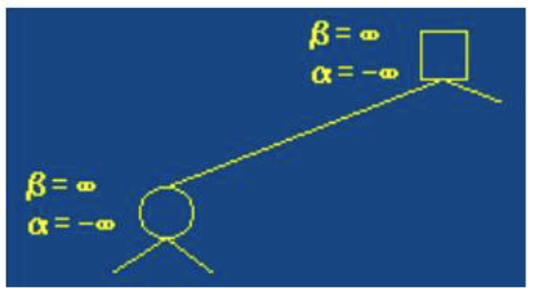
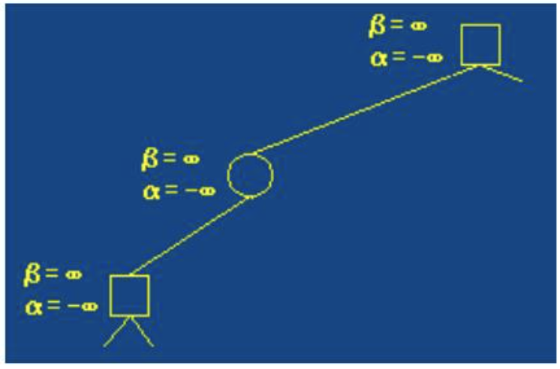
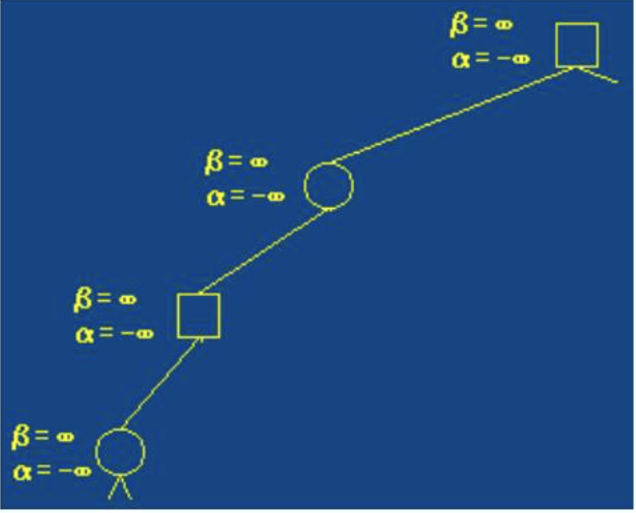
Continued…
Step-1
Step-2
Step-3

Slide 39
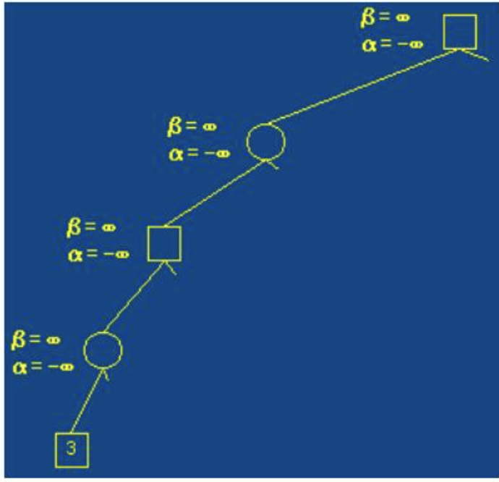
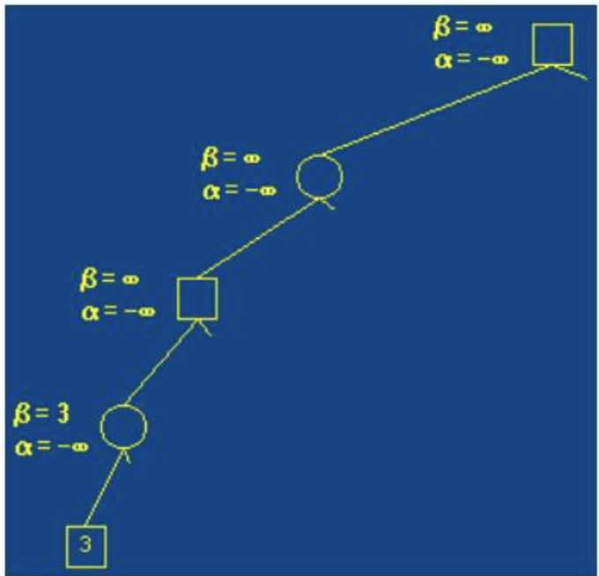
Continued…
Step-4
Step-5

Slide 40
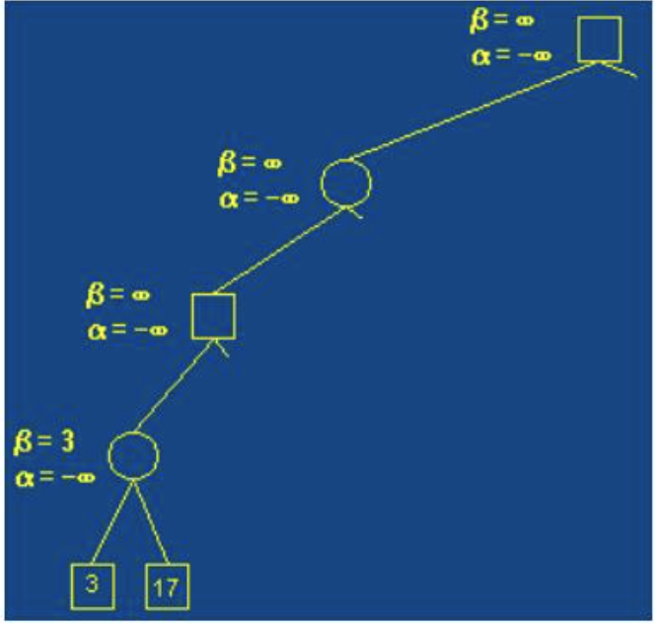
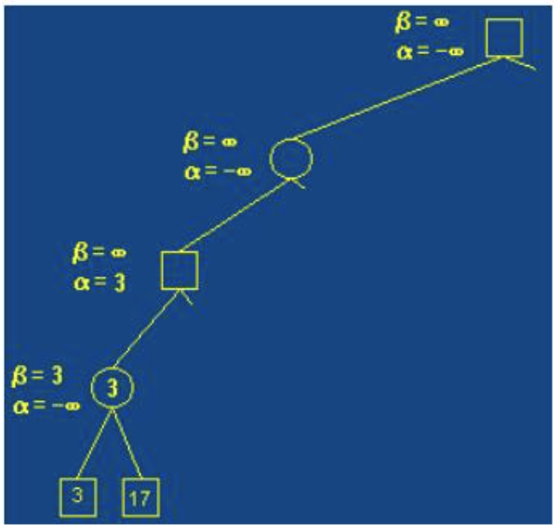
Continued…
Step-6
Step-7

Slide 41
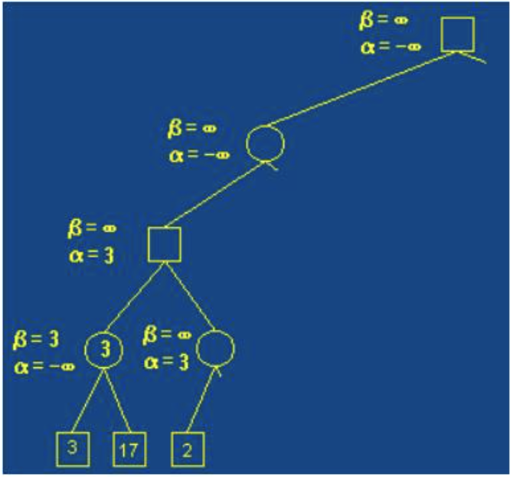
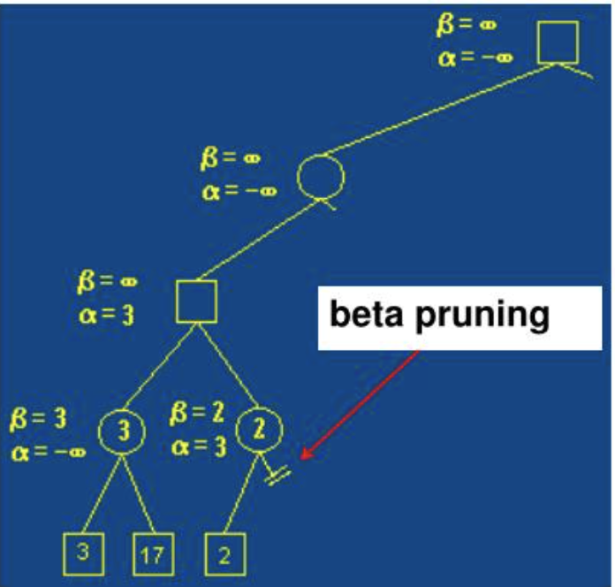
Continued…
Step-8
Step-9

Slide 42
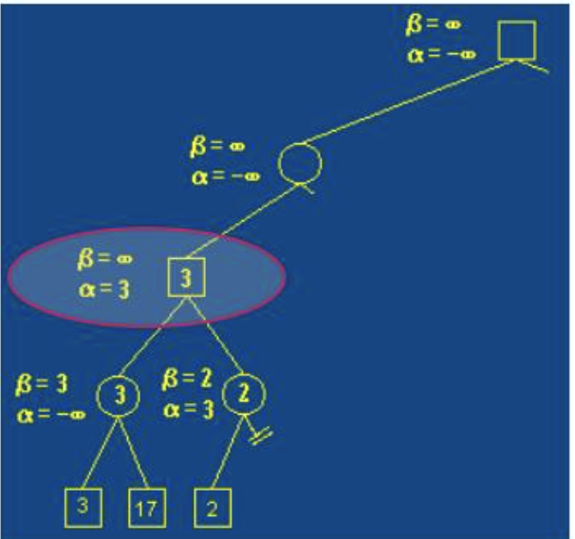
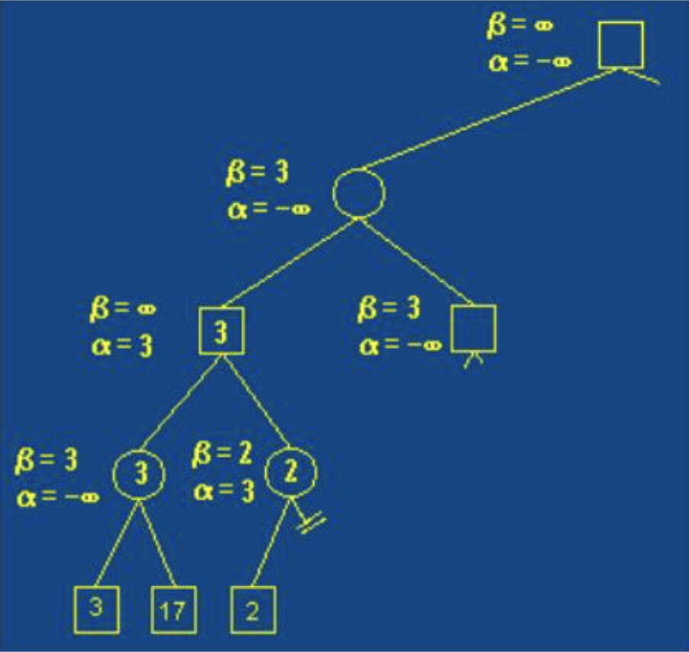
Continued…
Step-10
Step-12

Slide 43
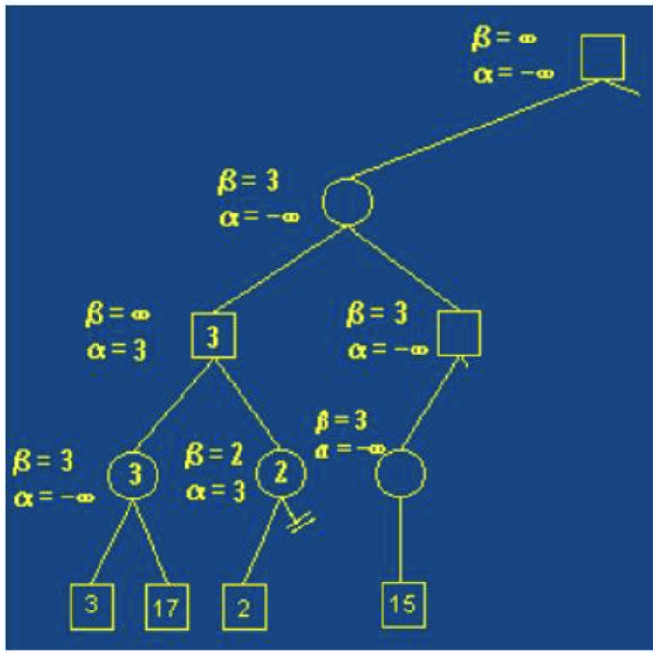
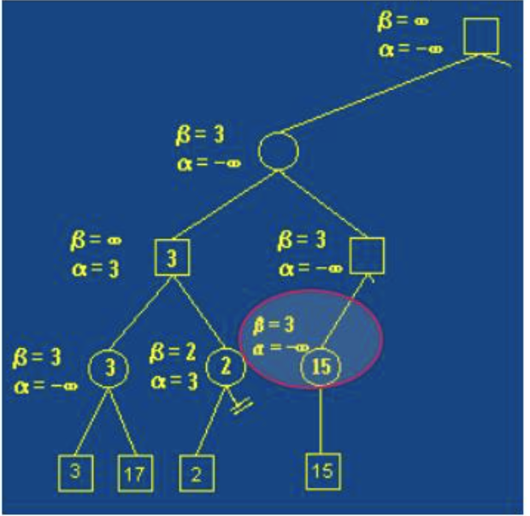
Continued…
Step-13
Step-14

Slide 44
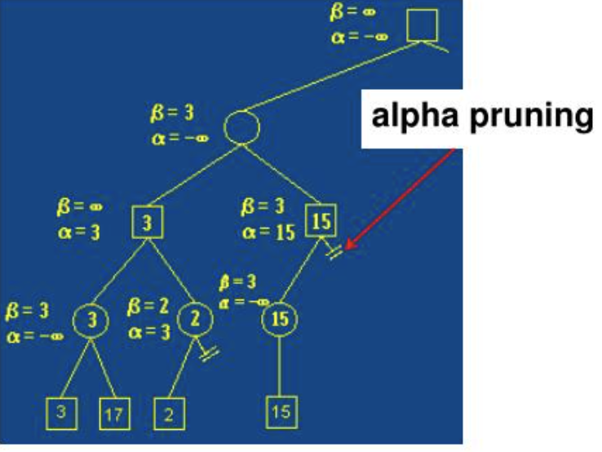
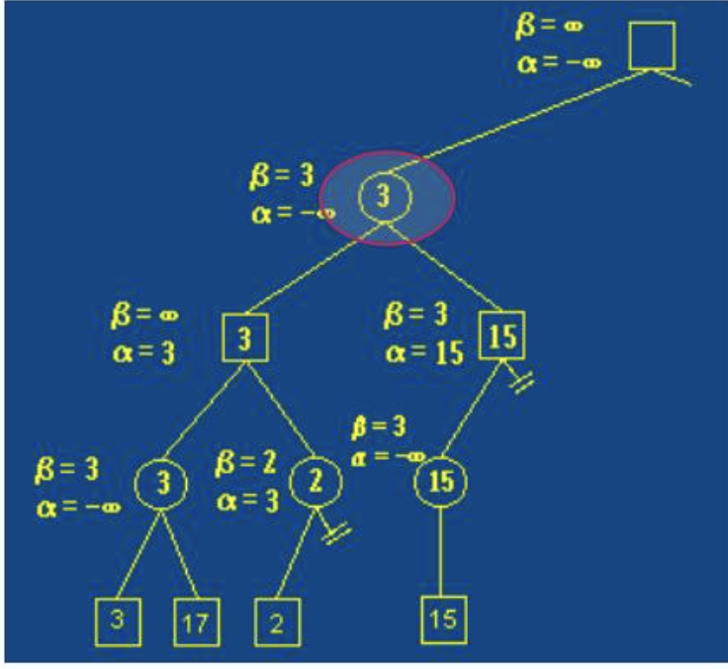
Continued…
Step-15
Step-16

Slide 45
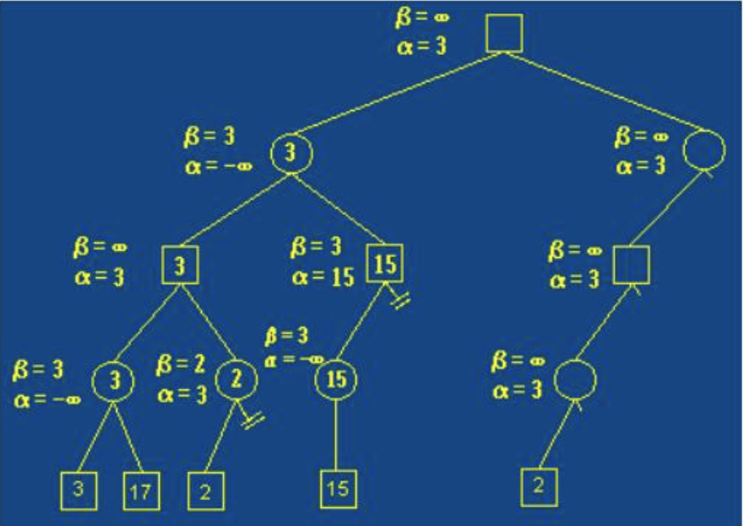
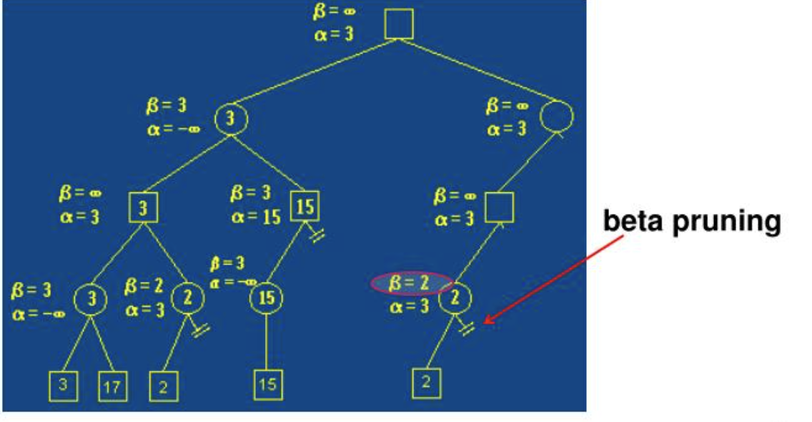
Continued…
Step-17
Step-18

Slide 46
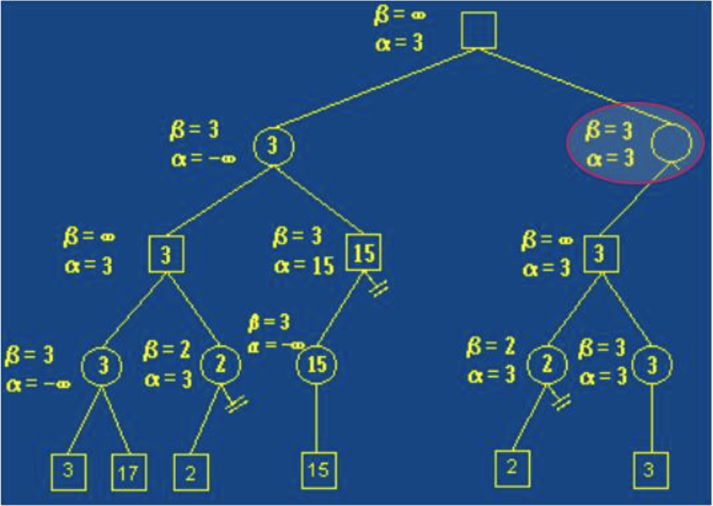
Continued…
Final Step

Slide 47
Constraint Satisfaction Problem
A constraint satisfaction problem (CSP) is a problem that requires its solution within some limitations or conditions also known as constraints. It consists of the following:
A finite set of variables which stores the solution (V = {V1, V2, V3,....., Vn})
It is a set of domains where the variables reside. There is a specific domain for each variable.(D = {D1, D2, D3,.....,Dn})
A finite set of constraints (C = {C1, C2, C3,......, Cn})
These are the three main elements of a constraint satisfaction technique. The constraint value consists of a pair of {scope, rel}. The scope is a tuple of variables which participate in the constraint and rel is a relation which includes a list of values which the variables can take to satisfy the constraints of the problem.

