Slide 1
UNIT-IV (Support Vector Machine)

Slide 2
Topics :
Support Vector Machine
Non Linear Support Vector Machines.
Example

Slide 3
Non Linear SVM
If data is linearly arranged, then we can separate it by using a straight line, but for non-linear data, we cannot draw a single straight line.
Imagine a case - if there is no straight line (or hyper plane) which can separate two classes? In the image shown below, there is a circle in 2D with red and blue data points all over it such that adjacent data points are of different colors.

Slide 4
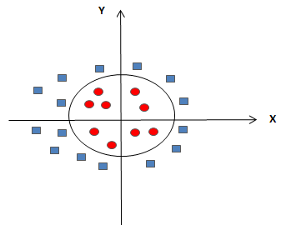
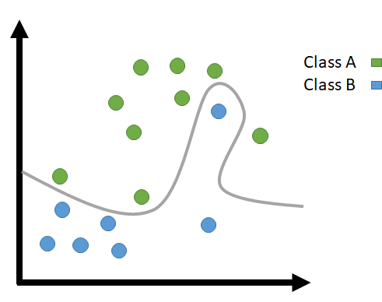
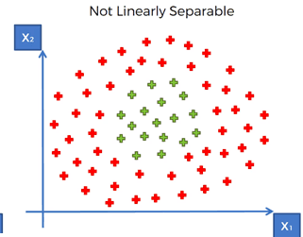
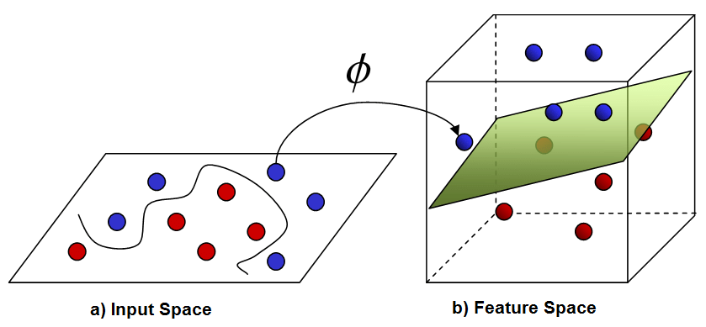
Contd..

Slide 5
Contd..
So to separate these data points, we need to add one more dimension.
For linear data, we have used two dimensions x and y, so for non-linear data, we will add a third dimension z.
So ,here we use a kernel function to handle non-linear separable data.
Kernels are used by classification algorithms to solve non-linear classification problems.
The kernel function transforms the data into a higher dimensional feature space to make it possible to perform the linear separation.

Slide 8
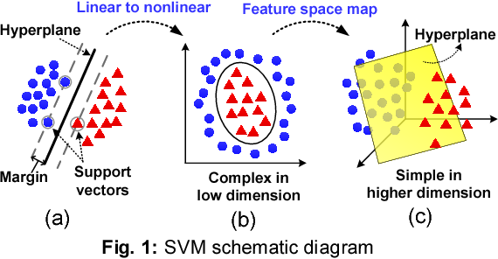
Contd..

Slide 9
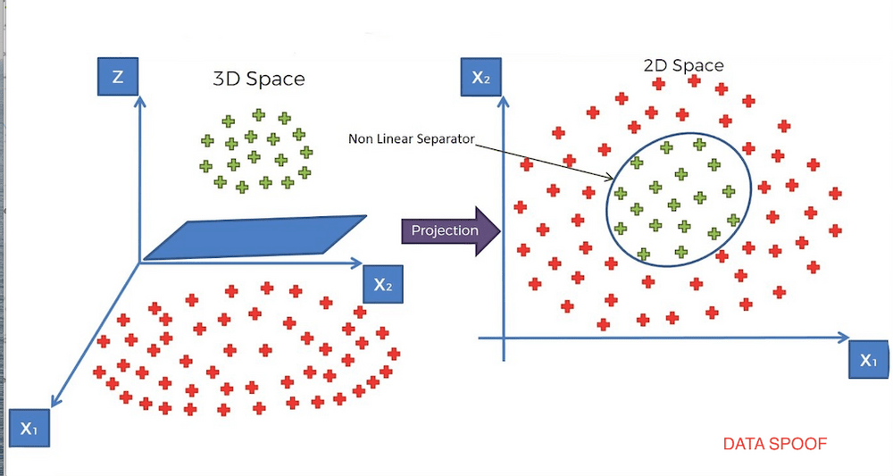
Example

Slide 10
Contd..
he kernel function is a function that may be expressed as the dot product of the mapping function (kernel method) and looks like this, K(x_{i},x_{j}) = Ø(x_{i}) . Ø(x_{j})
There are different types of Kernels are available to convert non linear to linear.
1. linear: u'*v
2. polynomial: (gamma*u'*v + coef0)^degree
3. radial basis (RBF) : exp(-gamma*|u-v|^2)
4. sigmoid : tanh(gamma*u'*v + coef0)
RBF is generally the most popular one.

Slide 11
Contd..

Slide 12
Example
In the Given Dataset, we have 4 are positively labeled data sets and 4 are negatively labeled data sets.

Slide 13
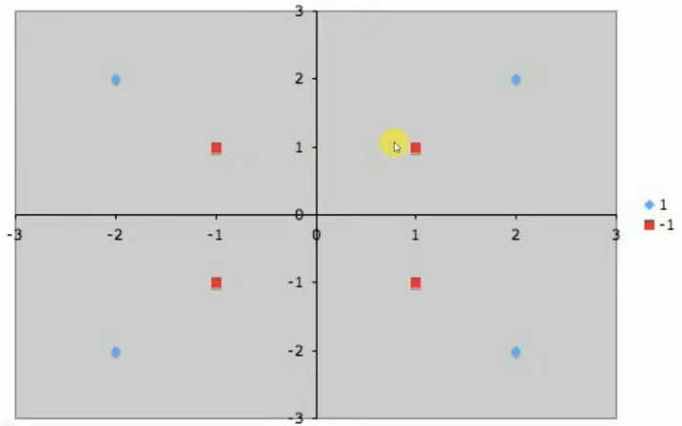
Contd..
Next ,we need to plot the data points

Slide 14
Here our Goal is to separate Hyper plane that accurately separately two classes.

Slide 15
Here our Goal is to separate Hyper plane that accurately separately two classes by using the Mapping Function RBF.

Slide 16
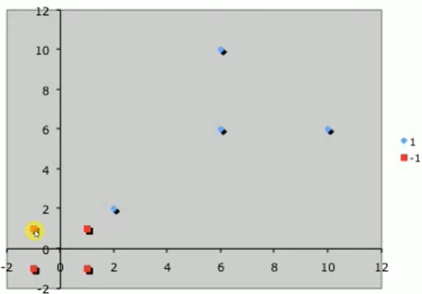
Next we can draw the Hyper plane by using updated Data Point

Slide 17
Contd..

Slide 18
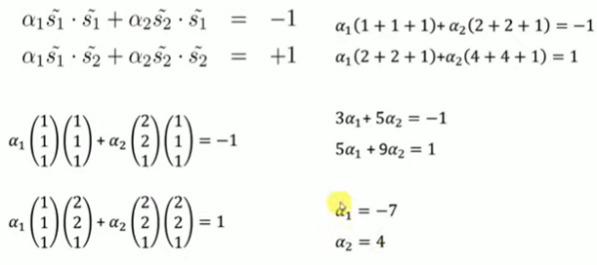
We need to calculate the 3 Variables. ie, α1, α2.
Which will be used to calculate the Weight Vector.

Slide 19
Once we get the 2 variables, after that we need to calculate the Weight Vector.

Slide 20
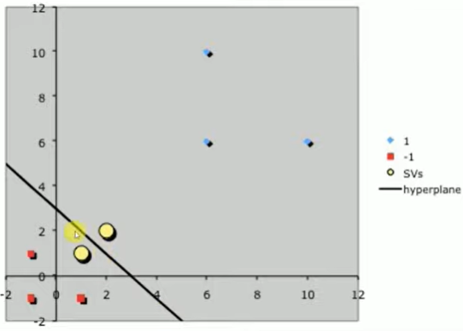
Here we get, the line is (1,0) ie, the line is parallel to Y- Axis.
Suppose , If the Line is (0,1) ie, the line is parallel to X- Axis.
If the line is (1,1) , ie, the line is parallel to 45 Degrees.

Slide 21
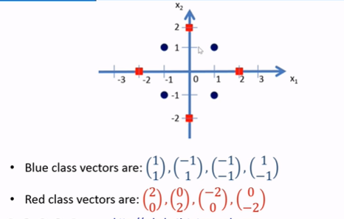
Example-2
In the Given Dataset, we have 4 are positively labeled data sets and 4 are negatively labeled data sets.

Slide 22
Here our Goal is to separate Hyper plane that accurately separately two classes by using the Mapping Function RBF.

Slide 25
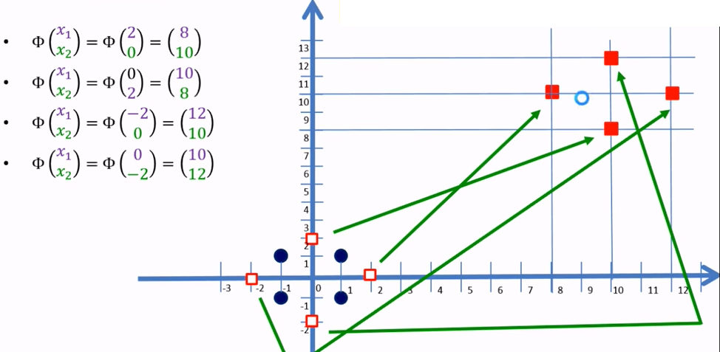
Draw the Hyper Plane by using updated Data Points

Slide 27
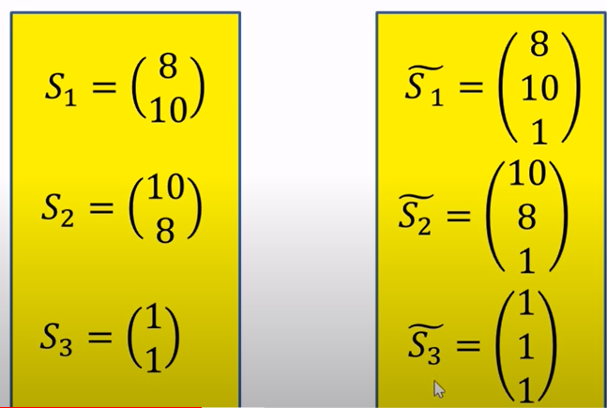
Here we will add the Bias value

Slide 28
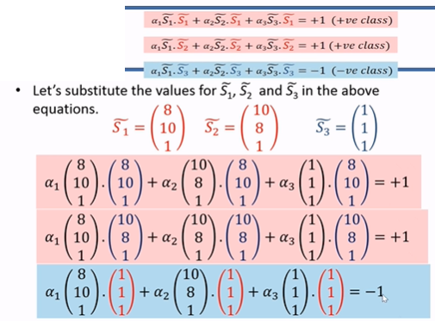

Slide 29
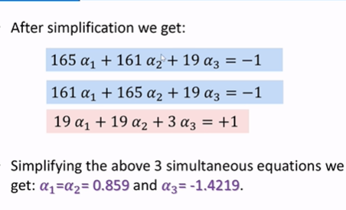

Slide 32
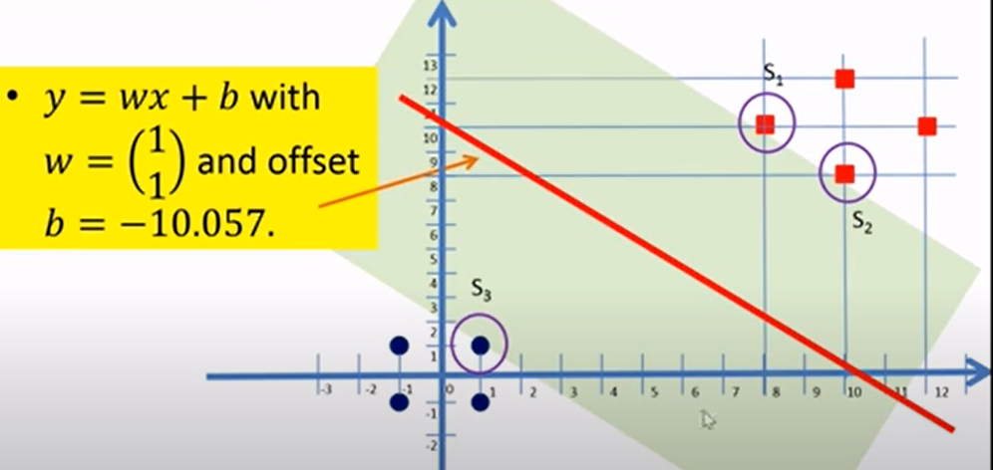

Slide 33
THANK YOU

