Slide 1
Programming Techniques for Turing Machine
TM is exactly as powerful as a conventional computer.
We present a number of examples of how we might think of the tape and finite control of the Turing machine.
None of these tricks extend the basic model of the TM they are only notational conveniences
Storage in the State
Multiple tracks
Subroutines

Slide 2
Programming techniques
We can use the finite control not only to represent a position in the program of the Turing machine but to hold a finite amount of data

Slide 4
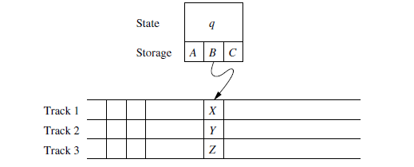

Slide 6
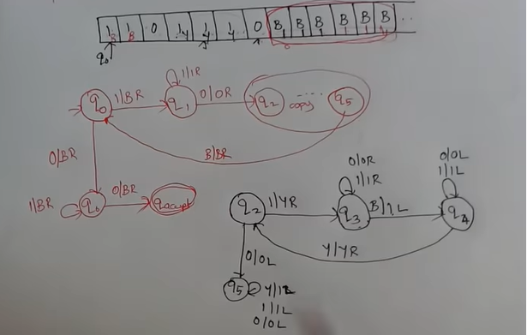

Slide 7
A Turing machine subroutine is a set of states that perform some useful process
This set of states includes a start state and another state that temporarily has no moves and that serves as the return state to pass control to whatever other set of states called the subroutine
The call of a subroutine occurs whenever there is a transition to its initial state
Since the TM has no mechanism for remembering a return address that is a state to go to after it finishes should our design of a TM call for one subroutine to be called from several states
We can make copies of the subroutine using a new set of states for each copy
The calls are made to the start states of different copies of the subroutine and each copy returns to a different state

Slide 8
Extensions to the Basic Turing Machine
Multi tape Turing machines
Non-Deterministic Turing Machines

Slide 9
Multi tape Turing machines
The device has a finite control (state) and some finite number of tapes.
Each tape is divided into cells and each cell can hold any symbol of the finite tape alphabet
As in the single tape TM the set of tape symbols includes a blank and has a subset called the input symbols of which the blank is not a member
The set of states includes an initial state and some accepting states

Slide 10
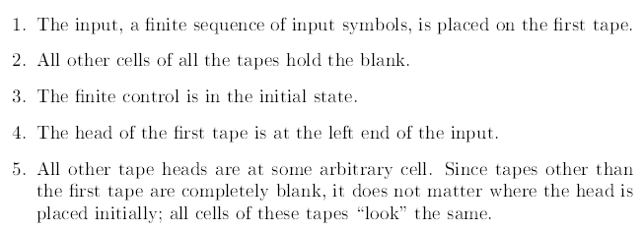
Initially

Slide 11
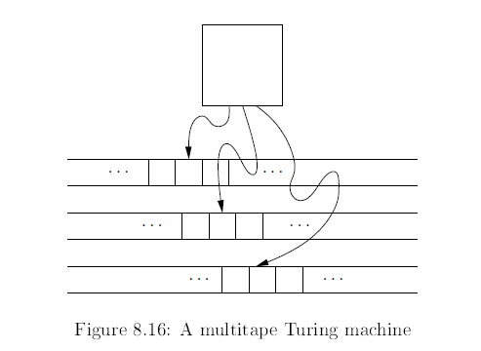

Slide 12
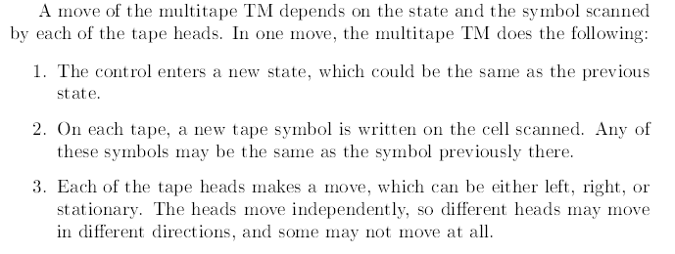

Slide 15
Non-Deterministic Turing Machines
A nondeterministic Turing machine NTM differs from the deterministic variety.
The NTM can choose at each step any of the triples to be the next move It cannot however pick a state from one a tape symbol from another and the direction from yet another
The NTM’s accept no languages not accepted by a deterministic TM

Slide 16
That is M accepts an input w if there is any sequence of choices of move that leads from the initial ID with w as input to an ID with an accepting state

Slide 18
