Slide 1
Artificial Intelligence
Dr. PARVATHANENI NAGA SRINIVASU [B.Tech, M.Tech, Ph.D.]
Associate Professor,
Department of Computer Science and Engineering,
Prasad V. Potluri Siddhartha Institute of Technology,
Vijayawada-520007, Andhra Pradesh, India.
Visiting Post-Doc Fellow-Dongguk University, South Korea.
Visiting Post-Doc Fellow- Sejong University, South Korea.
Review Editor- Frontiers in Plant Science
Review Editor- Frontiers in Materials
Honorary Member- London Journal Press
Life Member-Computer Society of India
Life Member-IAENG
Life Member-International Association of Engineers
Life Member-Engineering Research and Publications
Member-Indian Academicians and Research Associates
Mobile:+91-9000595535

Slide 2
Topics
Learning from Examples
Knowledge in Learning
Learning probabilistic Models
Reinforcement Learning

Slide 3
Components of the performance element
A direct mapping from conditions on the current state to actions.
A means to infer relevant properties of the world from the percept sequence.
Information about the way the world evolves.
Information about the results of possible actions the agent can take.
Utility information indicating the desirability of world states.
Action-value information indicating the desirability of particular actions in particular states.
Goals that describe classes of states whose achievement maximizes the agent's utility.

Slide 4
Learn from examples
What’re Goal and Hypotheses ?
Learning is to find an equivalent logical expression Each hypothesis proposes such an expression.
Hypothesis space is the set of all hypotheses the learning algorithm is designed to entertain.

Slide 5
Continued…
One of the hypotheses is correct:
H₁ V H₂ V…V H_{n}
Each H_{i} predicts a certain set of examples - the extension of the goal predicate.
Two hypotheses with different extensions are logically inconsistent with each other, otherwise, they are logically equivalent.

Slide 6
What are examples
An example is an object of some logical description to which the goal concept may or may not apply.
Ideally, we want to find a hypothesis that agrees with all the examples.
The relation between f and h are: ++, --, +- (false negative), -+ (false positive). If the last two occur, example I and h are logically inconsistent.

Slide 7
Learning

Slide 8
Inductive Learning

Slide 9
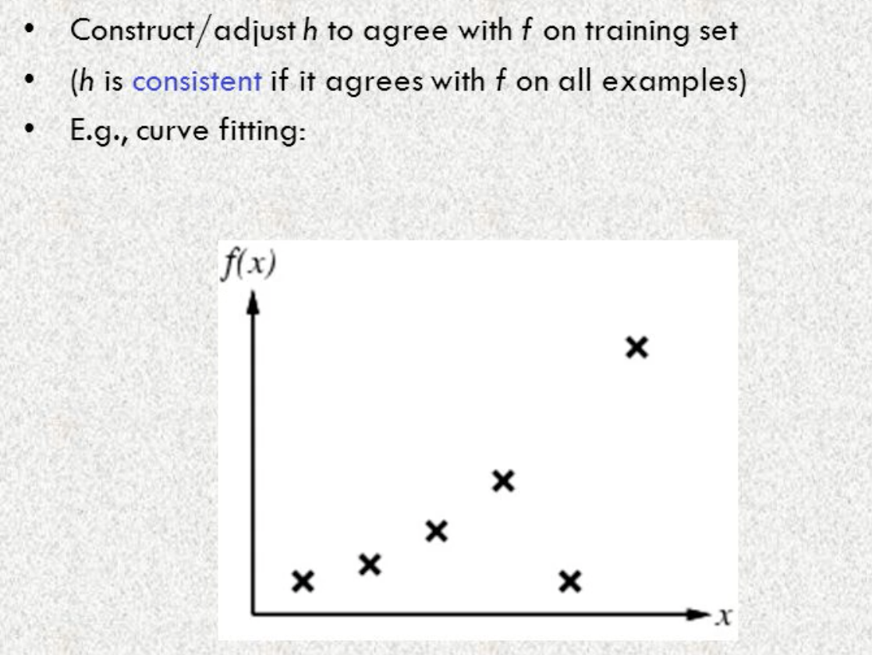
Inductive Learning

Slide 10
Inductive Learning

Slide 11
Current-best hypothesis search
Maintain a single hypothesis
Adjust it as new examples arrive to maintain consistency
Generalization for positive examples
Specialization for negative examples
Algorithm
Need to check for consistency with all existing examples each time taking a new example

