Slide 1
UNIT-IV (CASE BASED REASONING)

Slide 2
Topics :
Case Based Reasoning
CBR Workflow
CBR Example
Real Time Scenario

Slide 3
Case Based Reasoning
All instance based learners have 3 properties.
1. They are Lazy Learners
2. Classification is different for each instance
3. Instances are represented with n-dimensional Euclidean Space.
CBR is any kind of problem-solving approach that uses past solutions(experiences) to solve similar problems.
Ie, In CBR, everything is considered as case and based on previous cases , then we can find the solution.
Case-based reasoning is all around us.

Slide 4
Contd..
For example, Google Maps uses case-based reasoning to tell you how long your journey will take by examining the patterns of past users to see how long it took them to get from point A to point B.
Even if your path is from two slightly different points, it makes inferences on how long your journey will take.
Generally, In every Machine Learning Algorithm we have instances.
Here in case of CBR instances are represented as Symbols not values.

Slide 5
Definition of CBR
Definition: Case-based reasoning, a new problem is solved by adapting solutions that were also useful in the past.
Therefore, it is also referred to as an experience-based approach/ intelligent problem-solving method.
Therefore, it means learning from past experiences and using that .

Slide 6
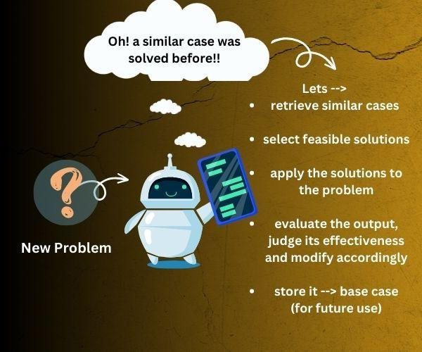
Definition of CBR

Slide 7
Contd..
Case-Based Reasoning classifiers (CBR) use a database of problem solutions to solve new problems.
CBR methods can be coupled with other methods
1. Artificial Neural Networks
2. Classification
3. Optimization Algorithm
4. Genetic Algorithm
5. Fuzzy Logic etc.

Slide 8
CBR Life Cycle
The CBR (Case-Based Learning) cycle is an iterative process that tells us how a new problem is approached.
It refers to collecting together past experiences and making use of relevant information.
The main steps in the Case-based reasoning cycle.

Slide 9
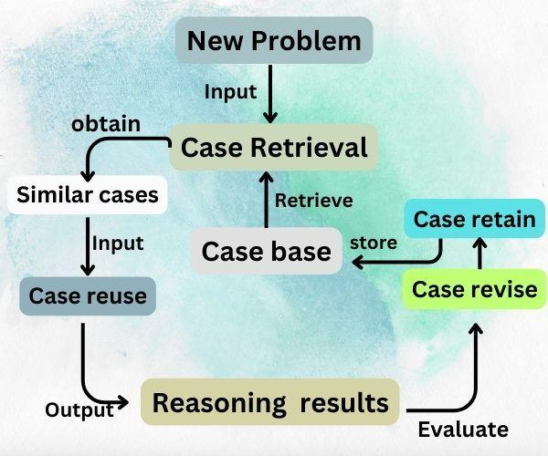
CBR Life Cycle

Slide 10
Contd..
New Problem: The CBR cycle starts when a new problem arrives.
Case retrieval: After properly analyzing the problem, the relevant information is extracted by comparing similar cases with the newly arrived problem. Therefore, we put together useful similar cases to solve the problem.
Case reuse: As a next step in the cycle, the past information is reused, and feasible solutions are selected from similar cases.

Slide 11
Contd..
Reasoning results: It refers to applying the filtered information and solutions by analyzing previous similar cases to the present problem. In this step, we generally use algorithms and heuristics to narrow down to a solution.
Case revision: After applying the necessary information, the next step is to evaluate the output→judge its effectiveness and produce feedback.
Suppose the result’s quality is not up to the mark. In that case, the solution is modified according to the feedback, and an efficient solution is recorded for future similar cases like this.

Slide 12
Contd..
Case retain: Storing this new problem-solving method in the memory system

Slide 13
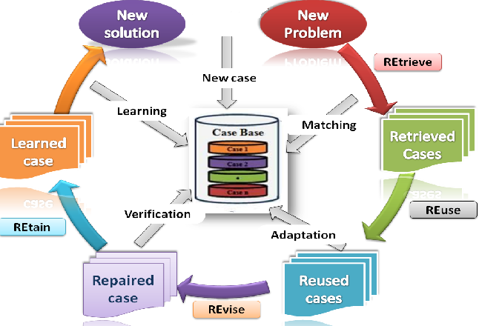
CBR Workflow

Slide 14
Prototypical Example of Case Based Reasoning
A CADET System Employs Case Based Reasoning to assist in the Conceptual Design of simple mechanical devices such as Water Faucets.
Here It uses a Library Containing Approximately 75 Previous Designs to suggest conceptual Designs to meet specifications of new Design Problems
Each Instance stored a Memory (Eg: Water Pipe) is represented by describing both its structure and Qualitative Function

Slide 15
Contd..
In our homes, now a days modern based taps are worked.
Here we have to take T- Junction Tap.
Ie, we lift the tap we will be getting the water. And based on the direction of the tap , ie. if it is completely towards left side , we will get hot water. Etc.
In our example, we can represented with the help of symbols not values.

Slide 16
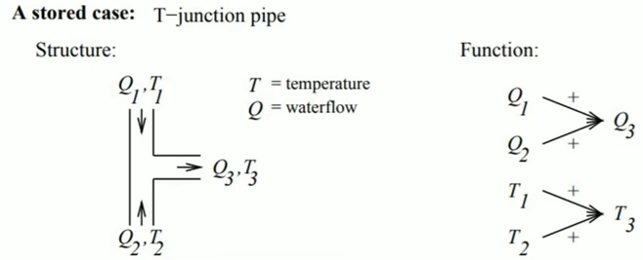
Contd..

Slide 17
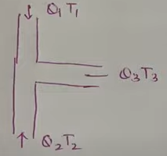
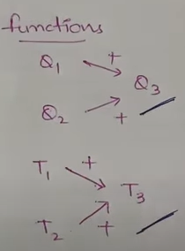
In this figure,
Q- Means Water flow and
T- Means Temperature.
so here in this figure, Q1T1 & Q2T2
and Q3T3 is the combo of both.
here we used the functions Q1
and Q2 will give you Q3
And T1 and T2 will give you T3.
So this is the basic system we have
in our house.
These type of examples are defined in
CADET System.

Slide 18
Contd..
Suppose we need to construct and manufacture of another tap. Which will control the temperature and water flow.
So here we have only the option to choose the Hot Water and Cold Water. But we don’t have the option to choose the Flow of water or we don’t have an option to choose the Temperature.
but here in our system , we can control the Temperature.
SO, here what we can do?

Slide 19
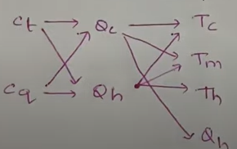
Contd..
So, here we have to take the help of the system based on existing system and we will do some modifications in the existing system in order to get the system that we have desired.
Here, Ct stands for Control of Temperature and Cq stands for Control of Water Flow
Qc and Qh - is the cold water and Hot water and Temperatures are various parameters etc.

Slide 20
CBR Vs other Techniques
The case-based reasoning is an exceptionally well-designed technique that uses past experiences to improve its performance.
Rule-based systems: In rule-based reasoning, pre-defined rules are used for solving problems. Experts in the field design this set of rules.
On the other hand, CBR is efficient in handling situations where the rules may not be efficient or are not present.

Slide 21
Contd..
Real time Example: An application of CBR with ML for forensic Autopsy

Slide 22
Contd..
System Flow graph
Step-1:

Slide 23
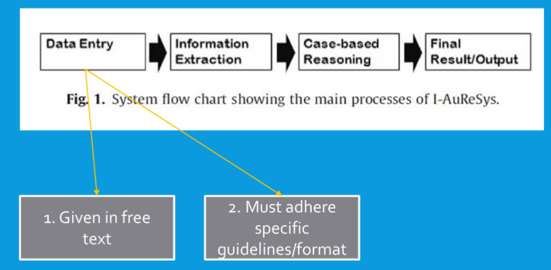
Contd..
Step-2:

Slide 24
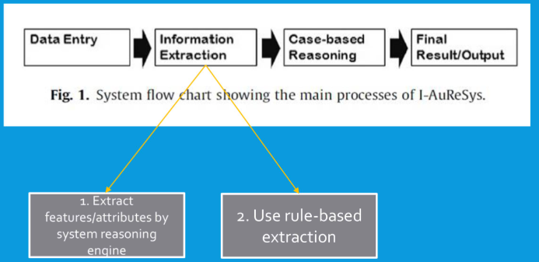
Contd..
Step-3:

Slide 25
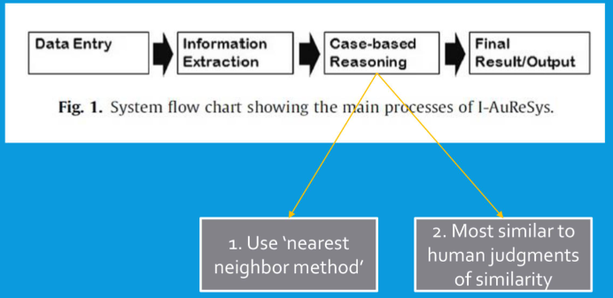
Contd..
Step-4:

Slide 26
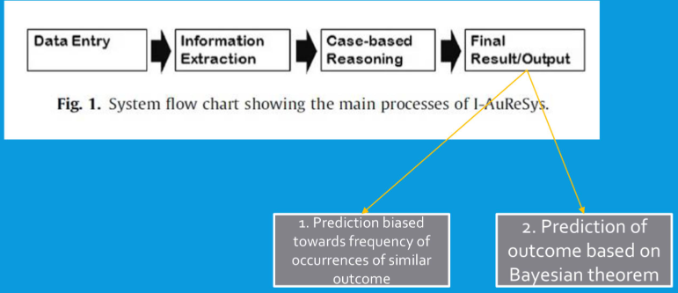
Contd..
Step-5:

Slide 27
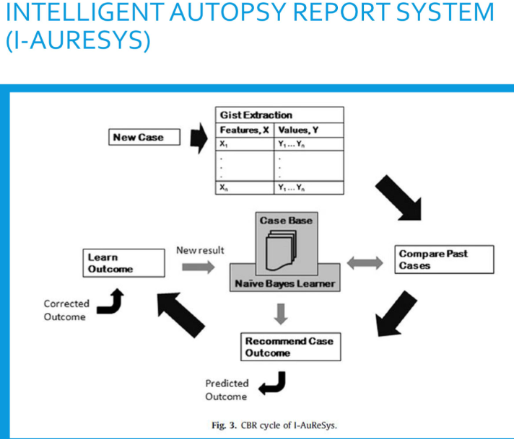

Slide 28
Applications of CBR
Financial Decision Making: CBR systems can be used in financial institutions to help make decisions on loan approvals, risk assessments, and investment strategies by comparing past cases with current situations.
Legal Reasoning: Case-Based Reasoning in machine learning systems can be used in the legal field to assist with case law research and the preparation of legal arguments by retrieving and adapting cases with similar legal issues.
Transportation: CBR systems can be used in transportation to optimize routing, scheduling, and resource allocation by learning from past cases.

Slide 29
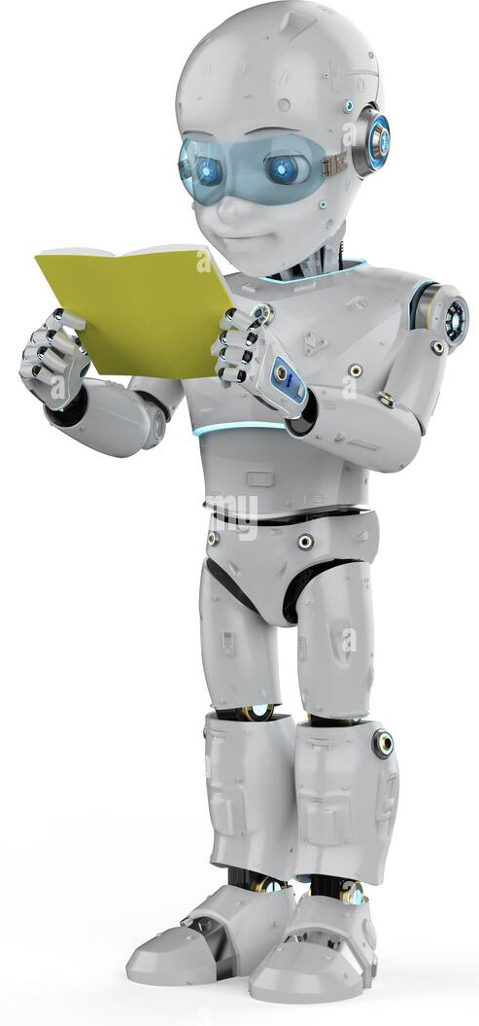
THANK YOU

