Slide 1
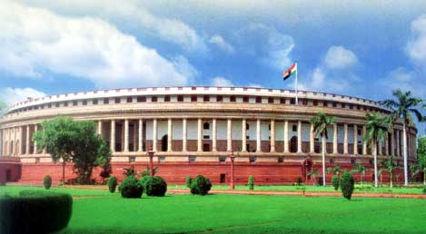
Parliament House of India
Parliament House is one of the most magnificent buildings in New Delhi which has one of the brightest clusters of architectural gems possessed by any country in the world. Visitors to the capital invariably pay a visit to this building as the two Houses of Parliament-the Lok Sabha (House of the People) and the Rajya Sabha (Council of States) are located within its walls.

Slide 2
The Indian Parliament consists of two houses are: 1>Rajya Sabha (Council of States) 2>Lok Sabha (House of the People)
Houses Of Parliament
Rajya Sabha
Lok Sabha

Slide 3
Rajya Sabha
The ‘Council of States’ which is also known as Rajya Sabha, a nomenclature that was announced by the chair in the House on the 23rd August, 1954 has its own distinctive features. The origin of the second Chamber can be traced to the Montague-Chelmsford Report of 1918.
The Constituent Assembly, which first met on 9 December 1946, also acted as the Central Legislature till 1950, when it was converted as ‘Provisional Parliament’. During this period, the Central Legislature which was known as Constituent Assembly (Legislative) and later Provisional Parliament was unicameral till the first elections were held in 1952.
Strength:-
Rajya Sabha being a federal chamber enjoys certain special powers under the Constitution. However, if Rajya Sabha passes a resolution by a majority of not less than two-thirds of members present and voting saying that it is “necessary or expedient in the national interest” that Parliament should make a law on a matter enumerated in the State List, Parliament becomes empowered to make a law on the subject specified in the resolution, for the whole or any part of the territory of India.

Slide 4
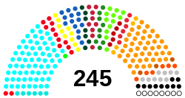
Seats in Rajya Sabha
245 Members of Rajya Sabha

Slide 5
Lok Sabha
Lok Sabha is composed of representatives of the people chosen by direct election on the basis of the adult suffrage. The maximum strength of the House envisaged by the Constitution is 552, which is made up by election of upto 530 members to represent the States, upto 20 members to represent the Union Territories and not more than two members of the Anglo-Indian Community to be nominated by the Hon'ble President, if, in his/her opinion, that community is not adequately represented in the House. The total elective membership is distributed among the States in such a way that the ratio between the number of seats allotted to each State and the population of the State is, so far as practicable, the same for all States.

Slide 6
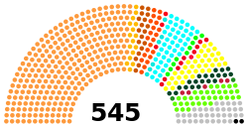
Seats in Lok Sabha
545 Members of Lok Sabha

Slide 7
Working, procedures and committees
The Parliament consists of the President of Republic of India and both the Chambers. The House and the Council are equal partners in the legislative process; however, the Constitution grants the House of People some unique powers. Revenue-raising or "Money" bills must originate in the Lok Sabha. The Council of States can only make recommendations suggestions over these bills to the House, within a period of fourteen days – lapse of which the bill is assumed to have been passed by both the Chambers.

Slide 8
Session of parliament
The period during which the House meets to conduct its business is called a session. The Constitution empowers the President to summon each House at such intervals that there should not be more than 6-month's gap between the two sessions. Hence the Parliament must meet at least twice a year. In India, the parliament conducts three sessions each year:
Budget session: In the months of February to May.
Monsoon session: In the months of July to September.
Winter session: In the months of November to December

Slide 9
Lawmaking procedures
India is a federal country, therefore laws can be made separately at different levels, by the Union Government (Federal Government) for the entire country and by the State Governments for their respective states. The legislative procedure in Indiafor the Union Government requires that proposed bills pass through the two legislative houses of the Indian parliament. The legislative procedure for states with bicameral legislatures requires that proposed bills be passed firstly in the state'sVidhan Sabha (Lower House) and then in the State Vidhan Parishad (Upper House). In states with unicameral legislatures, laws and bills need only be passed in the state's Vidhan Sabha, for there is no Vidhan Parishad.

Slide 10
Parliamentary committees
Parliamentary committees play a vital role in the Parliamentary System. They create a vibrant link between the Parliament, the Executive and the general public. In a committee, the matter is deliberated at length, views are expressed freely, the matter is considered in depth, in a business-like manner and in a calm atmosphere. In most of the Committees, public is directly or indirectly associated when memoranda containing suggestions and are received, on-the-spot studies are conducted and oral evidence is taken which helps the Committees in arriving at the conclusions.

Slide 11
Parliamentary committees are of two kinds:
Parliamentary committees
1> Standing committees
2> Ad hoc committees

Slide 12
Standing committees
There are standing committees in the Indian Parliament. Each house of Parliament has standing committees like the Business Advisory Committee, the Committee on Petitions, the Committee of Privileges and the Rules Committee, etc.
Standing committees are permanent regular committees which are constituted from time to time in pursuance of the provisions of an Act of Parliament or Rules of Procedure and Conduct of Business in Parliament. The work of these committees is of a continuing nature. The Financial Committees, DRSCs and some other committees are standing committees.

Slide 13
Ad hoc committees
Ad hoc committees are appointed for a specific purpose and they cease to exist when they finish the task assigned to them and submit a report. The principal ad hoc committees are the Select and Joint Committees on Bills. Others like the Railway Convention Committee, the Committees on the Draft Five Year Plans and the Hindi Equivalents Committee were appointed for specific purposes.
Joint Committee on Food Management in Parliament House Complex etc. also come under the category of ad hoc committees.

