Slide 1
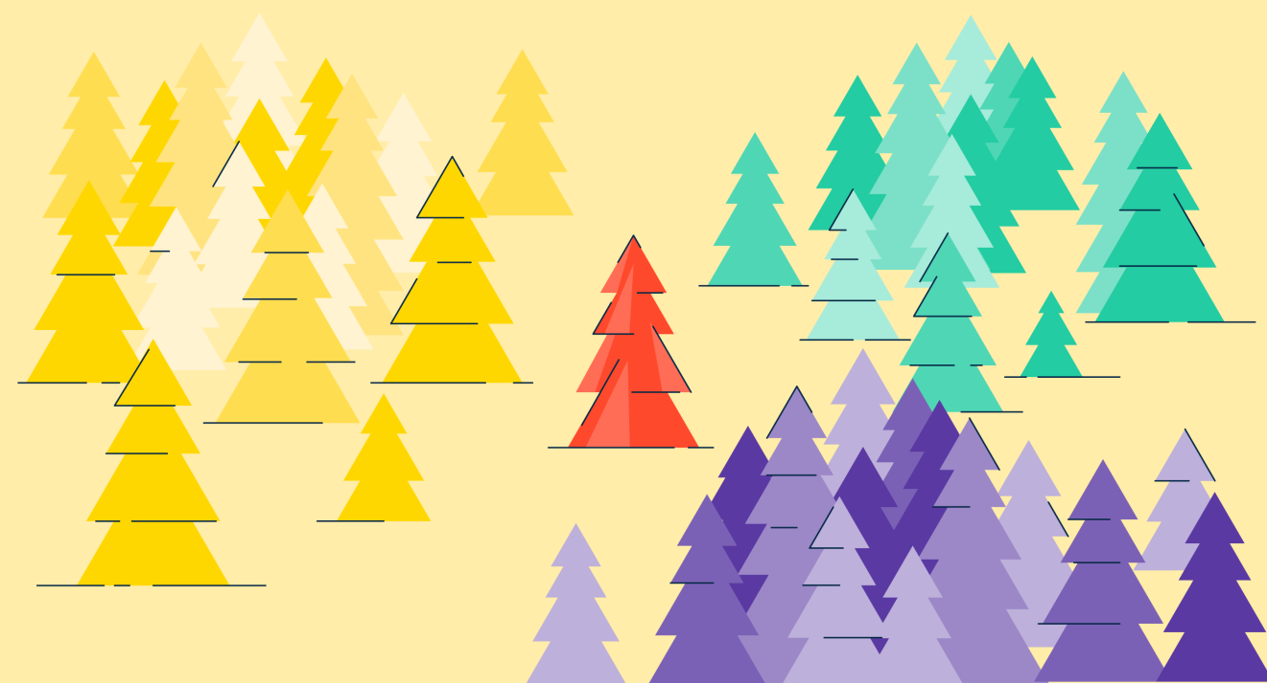
UNIT-IV (Instance Based Learning)

Slide 2
Topics :
K- Nearest Neighbor learning(KNN)
Choosing parameters for Nearest Neighbor
KNN Algorithm
Example of KNN

Slide 3
K-Nearest Neighbor(KNN) Learning
The most basic instance –based method is the K- Nearest Neighbor Algorithm.
K-Nearest Neighbour is one of the simplest Machine Learning algorithm based on Supervised Learning technique.
It is used to solve both classification and regression problems. However, it's mainly used for classification problems.

Slide 4
Contd..
The K-nearest neighbors (KNN) algorithm is a data classification method for estimating the data point will become a member of one group or another based on what group the data points nearest to it belong to.
The following two properties would define KNN well −
1. Lazy learning algorithm − KNN is a lazy learning algorithm, because it does not learn from the training set immediately instead it stores the dataset and at the time of classification, it performs an action on the dataset.
i.e, instead of Learning we have only memorizing the data.

Slide 5
Contd..
Eg: Learning and Memorizing
Suppose you have preparing for the exam, once you write the exam then what you have learnt erase from your brain that it is only the memorizing.
But instead of memorizing , if you learn and if you understand the concept and if you go to the exam, even after completing the exam also you will able to remember that topic.
2. Non-parametric learning algorithm − KNN is also a non-parametric learning algorithm because it doesn’t assume anything about the underlying data.

Slide 6
KNN Example
Suppose there are two classes, i.e., Class A and Class B, and we have a new unknown data point “?”, so this data point will lie in which of these classes.
To solve this problem, we need a K-NN algorithm. With the help of K-NN, we can easily identify the class of a particular dataset.
The data point is classified by a majority vote of its neighbors, with the data point being assigned to the class. Most commonly amongst its K nearest neighbors measured by a Distance Function.

Slide 7
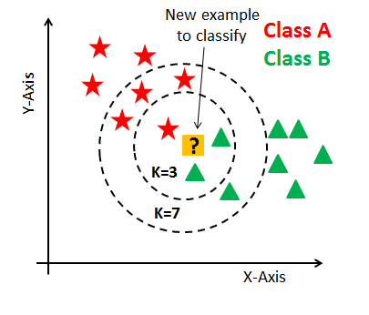
Contd..
Here, we can see that if k = 3,
then based on the distance function
used, the nearest three neighbors
of the data point is found and
based on the majority votes of its
neighbors, the data point is
classified into a class.
In the case of k = 3, for the above diagram, it’s
Class B. Similarly, when k = 7, for the above diagram, based on the majority votes of its neighbors, the data point is classified to Class A.

Slide 8
1. Choosing Parameters for Nearest Neighbor
Below are some points to remember while selecting the value of K in the K-NN algorithm:
1. There is no particular way to determine the best value for "K", so we need to try some values to find the best out of them. The most preferred value for K is 5.
2. A very low value for K such as K=1 or K=2, can be noisy and lead to the effects of outliers in the model.
3. Large values for K are good, but it may find some difficulties.

Slide 9
2. KNN ALGORITHM
The K-NN working can be explained on the basis of the below algorithm:
Step-1: Select the number K of the neighbors
Step-2: Calculate the Euclidean distance of K number of neighbors
Step-3: Take the K nearest neighbors as per the calculated Euclidean distance.
Step-4: Among these k neighbors, count the number of the data points in each category.
Step-5: Assign the new data points to that category for which the number of the neighbor is maximum.
Step-6: Our model is ready.

Slide 10
Contd..
There are four ways to calculate the distance measure between the data point and its nearest neighbor:
Euclidean distance,
Manhattan distance,
Hamming distance, and
Minkowski distance.
Out of the three, Euclidean distance is the most commonly used distance function or metric.

Slide 11
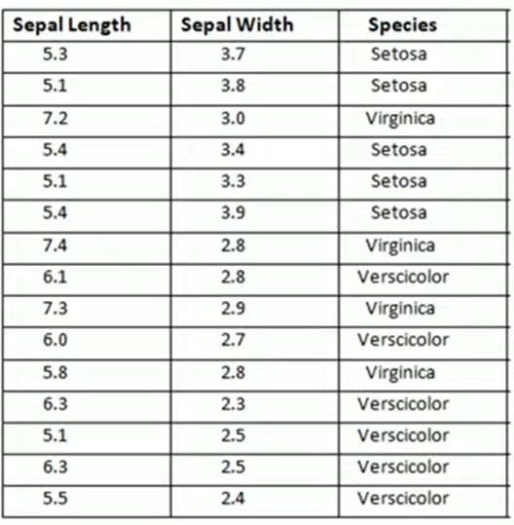
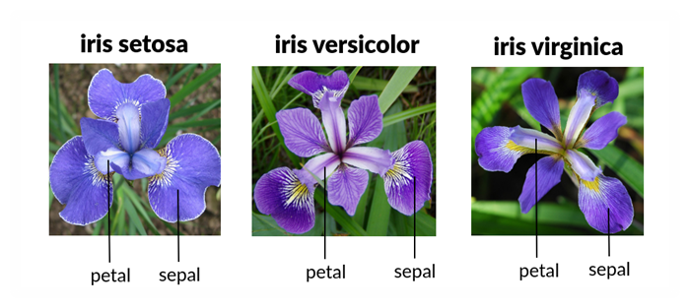
3. Example of KNN
Example-1: Consider the given data set, it contains 15 examples.

Slide 12
Contd..
Here we have 2 features. i.e, sepal length and sepal width. And here the Target is Species.
i.e, Target has 3 possibilities : Setosa, Virginica, Versicolor.
Now given the Value of K- we want to classify the new example. ie,
Suppose the value of K- may be 1 , 2 ,3 soon.
Here how to classify the species with the help of K-Nearest Neighbor Algorithm.

Slide 13
Step-1: First we need to calculate the Distance. Ie, here we have to use the Euclidean Distance.

Slide 14
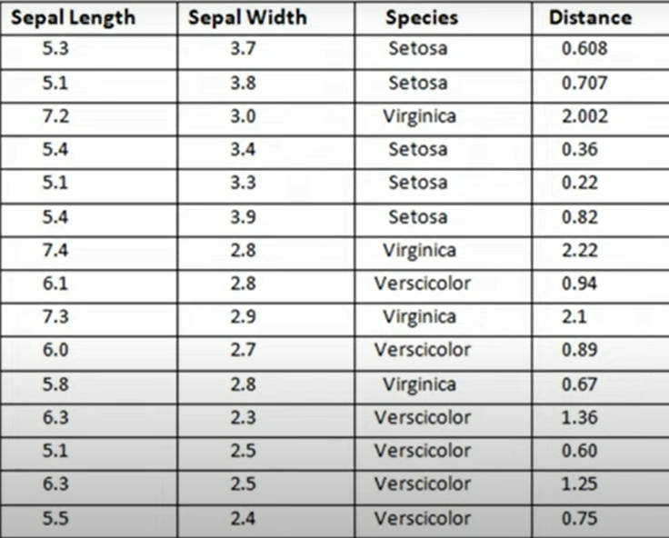
In the same way we have to calculate all the examples. And finally will get

Slide 15
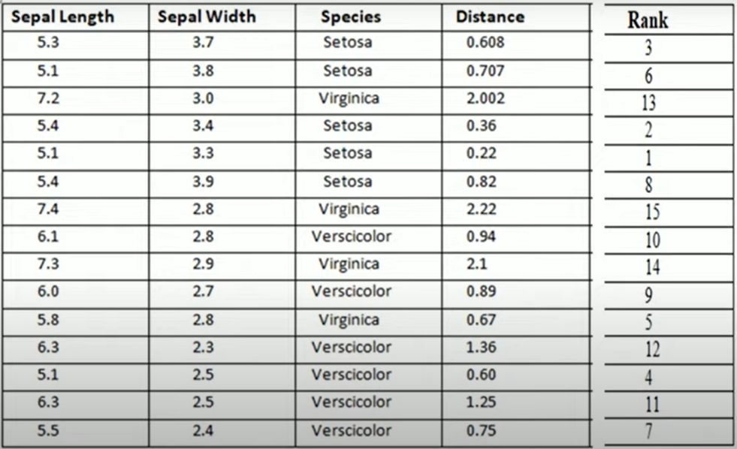
Step-2: To find Rank. Ie, here the distance which is having minimum is the First Rank.

Slide 16
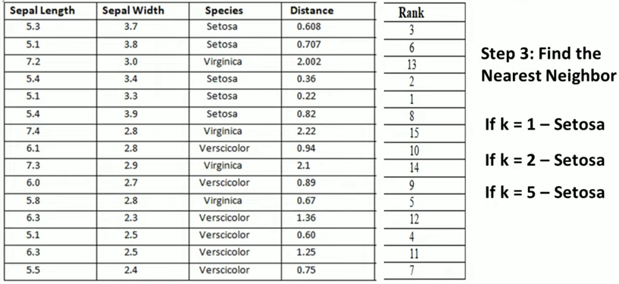
Step-3: To find K-Nearest Neighbour. Here, we have to take k=1 rank example etc.

Slide 17
Here, we can observe that , suppose we have to take
k=1 is Setosa, K=2 Setosa, K=3 Setosa, K=4 Versicolor, but majority of voting is Setosa. So Answer is Setosa for K=4.
K=5 Virginica, but majority of voting is Setosa. So Answer is Setosa for K=5 .
So Our new Example goes to Setosa.

Slide 18
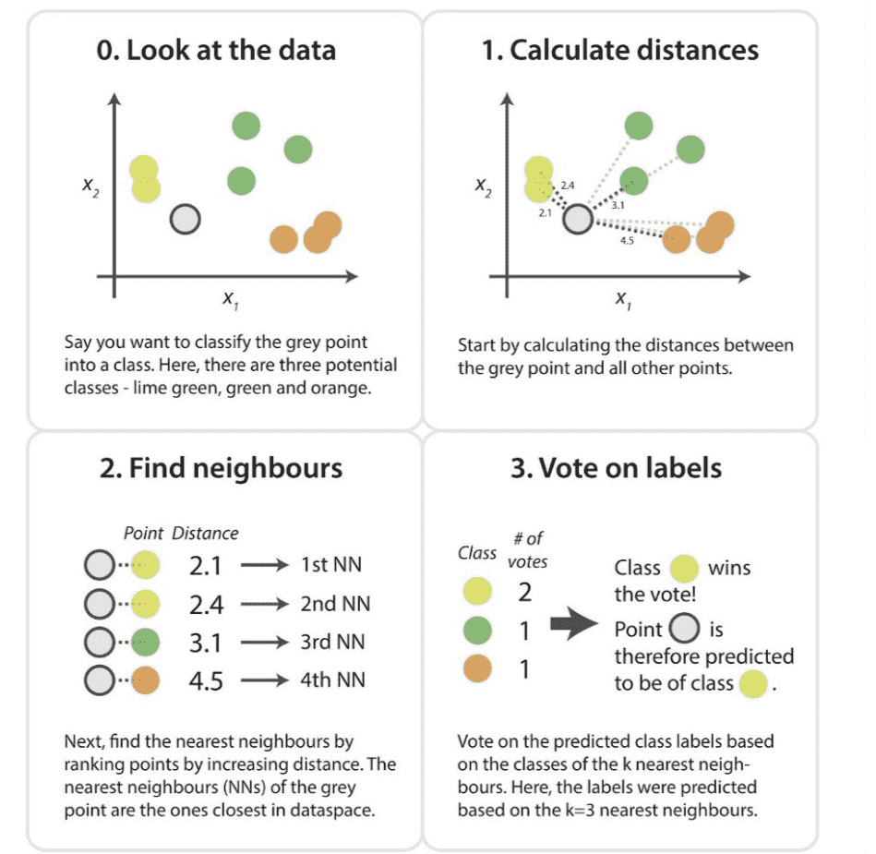

Slide 19
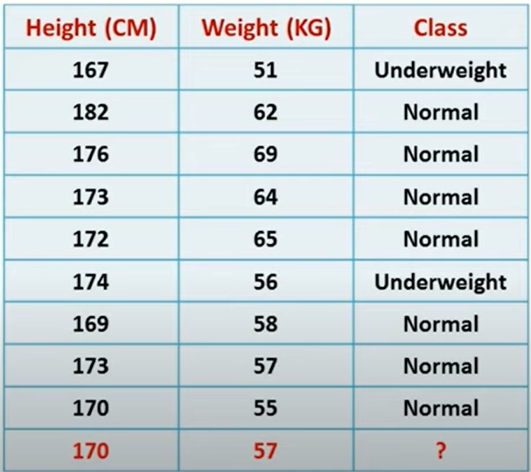
Example-2
To predict the Class Label for new instance.

Slide 20
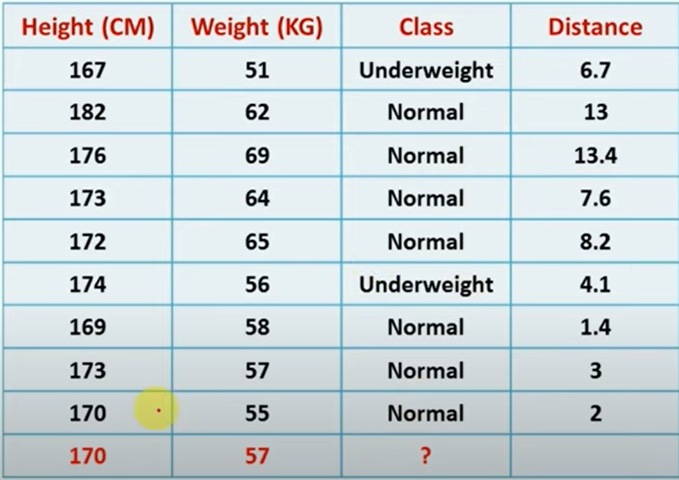
1. First we can calculate the Distance Formula:

Slide 21
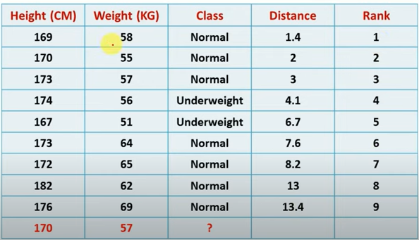
2. next, we can calculate the Rank:

Slide 22
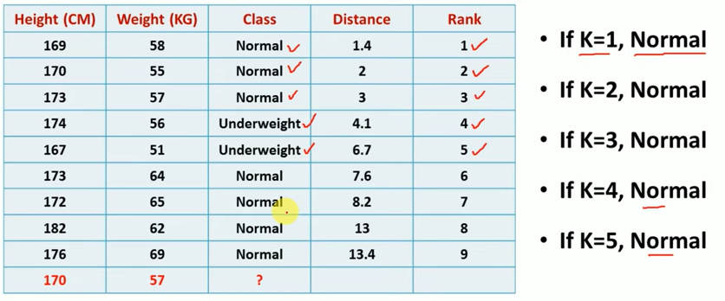
3. next, we can find the K-nearest Neighbor:
Based on the K- Neighbors, our new Instance is also Normal Class.

Slide 23
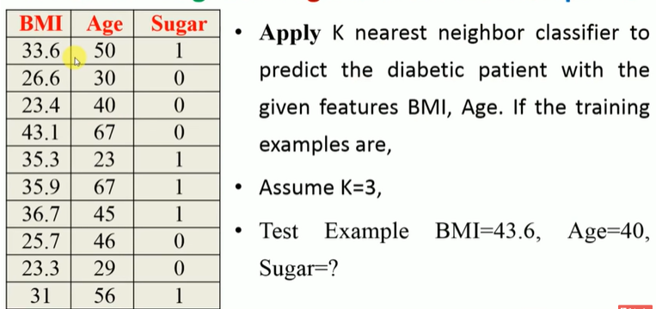
Example-3

Slide 24
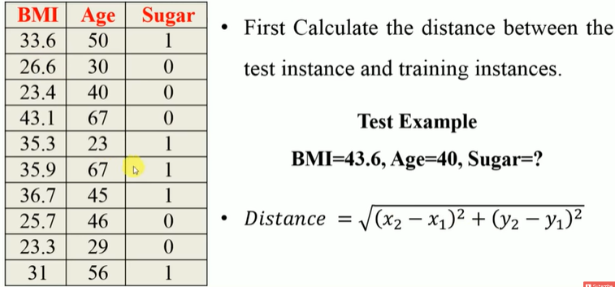
Contd..

Slide 25
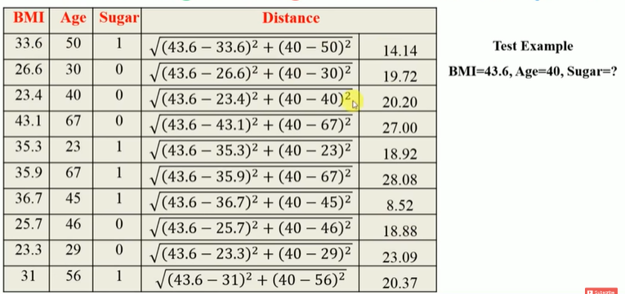
Contd..

Slide 26
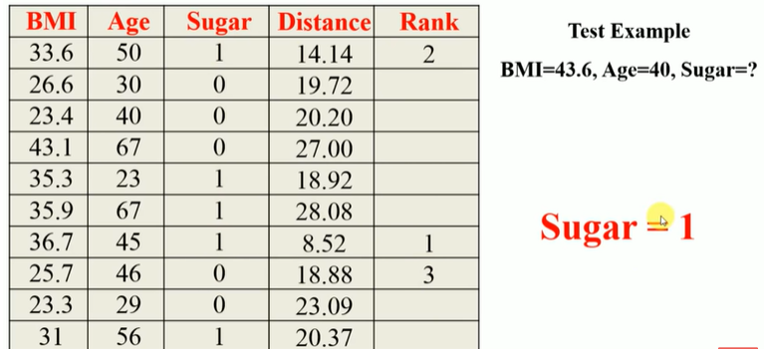
Contd..

Slide 27
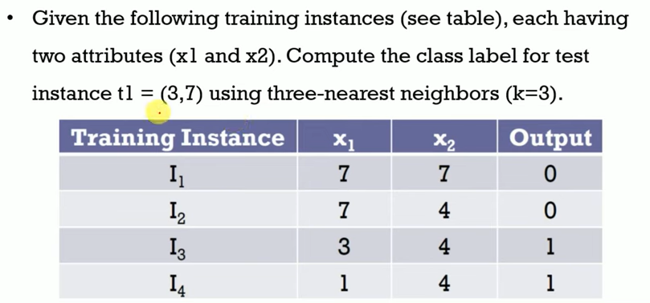
Example-4

Slide 28
First we can calculate Distance, Rank

Slide 29
Next, we can find the Nearest Neighbor is K=3.
So we can find first three K- nearest Neighbors.ie, I3, I4, I1
Here we can observe that the Majority . So here the majority in this case is “1”.

Slide 30
Applications of KNN
1. Finance — financial institutes will predict the credit rating of customers.
2. Healthcare — gene expression.
3. Political Science — classifying potential voters in two classes will vote or won’t vote.
4. Handwriting detection.
5. Image Recognition.
6. Video Recognition.
7. Pattern Recognition

Slide 31
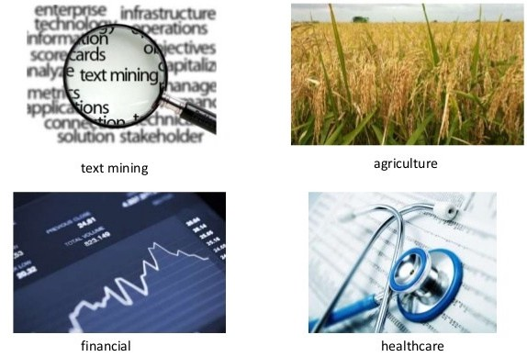

Slide 32
Weighted Nearest neighbour Algorithm

Slide 33
First we can calculate Distance, Rank

Slide 34
Next, We can Calculated as Inverse Square Distance. Ie, we can considered as the Weight for that particular instance.
That is also called as “ Weighted Nearest Neighbor Algorithm”

Slide 35
Here , we observe that “Minimum Distance and Maximum Weight”
Next, we can find the Nearest Neighbor is K=3.
So we can find first three K- nearest Neighbors. ie, I3, I4, I1
Here we can observe that the Majority . So here the majority in this case is “1”.

Slide 36
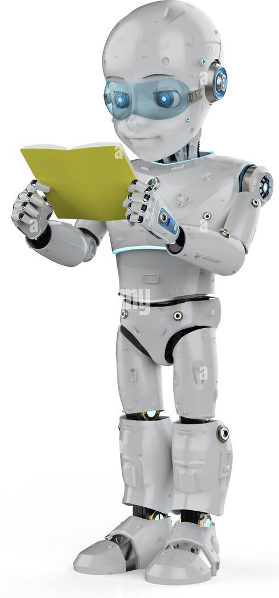
THANK YOU

