Slide 1
UNIT-III (Ensemble Methods)

Slide 2
Topics :
Ensemble Methods
Bagging
Boosting

Slide 3
Ensemble Methods
In simple English, Ensemble is nothing but group of items.
Ensemble methods is a machine learning technique that combines several base models in order to produce one optimal predictive model.
It is a powerful method to improve the performance of the model.
The main Aim is to combine all these models , to increase the Accuracy.

Slide 4
Contd..
For Eg: When you want to purchase a laptop, will you simply walk up to the store and pick any laptop? It’s highly unlikely.
Generally, You would likely browse a few web portals where people have posted their reviews and compare different laptop models, checking for their features, specifications and prices. You will also probably ask your friends and colleagues for their opinion.

Slide 5
Contd..
In short, you wouldn’t directly reach a conclusion, but will instead make a decision considering the opinions of other people as well. Here also we can follow the Ensemble Learning .
An ensemble is itself a supervised learning algorithm, because it can be trained and then used to make predictions.
By using the Ensemble Learning, we have 2 objectives:
1. Reducing the Error
2. Maintaining the Generalizations.

Slide 6
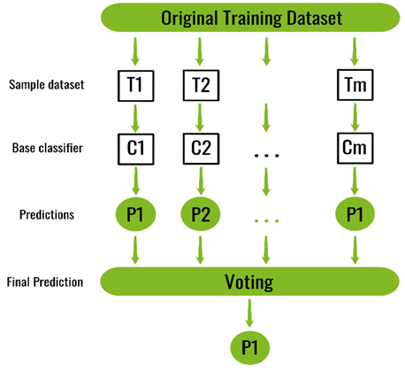
Figure: Ensemble Methods

Slide 7
Real Time Example
Consider the fable of the blind men and the elephant depicted in the image below.
The blind men are each describing an elephant from their own point of view.
Their descriptions are all correct but incomplete. Their understanding of the elephant would be more accurate and realistic if they came together to discuss and combined their descriptions.

Slide 8
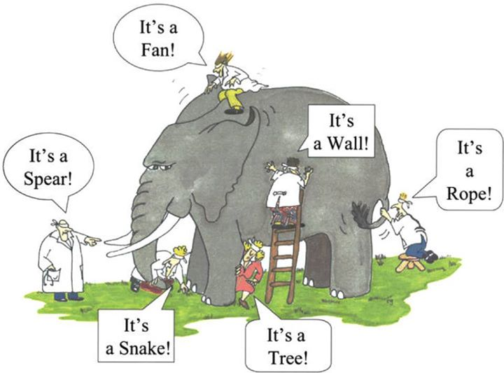
The main principle of ensemble methods is to combine weak and strong learners to form strong learners.

Slide 9
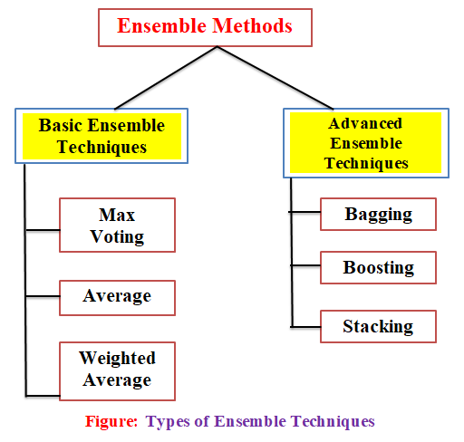
Types of Ensemble Techniques

Slide 10
Basic Ensemble Techniques
1. Max Voting: The max voting method is generally used for classification problems. In this technique, multiple models are used to make predictions for each data point.
The predictions by each model are considered as a ‘vote’.
The predictions which we get from the majority of the models are used as the final prediction.
For Example: when you asked 5 of your colleagues to rate your movie (out of 5);
we’ll assume three of them rated it as 4 while two of them gave it a 5.

Slide 11
Contd..
Since the majority gave a rating of 4, the final rating will be taken as 4. You can consider this as taking the mode of all the predictions.
The result of max voting would be something like this:

Slide 12
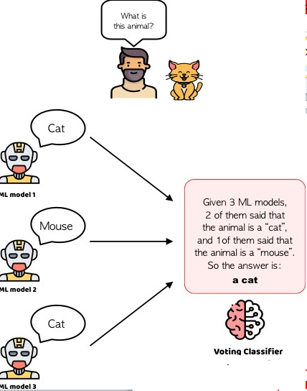

Slide 13
Contd..
2. Average Voting: Similar to the max voting technique, multiple predictions are made for each data point in averaging.
In this method, we take an average of predictions from all the models and use it to make the final prediction.
Averaging can be used for making predictions in regression problems or while calculating probabilities for classification problems.
For example, in the below case, the averaging method would take the average of all the values.
i.e. (5+4+5+4+4)/5 = 4.4

Slide 14
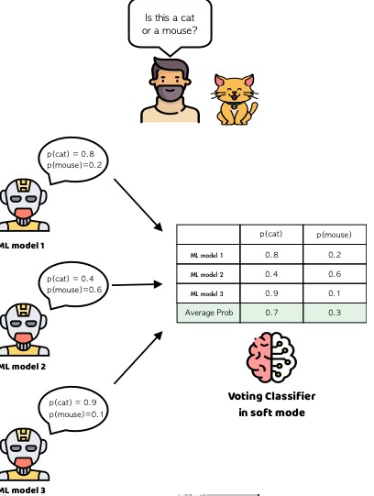

Slide 15
Contd..
3. Weighted Average: This is an extension of the averaging method.
All models are assigned different weights defining the importance of each model for prediction.
For instance, if two of your colleagues are critics, while others have no prior experience in this field, then the answers by these two friends are given more importance as compared to the other people.

Slide 16
The result is calculated as
[(5*0.23) + (4*0.23) + (5*0.18) + (4*0.18) + (4*0.18)] = 4.41.

Slide 17
Advanced Ensemble Techniques
Bagging and Boosting are the two very important ensemble methods to improve the measure of accuracy in predictive models which is widely used.
While performing a machine learning algorithm we might come across various errors such as noise . To overcome these errors we apply ensemble methods.

Slide 18
Contd..
1.Bagging: Bagging is an acronym for Bootstrapped Aggregation. And it is a simple and very powerful ensemble method.
It is mainly used in Decision Trees.
For Eg: In the analogy, each friend will take the test separately, and then their answers will be combined to form the final answer on the exam. There are many ways of combining the answers, but the most common way is voting.
Bagging is mainly used in Random Forest Algorithm.

Slide 19
How Bagging Works
In 1996, Leo Breiman introduced the bagging algorithm, which has three basic steps:
1. Bootstrapping
2. Parallel Training
3. Aggregation
1. Bootstrapping: Bootstrapping is a sampling technique in which subsets of observations from the original dataset are generated.
This means that each time you select a data point from the training dataset, you are able to select the same instance multiple times.

Slide 20
Contd..
2. Parallel Training: These bootstrap samples are then trained independently and in parallel with each other using base learners.
3. Aggregation: Finally, depending on the task(i.e. regression or classification), an average or a majority of the predictions are taken to compute the Accurate Results.

Slide 21
Contd..
In the case of regression, an average is taken of all the outputs predicted by the individual classifiers; this is known as soft voting.
For classification problems, the class with the highest majority of votes is accepted; this is known as hard voting or majority voting.

Slide 22
Implementation Steps of Bagging
Step 1: Multiple subsets are created from the original data set with equal tuples, selecting observations with replacement.
Step 2: A base model is created on each of these subsets.
Step 3: Each model is learned in parallel with each training set and independent of each other.
Step 4: The final predictions are determined by combining the predictions from all the models.

Slide 23
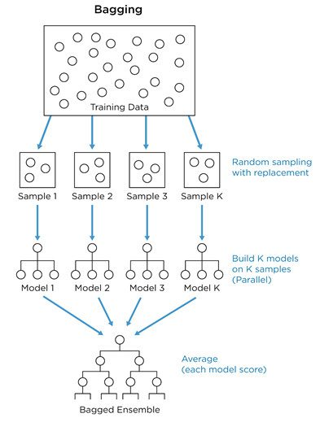

Slide 24
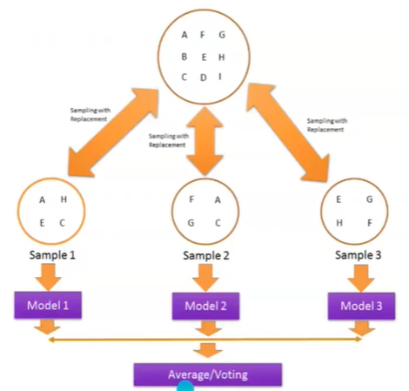

Slide 25
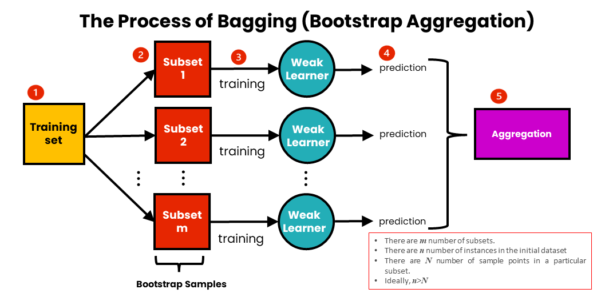

Slide 26
Random Forest Algorithm
Random Forest is a popular machine learning algorithm that belongs to the supervised learning technique.
It can be used for both Classification and Regression problems in ML.
It is based on the concept of ensemble learning, which is a process of combining multiple classifiers to solve a complex problem and to improve the performance of the model.

Slide 27
Contd..
As the name suggests, "Random Forest” is a classifier that contains a number of decision trees on various subsets of the given dataset and takes the average to improve the predictive accuracy of that dataset.
Here the random forest takes the prediction from each tree and based on the majority votes of predictions, and it predicts the final output.
The main Aim is the greater number of trees in the forest leads to higher accuracy and prevents the problem of overfitting.

Slide 28
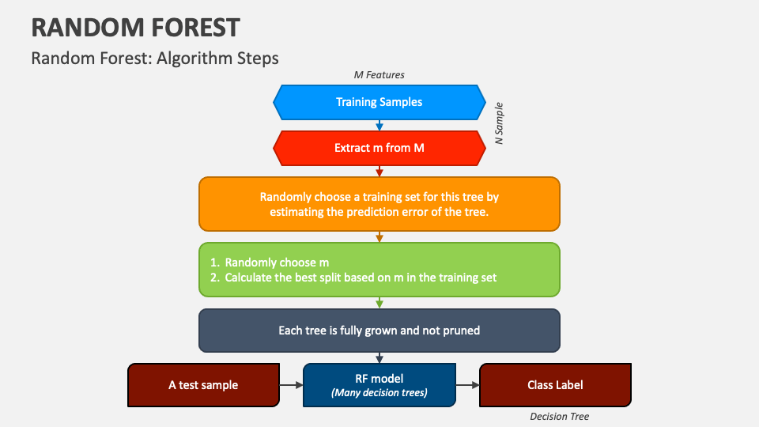
Contd..

Slide 29
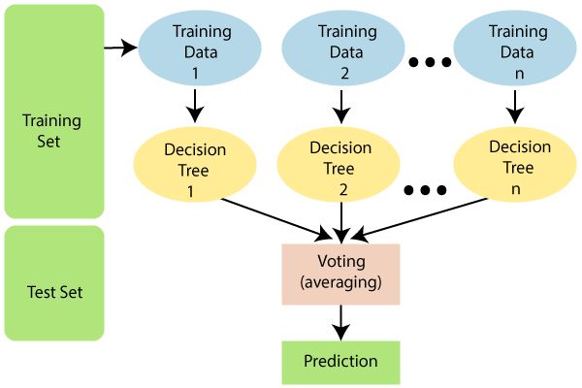

Slide 30
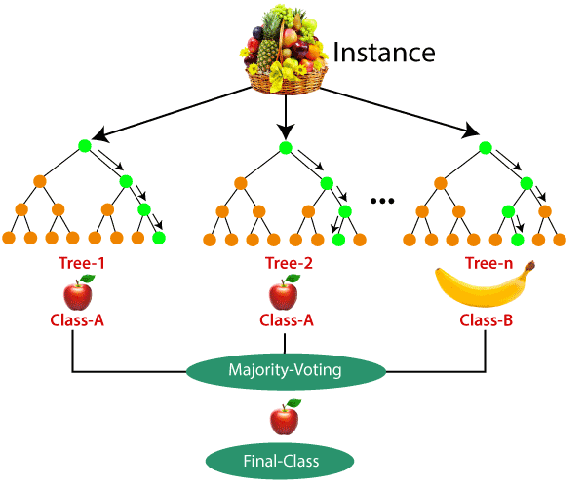
Example:

Slide 31
Applications of Random Forest
There are mainly four sectors where Random forest mostly used:
1. Banking: Banking sector mostly uses this algorithm for the identification of loan risk.
2. Medicine: With the help of this algorithm, disease trends and risks of the disease can be identified.
3. Land Use: We can identify the areas of similar land use by this algorithm.
4. Marketing: Marketing trends can be identified using this algorithm.

Slide 32
Contd..
2.Boosting: Gradient Boosting is an ensemble learning technique in which models are not run independently but sequentially.
Boosting is a kind of algorithm that is able to convert weak learners to strong learners.
In Boosting Technique, Each Algorithm. Ie, base learners are trained sequentially and at every time the next learner is trying to reduce the error by updating the parameters and perform better comparison to the previous learners.

Slide 33
How Boosting Works
Here’s what the entire process looks like:
1. Create a subset from the original data,
2. Build an initial model with this data,
3. Run predictions on the whole data set,
4. Calculate the error using the predictions and the actual values, Assign more weight to the incorrect predictions.

Slide 34
Contd..
Create another model that attempts to fix errors from the last model,
Run predictions on the entire dataset with the new model,
Create several models with each model aiming at correcting the errors generated by the previous one, Obtain the final model by weighting the mean of all the models.
Boosting algorithms is the family of algorithms that combine weak learners into a strong learner.

Slide 35
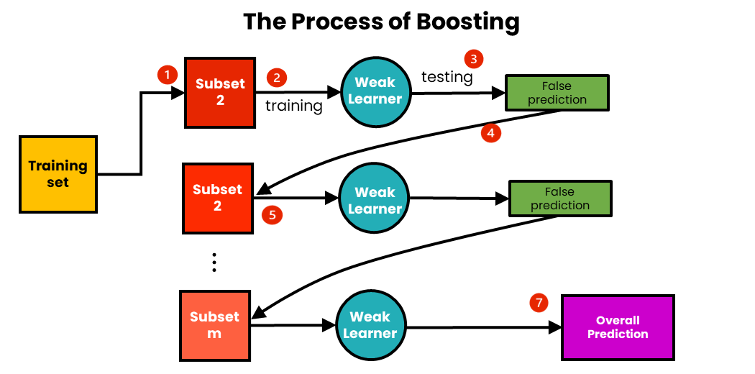
Contd..

Slide 36
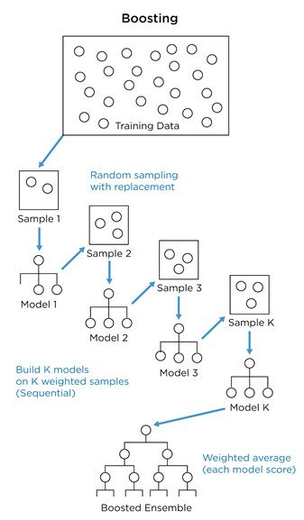
Contd..

Slide 37
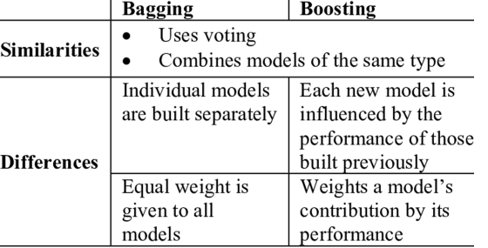
Differences between Bagging And Boosting

Slide 38
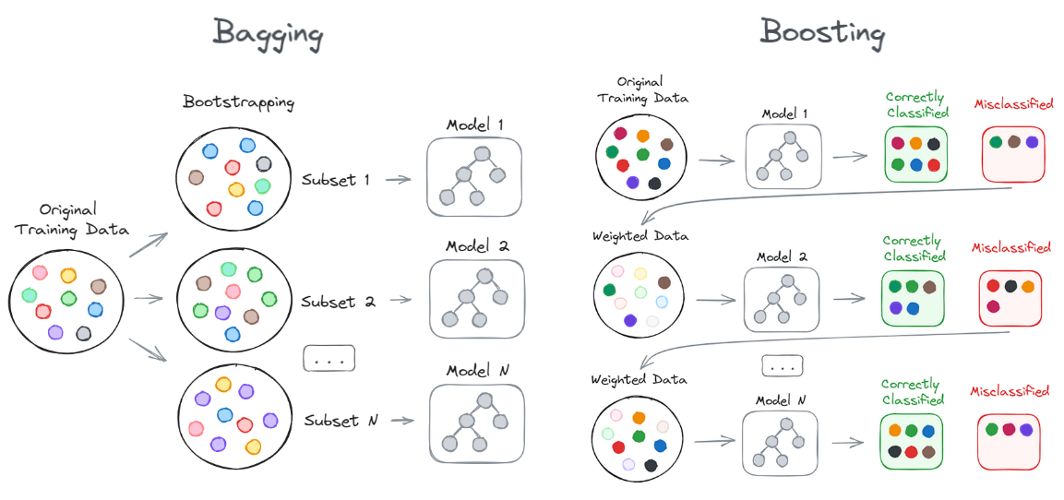
Differences between Bagging And Boosting

Slide 39
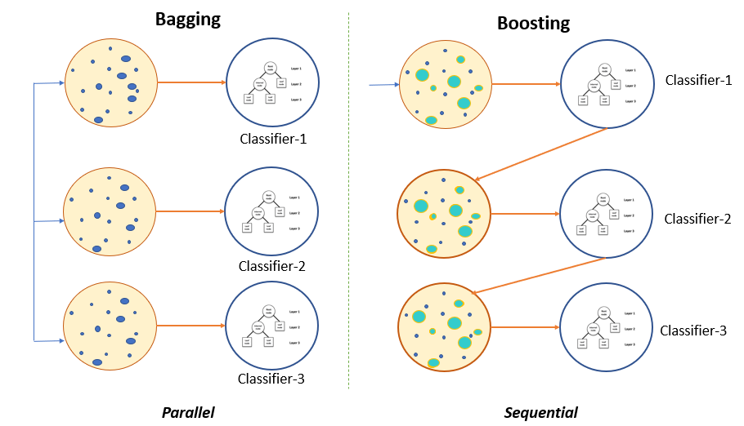
Differences between Bagging And Boosting

Slide 40
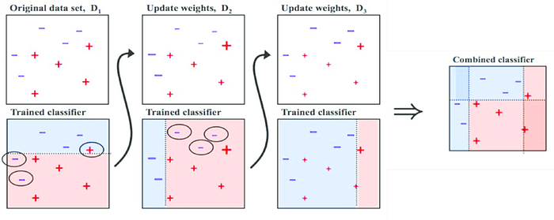

Slide 41
Main Steps involved in boosting are :
Train model A on the whole set
Train the model B with exaggerated data on the regions in which A performs poorly
…
Instead of training the models in parallel, we can train them sequentially. This is the main idea of Boosting!

Slide 42
In order to provide you with an idea about mail spam detection problem.
The spam detection problem can be divided into the following steps.
Detect if an email contains ‘how have earned the prize’?
If the email contains only an image?
Who is the sender?
How caps lock was used in the email?
Check the subject line in the email

Slide 43
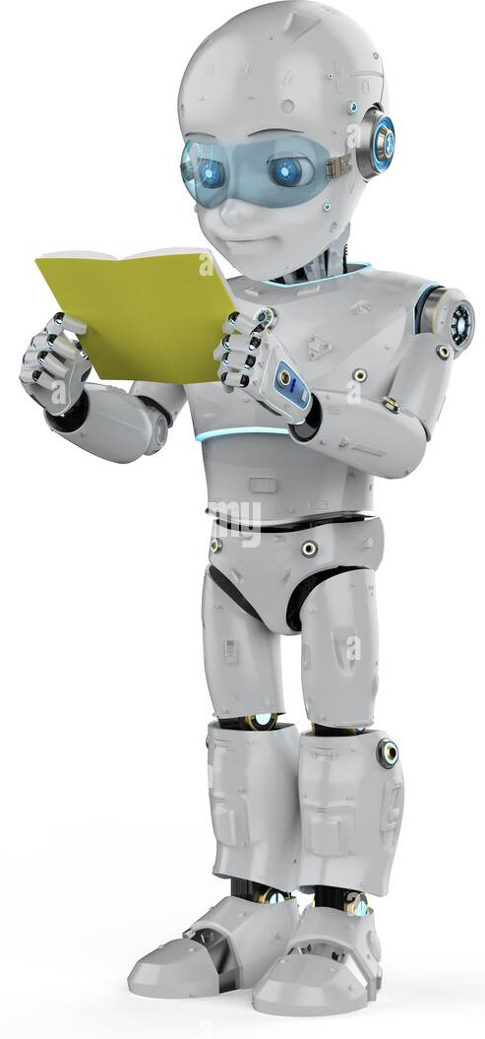
THANK YOU

