Slide 1
UNIT-V (Density Based Clustering)

Slide 2
Topics :
DBSCAN Algorithm
Example Problem

Slide 3
Density based Clustering
Density based clustering is also called as “DBSCAN Clustering”.
DBSCAN stands for “Density-Based Spatial Clustering of Applications with Noise”.
It is a popular unsupervised learning Algorithm and It was proposed by Martin Ester et al. in 1996.
DBSCAN is a clustering method that is used in machine learning to separate clusters of high density from clusters of low density.

Slide 4
Contd..
Here, DBSCAN identify the distinctive groups/clusters in the data, based on the idea that a cluster in data space is a contiguous region of high point density, separated from other such clusters by contiguous regions of low point density.

Slide 5
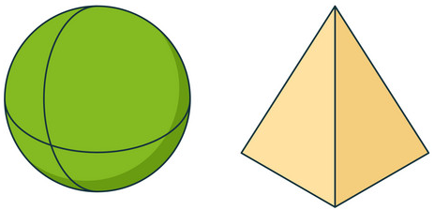
Why we need DBSCAN Algorithm?
Partitioning methods (K-means) and hierarchical clustering work for finding spherical-shaped clusters or convex clusters.
Partition-based and hierarchical clustering techniques are highly efficient with normal shaped clusters. However, when it comes to arbitrary shaped clusters or detecting outliers, density-based techniques are more efficient.

Slide 6
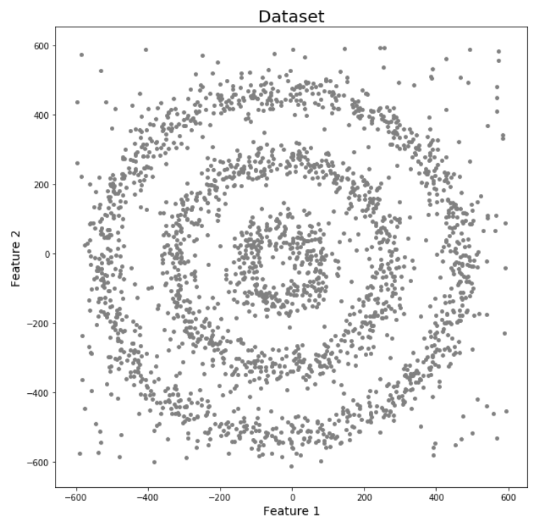
Contd..
K-Means and Hierarchical Clustering both fail in creating clusters of arbitrary shapes. They are not able to form clusters based on varying densities. That’s why we need DBSCAN clustering.
For Eg: Here we have data points densely present in the form of concentric circles:

Slide 7
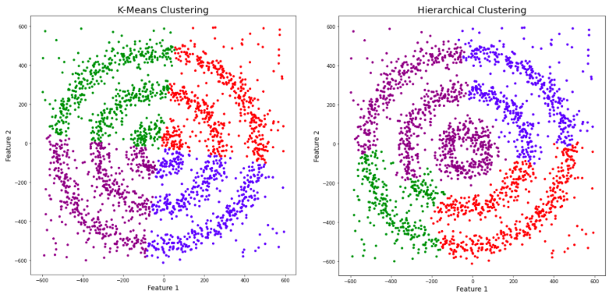
Contd..
We can see three different dense clusters in the form of concentric circles with some noise here.
Now, let’s run K-Means and Hierarchical clustering algorithms and see how they cluster these data points.

Slide 8
Contd..
Q: You might be wondering why there are four colors in the graph?
As I said earlier, this data contains noise too, therefore, I have taken noise as a different cluster which is represented by the purple color.
Sadly, both of them failed to cluster the data points.
Also, they were not able to properly detect the noise present in the dataset.

Slide 9
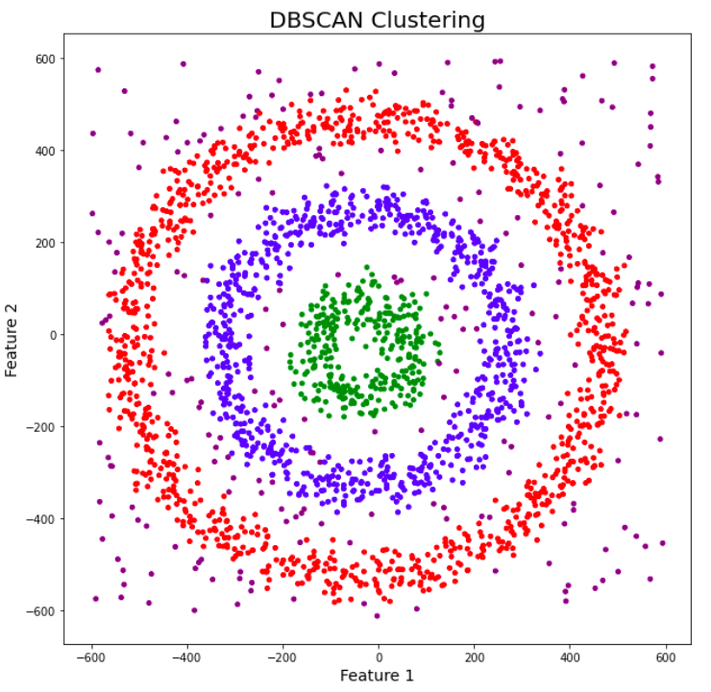
Contd..
Now, let’s take a look at the results from DBSCAN clustering.
DBSCAN is not just able to cluster the data points correctly, but it also perfectly detects noise in the dataset.

Slide 10
Contd..
The most exciting feature of DBSCAN clustering is that it is robust to outliers.
It also does not require the number of clusters. but in K-Means, where we have to specify the number of centroids.
It can discover clusters of different shapes and sizes from a large amount of data, which is containing noise and outliers.
DBSCAN can also be used for Anomaly Detection (Outlier Detection)

Slide 11
Contd..
The DBSCAN algorithm uses two parameters:
1. minPts: The minimum number of points (a threshold) clustered together for a region to be considered dense.
2. eps (ε): A distance measure that will be used to locate the points in the neighborhood of any point.
Three Main points to form the clusters
1. Core point: A point is a core point if there are at least minPts number of points (including the point itself) in its surrounding area with radius eps

Slide 12
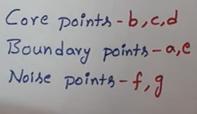
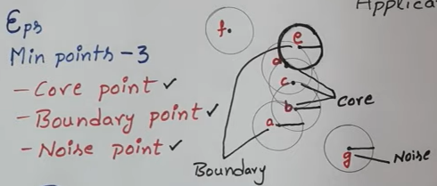
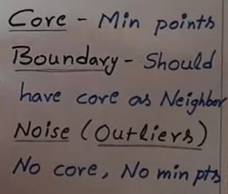
Contd..
2. Border point: A point is a border point if it is reachable from a core point and there are less than minPts number of points within its surrounding area.
3. Outlier or Noise Point: A point is an outlier if it is not a core point and not reachable from any core points.

Slide 13
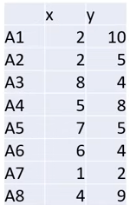
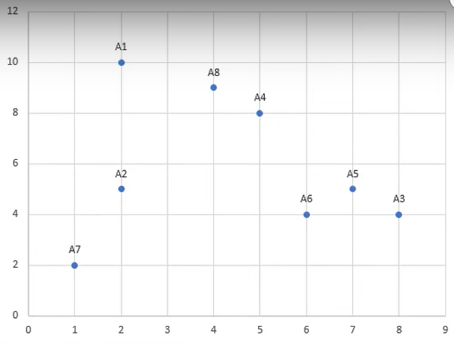
Example
Data Points:

Slide 14
Contd..
Step-1: First we need to calculate the Euclidean Distance between the Points.

Slide 15
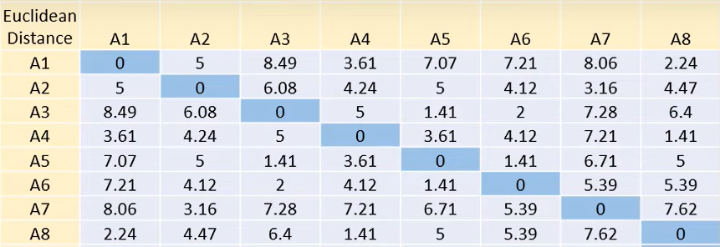
Contd..
In this table,

Slide 16
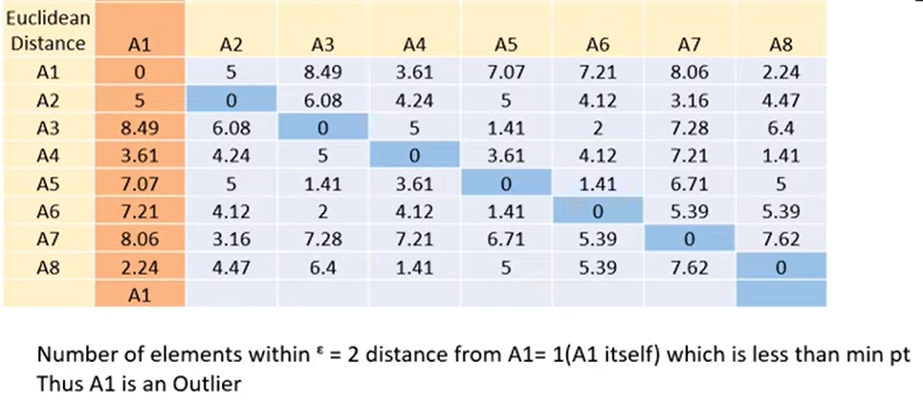
Contd..
Step-2: Now starts with Point A1. we will check how many points are with in this Epsilon. In A1 we again check either a Core or border or outlier.

Slide 17
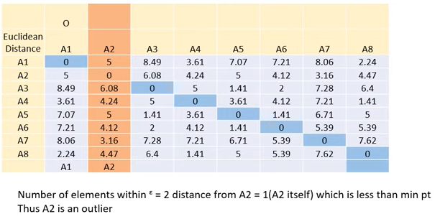
Contd..
Step-3: Now starts with Point A2. we will check how many points are with in this Epsilon. In A2 we again check either a Core or border or outlier.

Slide 18
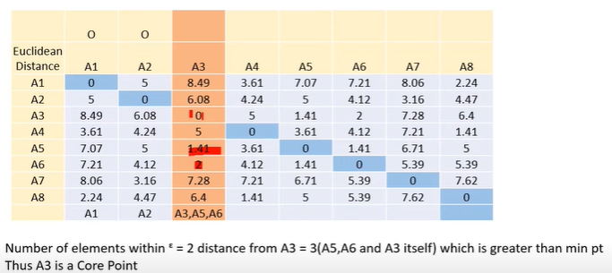
Contd..
Step-4: Now starts with Point A3. we will check how many points are with in this Epsilon. In A3 we again check either a Core or border or outlier.

Slide 19
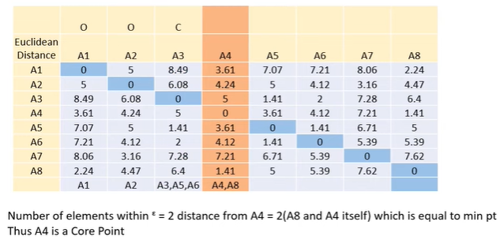
Contd..
Step-5: Now starts with Point A4. we will check how many points are with in this Epsilon. In A4 we again check either a Core or border or outlier.

Slide 20
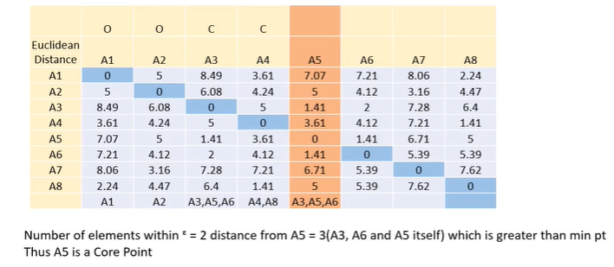
Contd..
Step-6: Now starts with Point A5. we will check how many points are with in this Epsilon. In A5 we again check either a Core or border or outlier.

Slide 21
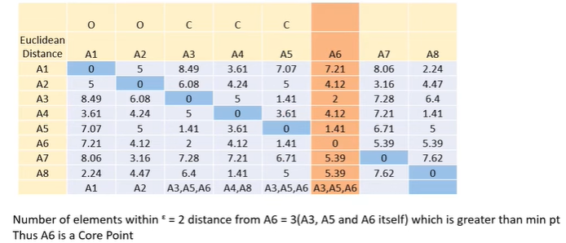
Contd..
Step-7: Now starts with Point A6. we will check how many points are with in this Epsilon. In A6 we again check either a Core or border or outlier.

Slide 22
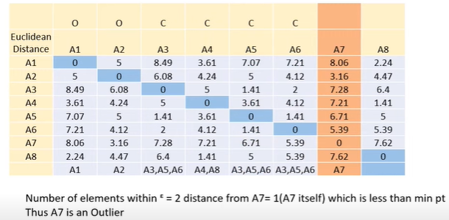
Contd..
Step-8: Now starts with Point A7. we will check how many points are with in this Epsilon. In A7 we again check either a Core or border or outlier.

Slide 23
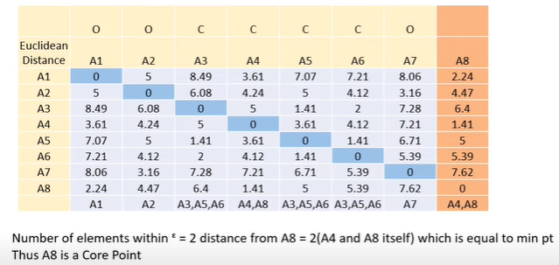
Contd..
Step-9: Now starts with Point A8. we will check how many points are with in this Epsilon. In A8 we again check either a Core or border or outlier.

Slide 24
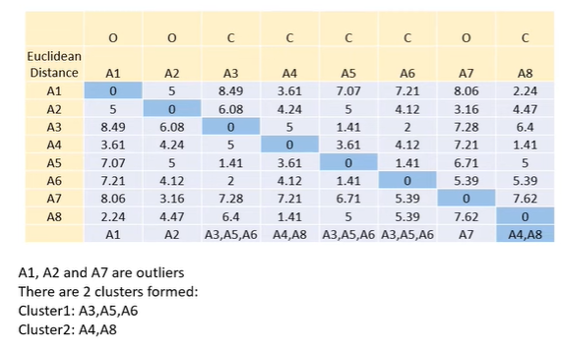
Contd..
Step-10: Finally we will check how many outliers and how many clusters are formed in this example.

Slide 25
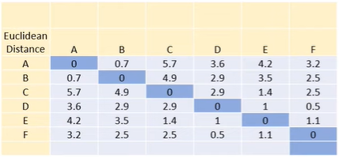
Example-2

Slide 26
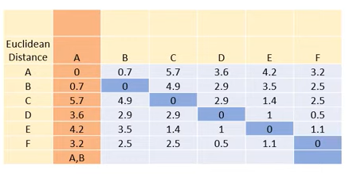
Contd..
Step-2: Now starts with Point A. we will check how many points are with in this Epsilon. In A we again check either a Core or border or outlier.

Slide 27
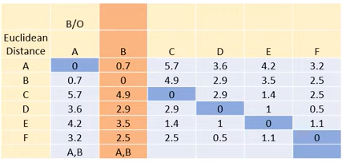
Contd..
Step-3: Now starts with Point B. we will check how many points are with in this Epsilon. In B we again check either a Core or border or outlier.

Slide 28
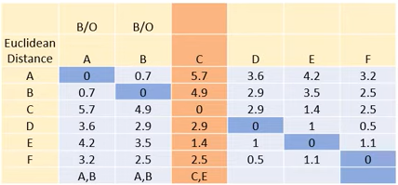
Contd..
Step-4: Now starts with Point c. we will check how many points are with in this Epsilon. In c we again check either a Core or border or outlier.

Slide 29
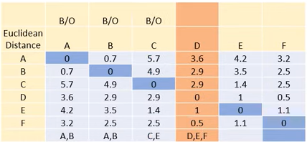
Contd..
Step-5: Now starts with Point D. we will check how many points are with in this Epsilon. In D we again check either a Core or border or outlier.

Slide 30
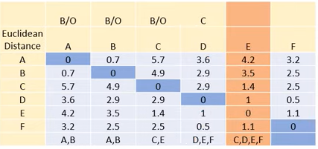
Contd..
Step-6: Now starts with Point E. we will check how many points are with in this Epsilon. In E we again check either a Core or border or outlier.

Slide 31
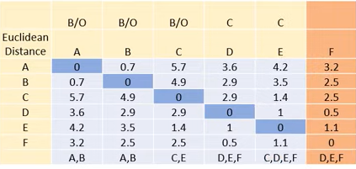
Contd..
Step-7: Now starts with Point F. we will check how many points are with in this Epsilon. In F we again check either a Core or border or outlier.

Slide 32
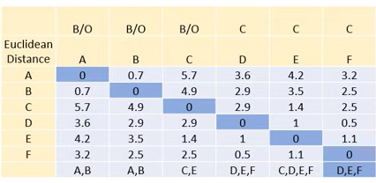
Contd..

Slide 33
THANK YOU

