Slide 1
Artificial Intelligence
Dr. PARVATHANENI NAGA SRINIVASU [B.Tech, M.Tech, Ph.D.]
Associate Professor,
Department of Computer Science and Engineering,
Prasad V. Potluri Siddhartha Institute of Technology,
Vijayawada-520007, Andhra Pradesh, India.
Visiting Post-Doc Fellow-Dongguk University, South Korea.
Visiting Post-Doc Fellow- Sejong University, South Korea.
Review Editor- Frontiers in Plant Science
Review Editor- Frontiers in Materials
Honorary Member- London Journal Press
Life Member-Computer Society of India
Life Member-IAENG
Life Member-International Association of Engineers
Life Member-Engineering Research and Publications
Member-Indian Academicians and Research Associates
Mobile:+91-9000595535

Slide 2
Topics
The Planning problem
planning with state space search
Planning graphs
Planning with propositional logic
Analysis of planning approaches
Hierarchical planning
Conditional planning
Continuous and Multi Agent planning.

Slide 3
Planning problem
An agent interacts with the world via perception and actions.
Perception involves sensing the world and assessing the situation.
creating some internal representation of the world.
Actions are what the agent does in the domain. Planning involves reasoning about actions that the agent intends to carry out.
Planning is the reasoning side of acting.
This reasoning involves the representation of the world that the agent has, as also the representation of its actions.
Hard constraints where the objectives have to be achieved completely for success.
The objectives could also be soft constraints, or preferences, to be achieved as much as possible.

Slide 4
Types of Planning
Projection into the future
The planner searches through the possible combination of actions to find the plan that will work
Memory based planning
looking into the past
The agent can retrieve a plan from its memory

Slide 5
Planning as a state-space search problem
Planning procedures are often state-space search problem, i.e. find a path on a state-space
Nodes = states of the world
Transitions between nodes = actions
Path on the state-space = plan
It is possible to explore the state-space in different ways
forward,
backward
With different strategies (breath-first, depth-first, best-first, greedy)
Using heuristics The STanford Research Institute Problem Solver (STRIPS) representation enables an efficient exploration

Slide 6
Continued…
The most straight forward approach is to use state-space search. Because the descriptions of actions in a planning problem specify both preconditions and effects, it is possible to search in either direction: forward from the initial state or backward from the goal

Slide 7
Forward State-Space Search
Planning with forward state-space search is similar to the problem-solving approach. It is sometimes called progression planning, because it moves in the forward direction.
We start with the problem’s initial state, considering sequences of actions until we reach a goal state.

Slide 8
Formulation of planning problem
The initial state of the search is the initial state from the planning problem. In general each state will be set of positive ground literals; literals not appearing are false.
The actions which are applicable to a state are all those whose preconditions are satisfied. The successor state resulting from an action is generated by adding the positive effect literals and deleting the negative effect literals.
The goal test checks whether the state satisfies the goal of the planning problem.
The step cost of each action is typically 1. Although it would be easy to allow different costs for different actions, this was seldom done by STRIPS planners.

Slide 9
Backward State-Space Search
Backward search can be difficult to implement when the goal states are described by a set of constraints which are not listed explicitly. In particular, it is not always obvious how to generate a description of the possible predecessors of the set of goal states. The STRIPS representation makes this quite easy because sets of states can be described by the literals which must be true in those states.

Slide 10
Formulation of planning problem
It is a search in the reverse direction: start with the goal state, expand the graph by computing parents.
The parents are computed by regressing actions: given a ground goal description g and a ground action a, the regression from g over a is g′: g′ = (g− ADD (a))∪ PRECOND (a).

Slide 11
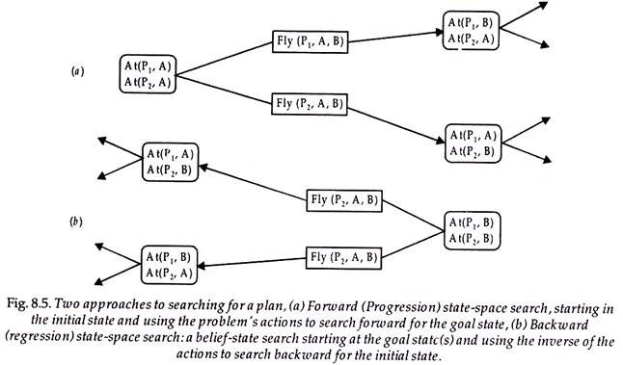
Forward Vs Backward

Slide 12
Planning Graphs
Planning graphs consists of a sequence of levels that correspond to time steps in the plan.
Level 0 is the initial state.
Each level consists of a set of literals and a set of actions that represent what might be possible at that step in the plan.
Records only a restricted subset of possible negative interactions among actions.

Slide 13
Continued…
Each level consists of
Literals = all those that could be true at that time step, depending upon the actions executed at preceding time steps.
Actions = all those actions that could have their preconditions satisfied at that time step, depending on which of the literals actually hold.

Slide 14
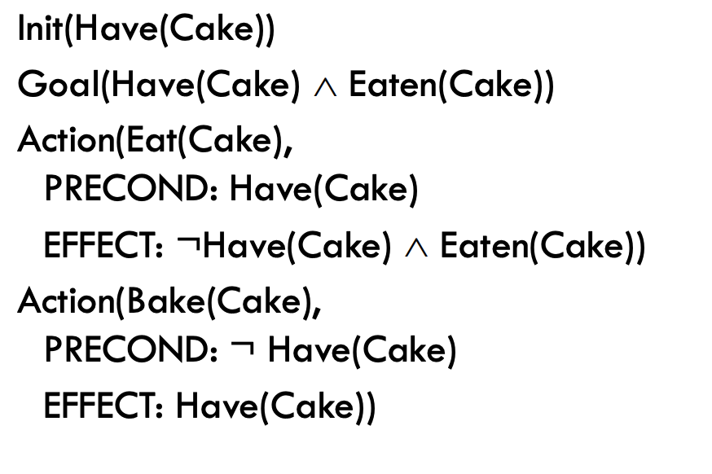
Example

Slide 15
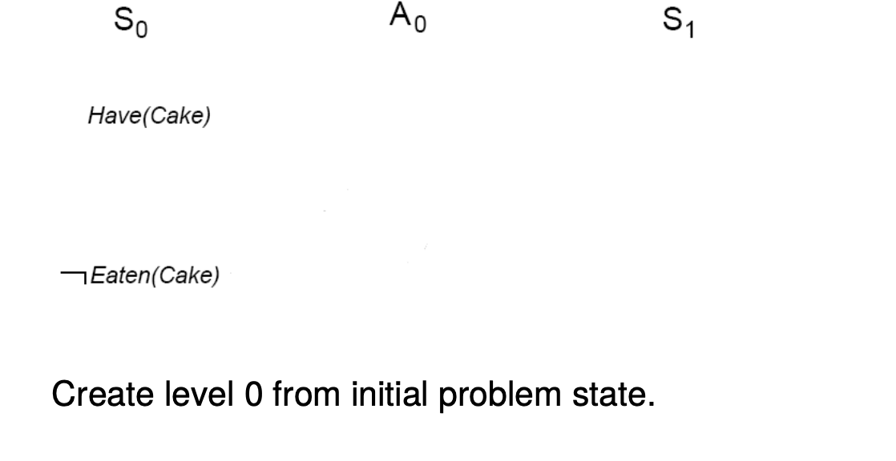
Initial Graph at L0

Slide 16
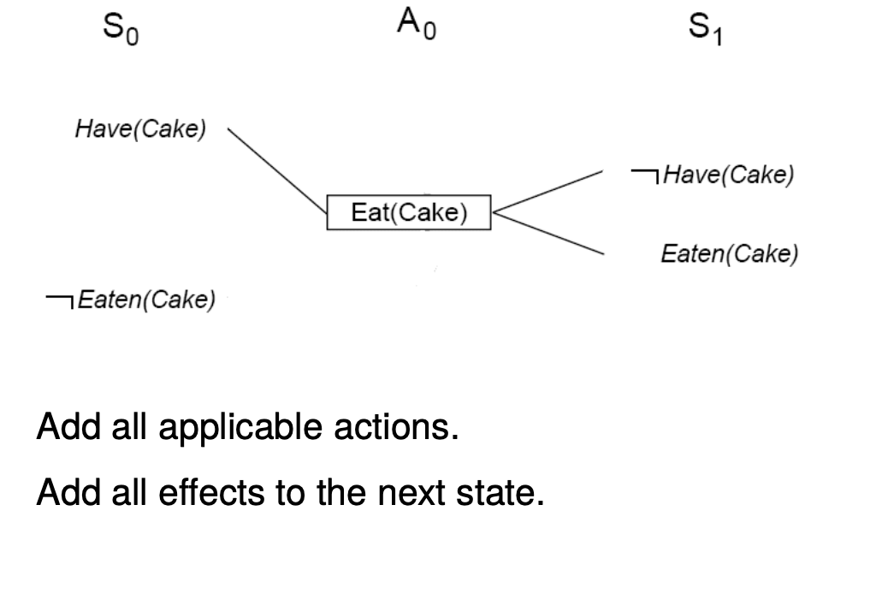
Graph at L1

Slide 17
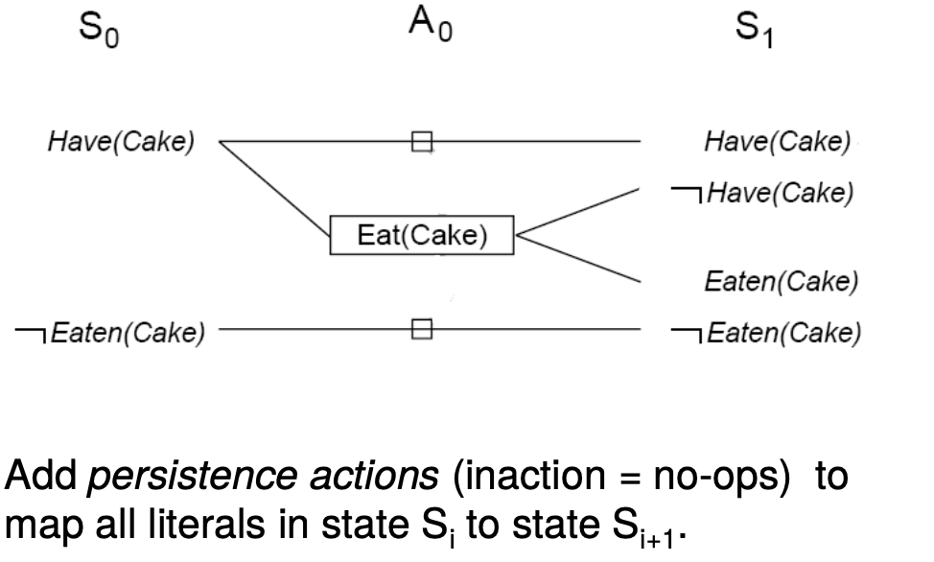
Graph at L1 updated

Slide 18
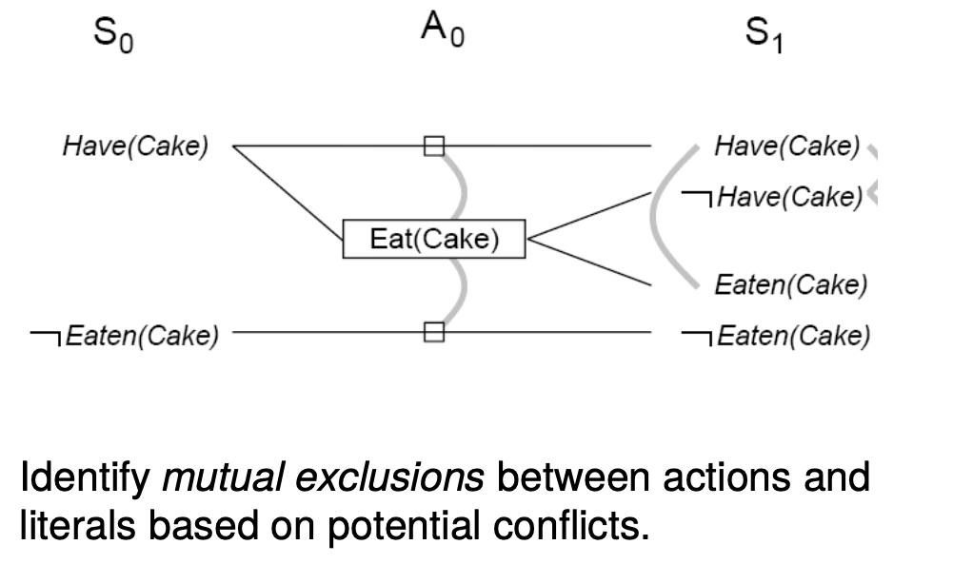
Graph with Mutual Exclusion

Slide 19
Mutual exclusion
A mutex relation holds between two actions when:
Inconsistent effects: one action negates the effect of another.
Interference: one of the effects of one action is the negation of a precondition of the other.
Competing needs: one of the preconditions of one action is mutually exclusive with the precondition of the other.
A mutex relation holds between two literals when:
One is the negation of the other.
Each possible action pair that could achieve the literals is mutex (inconsistent support).

Slide 20
Algorithm

Slide 21
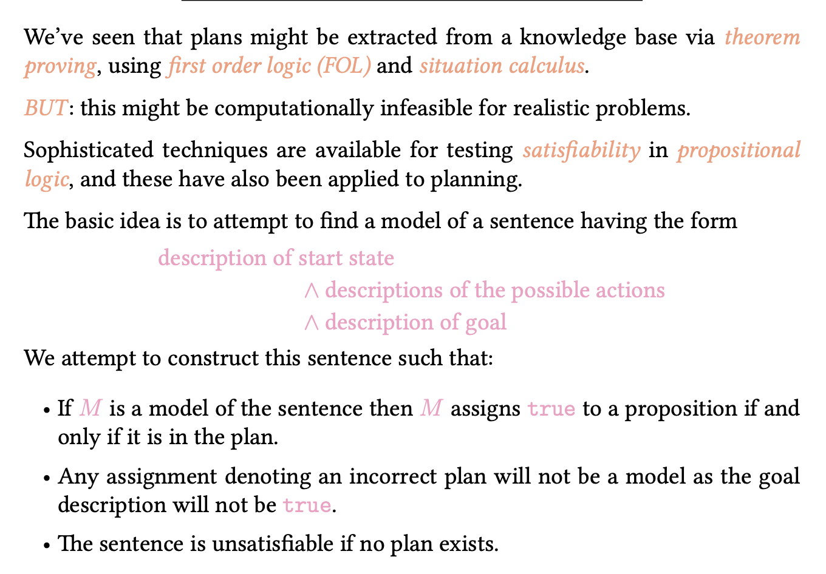
planning using propositional logic

Slide 22
Planning in the propositional logic

Slide 23
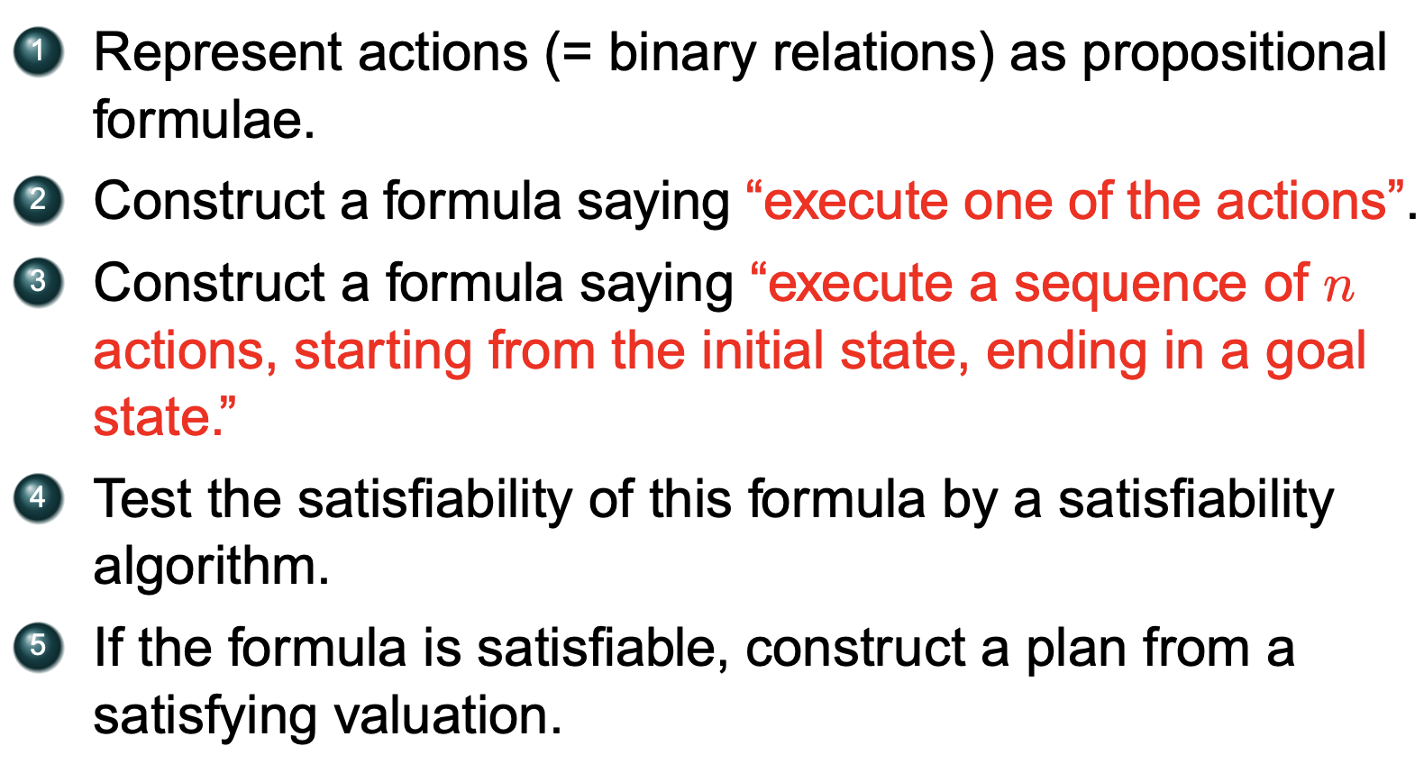
Planning in the propositional logic

Slide 24
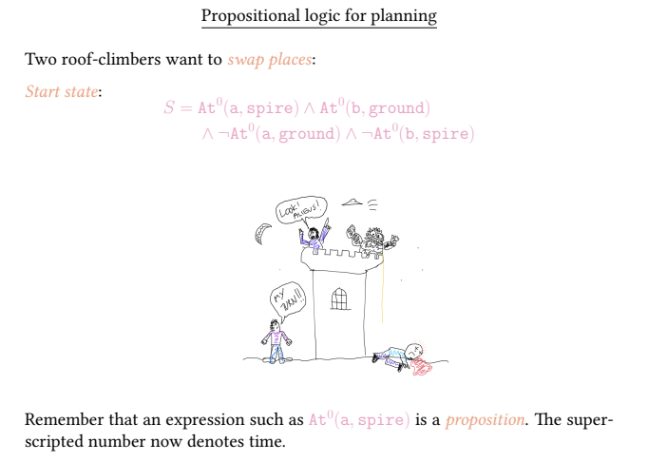
Example

Slide 25
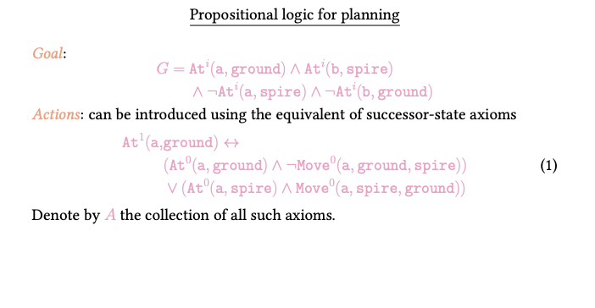
Example continued…

Slide 26
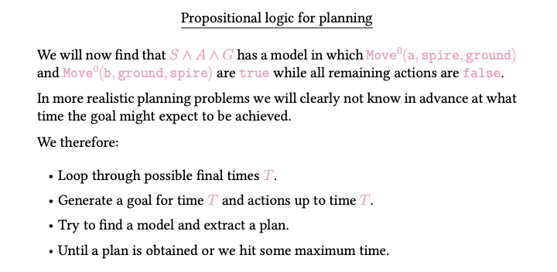
Example continued…

Slide 27
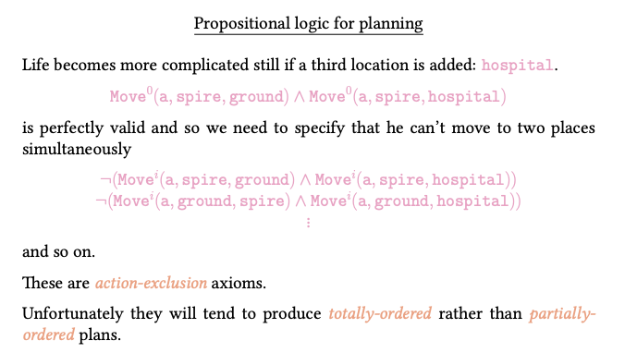
Example continued…

Slide 28
Hierarchical planning
Hierarchical Planning is an Artificial Intelligence (AI) problem solving approach for a certain kind of planning problems -- the kind focusing on problem decomposition, where problems are step-wise refined into smaller and smaller ones until the problem is finally solved. A solution hereby is a sequence of actions that's executable in a given initial state. This form of hierarchical planning is usually referred to as Hierarchical Task Network (HTN) planning.

Slide 29
Hierarchical planning

Slide 30
Hierarchical planning

Slide 31
Hierarchical planning- Example

Slide 32
Conditional planning
It works regardless of the outcome of an action. It deals with uncertainty by inspecting what is happening in the environment at predetermined points in the plan. It can take place in fully observable and non-deterministic environments. It will take actions and must be able to handle every outcome for the action taken.

Slide 33
Continued…

Slide 34
Continued…

Slide 35
Continued…

Slide 36
Continuous and Multi Agent planning

Slide 37
Continued…

Slide 38
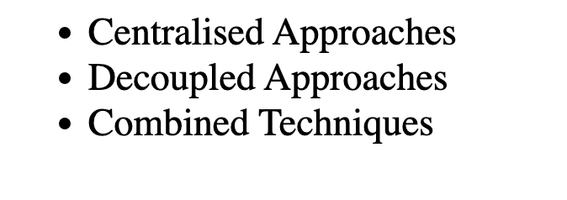
Approaches in Multi Agent Environment

