Slide 1
Understanding Random Variables and Probability Distributions …
“Data Scientist is a person who is better at statistics than any programmer and better at programming than any statistician.”
“statistics is the study of the collection, analysis, interpretation, presentation, and organization of data”.

Slide 2
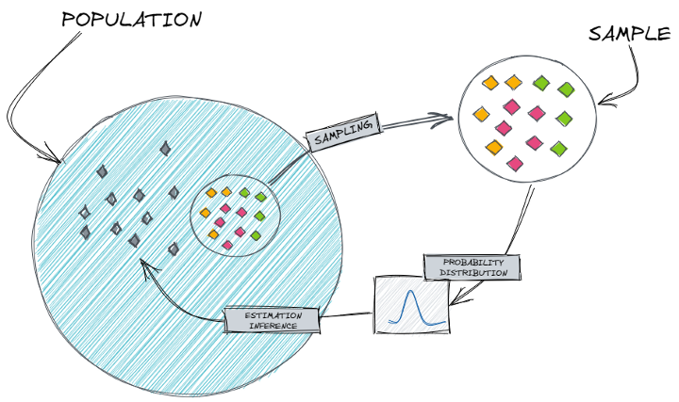
Probability
Probability is a subject that deals with uncertainty.
Why Probability?
Probability helps to predict the unknown outcome of any event

Slide 3
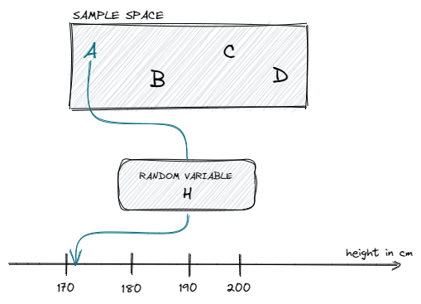
Introducing the Random Variable
The random variable is a variable whose value depends on the outcome of a random event.
Let’s assume, we have a sample space containing 4 students {A, B, C, D}. If we now randomly pick student A and measure the height in centimeters, we can think of the random variable (H) as the function with the input of student and the output of height as a real number.

Slide 4
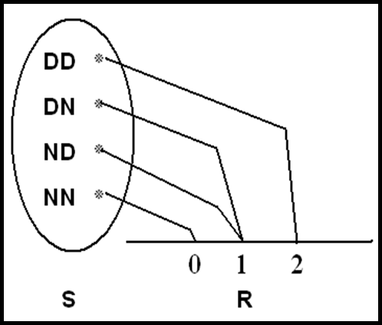
Example
Experiment:
Testing two components. (D=defective, N=non-defective)
Sample space: S ={DD,DN,ND,NN}
Let X = number of defective components when two components are tested.
Assigned numerical values to the outcomes are:
Sample point (Outcome) | Assigned Numerical Value (x)
DD | 2
DN | 1
ND | 1
NN | 0
Notice that, the set of all possible values of the random variable X is {0, 1, 2}.
Definition:
A random variable X is a function that associates each element in the sample space with a real number (i.e., X : S → R)

Slide 5
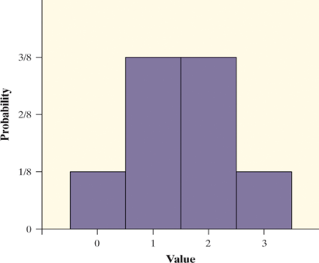
Cont…..
Consider tossing a fair coin 3 times.
Define X = the number of heads obtained in 3 tosses
X = 0: TTT
X = 1: HTT THT TTH
X = 2: HHT HTH THH
X = 3: HHH
X Values | 0 | 1 | 2 | 3
Probability | 1/8 | 3/8 | 3/8 | 1/8
A random variable can be either discrete or continuous.

Slide 6
Discrete and Continuous Random Variables
A discrete random variable is a random variable with a finite or countably infinite range (think integers or whole numbers).
Examples:
number of students in a class,
test questions answered correctly,
the number of children in a family,
the outcomes of rolling a die is countably finite
Where as, set of all natural numbers, it is countably infinite
When the range of a random variable is on a continuous scale (think an interval of real numbers) , it is called a continuous random variable.
Examples: Height, Weight, Amount of rainfall, pressure, mass, and distance etc.

Slide 7
Counting Techniques
Multiplication Principle:
If one probability experiment has outcomes and another has outcomes, then there are total outcomes for the two experiments.
Consider the example of tossing a coin twice .
Each toss is a probability experiment and on each toss, there are two possible outcomes:
Thus, for two tosses, there are 2*2=4 total outcomes.
If we toss the coin a third time, there are -------------total outcomes.
How to count the number of ways in which they can occur.
Permutation
A permutation is an ordered arrangement of objects.
For example, "MATH'' is a permutation of four letters from the alphabet.
4 ×3 ×2 ×1 = 4! = 24,
The number of permutations of n distinct objects is given by n×(n−1)×⋯×2 ×1 = n!
Combination
A combination is an unordered collection of objects from total objects.
For example, a group of three students chosen from a class of 10 students -- ¹⁰C₃
The number of combinations of objects selected without replacement from distinct objects is given by ^{n}C_{r} = n!/r!(n-r)!

Slide 8
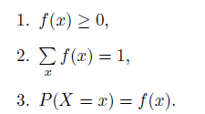
Probability Distribution
The probability distribution for a random variable describes how the probabilities are distributed over the values of the random variable.
Probability Mass Function(PMF):
probability distribution : P(X=1) = 1/6, P(X=2) = 1/6 and so on.
f(x) = P(X = x)
(x, f(x)) is called the probability function, probability mass function or probability distribution function of the discrete random variable X.
f(x) is considered a probability mass function if it satisfies the following conditions:

Slide 9
Probability Distribution
The probability distribution for a random variable describes how the probabilities are distributed over the values of the random variable.
Probability Mass Function(PMF):
Compute the probability that a discrete random variable equals a specific value.
Consider the context where we recorded the sequence of heads and tails in two tosses of a fair coin. The sample space for this random experiment is given by S={hh,ht,th,tt}. Define a random variable X that tracks the number of heads obtained in an outcome. Compute the probability that the random variable equals 1.
P(X = 1) = P({ht,th}) = # outcomes in {ht,th} / # outcomes in S = 2 / 4=0.5
p(1) = P(X = 1) = P({ht,th}) = 0.5. Also calculate p(2),p(0)

Slide 10
Probability Distribution
The cumulative distribution function (cdf) is related to the probabilities of the random variable equalling specific values. It provides a shortcut for calculating many probabilities at once.
Cumulative Distribution Function(CDF): The cumulative distribution function (cdf) of a random variable is a function on the real numbers that is denoted as and is given by
F(x) = P(X ≤ x), for any x ∈ R.
find the cdf for X . First, we find for the possible values of the random variable x=0,1,2.
F(0)= P(X<=0)= 1 / 4 =0.25
F(1) = P(X<=1) = P( X=0 or 1) = p(0) + p(1)
F(2) = P(<=2) = P(X=0 or 1 or 2) = p(0) + p(1) + p(2)
F(x) is considered a cumulative distribution function if it satisfies the following conditions:
If x<0 then cdf F(x)=0 , since the random variable will never be negative
If 0<x<1 then cdf F(x) = 0.25 since the only value <= value of x
Calculate
F(-3), F(0.1), F(0.9),F(1.9),F(2.8),f(18)

Slide 11
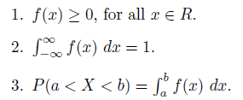
Probability density function
Probability density function:
The probability for a continuous random variable is always computed at intervals : P(a≤X≤b).
In case of a continuous random variable, f(x) is considered a probability density function if it satisfies the following conditions:
A continuous random variable will never equal a single value, probability of a continuous random variable taking a value in an INTERVAL, not at a point. And whether or not the endpoints of the interval are included does not affect the probability.

Slide 12
Probability density function
Cumulative Distribution Function: Let have pdf f , then the cdf is

Slide 13
Bernoulli Distribution
Flipping a coin -seeing which side comes up.
Asking a person to try to complete a task and seeing if they do or not.
Placing a plant in certain conditions and seeing whether it survives or dies.
The two possible values of a Bernoulli random variable are usually 0 and 1
The parameter in the Bernoulli distribution is given by the probability of a "success“ or a “failure”.

Slide 14
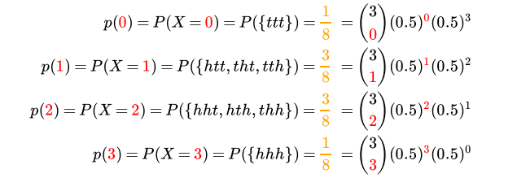
Binomial Distribution
Tossing a coin, adding another toss.
Suppose we toss a coin three times and record the sequence of heads (h) and tails (t). Probability of heads and tails is same as 0.5.
Since the three tosses are mutually independent, the probability assigned to any outcome is 0.5³.
the discrete random variable X to be the number of heads in an outcome. The possible values of X are 0,1,2,3.

Slide 15
Binomial Distribution
Binomial distribution is a statistical distribution that summarizes the probability that a value will take one of two independent values under a given set of parameters or assumptions.
The binomial distribution formula is for any random variable X, given by;
P(x:n,p) = ^{n}Cx p^{x} (1-p)^{n-x} Or P(x:n,p) = ^{n}C_{x} p^{x} (q)^{n-x}
where,
n = the number of experiments
x = 0, 1, 2, 3, 4, …
p = Probability of success in a single experiment
q = Probability of failure in a single experiment (= 1 – p)

Slide 16
Binomial Distribution
Example 1: If a coin is tossed 5 times, using binomial distribution find the probability of: (a) Exactly 2 heads (b) At least 4 heads.
Solution:
(a) The repeated tossing of the coin is an example of a Bernoulli trial. According to the problem:
Number of trials: n=5
Probability of head: p= 1/2 and hence the probability of tail, q =1/2
For exactly two heads: x=2
P(x=2) = ⁵C2 p² q⁵⁻² = 5! / 2! 3! × (½)²× (½)³
P(x=2) = 5/16
(b) For at least four heads,
x ≥ 4, P(x ≥ 4) = P(x = 4) + P(x=5)
Hence,
P(x = 4) = ⁵C4 p⁴ q⁵⁻⁴ = 5!/4! 1! × (½)⁴× (½)¹ = 5/32
P(x = 5) = ⁵C5 p⁵ q⁵⁻⁵ = (½)⁵ = 1/32
P(x ≥ 4) = 5/32 + 1/32 = 6/32 = 3/16

Slide 17
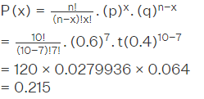
Binomial Distribution
Example 2: For the same question given above, find the probability of getting at most 2 heads.
Solution:
P(X ≤ 2) = P (X = 0) + P (X = 1)
P(X = 0) = (½)⁵ = 1/32
P(X=1) = 5C1 (½)⁵.= 5/32
P(X ≤ 2) = 1/32 + 5/32 = 3/16
Example 3: 60% of people who purchase sports cars are men. Find the probability that exactly 7 are men if 10 sports car owners are randomly selected.
Solution: Let’s Identify ‘n’ and ‘X’ from the problem. The number of sports car owners are randomly selected is n = 10, and The number to find the probability is X = 7.
Given: p = 60%, or 0.6. Therefore, the probability of failure is q = 1 – 0.6 = 0.4 Now, using the binomial distribution formula

Slide 18
Normal Distribution
This transformation, subtracting the mean and dividing by the standard deviation, is referred to as standardizing , since the resulting random variable will always have the standard normal distribution with mean 0 and standard deviation 1.

Slide 19
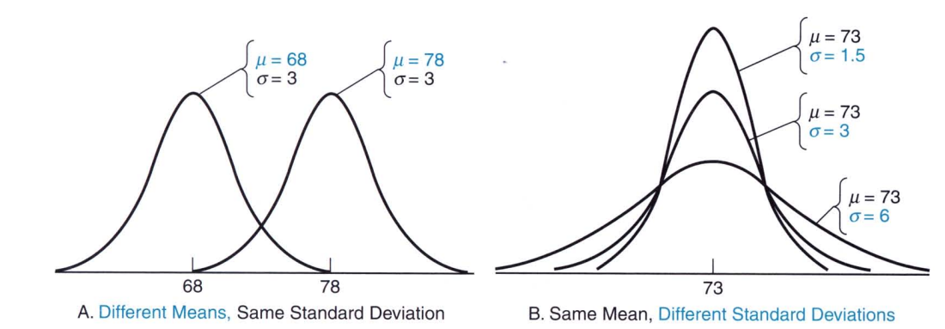
Normal Distribution

Slide 20
Uniform Distribution

Slide 21
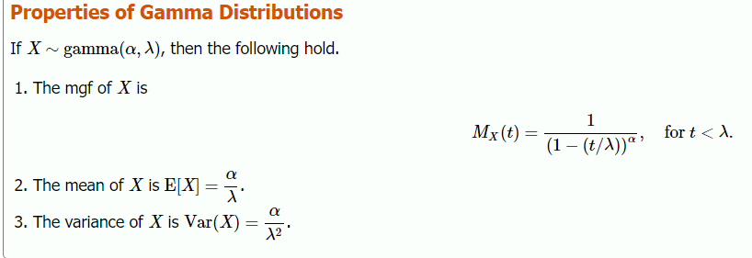
Gamma Distribution
The parameter α is referred to as the shape parameter, and λis the rate parameter. Varying the value of α changes the shape of the pdf, whereas varying the value of λ corresponds to changing the units

Slide 22
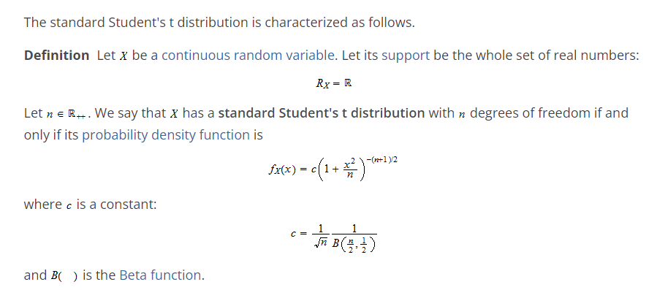
Student t Distribution
The parameter α is referred to as the shape parameter, and λis the rate parameter. Varying the value of α changes the shape of the pdf, whereas varying the value of λ corresponds to changing the units

Slide 23
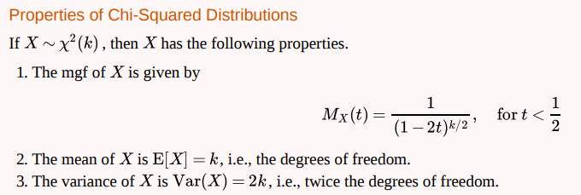
Chi-Squared Distribution

